Slide 1
Direct Retro Salary and Benefit Cost Transfers

Slide 2
Course Agenda
Lesson
1: Direct Retro Overview
3: Benefit Cost Transfer Overview
4: Enter Benefit Cost Transfer
2: Direct Retro Funding Updates

Slide 3

Course Objectives
Key Objectives:
Describe the use of direct retro at UC.
Describe the direct retro funding update process.
Identify the key information on the Review Retro Distribution page.
Enter direct retro funding updates.
Describe the benefit cost transfer process.
Enter a benefit cost transfer.

Slide 4

LESSON 1
Direct Retro Overview

Slide 5

Lesson Objectives
In this lesson, we will:
Summarize the direct retro process.
Identify the three sections of the Review Retro Distribution page.
Recognize the primary information provided on the Review Retro Distribution page.
Describe the use of the direct retro questionnaire.
Direct Retro Overview
3: Benefit Cost Transfer Overview
4: Enter Benefit Cost Transfer
2: Direct Retro Funding Updates
1

Slide 6

Direct Retro Overview
Direct Retro is a custom process to move salary costs from one account or fund to another; for example, regular pay and stipends.
Note: Benefit expenses (CBR, GAEL and Fringe) are moved automatically.
Direct retro is also known as a salary cost transfer (SCT).
The process provides an audit trail of changes made in the UCPath system and reduces the need for the manual adjustment of entries in the general ledger.
Modifications to the accounting entries using the direct retro process do not change the existing funding data in the UCPath Funding Entry page.
You should make appropriate corrections to the position funding to avoid processing the same direct retros in future pay cycles.
Notes:
The direct retro process transfers salary costs for selected pay distributions after the system generates the accounting entries but before posting those original entries to General Ledger.
The detailed accounting entries, specifically the earnings distribution, use the position funding data. Funding is dynamic and changes over time. The creation of new projects or grants, limited time funding expirations and organizational changes all impact position funding. Timing issues in funding maintenance may create discrepancies between what should have been accounted and what was accounted. UC uses direct retro to retroactively update the accounting entries.
Direct retro is also known as a salary cost transfer. Because the UCPath pages are labeled as Direct Retro and Retro Distribution, we use those terms in this training course.
The direct retro process is commonly used to clear the suspense account for expired or invalid funding data, move authorized pre-award spending without project/grant setup after the project/grant is in UCPath, or redistribute all or a portion of a prior period distribution to different funds due to delayed approval of a funding change.
Although modifications to the accounting entries using the direct retro process do not change the existing funding data on the UCPath Funding Entry page, you should make appropriate corrections to the funding to avoid processing the same direct retros in the following pay cycle.

Slide 7
Benefit Cost Transfer Overview
The Benefit Cost Transfer process moves only benefit costs like GAEL, CBR and Fringe but not salary.
There is no system-imposed limit on the number of times a transaction may be transferred via Salary Cost Transfer or Benefit Cost Transfer .
Notes:
The direct retro process transfers salary costs for selected pay distributions after the system generates the accounting entries but before posting those original entries to General Ledger.
The detailed accounting entries, specifically the earnings distribution, use the position funding data. Funding is dynamic and changes over time. The creation of new projects or grants, limited time funding expirations and organizational changes all impact position funding. Timing issues in funding maintenance may create discrepancies between what should have been accounted and what was accounted. UC uses direct retro to retroactively update the accounting entries.
Direct retro is also known as a salary cost transfer. Because the UCPath pages are labeled as Direct Retro and Retro Distribution, we use those terms in this training course.
The direct retro process is commonly used to clear the suspense account for expired or invalid funding data, move authorized pre-award spending without project/grant setup after the project/grant is in UCPath, or redistribute all or a portion of a prior period distribution to different funds due to delayed approval of a funding change.
Although modifications to the accounting entries using the direct retro process do not change the existing funding data on the UCPath Funding Entry page, you should make appropriate corrections to the funding to avoid processing the same direct retros in the following pay cycle.

Slide 8
Direct Retro Examples
Examples
Correct retroactive funding; redistributes all or a portion of a prior period distribution to different funds due to delayed approval or a funding change.
Move costs to the appropriate fund to clear the suspense, error or “default” account.
Move costs from one fund to another (including work study funds).
Moves authorized pre-award spending without project/grant setup after the project/grant is in UCPath.
Notes:
For last example, most departments have a fund that can be used to start a project before the funds are available.

Slide 9




Direct Retro Business Process
Notice that step 2 reminds us to make necessary changes to current funding in Funding Entry to avoid processing the same direct retros in the following cycle.
If the current funding doesn’t need to be updated you can skip this step.
Incorrect or missing funding is identified
Use Direct Retro Page in UCPath to move expense to correct fund source
Transaction is approved via the dept. AWE process.
Transaction is finalized and processed by UCPC.
Input correct fund source via the Funding Entry Page

Slide 10
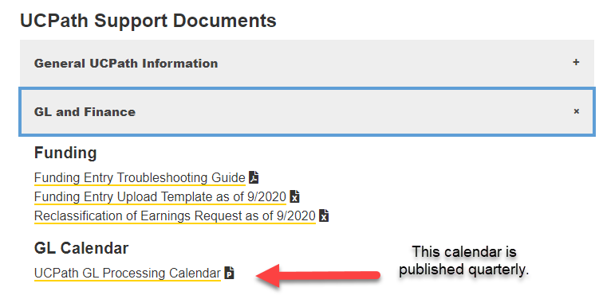
Direct Retro Calendar
Use the GL Processing Calendar on the UCI UCPath website for processing times for direct retro transactions.

Slide 11

Department Default Funding
If position funding is not set up by the time an employee gets paid, the salary costs are distributed to the department default funding that have been set up at go-live. The Direct Retro Process (Salary Cost Transfer) will be needed to transfer the costs to the appropriate funding afterwards.
This process ensures that an employee gets paid regardless of whether the position funding has been set up.
Funding NOT required before an employee can be paid.

Slide 12
Default / Suspense Accounts
Each department has default and suspense accounts to identify issues related to funding or lack of funding.
Default/Suspense accounts are identified by HR Department field.
Locations should utilize the Distribution of Payroll Expense Report (DOPE) to identify charges to all accounts.
Locations should manage all charges to their default/suspense accounts, i.e., make funding changes and/or Salary Cost Transfers when necessary.
Leverage the DOPE Report to identify incorrect payroll charges.
Notes:
Issues identified have the following statuses:
Suspense is used for valid FAUs that have expired
Edit Error is used when a Web service failure occurs
Department default is used if a value is missing
You must research which type of issue it is because all are set to go to the same suspense account.

Slide 13
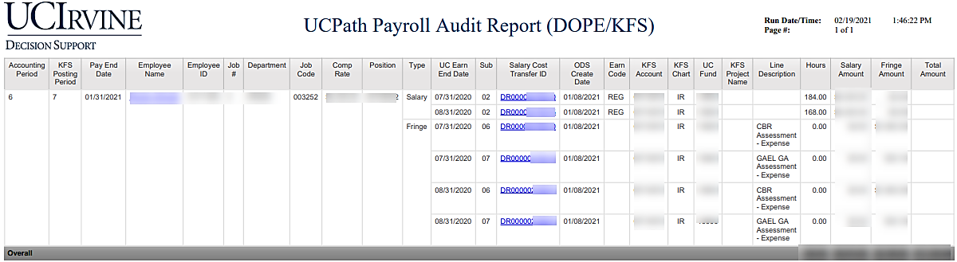
ZotPortal UCPath Decision Support
Location of DOPE Report: UCPath Decision Support > Payroll

Slide 14
System Process: Direct Retro
Review detailed accounting entries (aka distribution)
Enter direct retro changes
System updates detailed accounting entries
Generate detailed accounting entries
Notes:
This page presents the high-level direct retro process flow
[BOX 1] The detailed accounting entries must exist before an initiator enters a direct retro transaction. These entries are created during the post pay confirm processing in KFS. You can’t direct retro until someone has been paid. No future dated direct retros are allowed.
[BOX 2] Locations can use a pre-distribution audit report to review the accounting entry fund based distribution during the post pay confirm processing to determine whether accounting entries require updates. In addition, updates to existing funding data with an effective date prior to the current pay period begin date, require a review of the previously generated accounting entries. (UCI: at UCI this is done by XXXX in KFS) Audit report is created. This is used to determine what needs to change in the Old Data section of the Review Direct Retro page.
[BOX 3] After determining the necessary changes for employee salary cost distribution, an initiator enters the appropriate transactions in UCPath. These changes might include clearing the suspense account (invalid funding data), moving distributions already accounted for when there has been a delay of the new funding data or moving authorized pre-award spending without project/grant setup after the project/grant is in UCPath.
[BOX 4] The direct retro transaction updates the detailed accounting entries prior to posting to the GL system. This reduces the need for GL adjusting entries and provides an audit trail in the UCPath system. (UCI: this is done automatically in KFS) System updates detailed accounting entries.
This process can be repeated on the same pay earnings as long as the earlier transactions have a completed status, which means they have been approved and processed through the nightly or post confirm batch processing. Each transaction receives a unique system identifier.
Please note that not all payroll processors will be involved in all these steps, In some departments/ organizations these steps will be done by the local finance teams.

Slide 15
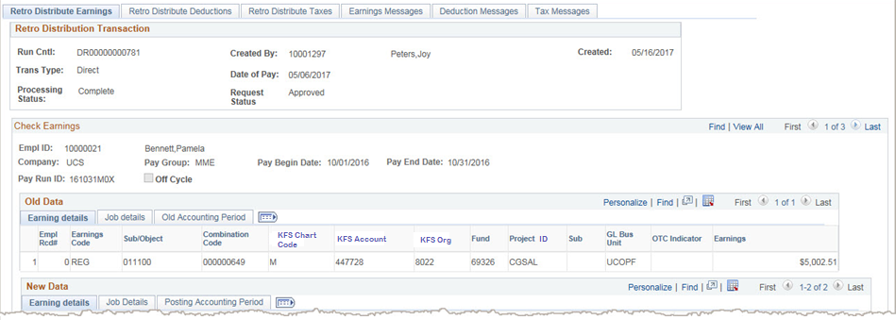
Review Retro Distribution
Use the Review Retro Distribution page to track changes made during the direct retro process to transfer salary costs at the accounting entry level.
Navigation: PeopleSoft Menu > Payroll for North America > Payroll Distribution > UC Customizations > Review Retro Distribution
There are 6 tabs on this page, however, UC currently only uses the Retro Distribute Earnings tab. The other tabs are informational only.
The Date of Pay field indicates the on-cycle payroll that already processed or the next on-cycle payroll that will process the direct retro.
The employee identification number and name in the Created By field identifies the user who created the transaction. The date in the Created field is the date the transaction was initiated, but not necessarily the date the transaction was processed.
The Trans Type always displays Direct.
The two status fields indicate the Processing Status and the Request Status. Processing statuses include Initiated, Editing and Complete. Initiated means the transaction is saved or submitted but still pending approval. Editing indicates the transaction is approved but still pending batch processing. Complete indicates the transaction has been fully processed.
Notes:
Currently UC is only using the Retro Distribute Earnings tab. The other tabs are informational only. Let’s begin with the Retro Distribution Transaction section on the first tab.
The transaction is picked up for redistribution and journalizing in the nightly batch or the post pay confirm process only when the Processing Status displays Editing and the Request Status displays Approved.
The Trans Type always displays Direct. The Date of Pay field indicates the on-cycle payroll that already processed or the next on-cycle payroll that will process the direct retro.
Let’s now review Check Earnings section.
It will sit in the Processing status while it goes through AWE. It will stay in Processing until it runs in the batch then it goes to Complete.

Slide 16
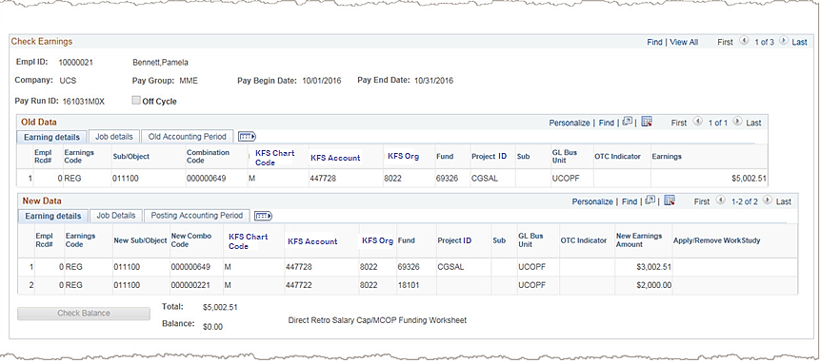
Review Retro Distribution (Cont’d)
The Check Earnings section displays the pay distribution and the audit trail of updated data. It includes pay related information and the earnings distribution before and after the retro distribution update.
Note the number of pay periods available for review. Click the View All link to display multiple data rows.
The fields in the header provide detail related to pay period selected during the direct retro entry. The Pay Run ID, Pay Begin Date and Pay End Date fields change as you display each of the multiple data rows. Be aware of how many data rows there are to review and which data row is currently displayed.
Notes:
Note the number of pay periods available for review. When multiple pay periods appear, use the View All functionality to list all earnings data, as well as the old data and the new data sections for each pay period. Use the scroll bar to move up and down the list.
These fields provide detail related to the pay period selected during the direct retro entry. The Pay Run ID, Pay Begin Date and Pay End Date fields change as you display each of the multiple data rows. Be aware of how many data rows there are to review and which data row is currently displayed.

Slide 17
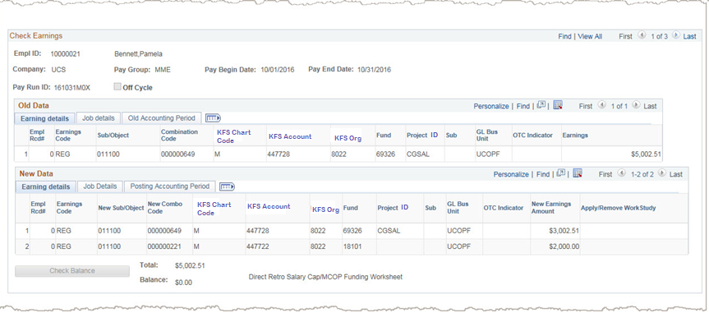
Review Retro Distribution (Cont’d)
For each pay earnings the existing/old funding distribution and the changed/new, funding distribution appears for the pay period selected. Remember to pay attention to the multiple data rows.
The combination of the old data and the new data provides the transaction audit trail. By reviewing line by line you see the changes made to the earnings distribution.
In this example there are three data rows. Remember to review the old and new data for each available pay period.
The Old Data section displays the funding information before the direct retro changes were entered.
Added row
The New Data section displays the information entered during direct retro entry. The highlighted fields are editable when entering the direct retro transactions. Therefore, these are the fields that display the updated data.
Notice that the old data has one line, but the new data has two lines. One row was added in the direct retro process.
Notes:
The combination of the old data and the new data provides the transaction audit trail. By reviewing line by line you see the changes made to the earnings distribution. Can you spot the difference in this example?
Start with the New Data section, which displays the information entered during direct retro entry. The highlighted fields are editable when entering the direct retro transactions. Therefore, these are the fields that display the updated data. In addition, direct retro entry can remove and/or add new data rows as required. To determine what has changed you must review both the new data and the old data.”
However this is only one of three data rows. Remember to review the old and new data for each available pay period.
Let’s move to the next slide to review the last section of the page.

Slide 18
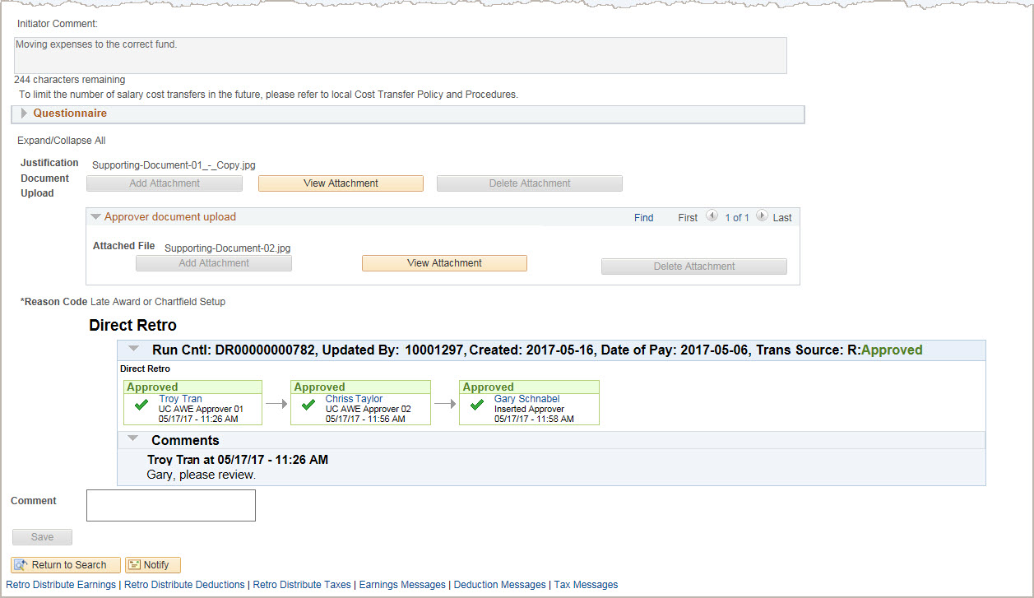
Review Retro Distribution (Cont’d)
The continuation of the Retro Distribution Transaction page.
Initiator Comment and Action Reason Code provide further information on why the transaction was entered.
The Questionnaire, is required if the transaction is classified as a high-risk cost transfer.
Click View Attachment to view the documents that the Initiator or Approver has added to the transaction.
Additional information regarding the approval or denial action appears. Approvers may enter comments on any transaction routed for their approval, but must enter comments when denying or pushing back the transaction to a previous approver during the approval process.
Notes:
The bottom of the Review Retro Distribution page displays the Initiator Comment field, the transaction Reason Code, Questionnaire answers, if applicable, and access to justification documents and additional information on the approval.
See the next slide to learn more about the questionnaire.

Slide 19
Direct Retro Questionnaire
The questionnaire is available for entry at any time. Only when the transaction is classified as a high-risk cost transfer does the questionnaire become required data entry.
The questionnaire fields become required when either of the following conditions are met.
The direct retro change increases the expense on a federal or federal flow-through fund and the payroll transaction’s original pay end date is more than 120 days old.
The direct retro increases the expense on a federal or federal flow-through fund and the fund/grant end date is more than 90 days old.
Data can be entered in the questionnaire section at the discretion of the initiator.
Notes:
The questionnaire is available for entry at any time; however, a high-risk cost transfer requires additional data entered in the UCPath system..
Because the questionnaire is available for entry at any time, the initiator can, but is not required, to enter data in the questionnaire section for a low-risk transfer.

Slide 20
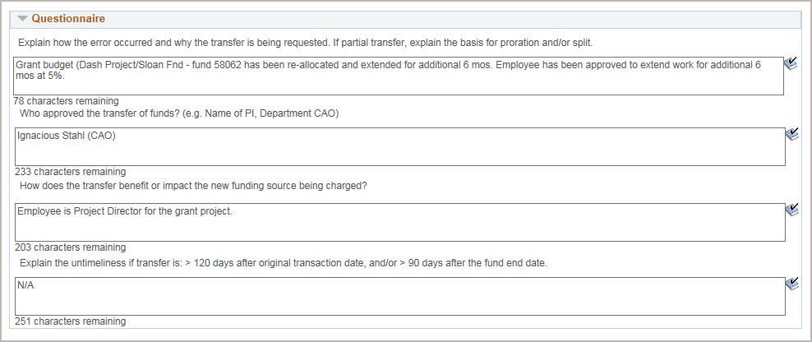
Questionnaire Sample
Here is an example of a completed questionnaire. The initiators must complete the questionnaire for high-risk transfers, but also can use it for other direct retro transactions.
Notes:
Initiator’s use the free-form text fields to provide additional detail regarding the transaction.
The answer to the first question should explain how the error occurred and why the transfer was requested. If it is a partial transfer, the initiator should explain the basis for the proration and/or split.
The second answer identifies the person who approved the transfer of funds. For example, the initiator can enter the name of the department or the Chief Accounting Officer.
The answer to the third question should indicate how the transfer benefits or impacts the new funding source being charged.
If the transfer is outside of the timing guidelines, the initiator should use the last text field to enter the reason the direct retro is late.”

Slide 21

Exercise
Review Retro Distribution
This is your opportunity to practice this task on your own.
Open the UCPath Help site and refer to the Review Retro Distribution topic.
Launch the Try It version of the topic.
Ask your instructor for assistance.

Slide 22

Objectives Review
Having completed this module, you should now be able to:
Summarize the direct retro process.
Identify the three sections of the Review Retro Distribution page.
Recognize the primary information provided on the Review Retro Distribution page.
Describe the use of the direct retro questionnaire.

Slide 23
LESSON 2
Direct Retro Funding Updates

Slide 24
Lesson Objectives
In this lesson, we will:
Describe the direct retro funding update process.
Enter direct retro funding updates.
1: Direct Retro Overview
3: Benefit Cost Transfer Overview
4: Enter Benefit Cost Transfer
Direct Retro Funding Updates
2

Slide 25
Funding Update - System Process
Enter new data and submit for approval
Run the process to display Retro Distribution component
Search for appropriate payroll data and select applicable transactions
Navigate to Process Direct Retro page and click Add a New Value tab
Click Add to display Process Direct Retro Distribution page
Notes:
This workflow illustrates the system steps for entering Direct Retro Transactions.
Submitting a transaction triggers approval workflow (AWE) at the Location level. Upon final approval, UCPath saves the data to the Department Budget tables.
A high risk direct retro transaction requires an additional, higher-level approval in UCPath. High risk transactions are explained in more detail on the next slide.

Slide 26
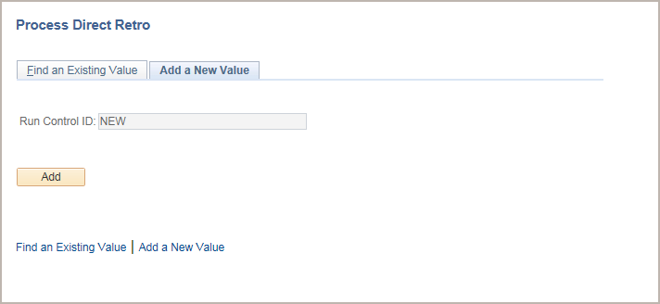
Add a New Value Tab
Navigation: PeopleSoft Menu > Payroll for North America > Payroll Distribution > UC Customizations > Process Direct Retro
Begin the steps for entering a direct retro transaction on the Add a New Value tab.
Notice that the Run Control ID displays a default value of NEW. You cannot update this value; when you successfully submit the transaction, the system automatically assigns your request a Direct Retro ID number.
Click Add to display the page on which you enter the new funding details.
Notes:
When displayed in Slide Show mode, this slide includes animation for the gray captions. Click to individually display each caption (and hide the previous caption) as you describe the objects on the Process Direct Retro page.

Slide 27
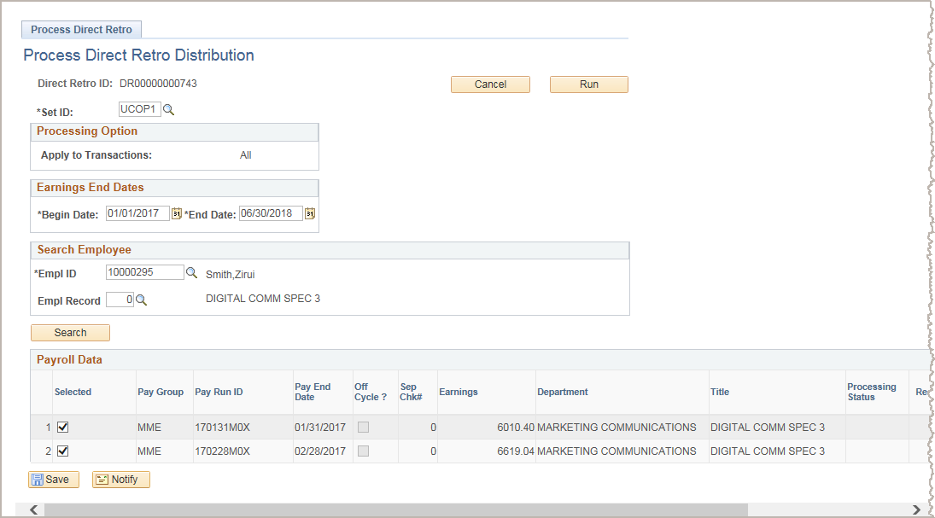
Process Direct Retro Search
Begin the system steps by entering the appropriate earnings date range, employee ID, and employee record then click Search.
Then, select the specific paycheck(s) for which you want to update funding and click Save.
Next, click Run to display the Review Retro Distribution page on which you enter the necessary funding updates.
Notes:
When displayed in Slide Show mode, this slide includes animation for six objects. Click to display each object as you describe the steps listed below.
Additional page / field notes:
Begin Date and End Date: The system defaults the dates to the begin and end dates of the current fiscal year, but you can enter a date range for the specific payroll date(s) for which you are searching. UCI: Please note that it's ok to set the dates wider to make sure you catch all relevant paychecks. The search will bring all paychecks that fall within those dates and you can then use Payroll Data section to select the paychecks that you wish to perform the Direct Retro on.
Empl Record: If the employee has multiple jobs, select the appropriate employee record. The system allows for updates to only one job’s earnings in a direct retro transaction. If all jobs require updating, enter multiple direct retro transactions (one for each job requiring a redistribution).
Payroll Data section
After you enter the employee’s ID and record number, click Search. All the processed payrolls for the employee within the given date range appear.
Select the check box next to the payroll for which you want to a direct retro transaction processed or select multiple check boxes to process adjustments for multiple payrolls in a single direct retro transaction.
Click the Save button to prompt the system to display the Run button (already shown in the image here). After you save the transaction, there is open activity on the selected pay period(s). This means that no other users can make changes for these periods until this transaction is complete (that is, until updates are made to the distribution lines). If necessary, click Cancel to close the transaction and the period(s) are available for updating.
Click the Run button, which triggers a process that fetches the payroll distribution data based on the payroll(s) selected and transfers it to the Retro Distribution component.

Slide 28
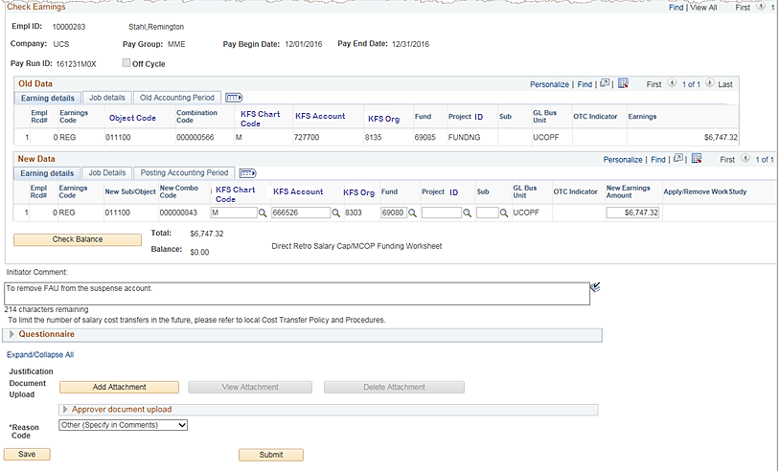
Distribute Earnings Page
The Old Data section displays the current funding detail.
In the New Data section, enter the funding update(s) and then click Check Balance.
For transactions where work study split is required, select the appropriate option from Apply/Remove Work Study list.
You have the option to enter comments and add one or more supporting documents.
When you are finished entering updates, click Save to check for errors.
Expand and complete the Questionnaire section, if applicable.
Select the reason for the adjustment.
To submit the transaction for review and approval, click Submit. After you submit it, the system displays the workflow routing details (not pictured here) below the Initiator Comment field.
Notes:
When displayed in Slide Show mode, this slide includes animation for the gray captions. Click to individually display each caption (and hide the previous caption) as you describe the objects on the Process Direct Retro page.
Additional page / field notes:
There are pages within the Retro Distribution component, but UC currently uses only the Retro Distribute Earnings page; it is the only page with editable fields. UC currently uses the direct retro process for earnings only. The funding for the deductions and taxes follow the earnings funding for payroll distribution. Therefore, the remaining pages in the component display informational data only.
Apply/Remove Work Study: You cannot enter Work Study funding on the Funding Entry page, but you can initiate a direct retro transaction to move charges to and from work study funds in UCPath. When the transaction is processed, the work study split is applied if the employee is work study eligible and there is an available work study award balance.
Check Balance button: After you enter data, check the balance. When the old data total does not match the new data total, the system generates an error message. The earnings must balance before you can save and submit the transaction. UCI: Note that unlike in FE, there are no percentages in Direct Retro transaction, you use a dollar amount and need to account for every penny of the Earnings Amount before you can submit the transaction.
Initiator Comment: Enter comments as appropriate. If you select the Reason Code of Other (Specify in Comments), you must enter comments or the system does not allow you to save and submit the transaction. UCI: Please note that the comments entered will be stored in UCPath and become a part of the record for this transaction.
Questionnaire: Provide answers to the questions/requests, as appropriate. Completion is required for high risk transactions. UCI: Initiators should confirm their local process for completing the Questionnaire; it may require assistance of the department/ school Finance Analyst;
Justification Document Upload: Attach a supporting document if necessary.
Reason Code: Select the appropriate reason. This is a required field. Valid values are: Align Salary to Effort, Data Entry Error, Late Award or Chartfield Setup, Other (Specify in Comments).
Process notes: Prior to final Location approval, the transaction remains in a hold state, which prevents it from being picked up in the nightly batch processing. Upon final Location approval, the transaction page updates the transaction status to Approved, which then makes the transaction available for Update Actuals Distribution processing.
UCI: Remember: Direct Retro is not where you correct the salary it's only where you change the funding distribution for past transactions.
The end-to-end system steps for initiating this type of transaction are covered in more detail during the instructor demonstration and participant exercise.

Slide 29
High Risk Transactions
A high risk direct retro transaction requires an additional, higher-level approval from Contracts and Grants Accounting in UCPath. If the transaction is determined as high risk the Initiator must complete the Questionnaire available on the Direct Retro Page.
More than 120 days after original transaction pay period end date
Increases expenses on a Federal or Flow-through Fund (FFT)
High Risk Approval Routing
or
Where the grant or funding end date is more than 90 days in the past
Notes:
When displayed in Slide Show mode, this slide includes animation for the objects. Click to individually display each object.
FFT Fund = Flow-through Fund
High-risk transactions are considered Salary Cost Transfers (SCTs) that are in violation of the 120 Day Rule and/or 90 Day Rule at the time of submission by the initiator.
Direct retro requests that increase or decrease the expense on a non-federal contract and grant fund are not considered high risk.
The AWE routing logic for a High Risk SCT excludes federal Work Study funds.

Slide 30
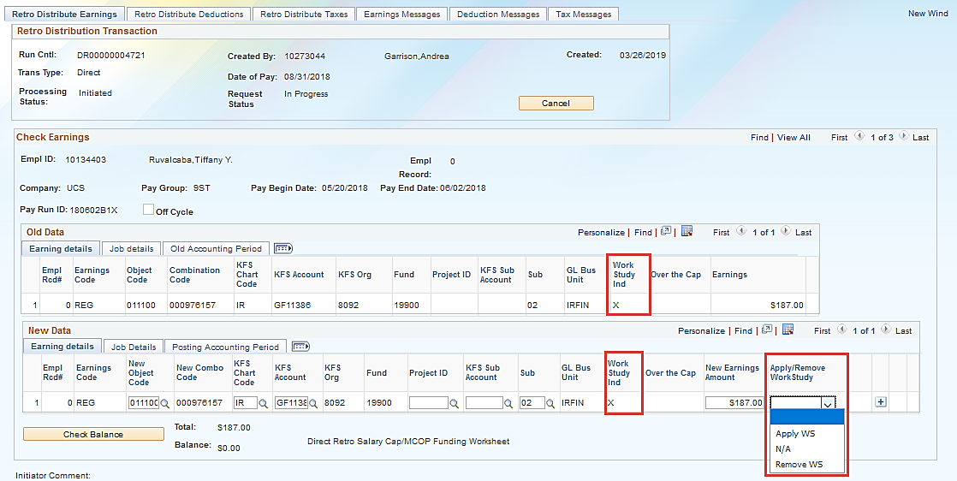
Direct Retro - Work Study
Work Study Indicator field
Apply/Remove Work Study field is enabled
Notes:
When a direct retro is processed for a student on work study, the Work Study Indicator field is displayed. In the New Data section, the Apply/Remove Work Study field is enabled with the values to Apply WS (work study), Remove WS (work study) or N/A (not applicable). In this example there are 3 checks that need to be updated. Be sure to click the View All link update all applicable checks within the selected date range.

Slide 31
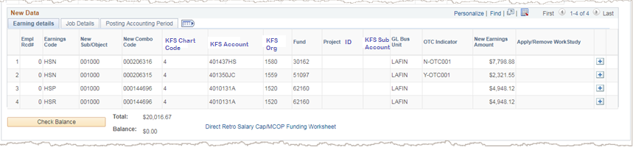
Salary Cap/MCOP Funding Worksheet
If you enter a capped fund in the New Data section, and the employee's Total UC Salary exceeds the fund’s annual salary Cap, the Process Direct Retro page displays the Salary Cap/Multiple Components of Pay (MCOP) Worksheet link.
Notes:
When displayed in Slide Show mode, this slide includes animation for two objects. Click to display each object.

Slide 32
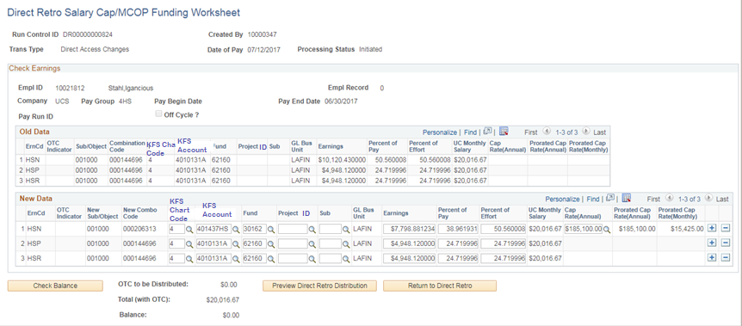
Salary Cap/MCOP Funding Worksheet (Cont’d)
Use to enter and link funding to the New Data section of the Direct Retro Update page.
When you navigate to the worksheet, the system defaults the new data to the same values as the old data, and you make the necessary updates to reflect how the expenses should be transferred.
After you make the necessary updates, click Preview to see how the system will allocate OTC amounts for new data. You can then adjust the OTC FAUs that are generated.
Notes:
When displayed in Slide Show mode, this slide includes animation for the gray captions. Click to individually display each caption (and hide the previous caption) as you describe the objects on the Direct Retro Salary Cap/MCOP Funding Worksheet page.
Additional page / field notes:
After you enter new funding information and distributed earnings, click the Check Balance button. The page displays the appropriate amounts in the OTC to be Distributed, Total (with OTC) and Balance fields.
If any page validations fails, the system displays an error message and you must correct the new distribution data.
Any new data changes entered on the Direct Retro main page are reinitialized and must be reentered on the Direct Retro Salary Cap/MCOP Funding Worksheet.

Slide 33
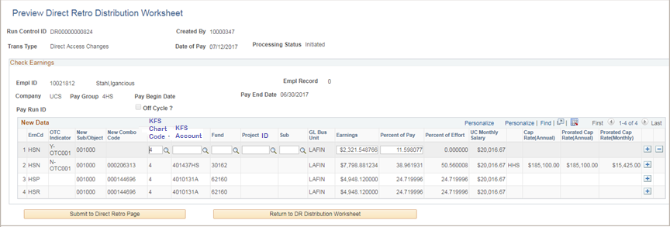
Direct Retro Distribution Preview
The Preview Direct Retro Distribution Worksheet page displays a preview of all funding distributions, so you can verify whether the data is accurate and complete, and includes the necessary applied caps and calculated OTC amounts.
This page is view-only except for Location-specific charfields for OTC funding lines where the OTC Indicator begins with letter Y. These rows must be funded by uncapped funds. If a Y-OTC Default Funding Profile was defined in the Funding Entry definition, the system copies the FAU into the Direct Retro Preview Y-OTC row. You can override or enter (if blank) the FAU on the Y-OTC row.
If you notice inaccuracies in the funding lines, return to the Direct Retro Salary Cap/MCOP Funding Worksheet to make necessary changes and regenerate the preview worksheet.
After all distributions rows are accurate, click Submit to Direct Retro Page. If the data passes the page funding edits, the system displays the transferred data on the Process Direct Retro page.
Notes:
When displayed in Slide Show mode, this slide includes animation for the gray captions. Click to individually display each caption (and hide the previous caption) as you describe the objects on the Preview Direct Retro Distribution Worksheet page.
The end-to-end system steps for initiating this type of transaction are covered in more detail during the instructor demonstration and participant exercise.

Slide 34
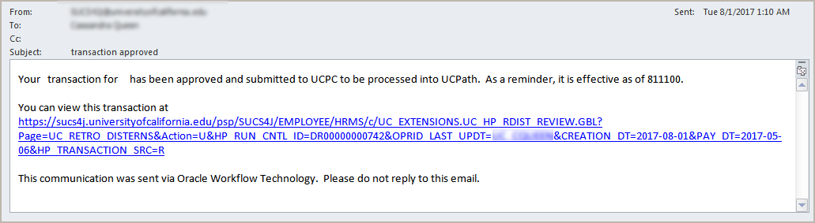
Approval Email Notification
After final approval of a direct retro update, the system automatically sends an email notification to the Location Initiator, which indicates the transaction is approved.
Notes:
Please note that once approved the transaction is processed and written into the system (nightly processing); it does not go through UCPC finalization.

Slide 35

Instructor Demo
Enter Direct Retro Funding Update
Watch as your instructor demonstrates how to enter a direct retro funding update in UCPath.
Follow along using the UCPath Help topic.
Open the UCPath Help site and refer to the Enter Direct Retro Funding Update topic.
Launch the See It version of the topic.
At the end of the demonstration, you will have the opportunity to practice this task.
Notes:
For UPK simulation-based demonstrations, open the See It view and walk through the activity while providing details and explaining the task. The users should follow along with the See It version of the UPK.

Slide 36
Exercise #1
Enter Direct Retro Funding Update
This is your opportunity to practice this task on your own.
Complete exercise 1 in your workbook.
Ask your instructor for assistance, if needed.

Slide 37
Instructor Demo
Enter Direct Retro Funding Update – MCOP
Watch as your instructor demonstrates how to enter a direct retro funding update in UCPath.
Follow along using the UCPath Help topic.
Open the UCPath Help site and refer to the Enter Direct Retro Funding Update – MCOP topic.
Launch the See It version of the topic.
At the end of the demonstration, you will have the opportunity to practice this task.
Notes:
For UPK simulation-based demonstrations, open the See It view and walk through the activity while providing details and explaining the task. The users should follow along with the See It version of the UPK.

Slide 38
Objectives Review
Having completed this module, you should be able to:
Describe the direct retro funding update process.
Enter direct retro funding updates.

Slide 39
LESSON 3
Benefit Cost Transfer Overview

Slide 40
Lesson Objectives
In this lesson, we will:
Describe the benefit cost transfer process.
1: Direct Retro Overview
Benefit Cost Transfer Overview
4: Enter Benefit Cost Transfer
2: Direct Retro Funding Updates
3

Slide 41

Benefit Cost Transfer Overview
During the direct retro process (salary cost transfers), fringe expenses – including composite benefit rate (CBR) and non-CBR benefit actuals – are automatically redistributed and prorated to follow user-specified salary expense redistribution.
The Benefit Cost Transfer (BCT) process allows Locations to move benefit costs from one account or fund to another.
It does not allow the movement of dollars from one deduction code to another; redistribution of dollars is restricted to the same deduction code.
Allows transferring of benefit expenses without moving salary expenses
Notes:
Last bullet – the process does not allow you to CHANGE the deduction code used but allows you to change the funding source for the benefits cost only.

Slide 42
Benefit Cost Transfer – Scenarios
Employee is paid on a funding source for which the sponsor:
Prohibits some, but not all, of the benefit expense components of the CBR from being charged to a specific funding source.
Requires a lower fringe rate than the configured CBR.
Prohibits all fringe expense (CBR and non-CBR) from being charged to a specific funding source.
Prohibits a benefit expense not included in the CBR (such as Tuition and Fee Remission, GAEL or Leave) from being charged to a specific funding source.
Miscellaneous benefit expense adjustments are required due to sponsor audit findings or award closeouts.
Fee remission: GSRs where appointment goes below 25%, or when an employee transfers from GSR to Reader or TA appointment.
Fee remission: For student employees on work study.
Transition from Location CBR (for example, UC Davis) to UCPath CBR.
Notes:
Second bullet – the funding source does not cover the full CBR

Slide 43

Benefit Cost Transfer – Reminder
Do not process a direct retro transaction (salary cost transfer) after you process a BCT transaction for the same paycheck/payroll transaction(s); it will cause benefit expenses to be out of sync between the direct retro and BCT.
If business need requires this, Locations are responsible for processing a subsequent BCT to move the benefit expense(s) back to the original full accounting unit or units (FAUs) before proceeding with a direct retro.
IMPORTANT REMINDER!
Benefit cost transfers should be final
Notes:
The scenario could be: the grant funding has not come in yet but a person needs to be get paid. They will likely be paid from the “default” account. Once the grant is funded, a direct retro is processed to move the money to the grant fund. Then a subsequent Benefits Cost Transfer must be processed to move the benefit related costs to yet another fund because the grant does not cover those costs.

Slide 44
Benefit Cost Transfer – System Process
Enter new data and submit for approval
Run the process to display Review Benefit Cost Transfer page
Search for appropriate payroll data, select applicable transaction(s) and click Save
Navigate to Process Benefit Cost Transfer page and click Add a New Value tab
Click Add to display Process Benefit Cost Transfer search page
Notes:
Submitting a transaction triggers approval workflow (AWE) at the Location level. Upon final Location AWE approval are picked up by the custom process and processed every night (other than post confirm GL cycle).
A high risk direct retro transaction requires an additional, higher-level approval in UCPath. High risk transactions are explained in more detail on the next slide.

Slide 45
High Risk Transactions
A high risk benefit cost transfer transaction requires an additional, higher-level approval in UCPath.
More than 120 days after original transaction pay period end date
Increases expenses on a Federal or Flow-through Fund (FFT)
High Risk Approval Routing
or
Where the grant or funding end date is more than 90 days in the past
Notes:
When displayed in Slide Show mode, this slide includes animation for the objects. Click to individually display each object.
FFT Fund = Flow-through Fund
High-risk transactions are considered Benefit Cost Transfers (BCTs) that are in violation of the 120 Day Rule and/or 90 Day Rule at the time of submission by the initiator.
Requests that increase or decrease the expense on a non-federal contract and grant fund are not considered high risk.

Slide 46
Module Objectives Review
Having completed this module, you should be able to:
Describe the benefit cost transfer process.

Slide 47
LESSON 4
Enter Benefit Cost Transfers

Slide 48
Lesson Objectives
In this lesson, we will:
Enter a benefit cost transfer.
Review an existing benefit cost transfer transaction.
1: Direct Retro Overview
3: Benefit Cost Transfer Overview
Enter Benefit Cost Transfer
2: Direct Retro Funding Updates
4

Slide 49
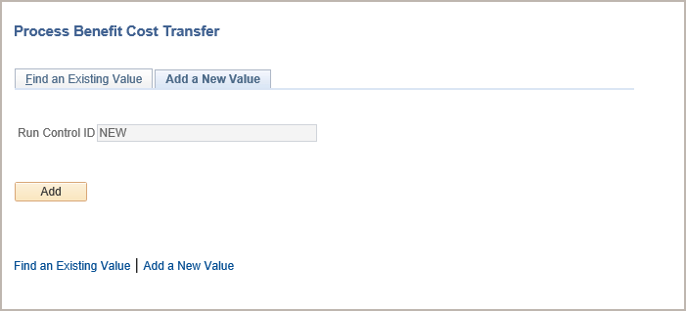
Benefit Cost Transfer – Add a New Value
Navigation: PeopleSoft Menu > Payroll for North America > Payroll Distribution > UC Customizations > Process Benefit Cost Transfer
Begin the steps for entering a benefit cost transfer transaction on the Add a New Value tab.
Notice that the Run Control ID displays a default value of NEW. You cannot update this value; when you successfully submit the transaction, the system automatically assigns a Direct Retro ID number.
Click Add to display the page on which you enter the new funding details.
Notes:
When displayed in Slide Show mode, this slide includes animation for the gray captions. Click to individually display each caption (and hide the previous caption) as you describe the objects on the Process Benefit Cost Transfer page.

Slide 50
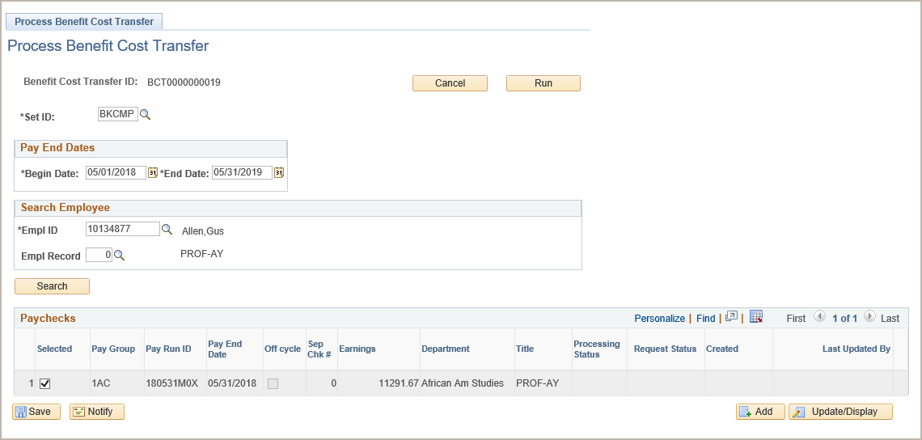
Process Benefit Cost Transfer Page
Use this page to search for the employee and the paychecks
Begin the system steps by entering the appropriate earnings date range, employee ID and employee record then click Search.
Select the specific payroll date(s) for which you want to update funding and click Save.
Click Run to display the Review Cost Benefit Transfer page on which you enter the necessary benefit cost updates.
Notes:
When displayed in Slide Show mode, this slide includes animation for six objects. Click to display each object as you describe the steps listed below.
Additional page / field notes:
Begin Date and End Date: The system defaults the dates to the begin and end dates of the current fiscal year, but you can enter a date range for the specific payroll date(s) for which you are searching.
Empl Record: If the employee has multiple jobs, select the appropriate employee record. The system allows for updates to only one job’s earnings in a direct retro transaction. If all jobs require updating, enter multiple direct retro transactions (one for each job requiring a redistribution).
Payroll Date section
After you enter the employee’s ID and record number, click Search. All the processed payrolls for the employee within the given date range appear.
Select the check box next to the payroll for which you want to enter a benefit cost transfer or select multiple check boxes to process adjustments for multiple payrolls in a single transaction.
Click the Save button to prompt the system to display the Run button (already shown in the image here). After you save the transaction, there is open activity on the selected pay period(s). This means that no other users can make changes for these periods until this transaction is complete (that is, until updates are made to the distribution lines). If necessary, click Cancel to close the transaction and the period(s) are available for updating.
Click the Run button, which triggers a process that fetches the payroll distribution data based on the payroll(s) selected and transfers it to the Review Benefit Cost Transfer page.

Slide 51
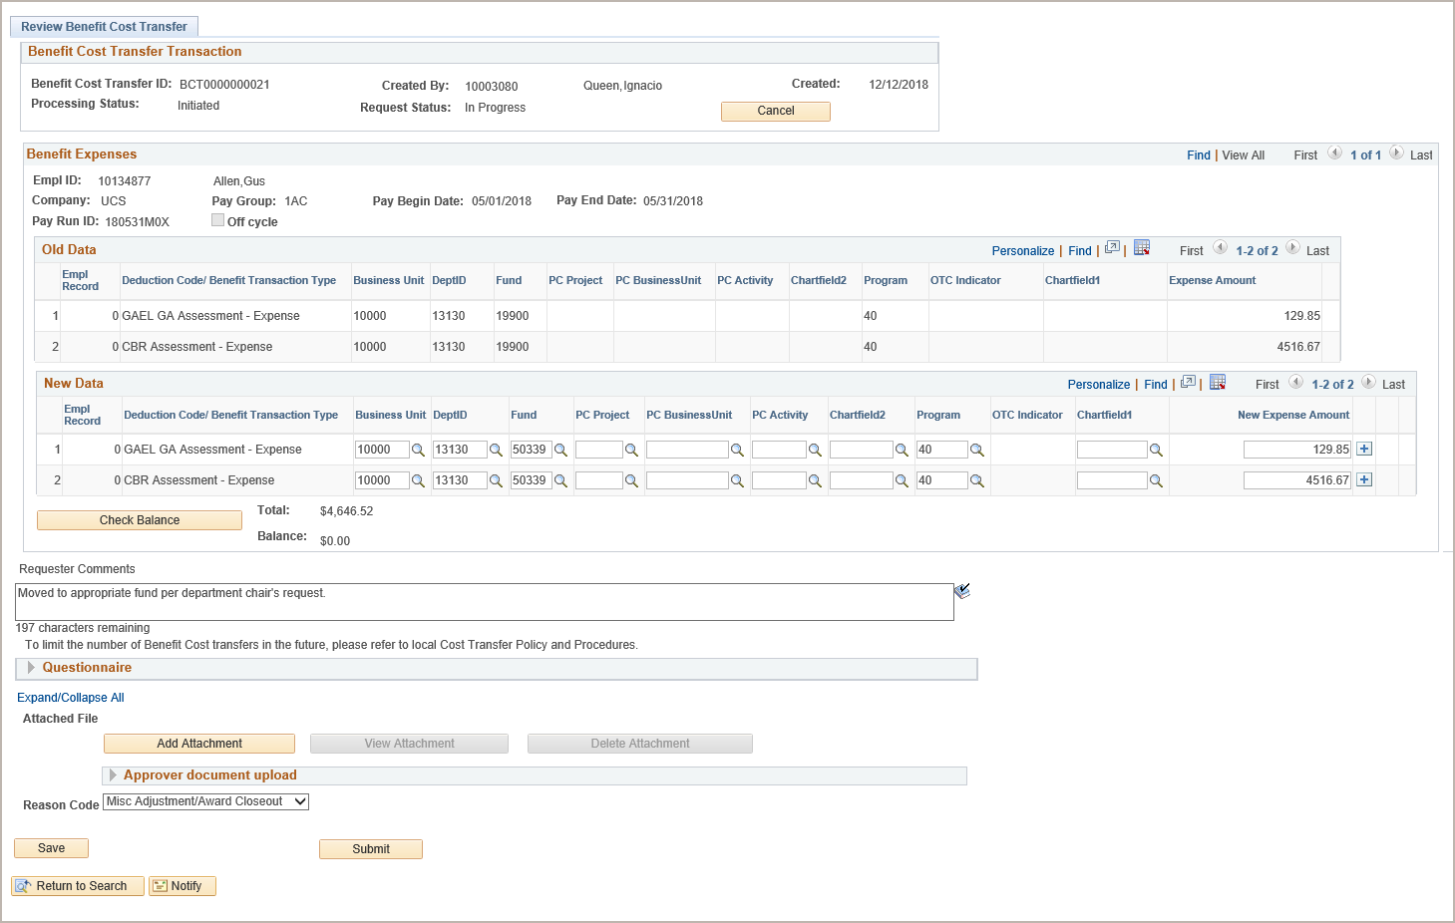
Review Benefit Cost Transfer Page
Use this page to enter updates
The Old Data section displays the current funding detail.
In the New Data section, enter the necessary update(s) and then click Check Balance.
You have the option to enter comments and add one or more supporting documents.
When you are finished entering updates, click Save to check for errors.
Expand and complete the Questionnaire section, if applicable.
Select the reason for the adjustment.
To submit the transaction for review and approval, click Submit. After you submit it, the system displays the workflow routing details (not pictured here) below the Reason Code field.
Notes:
When displayed in Slide Show mode, this slide includes animation for the gray captions. Click to individually display each caption (and hide the previous caption) as you describe the objects on the Process Benefit Cost Transfer page.
Additional page / field notes:
You can make several types of updates in the New Data section. You can add or delete rows based on the desired redistribution of funding, or split funding between multiple funding sources. However, you cannot create or eliminate benefit expenses using this transaction.
Check Balance button: After you enter data, check the balance. When the old data total does not match the new data total, the system generates an error message. The earnings must balance before you can save and submit the transaction.
Requester Comments: Enter comments as appropriate. This is a required field.
Questionnaire: Provide answers to the questions/requests, as appropriate. Completion is required for high risk transactions.
Justification Document Upload: Attach a supporting document if necessary.
Reason Code: Select the appropriate reason. This is a required field.
Process notes: Prior to final Location approval, the transaction remains in a hold state, which prevents it from being picked up in the nightly batch processing. Upon final Location approval, the transaction page updates the transaction status to Approved, which then makes the transaction available for nightly batch processing for redistribution and journalization.
The end-to-end system steps for initiating this type of transaction are covered in more detail during the instructor demonstration and participant exercise.

Slide 52
Instructor Demo
Enter Benefit Cost Transfer
Watch as your instructor demonstrates how to enter a benefit cost transfer in UCPath.
Follow along using the UCPath Help topic.
Open the UCPath Help site and refer to the Enter Benefit Cost Transfer topic.
Launch the Try It version of the topic.
At the end of the demonstration, you will have the opportunity to practice this task.
Notes:
For UPK simulation-based demonstrations, open the Try It view and walk through the activity while providing details and explaining the task. The users should follow along with the Print It version of the UPK.

Slide 53
Exercise
Enter a Benefit Cost Transfer Transaction
This is your opportunity to practice this task on your own.
Complete exercise 2 in your workbook.
Ask your instructor for assistance, if needed.

Slide 54
Approval Email Notification
After final approval of a benefit cost transfer, the system automatically sends an email notification to the Location Initiator, which indicates the transaction is approved.

Slide 55
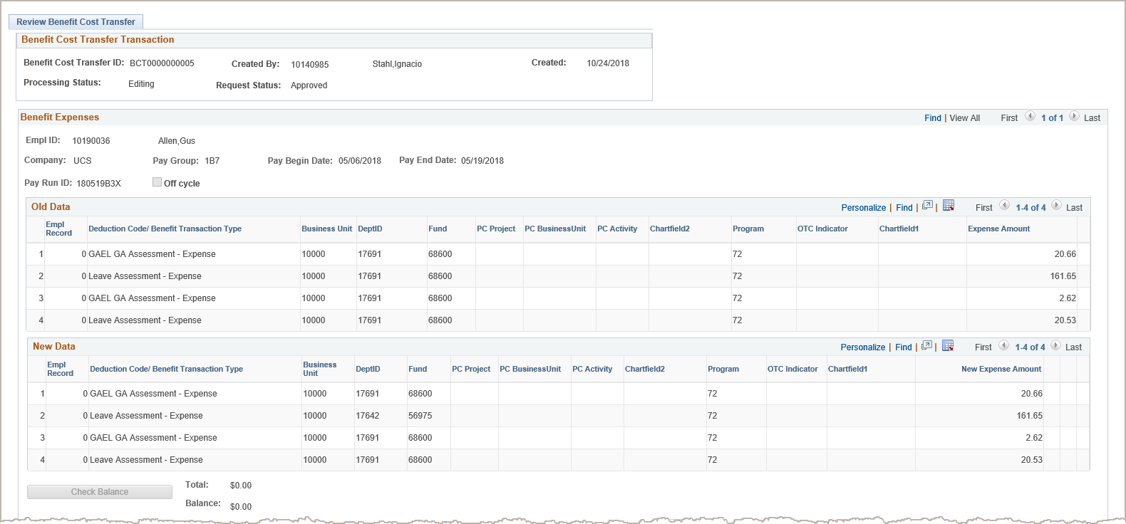
Review Benefit Cost Transfer Page
Navigation: PeopleSoft Menu > Payroll for North America > Payroll Distribution > UC Customizations > Review Benefit Cost Transfer
Use the Review Benefit Cost Transfer page to access a transaction that has been entered and saved, but not submitted. You can also use this page to access transactions that have been submitted and are awaiting approval or have already been approved.
Notes:
Additional page / field notes:
This page provides an audit trail of changes made on a particular benefit cost transfer transaction. It provides key information, such as process status, approval status, pay period(s), old and new data, initiator comments and approval details (if applicable).
The Benefit Cost Transfer Transaction section displays the system generated run control ID, the Location initiator’s ID and name, and the date on which the transaction was created. The Created field identifies the date the transaction was created, but not necessarily the date the transaction was processed. The two status fields indicate the processing status and the request status. Processing Status is the overall status. Valid values are: Initiated, Editing and Complete. The Processing Status of Editing indicates the transaction will be updated with the nightly process. Request Status indicates the AWE approval status of the transaction. Valid values are: In Progress, Approved, Denied and Complete.
The Benefit Expenses section displays the employee’s ID and name, and the pay distribution details. This section also provides an audit trail of updated data. It includes the Benefit distribution before and after the update.
Note the number of pay periods available for review. In this example, there was only one selected pay period as indicated by 1 of 1 displayed at the top of the Benefit Expenses section. When multiple pay periods appear, use the View All functionality to list all earnings data, as well as the old data and the new data sections for each pay period. Use the scroll bar to move up and down the list.

Slide 56
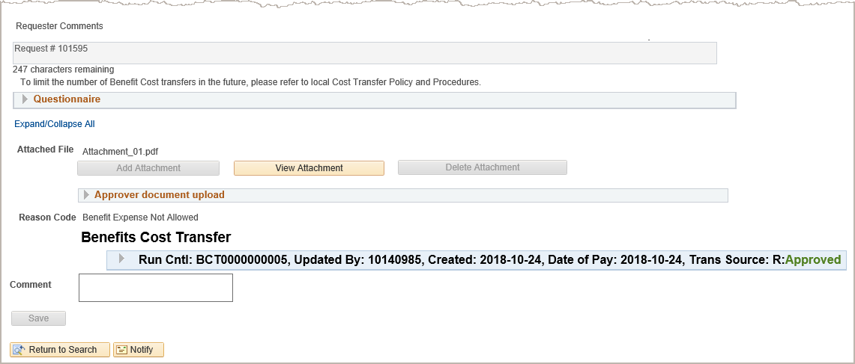
Review Benefit Cost Transfer Page (Cont’d)
The Requester Comments, Questionnaire answers, if applicable, and the transaction Reason Code provide insight as to why the BCT transaction was necessary.
The bottom of the page displays the Requester Comments field, Questionnaire answers, if applicable, the transaction Reason Code, access to justification documents and approval details.
If the initiator or the approver uploaded one or more documents to the transaction, the View Attachment button is enabled. Click the button to view the attached document(s).
If the transaction has been submitted, as in this example, the system displays the approval routing details, including the approval actions that have taken place.
In this example, the transaction has been approved. Click ► to expand the section to see the specific approver(s) to which the transaction was routed.
Approvers can enter comments on any transaction routed for their approval, but must enter comments when denying or pushing back the transaction to a previous approver during the approval process.
Notes:
When displayed in Slide Show mode, this slide includes animation for the gray captions. Click to individually display each caption (and hide the previous caption) as you describe the objects on the page.

Slide 57
Instructor Demo
Review Existing Benefit Cost Transfer Transaction
Watch as your instructor demonstrates how to enter a benefit cost transfer in UCPath.
Follow along using the UCPath Help topic.
Open the UCPath Help site and refer to the Review an Existing Benefit Cost Transfer Transaction topic.
Launch the Try It version of the topic.
At the end of the demonstration, you will have the opportunity to practice this task.
Notes:
For UPK simulation-based demonstrations, open the Try It view and walk through the activity while providing details and explaining the task. The users should follow along with the Try It version of the UPK.

Slide 58
Module Objectives Review
Having completed this module, you should be able to:
Enter a benefit cost transfer.
Review an existing benefit cost transfer transaction.

Slide 59
Course Review

Slide 60

Putting It All Together
The direct retro process:
Clears the suspense account for expired or invalid funding data.
Moves authorized pre-award spending without project/grant setup after the project/grant is in UCPath.
Redistributes all or a portion of a prior period distribution to different funds due to delayed approval of a funding change.
Modifications made using the direct retro process do not change the existing funding data in the UCPath, you must update the funding on the Funding Entry page.
The Review Retro Distribution page provides an audit trail of changes made on a particular direct retro transaction. It provides key information, such as process status, approval status, pay period, old and new data, initiator comments and transaction reason code.
A high risk direct retro transaction requires an additional, higher-level approval in UCPath.
If you enter a capped fund in the New Data section, and the employee’s Total UC Salary exceeds the fund’s annual salary cap, use the Salary Cap/Multiple Components of Pay Worksheet to enter over the necessary cap details for the transaction.

Slide 61
Putting It All Together Cont’d
The benefit cost transfer process allows Locations to move benefit costs from one account or fund to another.
This process restricts redistribution of dollars to the same deduction code; it does not allow the movement of dollars from one deduction code to another.
Submitting a benefit cost transfer transaction triggers approval workflow (AWE) at the Location level.
High-risk transactions are considered Benefit Cost Transfers (BCTs) that are in violation of the 120 Day Rule and/or 90 Day Rule at the time of submission by the initiator.
After final approval of a benefit cost transfer, the system automatically sends an email notification to the Location Initiator, which indicates the transaction is approved.

Slide 62
Course Objectives Review
Having completed this course, you should be able to:
Describe the use of direct retro at UC.
Identify the key information on the Review Retro Distribution page.
Describe the direct retro funding update process.
Enter direct retro funding updates.
Describe the benefit cost transfer process.
Enter a benefit cost transfer.
Review an existing benefit cost transfer transaction.

Slide 63
Course Resources

Slide 64
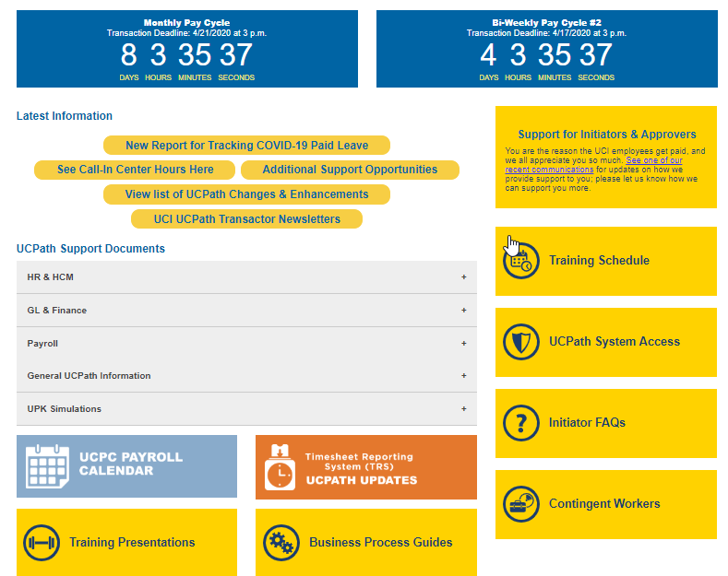
Reference Material for Review
The UCPath Help site is your first level of support. Search for conceptual content, job aids or step-by-step instructions for UCPath tasks.

Slide 65

Where to Get Help
The UCPath Help site is your first level of support. Search for conceptual content, job aids or step-by-step instructions for UCPath tasks.
From the Transactional Users website, expand the UPK Simulation section in the middle of page and then click the “Location Users” link to open the site. *An Adobe PDF version is available for users with screen readers.
If you’re experiencing issues, or have questions about transactions, please contact the Employee Experience Center at (949) 825- 0500, or submit a ticket by visiting UCPath.UCI.Edu

Slide 66
Thank You!
Training End

