Slide 1

Course: Funding Entry
Notes:
Welcome to Budget Distribution training. This course outlines the process required to create and maintain permanently budgeted positions in UCPath so that the information is transferred into Kuali Budget Module (KBM). It is recommended to take the Funding Entry training prior to taking this course. Many of the concepts taught in Funding Entry are carried over into this course.

Slide 2

Course Instructions
The course menu can be found on the left side of the screen.
The glossary is next to the menu as a secondary tab for key terms.
Please note the navigation buttons at the bottom of the screen, they will be displayed the entire course.
Feel free to try any of the activities referenced in this course for further understanding.
Course Resources can be located on the top right corner of screen.

Slide 3

About This Course
The Funding Entry course describes the process to fund positions for payroll processing to ensure payroll expenses are allocated to the correct KFS account and fund.

Slide 4

Course Agenda
Lesson Topics
1: Funding Entry Overview
2: New Position Funding
3: Position Funding Updates

Slide 5

Lesson 1
Funding Entry
Overview

Slide 6


Objective Tracker
Lesson 1 Objectives
In this lesson, you will learn how to:
Describe the Funding Entry process in UCPath
Explain how Position Management relates to funding

Slide 7
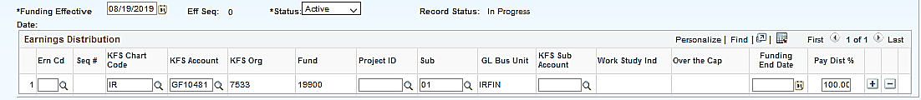
Funding Entry in UCPath
Funding Entry is the process of entering Chartfield String(s) on the Funding Entry page to indicate source of funding for earnings, employer-share deductions, and employer-share taxes, as well as for salary encumbrances.
Funding is associated with a position and entered on the Funding Entry page.
Funding Entry fields correspond with the UCI KFS configuration.
Notes:
Funding entry data identifies the funding source and pay distribution for each position at UC. When entering funding information in the Earnings Distribution section,

Slide 8



Position Management Overview
Position Management coordinates 3 components Position, Person and Job.
When an employee is hired into a position, a job is created.
Position
Person
Job
Administrative Assistant
Employee -
Jill Jones
Jill Jones - Administrative Assistant
Notes:
This is a refresher on Position Management. For more information on Position Management please see the Position Control ILT training.
Understanding Position Management is key to learning about other processes and transactions in UCPath.
In UCPath every employee will have an assigned position, or positions if they have multiple jobs. This graphic illustrates the relationship between the position, person and job in UCPath.
Funding is assigned to a position not an employee.

Slide 9

Position Funding in UCPath
The position can be vacant or filled when new funding is assigned or funding updates are made.
As employees move in and out of a position, funding remains the same for
that position unless changes are made.
Funding is assigned to a position not an employee.
Notes:
In UCPath funding is attached to a position not an employee. The change from the funding being attached to the employee to position funding represents a major shift in funding philosophy. It means that once set up the position funding can remain in place as people move in and out of the position.

Slide 10
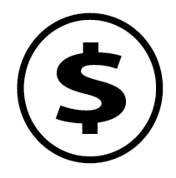
Funding Entry – Key Change
Previous
UCPath
Previously funding was tied to an employee. Funding information, the salary amount, FTE percent and description of service code were all entered when the employee was hired.
In UCPath funding source is separate from all those other elements. It is tied to a position and entered on the Funding Entry page. You can fund a position before you hire anyone into the position.

Slide 11
Department Default Funding
All departments have a default funding account set up which is managed centrally.
If position funding is not set up by the time an employee gets paid, the salary costs are distributed to the department default funding account.
A Direct Retro transaction will be needed to transfer the salary costs to the appropriate funding account if they are charged to the department default account.
This process ensures that an employee gets paid regardless of whether the position funding has been set up.
Funding required before an employee can be paid.
Previously
Funding NOT required before an employee can be paid.
UCPATH

Slide 12
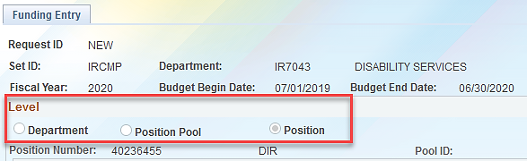
Funding Entry Levels in UCPath
Funding entry has three levels. UCPath looks for the lowest level of funding when generating the payroll accounting entries.
  Position (lowest level) – uses the funding data entered for the position.
  Position Pool (not used at UCI)
  Department (managed Centrally) – uses the funding data entered for the department.
Note: Department initiators only responsible for adding and updating Position Funding.
Notes:
The UCPath system looks for the lowest level of funding when generating the payroll accounting entries. In other words, the system looks at the employee’s position and searches for position level funding first, position pool level funding second and department level funding last. Since we are not using Position Pool level funding at UCI, if Position level funding is missing then it uses Department level funding.
The department Initiators are only responsible adding and updating Position Funding. Department default funding was set up prior to go-live and is managed centrally.

Slide 13

Business Process Steps
To avoid payroll costs being charged to the department default account position funding should be set up prior to an employee getting paid or, if possible, prior to being hired.
1. Create a position via Position Control or utilize an existing position.
2. Set up position funding using the Funding Entry page.
3. Hire the appointed employee into the position and create a job.
Notes:
To avoid payroll costs being charged to the department default account position funding should be set up prior to an employee getting paid or, if possible, prior to being hired.
However, please note that from the system perspective the position funding can be added or updated at any point after the position has been created.
Note: All departmental pre-processes must followed prior to entry into UCPath including location approvals, all necessary consultations, policy, and procedures

Slide 14
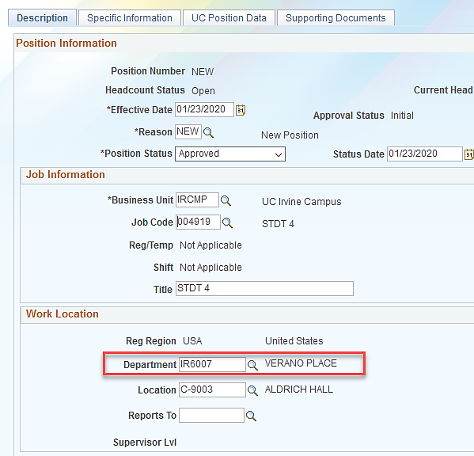
Department / Position Relationship
Departments own positions
Only a person with access to your department can access or make changes to your positions
Funding is linked with
a unique position/department combination
  If the department is changed the link is broken and funding must be entered for the new combination
New Position Control Request
Notes:
Note: If the department is changed for a position the funding is no longer applicable. New funding must be entered for that position/department combination.
If split funding is needed for a position, the department that owns the position must enter the funding for both departments.

Slide 15
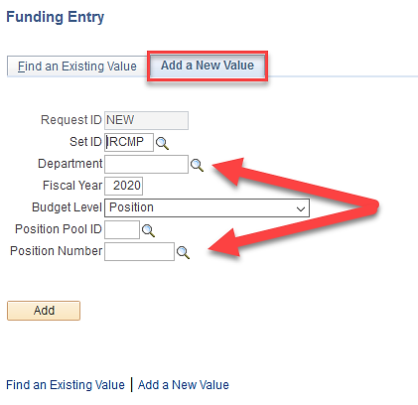

Department & Position Number Needed
Whenever accessing the Funding Entry page, Department and Position Number must be entered on the Add a New Value tab.
You cannot access the Funding Entry page without these two pieces of information.
Note: As the previous slide mentioned, you also must have security access to the department to which the position belongs.

Slide 16

Lesson 1 Complete
Lesson Summary:
Described the business process for Funding Entry
Explained the relationship between Position Management and funding

Slide 17
Lesson 2
New Position
Funding

Slide 18
Objective Tracker
Lesson 2 Objectives
In this lesson, you will learn how to:
Describe the Funding Entry system process
Submit a Funding Entry request

Slide 19
System Process Flow: Funding Entry
Create position
Enter funding data
Review and approve the funding data
Look up funding entry
Generate detailed accounting entries
Notes:
This diagram is a high-level process flow of funding entry.
The funding level (position) must exist before creating any funding entry.
Next, enter or modify funding data.
Manually entered data passes through an approval workflow. Use the Funding Entry Inquiry page to review approved funding data.
The Funding Entry Inquiry page does not display submitted or rejected data.
The information found on the Funding Entry Inquiry page creates detailed accounting entries during GL closing.

Slide 20
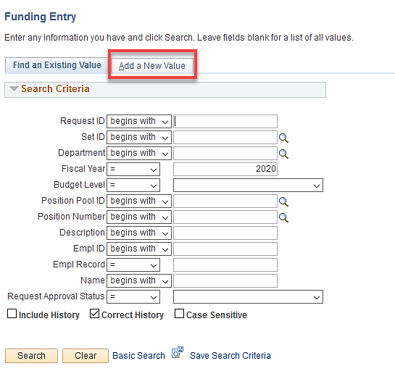
Funding Entry Page
Navigation: PeopleSoft Menu > Set Up HCM > Product Related > Commitment Accounting > UC Customizations > Funding Entry
Notes:
All funding entry and updates are done on the Funding Entry page. Here is the navigation path.
This page defaults to the Find an Existing Value tab. To enter, update or simply view funding for a position, click the Add a New Value tab.
When you come to the Funding Entry page, 95% of the time you should click the Add a New Value tab to proceed.

Slide 21
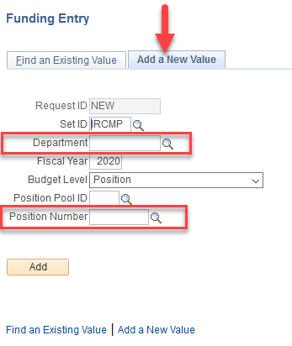
Add a New Value tab
To enter new funding, update existing funding, or view existing funding information, enter the following:
  Department in which the position resides
  Position Number
Note: The Fiscal Year will default to the current period. If you wish to enter funding for a future period, this field must be updated here.
Notes:
The only Budget Level funding initiators are ever responsible for entering in UCPath is Position.

Slide 22
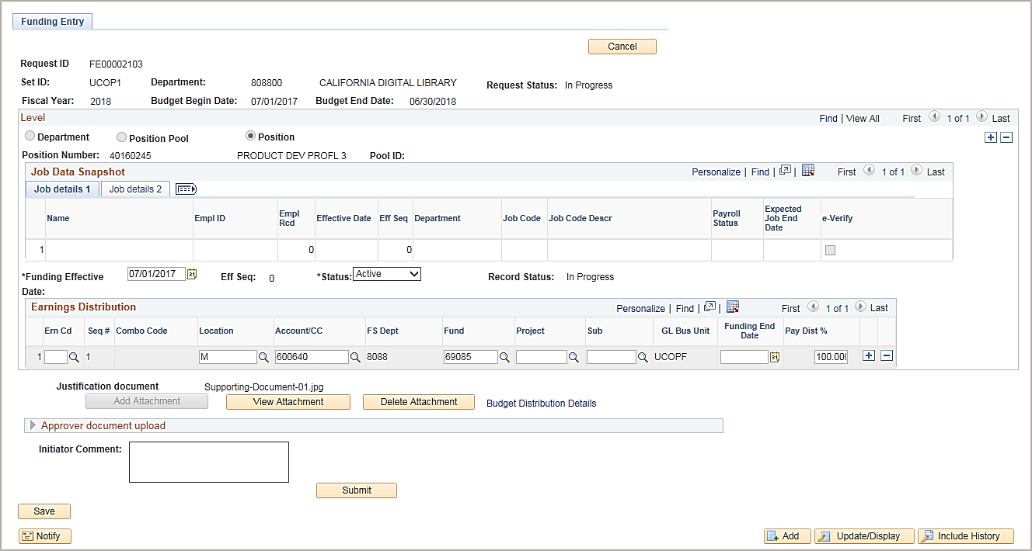
Funding Entry Page – Top Section
Note: No incumbent data in the Job Data Snapshot section.
The Funding Effective Date should fall within the budget begin and end date.
Notes:
This is the Funding Entry page that has been completed for a vacant position. We know the position is vacant because no employee information is listed in the Job Data Snapshot section of the page.
The initial Funding Effective Date must be equal to either the Position Effective Date or Appointment Effective Date.
The most common errors encountered when entering Funding are:
Selecting a Funding Effective date that falls outside of the Budget Begin and Budget End dates (Fiscal Year) at the top of the Funding Entry page.
Selecting a Funding Effective Date that is prior to when the position was created.
Entering a Funding End Date but not establishing new funding to take affect immediately afterwards.
Selecting funding that was not available (closed, not valid in KFS or not yet available in UCPath from KFS).

Slide 23

Funding Entry – Earnings Distribution
Continued
Enter funding source(s) and distribution percentage(s) in the Earnings Distribution section.
For split Funding, insert additional rows with the appropriate Earn Code.
The Pay Dist % must equal 100% for all rows combined, even for single funding source, at the Earn Code level.
Enter applicable comments regarding the funding.
Click Save and then Submit.
Notes:
Click for animation.
The Earnings Distribution section of the page is where you enter the KFS account/fund/project information to be used to fund this position’s salary.
The pay distribution (Pay Dist %) must equal 100 percent for all rows combined at the earn code level.
There must be at least one row with a blank earn code to collect any earnings that are not identified by a specific earn code type. (We’ll talk more on that on a later slide.)
After entering the funding information in the Earnings Distribution section and entering the Initiator Comments, click the Save button to ensure there are no errors with the data entered. If no errors are presented in red, click the Submit button.

Slide 24
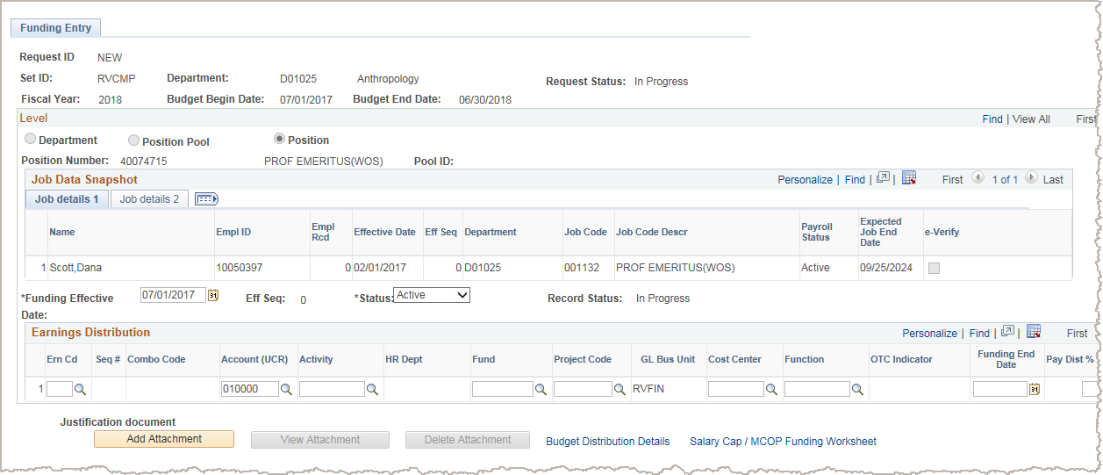
Funding Entry Page – Filled Position
Note: Incumbent data in the Job Data Snapshot section. The remaining sections of the page are the same as for the vacant position.
Notes:
Click for animation.
We can tell this position is filled because the employee in the position is identified on the Job Details tab in the Job Data Snapshot section.
If you enter one or more funds that require the employee to be verified, the system displays a warning message.
The funding page will provide a warning message if the position contains a fund(s) that requires employees paid on that fund to be E-Verified.
The UCPath Funding page will indicate whether an employee has been E-Verified

Slide 25
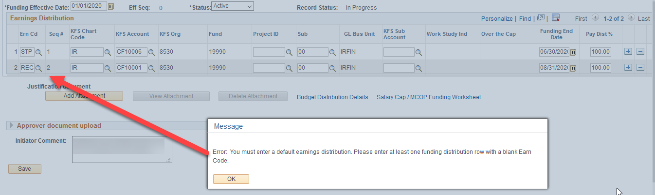
Blank Earn Code Row
UCPath will not allow submission of a funding entry without the blank earn code row.
Notes:
This is the error message generated in UCPath when the blank earn code row is missing. Notice there is a line for earn code – STP at 100% and a line for earn code – REG at 100%.
This can be fixed in two ways:
Add another row for the blank earn code with a different account, or
Replace the REG earn code with a blank if the same account is to be used.

Slide 26
Earnings Distribution Single Fund
A single funding source for all earnings.
The Earn Code field is blank indicating it includes all earnings.
The only sequence number is 1.
There is a single row for the chart string.
The pay distribution equals 100%.
Notes:
Let’s review a few samples of earnings distribution options for funding.

Slide 27
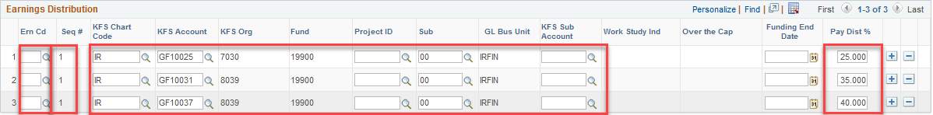
Earnings Distribution Multiple Funds
Multiple funding sources for all earnings.
The Earn Code field is blank indicating it includes all earnings.
Sequence # 1 applies to all lines so the pay distribution for all lines must add up to 100%.
One row appears for each unique chart string.
In this example value in the Account field is unique on each line.
The combined pay distribution is 100%.
Notes:
Although only Regular earnings are being used, multiple funding sources (accounts) are used to fund this position.

Slide 28
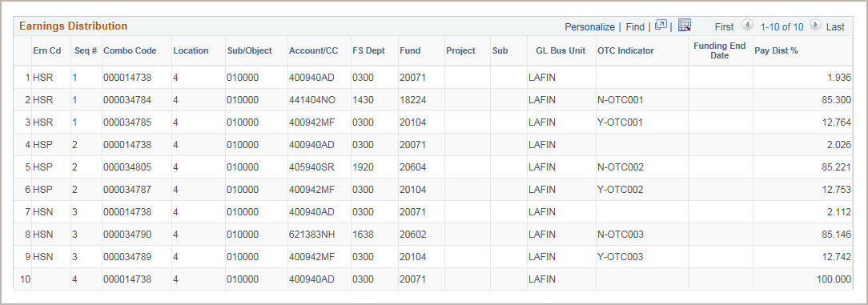
Earnings Distribution - MCOP
Multiple funding sources for three of the earnings code values and a single funding source for the regular earnings (blank) row.
Four sequence numbers appear: one for each value in the Earn Code field, including the blank value. Multiple rows represent the earn codes and how the distribution of the earnings codes allocate across the funding sources.
The pay distribution for each sequence number totals 100%.
In this example, the row with the blank Earn Code field value, has a single funding source. Any earnings not identified on other lines are funded on this line. All other earnings have distributions across three funding sources.
Notes:
In this example, funding is split between four different earnings codes.
Notice that this example also includes Over the Cap values. As a reminder, Over the Cap identifies whether a distribution line is over-the-cap (salary cap), under-the-cap or uncapped (has no salary cap). An uncapped row has a blank Over the Cap indicator. An indicator starting with the letter N is the up-to-the-cap row. An indicator starting with the letter Y is the over-the-cap row. The value at the end of the indicator, for example OTC001, links the OTC row to the capped funding source line that is responsible for OTC funding line.

Slide 29
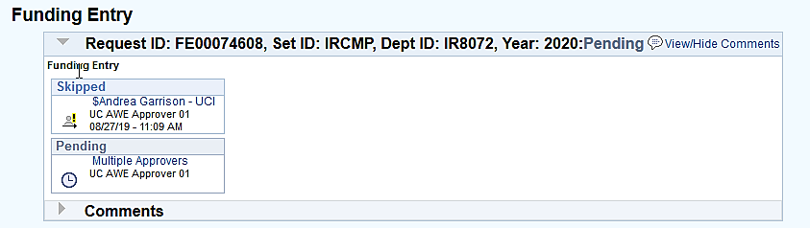
Funding Approvals
All Funding Entry and Updates submitted via the Funding Entry page goes through online Approval Workflow Engine (AWE).
Notes:
The approval workflow will use the HR Department approver workflow.

Slide 30
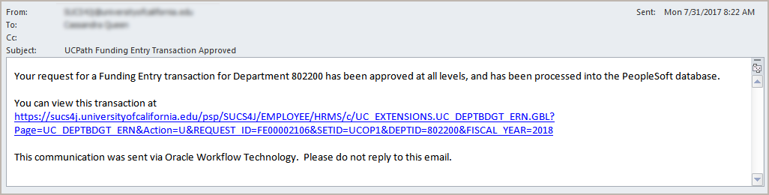
Approval Email Notification
After final approval of the funding entry or funding update, the system automatically sends an email notification to the Location Initiator, which indicates the transaction is approved or denied.
Notes:
Similarly, the system sends a notification when a Location Approver denies a funding entry transaction.

Slide 31
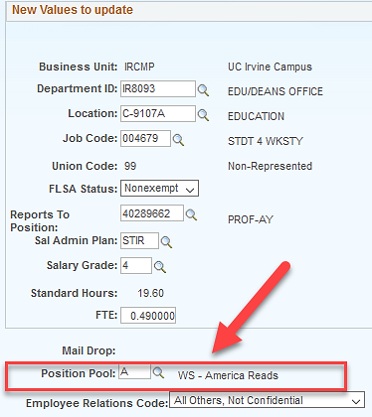
Work Study Funding
Work Study Distributions cannot be entered on the Funding Entry Page.
  UCPath manages the Work Study Distribution and Split Percentage via the Position Pool.
  If the position has a Position Pool for the current Award Period then the position is considered a Work Study position.
  For those earnings that are considered Work Study Eligible, UCPath will determine if there
  is an award balance to cover the submitted earnings.
  Once the work study funds are depleted, remove the Position Pool ID using a PayPath action.
  Navigation: UC Customizations > UC Extensions > PayPath Actions > Position tab
PayPath Position Data tab
Notes:
Remember that Work Study Funding cannot be added on the Funding Entry page.

Slide 32

KFS Sub Account & Work Study
When entering funding for any Work Study position, do not enter data in the KFS Sub Account field.
It is ok to use this chartfield for other positions that do not use Work Study funding.
Notes:
Do not enter information in the KFS Sub Account field when entering funding for a Work-Study position. The Work Study tables already have a value for this chartfield and it causes a problem with funding.

Slide 33
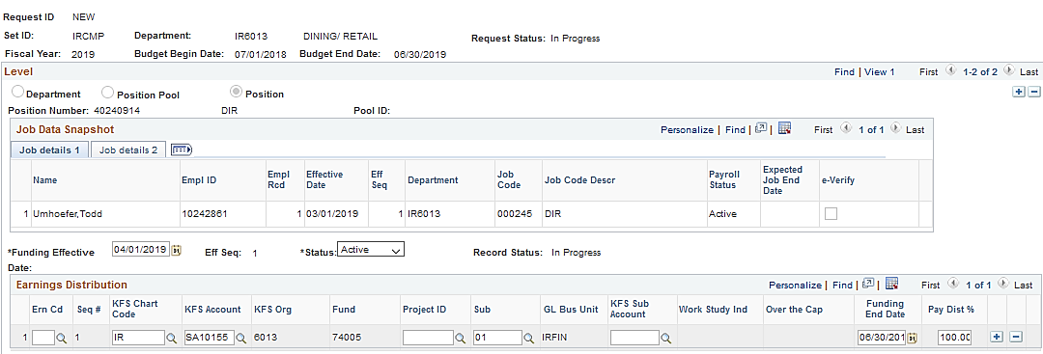
Missing Funding and Errors
Department Default Account – missing funding information.
Campus Suspense Account (BF10002) – funding end date approaches without new valid funding in place.
Department Suspense Account – invalid funding information.

Slide 34

Instructor Demo
Please watch along as the instructor performs a demonstration in the UCPath system.
After the demonstration is complete, feel free to pause the course and try yourself by visiting the UPK Helpsite in the resource section of this course.
Search the UPK Helpsite for “Submit a New Position Funding Entry Request”

Slide 35
Salary Caps and Multiple Components Of Pay (MCOP) Worksheet

Slide 36
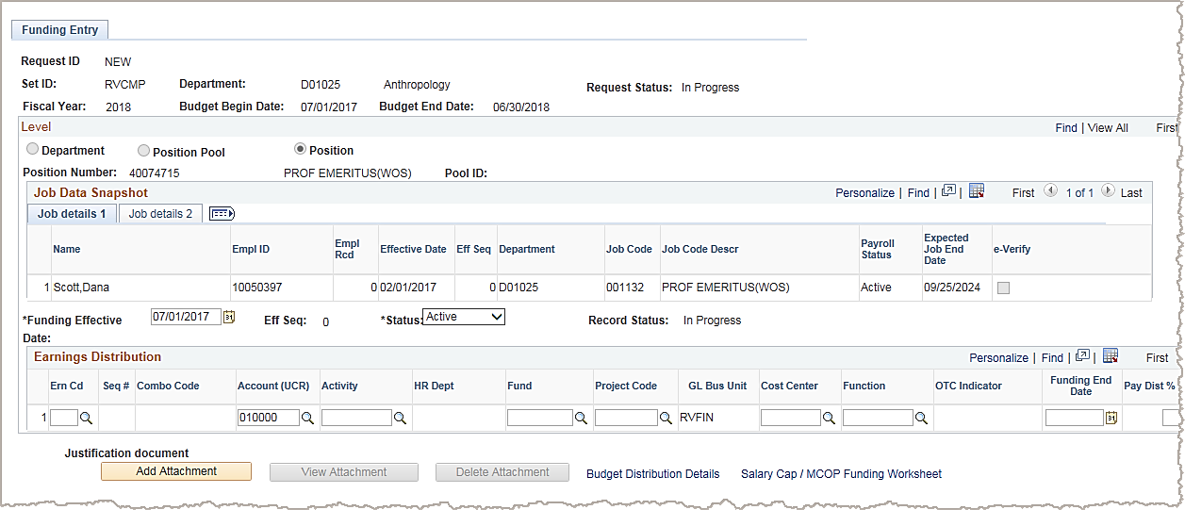
Salary Caps / MCOP Worksheet
Many UCI employees are paid using funds that have salary caps (i.e., grant funds) and/or
with multiple components to their pay (i.e., NSTP, Offscale or HCOMP).
The scenarios below trigger the use of the Salary Cap/MCOP Funding Worksheet.
Entering an account/fund combination on the Funding Entry page that has a salary cap
Hiring someone and setting their compensation with multiple types of pay.

Slide 37
Instructor Demo
Please watch along as the instructor performs a demonstration in the UCPath system.
After the demonstration is complete, feel free to pause the course and try yourself by visiting the UPK Helpsite in the resource section of this course.
Search the UPK Helpsite for “Submit a New Position Funding Entry Request - MCOP”

Slide 38
2 Lesson Complete
Lesson Summary:
Describe the Funding Entry system process
Submit new funding entries for positions

Slide 39
Lesson 3
Funding Entry
Updates

Slide 40
Objective Tracker
Lesson 3 Objectives
In this lesson, you will learn how to:
Describe the Funding Entry Update process
Enter a Funding Entry Update transaction
List available report resources

Slide 41
Position Funding Update Examples
Reasons to update position funding include:
  Add a new grant that was recently awarded.
  Modify the distribution percentage being paid across
  Fund A and Fund B.
  Changes to a funding start and/or end date, including removal of the funding end date.
  Add or update Salary Cap information.

Slide 42
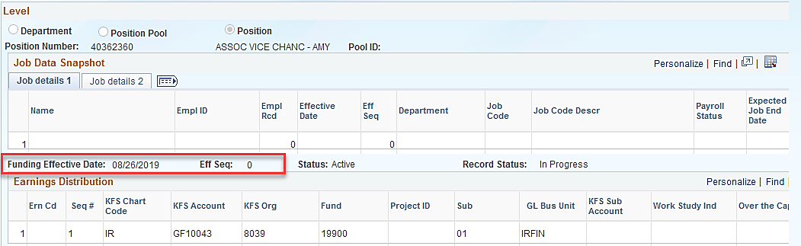
Funding Updates Process Overview
The Initiator can manage all associated position and funding entry updates in UCPath.
Use the Funding Entry page to update position funding.
  This page is effective-dated, which allows a Location to retain a history of the position’s funding throughout each fiscal year.
  This page also allows for effective sequencing, in the event you must make more than one update on the same effective date.

Slide 43
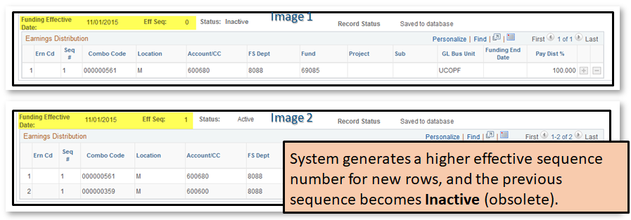
Effective Sequence
Effective Sequence is used in combination with the Funding Effective Date when there is a change for the same date.
If there are two rows with the same Funding Effective Date, UCPath will use the row with the highest Effective Sequence (Eff Seq) for processing.
UCPath will use image 2 below because it has a higher Effective Sequence
(Eff Seq) of 1.
Notes:
If you discover an error for a funding distribution entry, you may add a new effective dated row with same funding effective date. UCPath will use the row with the highest effective sequence for processing. In the screenshot, UCPath will use the information in Image 2.
A Salary Cost Transfer via Direct Retro can be avoided if this is fixed and approved BEFORE payroll runs.

Slide 44
Funding Updates - System Process
Navigate to Funding Entry page
Search for and select appropriate position funding record
Insert effective-dated row and enter updates
Attach supporting documents, enter comments, then Save
Click Submit to send for review and approval
Notes:
Funding entry transactions flow through AWE. After the Location Initiator successfully saves and submits the funding entry transaction, the system automatically sends each approver in the workflow an email notification indicating the transaction is ready for review and approval. In addition to receiving a system-generated email notification, the system displays each new funding entry awaiting approval in the appropriate approvers’ Worklist.
After final Location approval of the transaction, the data is committed to the Department Budget tables in UCPath. The system automatically sends an email notification to the Location Initiator indicating the funding entry is approved.

Slide 45
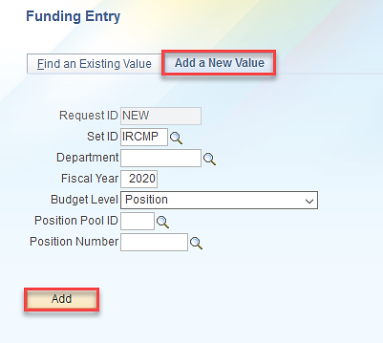
Funding Update – Add a New Value
The Add a New Value tab is selected when entering a funding update.
Notes:
Whenever you want to add a new value or update funding values the Add a New Value tab is used. Enter the Department of the position, the Fiscal Year the updated funding falls within and the Position Number. Click the Add button.

Slide 46
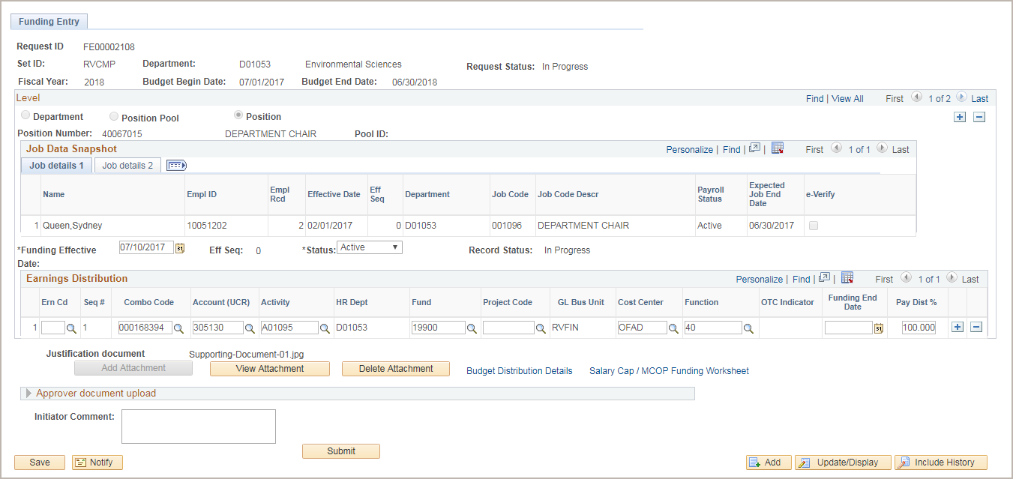
Funding Update – Funding Entry Page
This is the same page you use to enter new funding for a position. It is effective-dated so that you can maintain a history of funding changes.
Insert a New Effective Dated Row.
Change or accept the Effective Date.
Enter the appropriate funding source(s) and distribution percentage(s)
Attach supporting documents.
Enter applicable comments.
Click Save to check for errors.
Fix any errors.
Save until fixed.
Click Submit for Approval
Notes:
Click for animation.
When displayed in Slide Show mode, this slide includes animation for the gray captions. Click to individually display each caption (and hide the previous caption) as you describe the objects on the Funding Entry page.
Additional page / field notes:
The Funding Entry Page is the same page you use to enter new funding for a position. It is effective-dated so that you can maintain a history of funding changes.
This is a custom UC page designed to streamline funding data entry. Charts of accounts vary based on UC location, which means UC has a large volume of funding to enter and maintain.
For funding updates, the Location Initiator must first insert a new effective-dated row. After you insert a new row, the system copies forward the previous row of information so that you can make the necessary adjustments.
UCLA: The funding effective date can be a:
Future date that will go into effect when that day is reached
Today’s date to have the funding go into effect today or a
Past Date, as long as Payroll has not yet been run for that pay period
You can enter an effective date for historical rows that may be earlier than the date for the current effective row, but this should be a rare occurrence. Also note there is an effective sequence field for situations where there may be two entries on the same date. Remember that funding should be entered on a timely basis with proper effective dates. More information about historical rows appears at the end of this module.
To support funding entry for multiple charts of accounts, this Location-specific entry page displays labels that correspond to each Location’s respective chartfields. The example shown here reflects UC Riverside’s chartfields.
The end-to-end system steps for initiating this type of transaction are covered in more detail during the instructor demonstration and participant exercise.

Slide 47
Instructor Demo
Please watch along as the instructor performs a demonstration in the UCPath system.
After the demonstration is complete, feel free to pause the course and try yourself by visiting the UPK Helpsite in the resource section of this course.
Search the UPK Helpsite for “ Enter Position Funding Update”

Slide 48
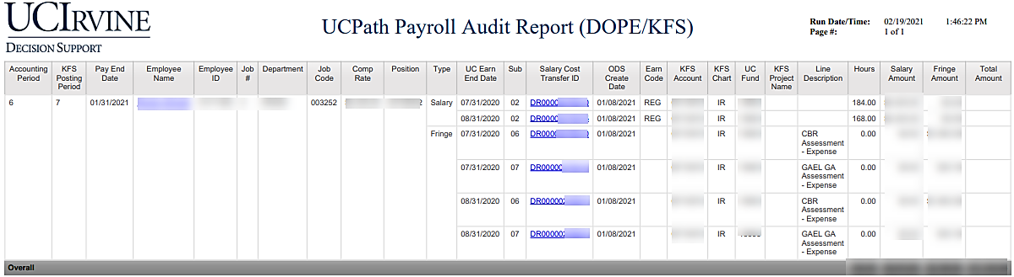
ZotPortal UCPath Decision Support
Location of DOPE Report: UCPath Decision Support > Payroll
Other Funding Report: UCPath Decision Support > Job
Position Funding Audit Report: Used to identify positions that have active funding.

Slide 49
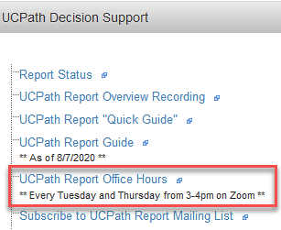
Report Resources
Feel free to download the Cognos Report Quick Reference Guide in the Resources section of this course.
UCPath Report Office Hours are available for additional support or training every Tuesday & Thursday from 3:00pm – 4:00pm PST via a live Zoom session

Slide 50
Lesson 3 Complete
Lesson Summary:
Describe the Position Funding Update process
Enter a Position Funding Update
List available report resources

Slide 51

Course Summary
In UCPath, fund source information is entered on a separate page, Funding Entry page.
Funding is assigned to a position and entered using a position and department combination.
If the Department for a position changes, the funding link is broken and has to be entered using the position and new department.
Funding is not required to be entered before an employee can be paid.
    If the funding is not entered before payroll cut-off the department default account will be charged and salary cost transfer must be processed to transfer the salary cost to the right fund source.
  The DOPE report is used to reconcile position funding information after payroll has processed.

Slide 52

Online Course Resources

Slide 53


Where to Get Help
The UCI UCPath website is your first line of support for all UCPath related questions.
Use the Search feature to find conceptual content, job aids or step-by-step instructions for UCPath tasks.
  You may also find things like:
    FAQs
    Training presentations
    Lessons learned recordings
    And more!

Slide 54


Point Of Contact
If you need additional assistance regarding UCPath or transactions, you may contact your School/Division Point of Contact (POC) for direct support.

Slide 55

Employee Experience Center
If you are still experiencing issues, or have unanswered questions about transactions, please contact the Employee Experience Center (EEC) at (949) 824-0500, or submit a ticket by visiting ucpath.uci.edu

