Slide 1
Welcome to Inquiry & Navigation
Notes:
Welcome to the Workforce Administration course: Position Control.
This UCPath training course is designed to teach you how to interact with the UCPath system. It will focus on the concepts, terminology, and processes directly related to the system. Your UC Location may also provide additional resources to help you understand relevant business process or policy information specific to your location or role.

Slide 2

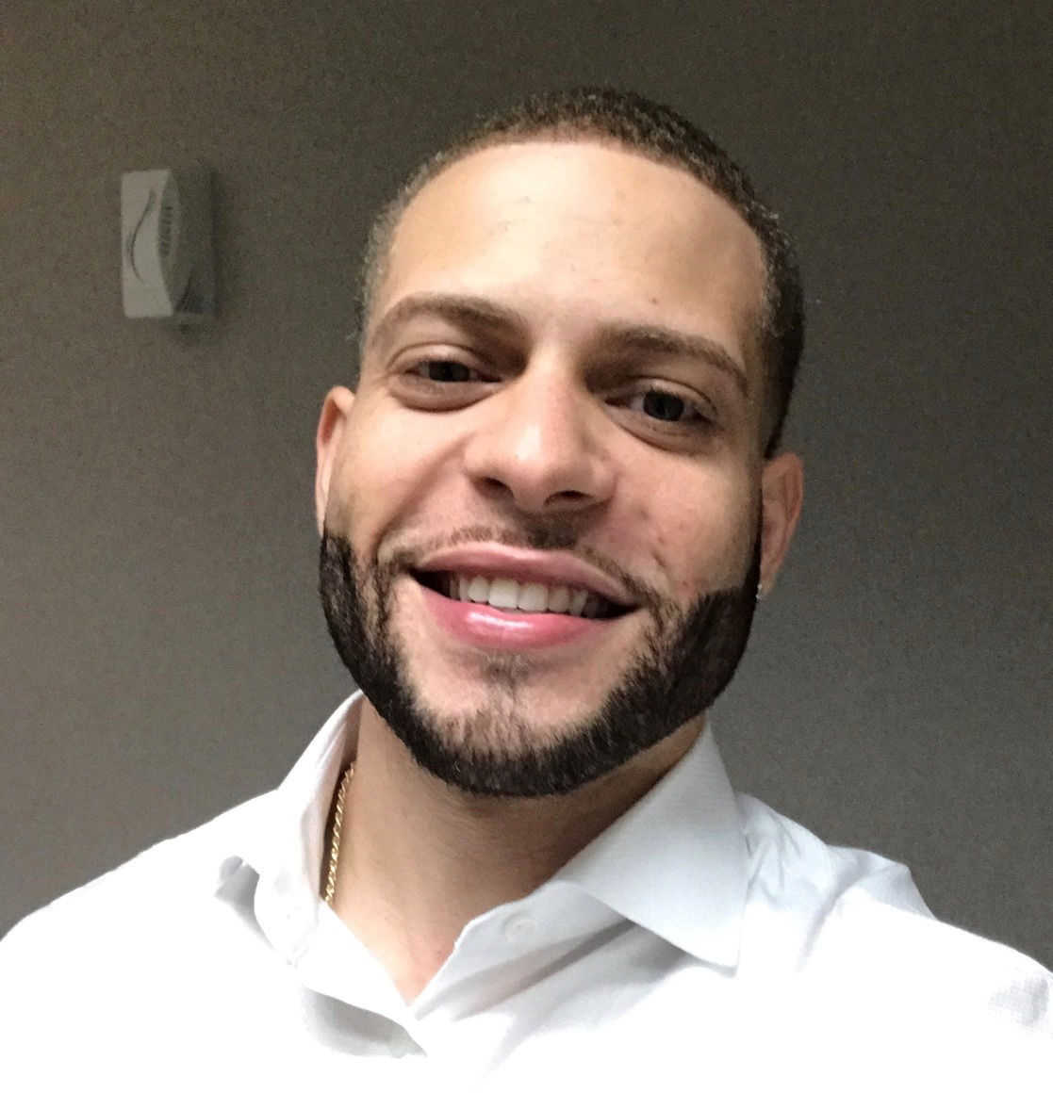
Introductions
Instructor
Name: Angel Rivera
UCI Role: Training Lead
2 Years in UCPath
10 Years of PeopleSoft related experience.

Slide 3
Course Agenda
Lesson
1. UCPath & KSAMS
2. Roles & Access
3. General Navigation
4. Data Inquiry
5: Review Position Control Transactions

Slide 4

Course Objectives
Key Objectives:
Learn the about the relationship between UCPath & KSAMS
Understand how KSAMS determines user view and accessibility
Navigate the UCPath Menus and Dashboard
Learn how and where to view UCPath transactional data
Understand when you may have to refer to a Cognos Report

Slide 5
Key Terms
UCPath Term | Definition
Employee Dashboard | Refers to the landing page the employee will see upon accessing the UCPath site. This dashboard page will contain data related to employee personal information, benefits, and compensation.
Employee Actions | The main menu option that employees will need to access to cascade additional self service menu options for reviewing and updating information.
Personal Information | All information related to employee biographical and demographical details. These details may include name, address, years of service, gender, education, etc.
Manager Dashboard | Refers to the landing page managers will have access to upon accessing the UCPath site. This will allow managers with direct reports to review data related to employee information, absence balances, compensation history, historical profiles, and current team profiels.

Slide 6
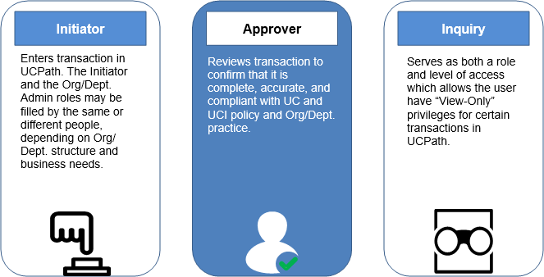
UCPath Generic Roles
Notes:
At a high level, Department Employees are assigned security roles based on their job responsibilities within the department. There are 3 generic user roles….Users can be setup as an Initiator, Approver, or Inquiry Only role.
Initiators: In each department, there are HR and Finance initiators that are responsible for Employee data and Financial/payroll entries.
Approvers have the ability to review, approve or deny transactions. Transactions submitted will be routed via the approval workflow engine will appear in a “Worklist” in UCPath for approvers.
Some users may have the Initiator and Approver role in UCPath; however, AWE has built in rules so that Initiators cannot approve their own transactions.*
Inquiry Only Role provides a read-only view to data in ucpath. Inquiry Only based roles will not have the ability to enter transactions, nor approve them in UCPath.

Slide 7

KSAMS
KSAMS is used to regulate and manage employee access to numerous business applications and secure systems.
Access to these applications and systems (like KFS) are role-based and can be requested by anyone with an active UCInetID.
However, final approval is granted by your Departmental Security Administrators (DSA) or other specific role approvers.
*Please note that you cannot access KSAMS from off-campus without first using the VPN.
Notes:
For those not familiar with KSAMS, this is UCI’s security administration system which regulates user access to various applications and systems used at this location.

Slide 8
LESSON 1
UCPath & KSAMS

Slide 9

Lesson Objectives
In this lesson, we will:
Understand the relationship between UCPath & KSAMS.
Explore how access is assigned and determined.
Learn how and where to request UCPath access.
UCPath & KSAMS
Roles & Access
General Navigation
Transaction Inquiries

Slide 10

UCPath Access Principles
A user profile is required to access UCPath.
Each user is assigned a unique user profile.
Users will have access only to the functions required to support their job (Role Security).
Users will have access only to the population of employees they are authorized to view/manage (Row Level Security)
All employees are initially assigned basic access to UCPath (Employee Self-Service.)
To request additional access to UCPath employees will need to consult with their manager or supervisor.
Security provisioning at UCI will be managed via KSAMS through the Department Security Administrators(DSA)
*UCPath Center designs and maintains UCPath roles and permissions.

Slide 11

UCPath Access
All UCI employees are assigned a basic role and level of access, Employee Self Service .
User access is assessed & determined by dept. managers/supervisors.
Users can request additional access by filling out a KSAMS Access Form via OIT.
KSAMS Access requests are submitted and approved by Department Security Administrators (DSA)
Notes:
ESS – employees own personal information details and job related data, including compensation details and access to view paychecks.

Slide 12

User Profile Details
User Profile - User account that consists of:
Credentials- (UCINet ID and Password)
EMPLID (Employee ID)
Role Security
Row Level Security
KSAMS uses an individual’s UCINet ID to control access to UCPath and within UCPath. “Access” refers to what is visible to a user and whether or not a user can make changes (read-only access, or read-write access).

Slide 13



Role vs. Row Level Security - Overview
Role Security What job functions/task(s)? |  | The task(s) the role provides access to perform. Depending on the user’s job function, access to a role may be read-only (view only) or read-write (make changes). Example: See the budget (read-only). Enter budget transactions (read-write). Think of the Role like having chairs.
View Only | Read/Write
Row Security What departments(s)? |  | The employees of department(s) who the tasks are being performed for. Example: Math Department Employees Human Resources Employees Think of the Row like employees.
Employees

Slide 14
Row Level Security - Example
1
Examples:
Green: If you grant a user node 1 they get access to all nodes that roll up to node 1 (2,3,4,5,6,7,8)
Red: If you grant a user node 3 they get access to all nodes that roll up to node 3 (6,7,8)
Yellow: If you grant a user node 6 and 7 they get access to only these two nodes.
2
3
4
5
6
7
8

Slide 15
KSAMS Access Request
To request additional access in UCPath, submit a KSAMS Add Access Request Form.
KSAMS Add Access Request Form (Online)
The form requires you to enter your Name or UCInetID, the KSAMS Role Name, and a Justification/Reason explaining why you need the security role. More than one role, for the same user, can be included in the same add access request; however, reasons for requesting each role must be clearly stated.
There are two other ways of applying to add access. A manager can request adding KSAMS access for a person on their staff. A DSA (Departmental Security Approver) can be contacted directly by a manager or staff to request adding KSAMS access.
Please refer to the KSAMS Security Guide for additional information

Slide 16

KSAMS Approval Workflow
Requestor Submits
KSAMS Form
If Denied, Requestor Starts Over or Withdraws Request
Designated DSA Approves or
Disapproves
Optional Second Level Approver Approves or
Disapproves
If approved, sends assignment request to UCPath

Slide 17
Lesson Objectives
In this lesson, we will:
Understand the different UCPath Roles
Understand the system impact these roles may have
UCPath & KSAMS
Roles & Access
General Navigation
Transaction Inquiries

Slide 18
LESSON 2
UCPath Roles & Access

Slide 19
Roles & Access Overview
In UCPath, there are various roles available which will enable users to modify and view employee data
There is a “UCPath Roles Wiki” on our UCPath website that users can to access to review details and training requirements for all roles.
Please contact your DSA or CPO for additional information.

Slide 20
Initiator Roles - Example
Note: In UCPath, “Roles” may have multiple system roles combines into one.
UCP-Campus-HCM Initiator | Allows users to performs actions such as Hires, Create positions, change Full Time Equivalency (FTE), among other HR related actions.
UCP-Campus-Payroll Initiator | Allows users to perform payroll actions such as providing employees one time and recurring additional pay, and payroll requests.
UCP-Campus-Cost Transfers Initiator | This role allows users to perform salary cost transfers, known in UCPath as Direct Retro transactions.
UCP-Campus-Funding Initiator | This role allow users to enter or modify KFS Account/Funds to department positions in UCPath.

Slide 21
Approval Workflow Roles
UCP-Campus-HCM Approver 1 or Medical Residents | UCPath routes HR related transactions to designated users who have this role to review and approve.
UCP-Campus-Payroll Approver 1 or Medical Residents | UCPath routes HR related transactions to designated users who have this role to review and approve.
UCP-Campus-General Ledger Approver 1 or Medical Residents | UCPath routes HR related transactions to designated users who have this role to review and approve.
The Medical Residents role permits the person to only approve transactions for Medical Residents

Slide 22
Inquiry Roles
HCM Inquiry | Allows users to view general employee data. No ability to create or edit data.
GL Inquiry | Allows uers to view financial data related to employee job records. No ability to add or modify financial data.
Some users may have initiator access in one module, and inquiry only access in another.
Example: HCM Initiator Role x GL Inquiry Only
Segregation of duties is always considered when assigning roles in UCPAth.

Slide 23
Reporting Roles
UCP DSS-Budget Office Report Viewer UCP DSS-Central HR Report Viewer UCP DSS-Central Payroll Report Viewer - Campus and Med Center UCP DSS-Central Payroll Report Viewer - Med Center UCP DSS-Emergency Contact Report Viewer UCP DSS-General Report Viewer - HR Department UCP DSS-Emergency Contact Report Viewer | UCP DSS-General Report Viewer - KFS Org UCP DSS-Graduate Division Report Viewer UCP DSS-OEOD Report Viewer UCP DSS-Parking Report Viewer UCP DSS-Special Access Report Viewer UCP DSS-Summer Session Report Viewer UCP DSS-TAM e-Performance Report Viewer UCP DSS-UCPath Report Admin

Slide 24
Lesson Objectives
In this lesson, we will:
Understand the relationship between UCPath & KSAMS.
Explore how access is assigned and determined.
Learn how and where to request UCPath access.
UCPath & KSAMS
Roles & Access
General Navigation
Transaction Inquiries

Slide 25
LESSON 3
General Navigation

Slide 26

General Navigation:
Employee Self Service

Slide 27
What is Employee Self Service
A platform for all employees to view and manage their personal information, as well as view job related details.
Employees will be able to view their leave and accrual balance details.
Sabbatical credits for Academic Employees
Health and other benefit related information.
Access Open Enrollment and manage dependents.
And much more…

Slide 28
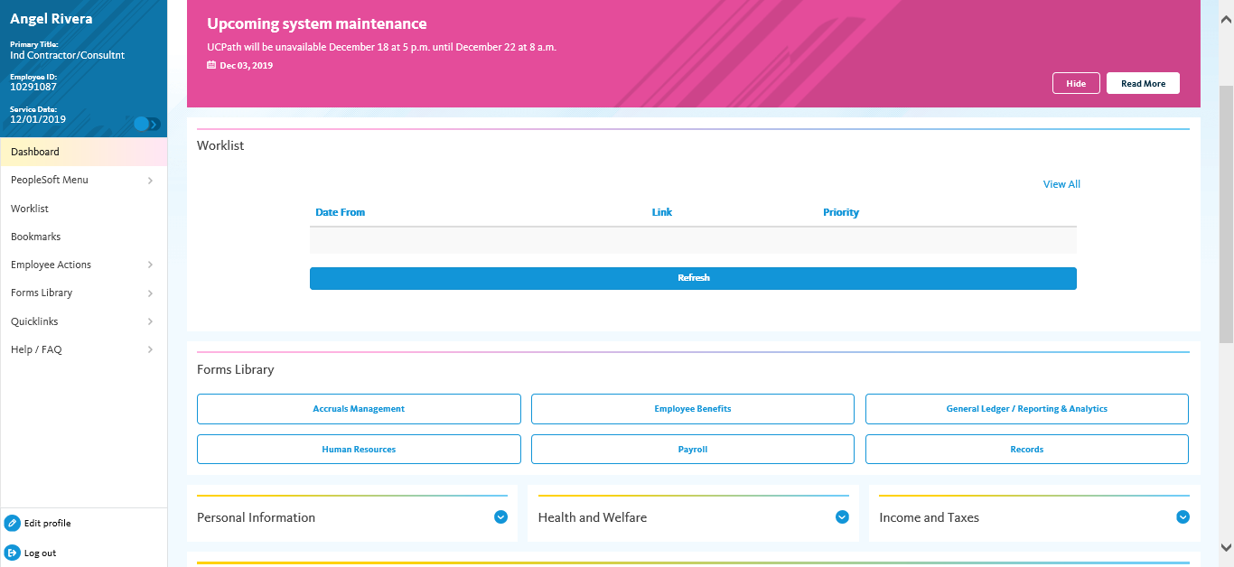
Employee Self Service Dashboard
Employee Information displays in the upper left corner including your Name, Title, Employee ID, and Service Date (for leave purposes)
Navigation menu provides access to all UCPath activities. The menu options are based on your system role and may differ from the options available to your colleagues.
♦ Employee Actions provides access to all self-service activities, such as updating your address, updating your emergency contacts or setting up direct deposit.
♦ Forms Library provides access to frequently used documents, such as the Dependent Information Update form.
♦ Quicklinks provides access to frequently used tools and sites, such as the payroll calendar, holiday schedule, campus websites and more.
♦ Help / FAQ provides access to training materials, UPKs, the Ask UCPath tool and other support links.

Slide 29
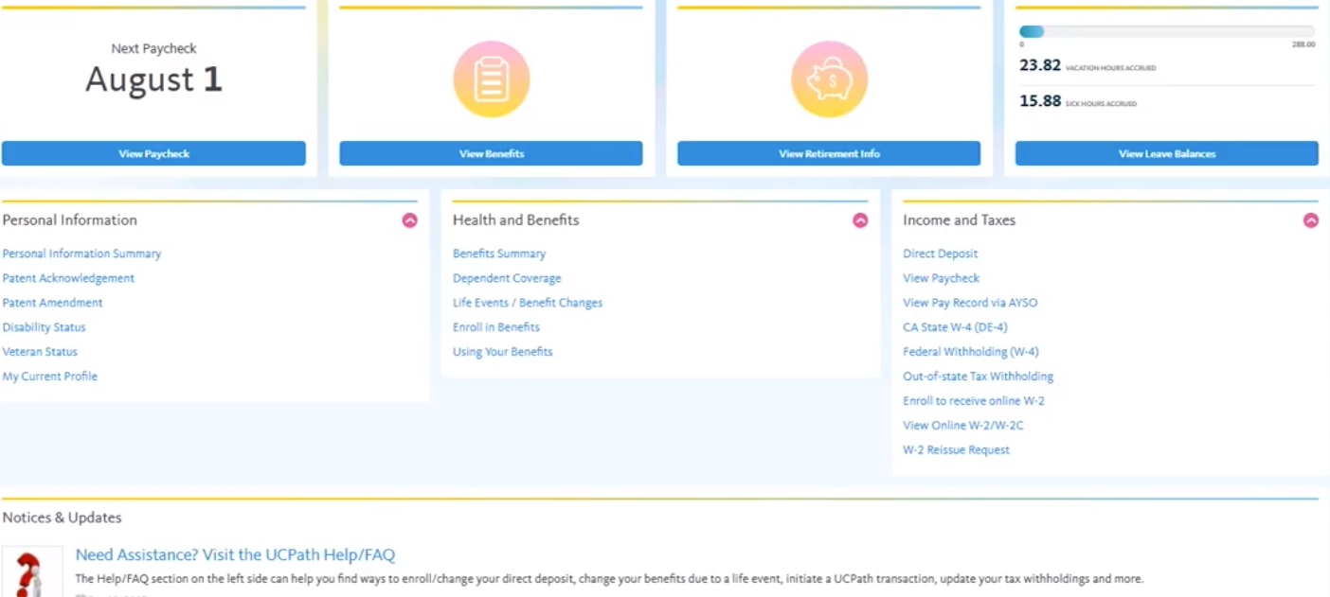
Employee Self Service Dashboard (cont.)
Personal Information section will display data related to employee biographical and demographical information.
Displays information related to employee benefit elections and eligibility details..
Displays information related to employee compensation and income related information.
Notes:
Personal information: Veteran status, disability status, patent acknowledgement, etc.
Health & Welfare: Benefit related details, benefit enrollment, dependent related information.
Income & Taxes: Compensation details, W-2 (2020), etc.

Slide 30
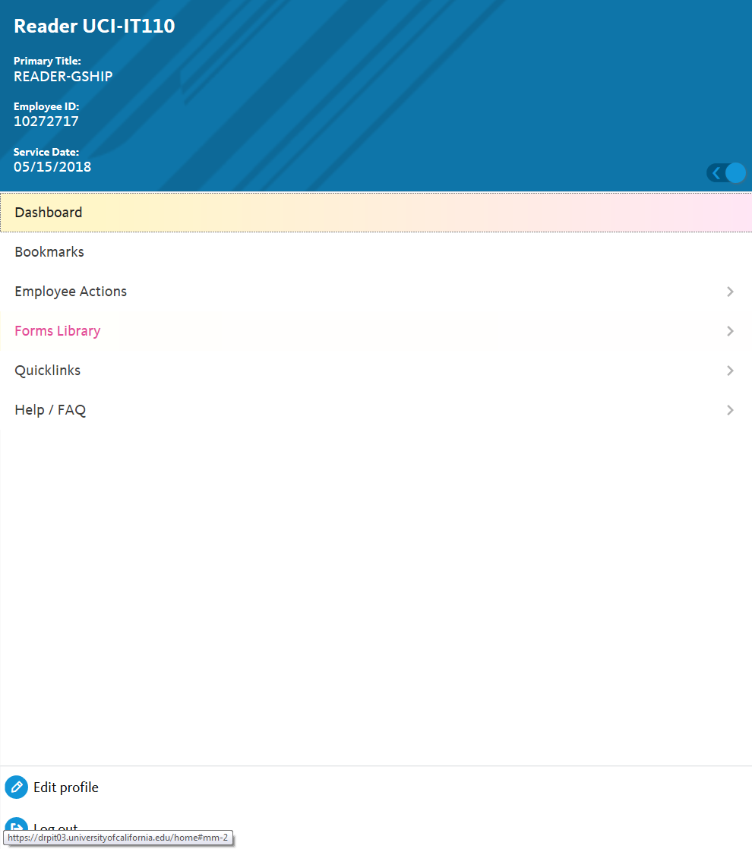
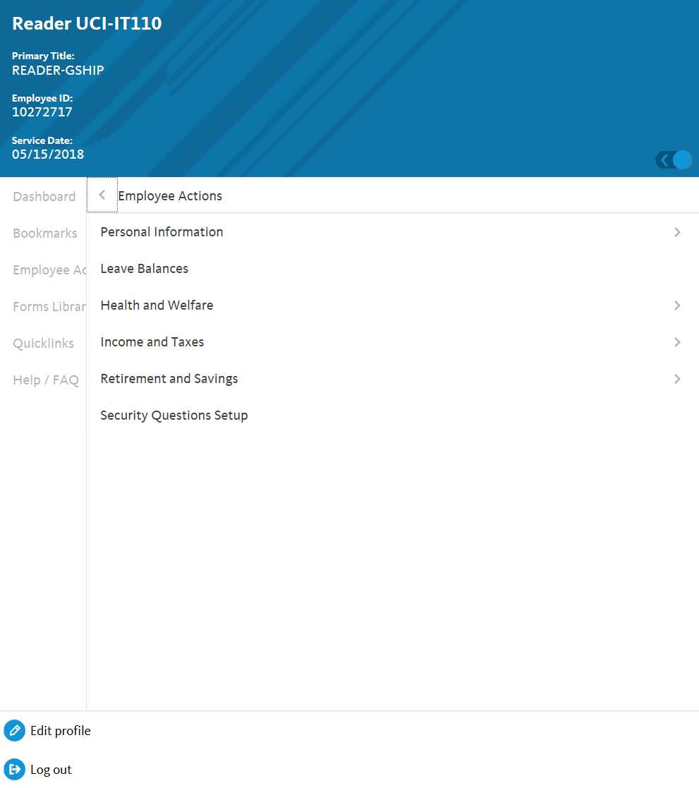
Employee Actions Menu
Employee Action Menu
Notes:
Click employee actions from menu
Self Service Menu options appear.

Slide 31
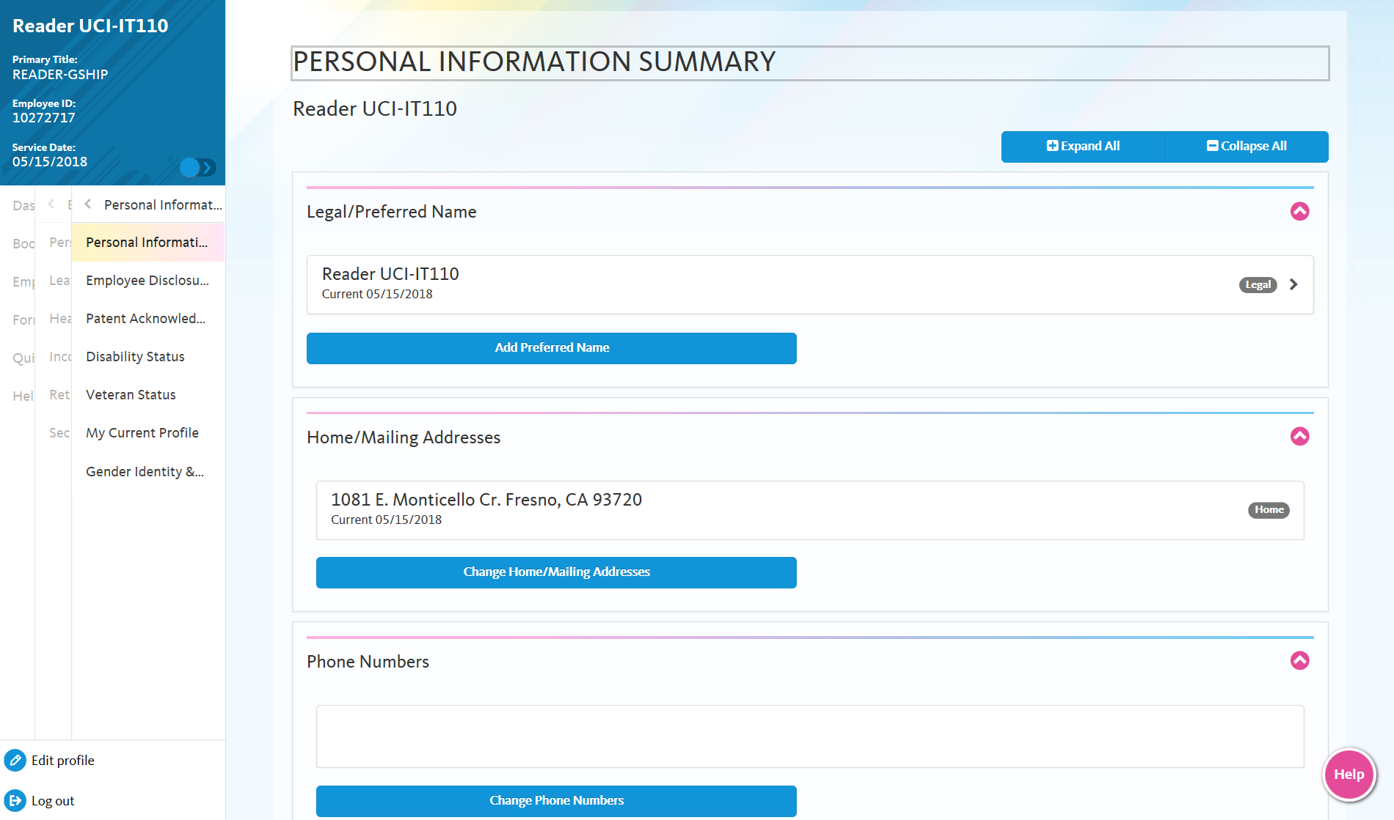
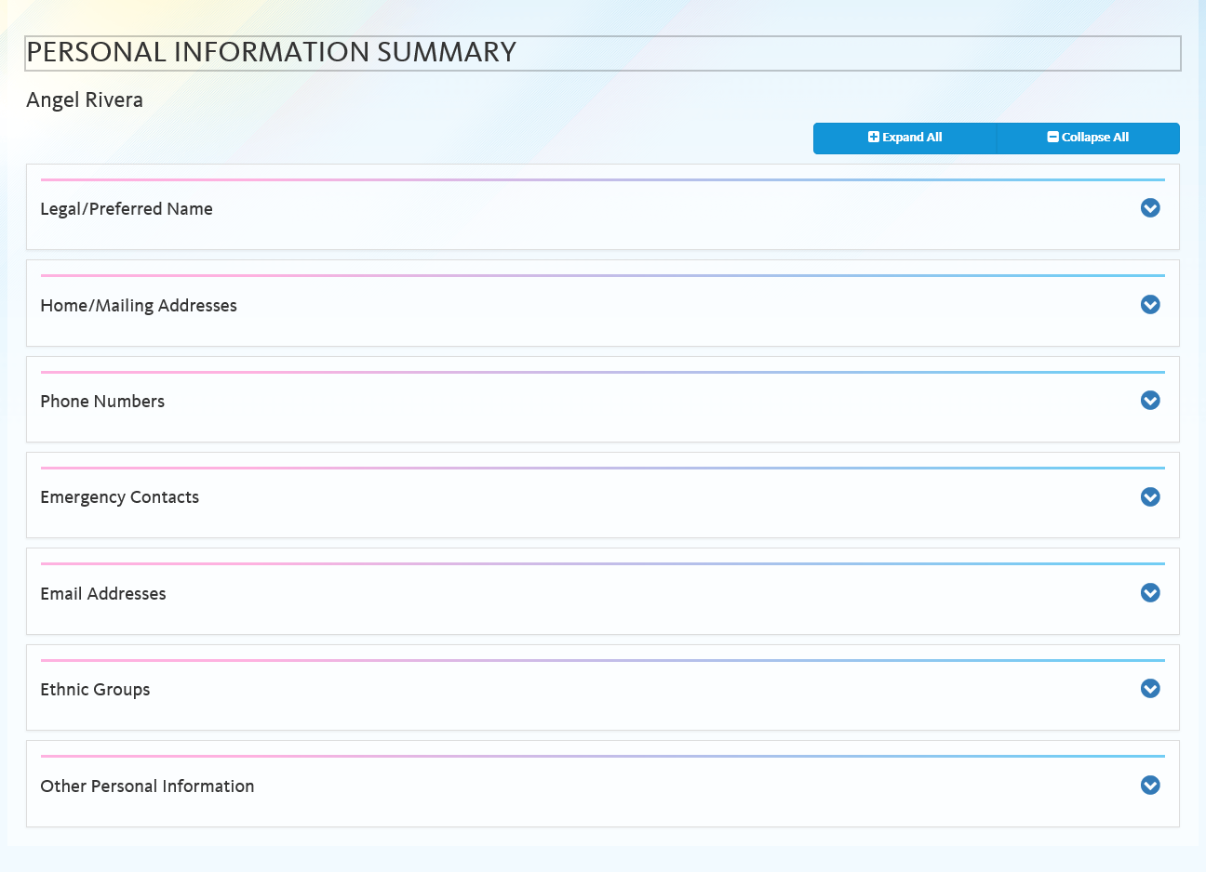
Personal Information
Legal Name changes are routed through AWE.
Notes:
1. Legal name changes require proof and route via AWE
2. Other information tab includes things like
Empl ID
DOB (not viewable?)
Start Date
Education level
Military Affiliations

Slide 32
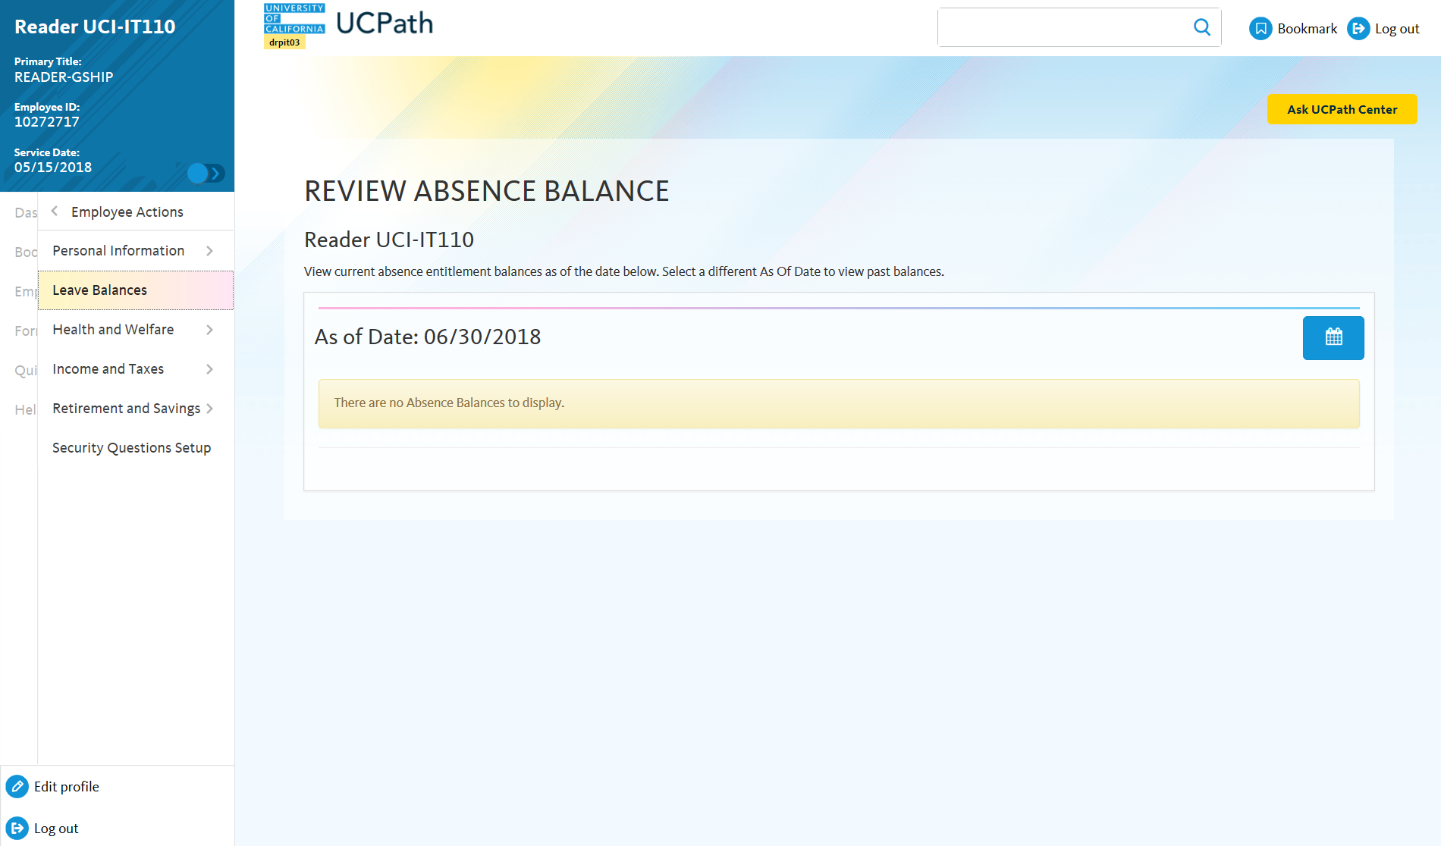
Check Leave Balances

Slide 33
Employee Disclosures
Employees can update their disclosure options. The questions you see are based on whether or not your position is represented by union.

Slide 34
Patent Acknowledgment

Slide 35
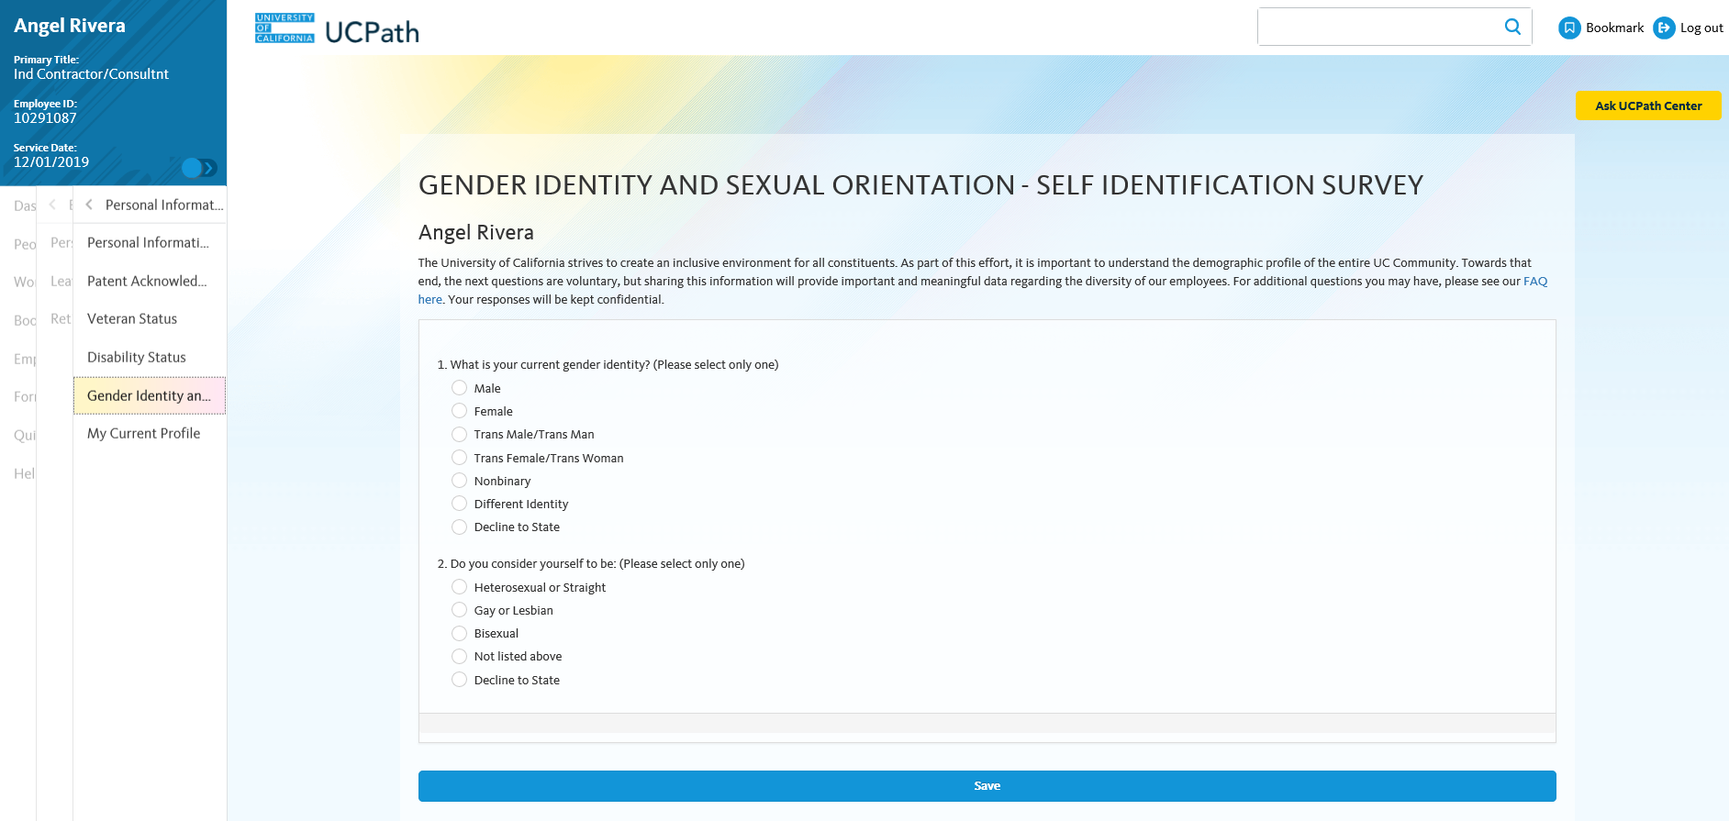
Gender Identity – Self Identification
Gender and Sexual Orientation is only identified by the employee via Self Service. HR Initiators will not be able to enter Gender identity upon hire.

Slide 36
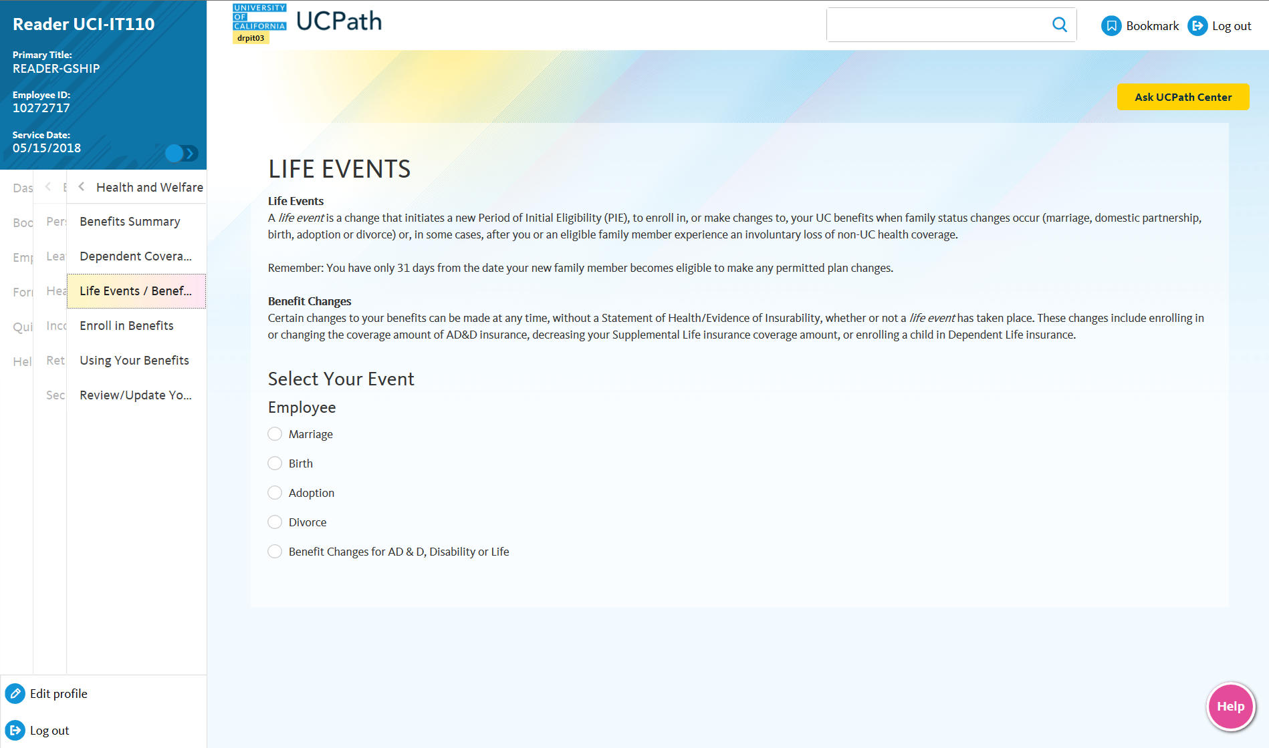
Health, Welfare, & Life Events
Notes:
Options to record life events within UCPath.

Slide 37
My Current Profile
Qualifications tab will display honors and awards and an active/valid licenses and certifications..
Education tab will display information related to any degrees obtained from attending college or university.
Oath/Patent Signature Date tab will display the Oath/Patent form and can be signed or viewed.
Employment Verification tab will display information shared with UC’s partner that performs verification activities.
Notes:
Note: Faculty, academic personnel and staff are automatically included in the daily update sent to UC's external partner that performs employment verification activities.
Employees can go to Employee verification tab to opt out.

Slide 38
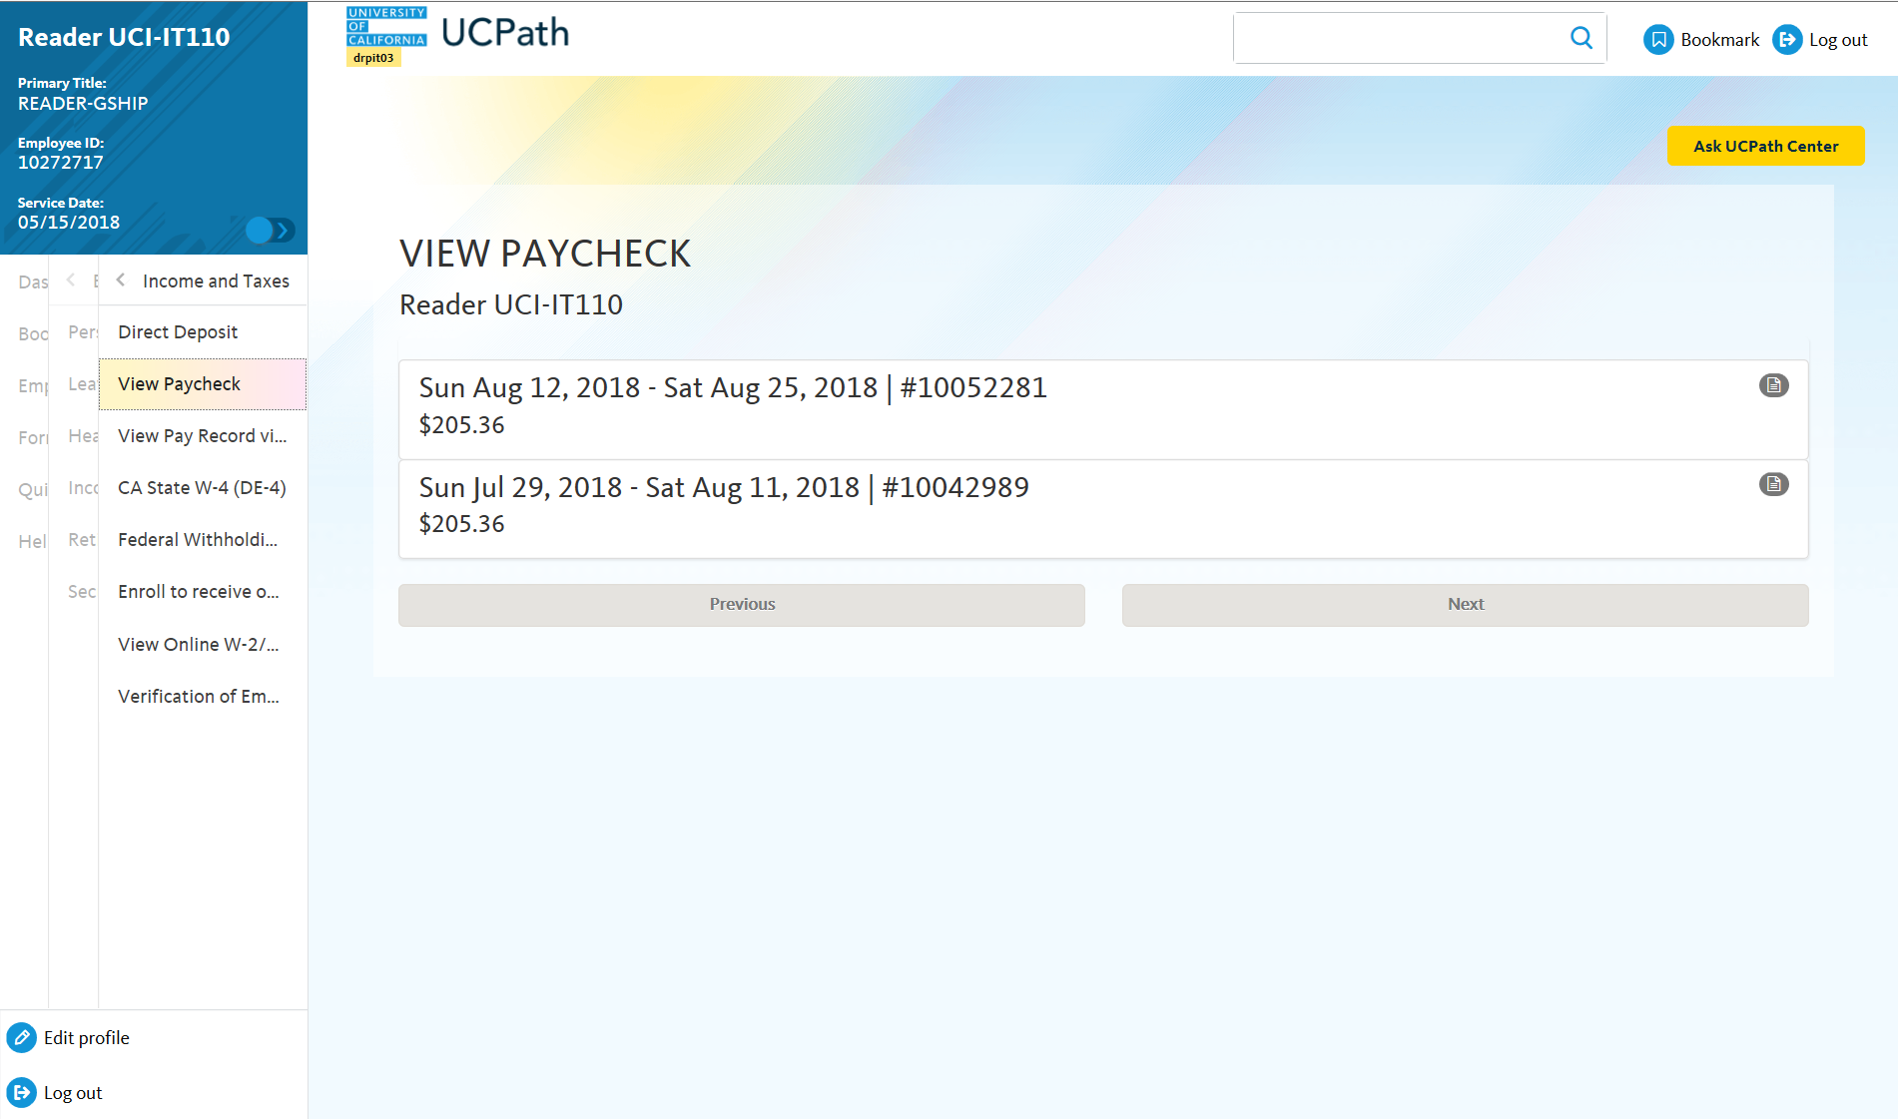
Income & Taxes
CWR’s are not paid by the University, therefore may have limited Employee Self Service Menu options.
Notes:
Ability to see and request W’2s
View withholdings
Request Verification of Employment letters

Slide 39
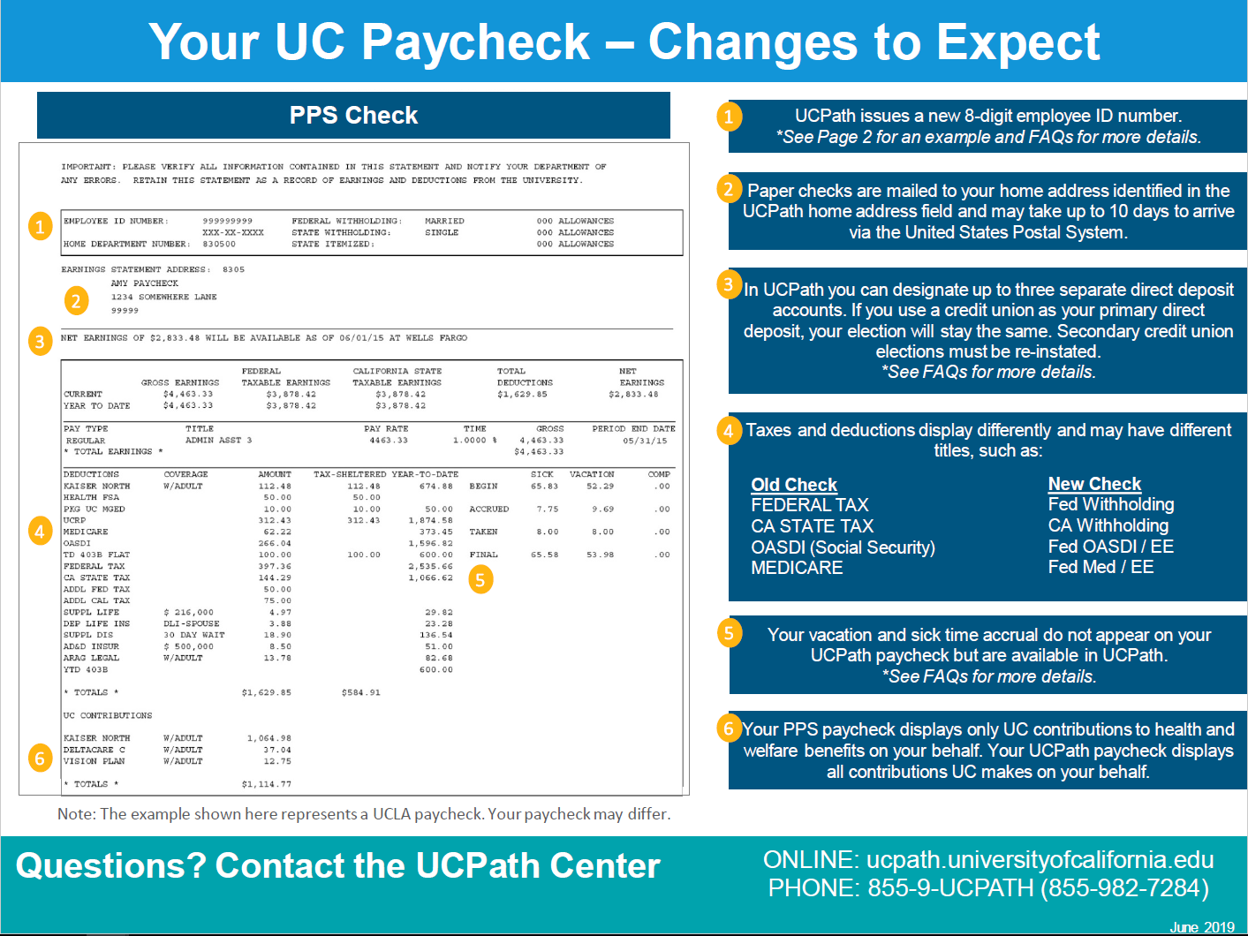
Paycheck Changes Job Aid
Please refer to the “Paycheck Samples” module within the Self Service Users UPK site to view information on Paycheck changes for different employee types.

Slide 40
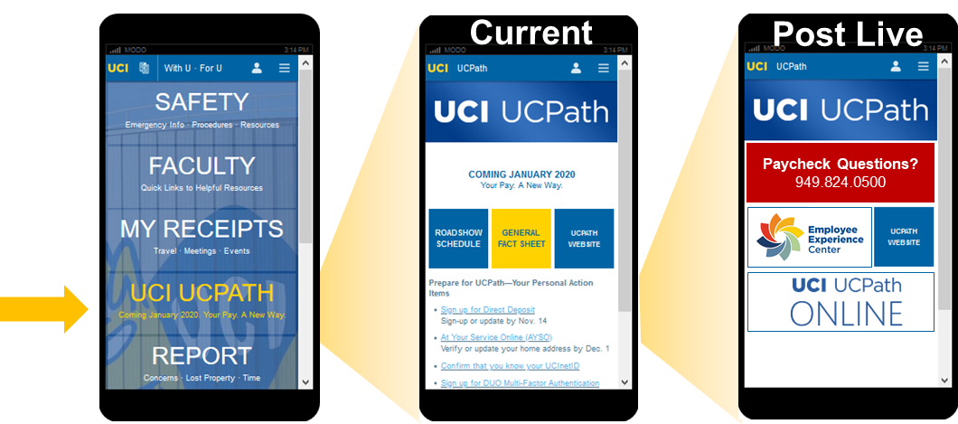
Where do I go if I have paycheck questions?
Go to dedicated UCPath Support Number 949-824-0500
Employee Experience Center Website eec.hr.uci.edu
Knowledge articles
Open case to ask a question, get help
Quickly available in With U • For U mobile app (multiple access points)

Slide 41
General Navigation:
Manager Self Service

Slide 42
What is the Role of “Reports To” in UCPath
Determines who you will see in Manager Self Service
View Employee Absence balances
View Employee Information:
Email Address
Emergency Contacts
Home and mailing addresses, Phone #’s
View Current Team Profile:
Education
Honors and Awards
Licenses and certifications
View Compensation History

Slide 43
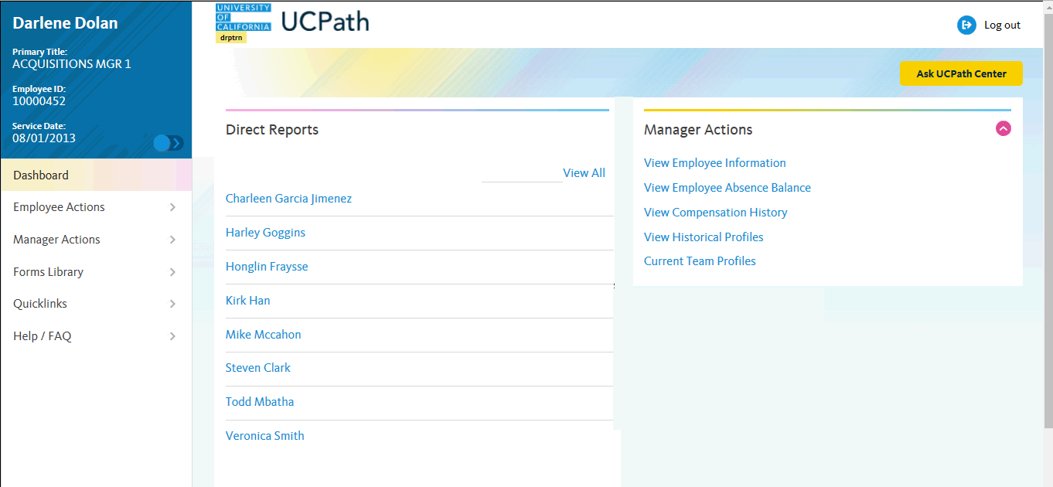
Manager Self Service Dashboard
Employee Information displays in the upper left corner including your Name, Title, Employee ID, and Service Date..
Navigation and Menu options are based upon assigned KSAMS role security.
ALL employees will have access to their own information.
Managers may access employee information for a specific direct report by selecting the employees’ hyperlink within the Direct Reports pane.
Managers may view employee information by selecting the activity in the Manager Actions pane.

Slide 44
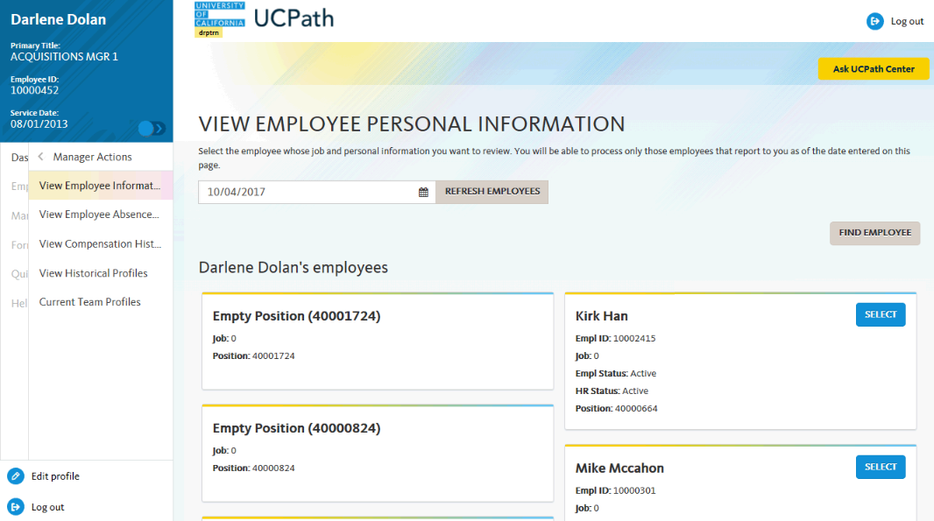
View Employee Information
The View Employee Personal Information menu page displays all employees and open positions in your direct report line as of today's date.
Managers may also search for a specific employee by clicking the Find Employee button and entering the appropriate search criteria.
Managers may view direct reports as of another date by selecting the calendar icon within dated field.
Click the Refresh Employees button to display the updated and refresh the page

Slide 45
Position and Job Data Identifiers
UCPath creates when employees are joined with a position. Job Data attributes include i.e.. Empl ID, Job, Empl Status etc…
Within the View Employee Personal Information section, managers will see position and job data identifiers. As previously discussed, positions can be active without an attached employee.
Click the select button to view current employee profile.
Note: The “Job” number displayed will be associated with the assigned job record number of the incumbent who fills the position upon hire.

Slide 46
Manager Review of Absence Balances
Leave balances for monthly employees are updated at the end of the pay period following the month employee took or earned the leave. For Example: Leave taken in November is updated is updated in November totals at the end of December.
Leave balances for bi-weekly employees are updated in the pay period for which they took the earned leave. For Example: leave taken in the first half of November is updated during the processing for the first half of November.

Slide 47
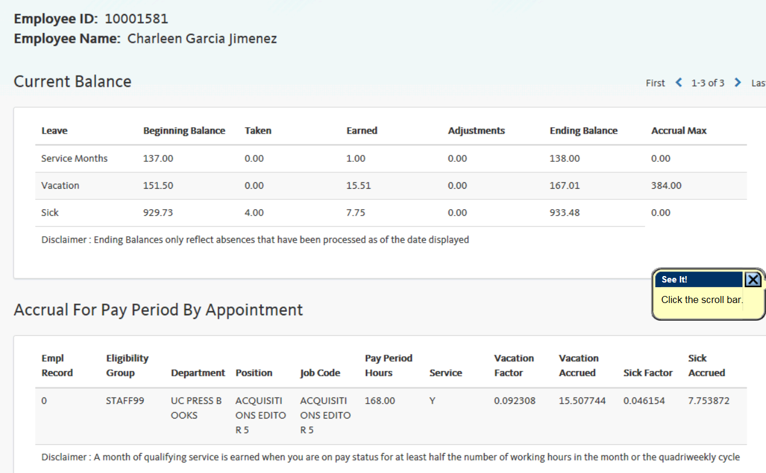

View Employee Absence Balances
Example of Employee Leave balances

Slide 48
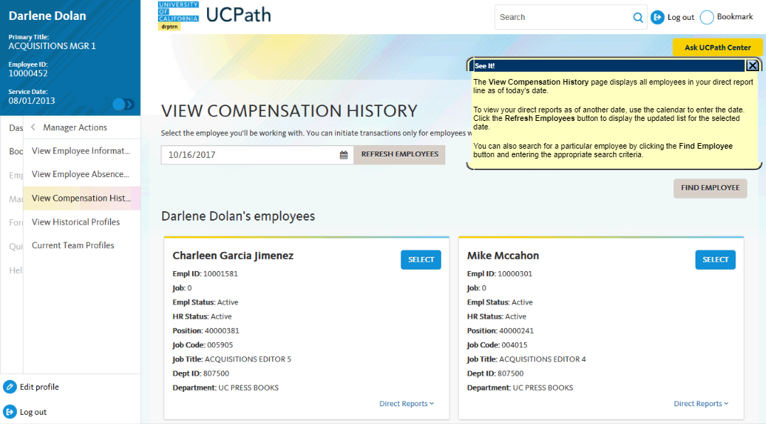
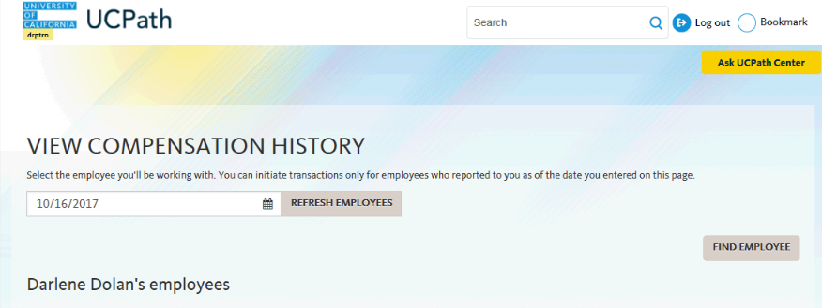
Employee Compensation History
The View Compensation History page displays all employees in your direct report line as of today's date. Use the select button to access the compensation history page.
You can also search for a particular employee by clicking the Find Employee button and entering the appropriate search criteria.
To display the compensation history for a particular employee, click the Select button to the right of the person's name
Notes:
Compensation history will only show what comes out of ucpath.

Slide 49
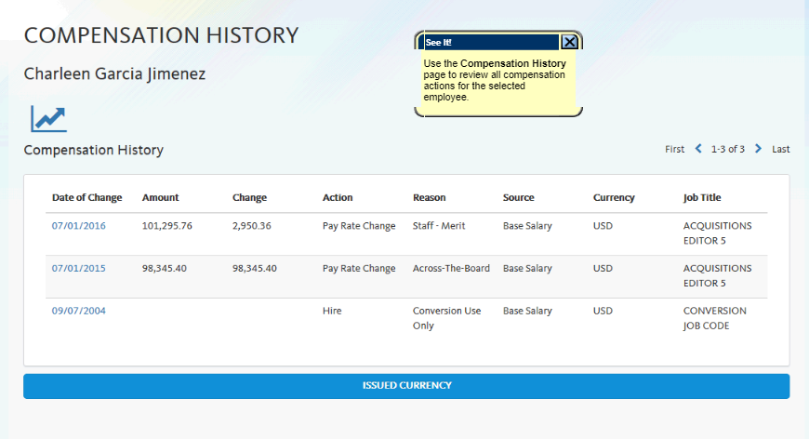

Employee Compensation History
The Compensation History page will display the compensation history data for the selected employee. Within this page, several data rows will be available for view i.e.. Date of compensation change, source, compensation amount etc.. To review job data specific to a direct report, the manager will navigate to the PayPath options page.
You also can view these details in a chart format by selecting the compensation history button.

Slide 50
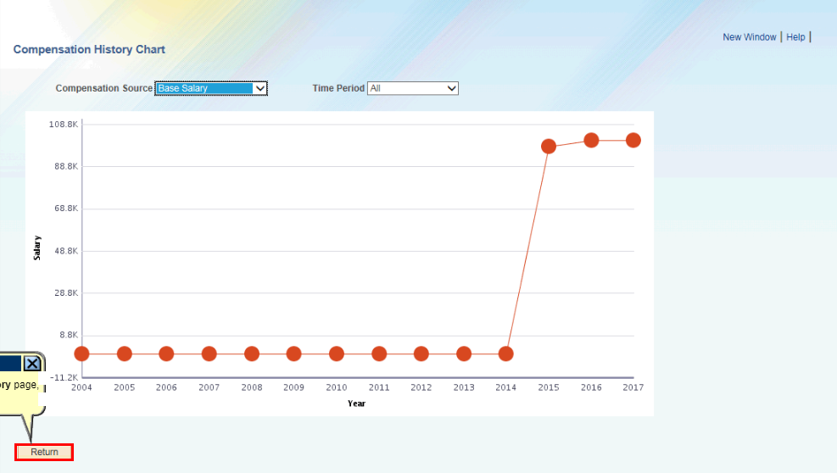

Employee Compensation History
The compensation history displays compensation actions for the selected employee in a line graph. Managers may review the graph by specific compensation sources and time periods using the two filters at the top of the page.
Notes:
Chart will only reflect changes/progress from the time they were assigned to your department.

Slide 51
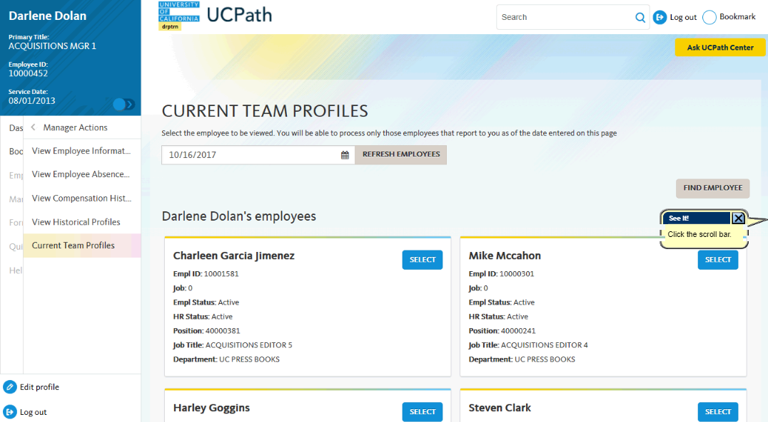
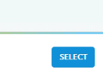

View Team Profiles
The Current Team Profiles page displays all the employees in your direct report line as of today's date.
Click the Select button to the right of the person's name to access the direct report’s profile.

Slide 52
(UCPC) UCPath Center Inquiry
Selecting the Ask UCPath Center button will allow Managers to submit questions directly to UCPC for themselves, or direct report.
NOTE: Mangers are recommended to follow the escalation map and/or obtain local or central assistance before escalating inquires to UCPC.
UCPC inquiry turnaround time may vary by priority.

Slide 53
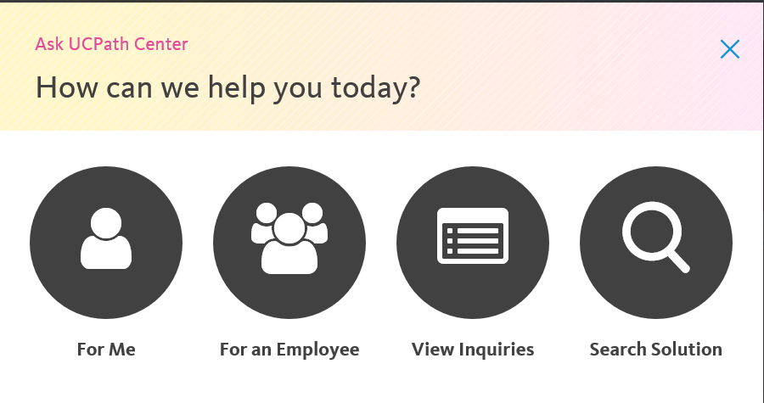
Opening a Case with UCCPC
Managers may submit inquires to UCPC for themselves or another employee. They may also view previously submitted inquires, or search for solutions related to their request, that may have been previously posted.

Slide 54
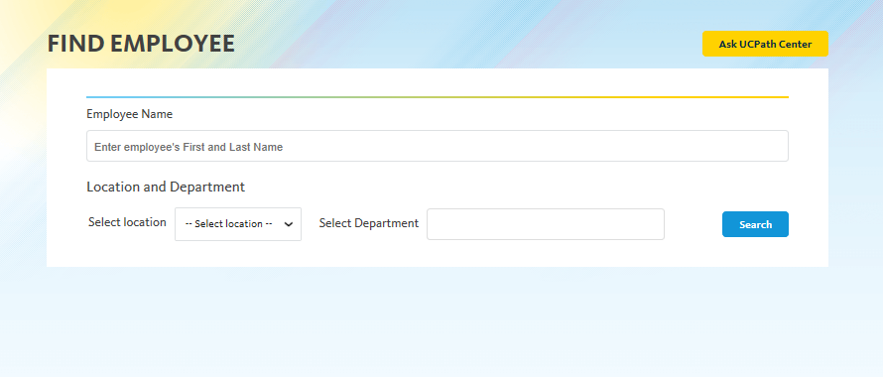
UCPC Case for Employee
Please enter employees first name and last name, along with location (IRCMP, IRMED) and department

Slide 55
When to submit EEC vs. UCPC Ticket
If a user has a question regarding a transaction, they should always call or submit a ticket to the Employee Experience Center first.
If user has submitted a transaction, has called the EEC and are unable to resolve the issue, then submit a ticket on “Behalf-Of” the Employee.

Slide 56
View Paycheck Report
Some managers may have access to the UCI Cognos Department Paycheck report to view employee paycheck information.
Managers who do not have access may have to contact their Department manager, or Dean’s office, to get paycheck related information.

Slide 57
LESSON 4
Transaction Inquiries

Slide 58
Lesson Objectives
In this lesson, we will:
Login to UCPath and navigate various pages.
View Job Data & Financial Data
View transaction status.
Understand when to refer to a Cognos Report
UCPath & KSAMS
Roles & Access
General Navigation
Transaction Inquiries

Slide 59
Transaction Inquiries
Log into UCPath Portal with your UCI Net ID
If you do not have the DUO device you confirm access with, please say so in the chat.

Slide 60
Navigation Agenda
Person Org Summary vs. Workforce Job Summary
Position Data & History
Security Based
View Position transaction status
Funding Inquiries
Funding Rows / Sequences
Work study fund
Template Transaction Inquiries
Local Transaction Status
UCPC Transaction Status
Job Data Page – refer to job aid
PayPath
No paypath status / review page
Extended Leave of Absences

Slide 61
Workforce Job Summary vs. Person Org Summary
Workforce Job Summary
Person Org. Summary
Displays complete Employee Job History (No earlier than 12/1).
Record of changes to various data.
Security enabled search page– can only view employees you have been assigned access to.
Displays current & historical compensation history.
Job data details are spread across different tabs.
Includes current basic job data information.
Does not display historical job data.
Page is not security enabled - can view any employee across any UC Location.
Does not display compensation details.
Allows user to view all employee job records.
VS.

Slide 62
WFJS vs. Person Org. Summary
Person Org Summary:
Navigation: Peoplesoft Menu > Workforce Administration > Personal Information > Person Organizational Summary
Navigation: PeopleSoft Menu > Workforce Administration > Job Information > Review Job Information > Workforce Job Summary
Workforce Job Summary:

Slide 63
Exercise 1:
This is your opportunity to perform an activity related to the lesson.
Navigate to Workforce Job Summary page & Person Organizational Summary

Slide 64
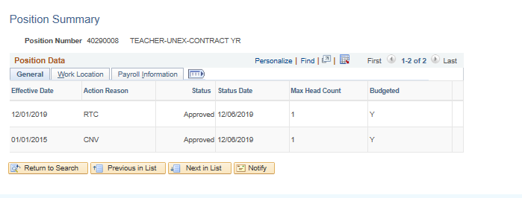
Position History / Summary
Navigation: PeopleSoft Menu > Organizational Development > Position Management > Review Positions > Position

Slide 65
Exercise 2:
This is your opportunity to perform an activity related to the lesson.
Navigate to Position Summary page and view a position within your department.

Slide 66
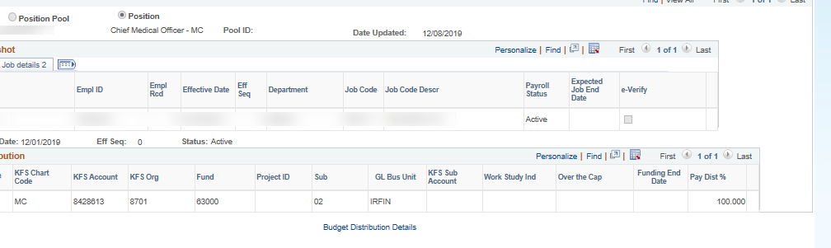
Funding Inquiries
Navigation: PeopleSoft Menu > Set up HCM > Product Related > Commitment Accounting > UC Customizations > Funding Entry Inquiry

Slide 67
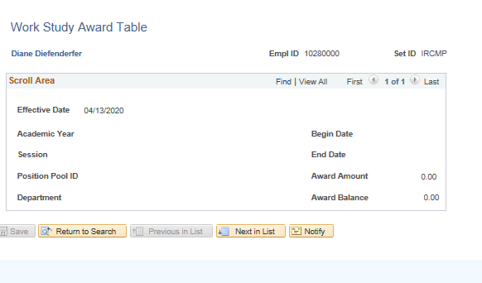
View Work Study
Navigation: PeopleSoft Menu > Set up HCM > Product Related > Commitment Accounting > UC Customizations > Work Study

Slide 68
Exercise 3:
This is your opportunity to perform an activity related to the lesson.
Navigate to Funding Inquiry & view funding for a position within your department.

Slide 69
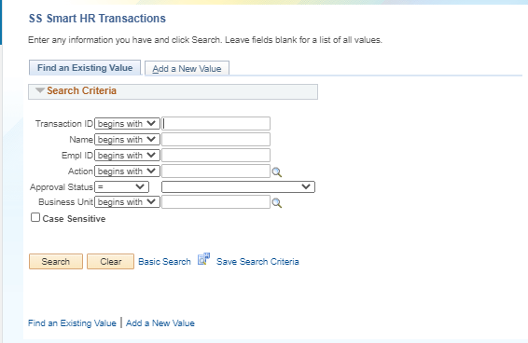
Template Transactions
Navigation: PeopleSoft Menu > UC Customizations > UC Extensions > SS Smart HR Transactions
Template Transactions can be used using a variety of criteria.
It is recommended to note the transaction ID when its submitted to track the approval workflow.

Slide 70
Template Transaction Status
Smart HR templates are one of the transactions that have the lengthiest processing times.
Smart HR Templates have to be processed at the UCPath Center.
Key Statuses:
Approved = Local UCI Approval
Complete = Processed at UCPath Center
Denied/Rejected = Denied @ UCI or UCPath Center

Slide 71
Exercise 3:
This is your opportunity to perform an activity related to the lesson.
Navigate to Template Transaction Status page, view any pending transactions. Additionally, if you have a transaction ID #, that may be used as well.

Slide 72

PayPath Inquiries
Currently, there isn’t any location to view any pending pay path transactions.

Slide 73
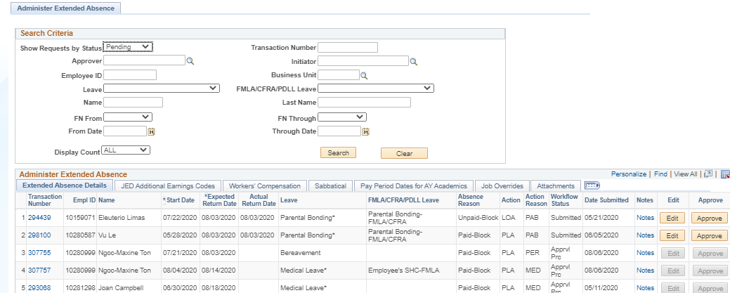
Extended Leave of Absences
Navigation: PeopleSoft Menu > Global Payroll & Absence Management > Payee Data > Maintain Absences > UC Customization > Extended Absence Trans History

Slide 74
Exercise 4:
This is your opportunity to perform an activity related to the lesson.
Navigate to the Administer Extended Absence Page & search for employees on a leave of absence within your department.

Slide 75
Course Review

Slide 76
Course Resources

Slide 77
Reference Material for Review
Links to helpful reference material:
http://www.hr.uci.edu/ - UCI HR Website
https://ap.uci.edu/ - UCI Academic Personnel Website
http://www.uclc.uci.edu/ - UC Learning Center Website
https://ucpath.uci.edu/training/index.php - UCI UCPath Training Website
UCI UCPath Website (Internal Training content)
http://ucpath.uci.edu – UCI UCPath website

Slide 78

Where to Get Help
The UCPath Help site is your first level of support. Search for conceptual content, job aids or step-by-step instructions for UCPath tasks.
From the UCPath portal homepage, expand the Help / FAQ section on the left side of the page and then click the “Location Users” link to open the site. *An Adobe PDF version is available for users with screen readers.
If you’re experiencing issues, or have questions about transactions, please contact the Employee Experience Center at (949) 825- 0500, or submit a ticket by visiting UCPath.UCI.Edu
Training Questions? UCPathTraining@uci.edu

Slide 79
Thank You!
Training End

