Slide 1
Welcome to
Position Control
Notes:
Welcome to the Workforce Administration course: Position Control.
This UCPath training course is designed to teach you how to interact with the UCPath system. It will focus on the concepts, terminology, and processes directly related to the system. Your UC Location may also provide additional resources to help you understand relevant business process or policy information specific to your location or role.

Slide 2


Introductions
Instructor
Name: Angel Rivera
UCI Role: Training Lead
2 Years in UCPath
10 Years of PeopleSoft related experience.

Slide 3
General Rules
Classroom Etiquette
Please silence cell phones
Keep your mics muted
No email or web surfing
Return from breaks on time
Please communicate via zoom chat

Slide 4
Course Agenda
Lesson
1. Position Management Overview
2. Add New Position
3. Fast Class: Position Classification
4. Update Vacant Position
5. Review Position Transactions
5: Review Position Control Transactions

Slide 5

Course Objectives
Key Objectives:
  Identify Position Management pages in UCPath and how they will be utilized at UCI
  Explain the relationship between position information and job data.
  Initiate a position control request for a new position & vacant position.
  Discuss and learn about the Fast Class & AP Recruit process.
  View pending & existing position information.

Slide 6
Key Concepts & Vocabulary
UCPath Term | Definition
Position Control | Position control refers to an AWE-enabled page in UCPath that must be used to create new positions and update vacant positions.
Position Management Page | The Position Management page is a page in UCPath where the Position Administrator can make updates to Positions without AWE. Position Administrator role will be limited by an authorized security role.
Budget Distribution Page | Budgeting for positions involves departments estimating salary expenditures and comparing estimates with actual expenditures.
Fund | Funding for positions refers to the assignment of the account(s) that pays for a position’s compensation.
Location | A Location is a University of California (UC) campus and its associated medical center, if applicable. For example, UCLA is a Location and includes both the campus and the UCLA Medical Center.

Slide 7
Key Concepts & Vocabulary
UCPath Term | Definition
Position Management | Positions are the foundation of UCPath, the common thread that binds job, funding, and organizational data together.
Position & Position Data | Position refers to a slot in the organizational structure, as represented in UCPath. All employees will have a position. Position data refers to the data elements that establish departmental structure and organizational hierarchy.
Job & Job Data | A job in UCPath is used to organize employment information, or job data, with an employee. Once an employee is hired into a position, a job record is created.
Approval Workflow Engine | AWE is a UCPath functionality that routes transactions in UCPath to designated roles (e.g., Initiator or Approver). Upon approval, transactions are either routed to the UCPath Center (UCPC) for finalization or are finalized in UCPath database.

Slide 8




Position Management Roles
+
Position
Initiator
Enters and submits a Position Control Request for approval.
Cannot approve their own transactions.
Position Approver
Reviews and approves Position Control Requests. Adds ad hoc Approver/ad hoc reviewer to AWE workflow when necessary.
Position Administrator
Has access to all department positions. Also has ability to make edits to vacant and filled positions.
Notes:
Roles related to Position Management include Position Initiator, Position Approver and Position Administrator.
Position Initiators use the Position Control Request page to request new positions or to request changes to existing vacant positions, when approvals are required. Note that updates to filled positions will be submitted via PayPath. Current PPS Preparers equal Initiators.
Position Approvers have the ability to approve or deny Position Control Requests.
Some users may have the Initiator and Approver role in UCPath; however, AWE has built in rules so that Initiators cannot approve their own transactions.
Position Administrators are located in the UCI campus Central HR office. They will be responsible for making certain position data changes that cannot be updated by an initiator using paypath actions.

Slide 9
LESSON 1
Position Management Overview

Slide 10

Lesson Objectives
In this lesson, we will:
Describe the Position Management pages within UCPath.
Explain the relationship between position data and job data.
Understand when to add vs. update a vacant position.
Understand the implications of positions for funding and departmental budgets.
Position Management Overview
Add New Positions
Fast Class: Pos. Classification
Review Position Transactions
Updating Positions
2

Slide 11
Position as Foundational Concept
Position
Positions are the foundation of UCPath; they are the common thread that binds job, funding, and organizational data together.
Position Control is used to create new or manage vacant and positions, track position details, and facilitate the maintenance of funding and budgets.
Funding
Job
Budget
Payroll
Notes:
Positions are a new UCPath concept. We will show you how to create and update positions using the Position Control Request page and PayPath Actions.
Positions are the foundation of UCPath, and are the common thread that binds job, funding and organizational data together. Position Management is an umbrella term for the transactions used to manage vacant and filled positions, track job details, and facilitate the maintenance of funding and budgets.

Slide 12

What is a Position in UCPath?
In UCPath a position is required to hire or rehire an employee.
A position is like a chair. Like chairs, positions can be filled or vacant and can have different people sitting in them at different times.
UCI employees are assigned to a single headcount position (one-to-one) where a unique position number is assigned to a single employee.
  Multi-headcount position are not allowed.
  New positions must be created for all permanently budgeted positions.
Notes:
What is a position in UCPath?
A position represents a role in a department. In UCPath, a position is like a chair. Like chairs, positions can be filled or vacant and can have different people sitting in them at different times.
Employees at UCI are assigned to a single headcount position where one position is assigned to only one employee.

Slide 13


Position Management Overview
Position Management coordinates 3 components Position, Person and Job.
When an employee is hired into a position, a job is created.
Position
Person
Job
Administrative Assistant
Employee - Emilia Jones
Emilia Jones - Administrative Assistant
Notes:
Here is a graphical depiction of how Position Management works.

Slide 14

Position Attributes
IMPORTANT NOTES:
Position is independent of an employee.
Position attributes will stay the same, even as incumbents (employees) come and go.
Position Number
Job Code
Union Code
FLSA Status
FTE (Position)
Standard Hours for the Position
Department
Location
Reports to
Salary Plan/Grade
Notes:
Here are the attributes associated with positions.

Slide 15
Job Attributes
IMPORTANT NOTES:
When the employee is hired, they inherit the attributes of the Position. This process creates Job Data.
Additional information, unique to the person, is added to complete an employee’s Job Record during the hire.
    i.e., Compensation, Employee class
  Some job attributes are unique to Staff or Academics only.
    i.e., Probation vs. Post-Doc Anniversary date
Employee Class
Academic duration of appointment
Post Docs Anniversary Date
Step
Pay Components (if applicable)
Compensation Frequency
Expected Job End Date
End Job Automatically box
Probation Code (Staff only)
Probation End Date (Staff only)
Trial Employment End Date (Staff only)
PY Career Duration
Eligibility for Review (e.g., merit increase)
Notes:
Here are the attributes associated with an employee’s job record.

Slide 16
How Positions are used
All employees, including student employees, are assigned a position number & employee ID.
  Exception: Some Contingent Workers
Each position has a unique number (eight numeric characters auto generated by UCPath; there is no smart coding in the number).
When an employee is hired or transferred they are assigned a position number.
Employees can be assigned to more than one position when they have more than one job.
When an update is made to an employee’s position data, the changes will be cascaded to the employee’s job data if applicable. (i.e., FTE changes)
Created positions can be re-used (i.e., for seasonal workers) .

Slide 17
Why Use Positions?
The use of positions in UCPath will streamline data entry, reduce errors, and improve reporting. Here are a few ways positions produce these benefits:
Position information remains the same unless changed or updated, regardless of employee terminations or transfers.
Information related to positions and employees is separate, so there is no need to re-enter position data when the incumbent (employee) changes.
All Positions can be updated & re-used. No multi-head count positions.
Approved Position information is defaulted into other UCPath pages that have the same fields to avoid duplicate data entry (i.e., Job Data page, Person Org Summary)
Positions links key data elements and helps facilitate the hiring process by defining the hierarchy and organizational structure of a department, and tie employees to KFS account and funds that determine how & where labor costs are distributed.
Notes:
The use of positions in UCPath will streamline data entry, reduce errors, and improve reporting. Here are a few ways positions produce these benefits:
Once entered, position data remains with the position unless changed or updated regardless of employee terminations or transfers
UCPath keeps the data related to positions and employees separate, so there is no need to re-enter position data when the incumbent changes
Position data is defaulted into other UCPath pages that have the same fields to avoid duplicate data entry. The Job Data page is an example of a UCPath page that has some fields in common with the Position Data page. When you enter data into the Position Data page, the Job Data page updates, as well.
Finally, positions link key data elements, facilitate the hiring process, help to define the hierarchy and organizational structure of a department, and tie employees to accounting chart fields that determines how labor costs are distributed.

Slide 18



How Position Control Management works
Director of Personnel – Anne
Senior Analyst – John
Admin Assistant -vacancy
Finance Analyst – vacancy
Payroll Analyst – Lucy
Position represents the chair(s) in the org chart above. It establishes departmental structure and organizational hierarchy, including ‘Reports To’ , which determines what the supervising position is.
Each organization will consist of occupied and unoccupied positions which, like chairs, can have different people in them or can remain empty.
You may update or change position information, even they are filled or vacant.
  Filled positions allow less data to be changed.

Slide 19

Position Attributes – ‘Reports To’
Supervisors who are assigned as ‘Reports To’ will have view only access in Manager Self Service to their employees position & job information summary pages - (e.g., salary, appointment details).
‘Reports To’ functionality can also be used to further establish the hierarchy within the department or school.
In the example below, 4 positions report directly to the position of ‘Director of Personnel’
Director of Personnel – Anne
Anne’s position number is listed in the “Reports To” field
Senior Analyst – John
Admin Assistant -vacancy
Finance Analyst – vacancy
Payroll Analyst – Lucy
Notes:
This image also shows how position management uses “Reports To” to create an organizational or departmental org structure.

Slide 20
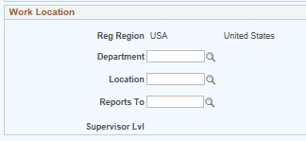
“Reports To” Field – Position Attribute
The “Reports To” field in Position data should be filled with the Supervisor or Manager’s position number.
Supervisors who are assigned as ‘Reports To’ will have view only access in Manager Self Service to their employees job information summary pages
(e.g., salary, leave balances, other appointment details).
Notes:
This image also shows how position management uses “Reports To” to create an organizational or departmental org structure.

Slide 21
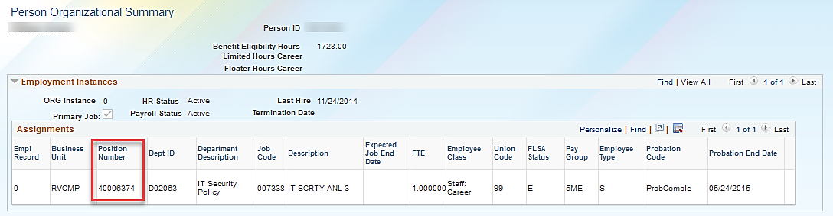
Position Control Request - Reports To
To find the position number for the person you wish to assign as a supervisor or manager, use the Person Organizational Summary page in UCPath.
You may also use the Employee Roster Report in Cognos.
(Navigation: Main Menu > Workforce Administration > Person Information > Person Organizational Summary)
Notes:
The New Window link can be used to open another UCPath window so you can locate the Reports To Position Number.
Animation: please click the mouse button to display the animation on this slide.
Click to display screenshot of checking position number of the Reports To employee in Person Org Summary

Slide 22
Permanently Budgeted Positions
The Budget Distribution page must be updated when:
New positions are created for permanently budgeted positions either by the departments or the Budget office.
Any type of pay change occurs for permanently budgeted positions. This includes:
    Promotions and/or Reclassifications
    Step increases
    Merit increases
    Equity increases
Permanently budgeted positions are vacated:
    Terminations (Including transfers out)
    Retirements
Notes:
The Budget office will create positions for Academic Senate Faculty and Librarians. Those position numbers will replace the previous Salary Control numbers. Departments will create positions for permanently budgeted staff positions. Both positons should follow the naming convention that will be discussed on the next slide.
Whenever a permanently budgeted position has a pay impacting change that has been fully processed, you must then go to the Budget Distribution page so that the new Annualized Budgeted Rate gets updated.
The same is true when a permanently budgeted position is vacated. You must go to the Budget Distribution page once the change is fully processed so that the Annualized Budgeted Rate is updated to the low end of the Salary Grade for the position.

Slide 23


Position Management Actions
Position life cycle involves creation and maintenance of positions. Below are the key actions used to manage positions.
Creating New Positions
Updating Filled Positions
Updating Vacant Positions
Inactivating or Freezing Positions
Notes:
Now we’ll review example business cases for the basic position management transactions: creating a new positions, updating a filled position, updating a vacant position, and freezing or inactivating a position.
UCI positions can have a status of approved, frozen or inactive.
Approved status is used for vacant or filled positions that have been approved and have funding and/or budget established. (please note that all filled positions must have approved status)
Frozen status is used for vacant positions that will be recruited for in the future.
Inactive status is used for vacant positions that will no longer be recruited for in the future.
Note: Proposed status is not used at UCI as all positions must be approved and budgeted before they are created in the system

Slide 24

Position Management Overview:
Position & SmartHR Templates

Slide 25
What are Smart HR Templates?
Custom set of data pages that will link Employees (staff, academic) to vacant positions to create a job.
There are various hire templates that can be utilized depending on the situation and the type of hire.
Other templates are available to initiate other types of transactions (voluntary/involuntary terminations, retirement, and more)
In UCPath, after creating a position, you may hire an employee into that position using Smart HR Templates.
Please see the Template Transactions I & II courses for details*
Notes:
Smart HR Templates are:
Custom person data entry pages (created specifically for UCPath) that link various employee types (staff, academic) to vacant positions to create a job.
There are various templates that exist depending on the type of hire
Other templates are available to initiate other types of transactions: voluntary/involuntary terminations, retirement, and more. We will review all the Smart HR Templates in the Template Transactions courses.
In UCPath, after creating a position, you may hire an employee into that position using Smart HR Templates.
Pfr notes – so now you have gone through the interview process and have someone to hire into the vacant chair. You use a Smart HR Template to add this new hire. You have to enter the position number on the Smart HR Template

Slide 26
Position Data and Smart HR Templates
To create a “job” (hire an employee) the Department HR Initiator will use Smart HR Templates in UCPath.
For most New Hire and Rehire transactions, the HR Initiator must enter a Position Number (required field) into the Job Data tab of the template.
Once the position is entered/selected, UCPath includes customizations to auto-populate certain position attributes into the template
Salary Admin Plan and Grade are identified during the position creation, but the Compensation Amount is identified on the SmartHR Template.
After Local UCI approval, the template is sent to be processed by the UCPath Center and the new employee job record is generated in UCPath.
Notes:
When displayed in Slide Show mode, this slide includes animation. Click to display each blue shape.
Smart HR templates are used for staff, student, academic employees and contingent workers.
For staff, student and academic hires, the position number must be entered when the Location Initiator completes the new hire template.

Slide 27
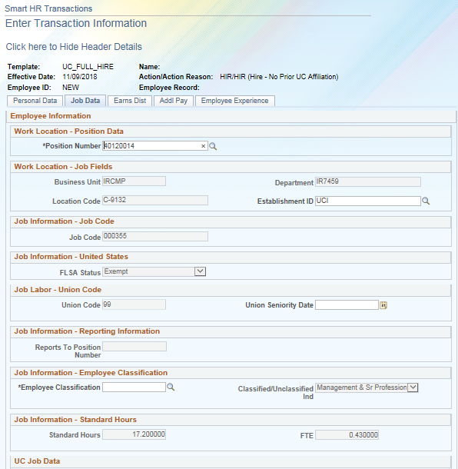
Position Data and Smart HR Templates (cont’d)
Smart HR templates are customized so that position attributes default from the position number entered. Most fields that auto populate from the position number are grayed out indicating they are view only, including Business Unit, Department, Location Code, Job Code, and others.
Notes:
When hiring an employee, once the Position Number field is populated and you tab out of the field several other fields have information that is auto populated. This helps to avoid duplicate data entry of this information because it was entered when the position was created and also used for the job record.

Slide 28

Positions for Contingent Workers
Contingent Workers (CWR) are individuals who have a relationship with the University but do not receive pay from the University. (Examples include staff volunteers and visiting scholars).
Only Contingent Workers who supervise others are required to have a position;
  Otherwise they do not have positions. There are dedicated Smart HR Templates that are used to add CWRs with and without positions.
Please refer to Template Transactions training, or the Contingent Worker User Guide for additional information.
Notes:
Contingent Workers are similar to Without Salary Employees. They do not receive pay from the University. There are two different Smart HR Templates for Contingent Workers, one that requires a position and one that does not require a positon.
For more information regarding Contingent Workers review the Workforce Administration WFA.01 Contingent Worker Business Process Guide found on the Zot Portal
The Employee Roster Report will display job end dates for CWRs so that supervisors and departments can have awareness and can manage cwr employee job instances.

Slide 29
Key Takeaways
A position is required to hire or rehire an employee.
Each new position is assigned an 8-digit number for identification.
Positions can be updated whether vacant or filled. The Position Control Request page will be used to create new positions and update vacant positions.
Employees are assigned to more than one position when they have more than one job. (concurrent job/hire)
At UCI all positions are assigned to only one employee.
Only Contingent Workers who supervise others are required to have a position; otherwise they do not have positions.
Notes:
Here are some points to remember about positions:
A position is required to hire or rehire an employee.
Positions can be maintained even when vacant.
Employees can be assigned to more than one position when they have more than one job.
Positions are typically assigned to only one employee. Summer session (instruction) is one of the rare instance where a position may be shared with multiple employees.

Slide 30

Lesson Objectives Review
Having completed this lesson, you should now be able to:
Describe how Position Management is utilized at UCI.
Explain the relationship between position data and job data.
Understand the functionality of the Reports To.
Describe when to create a position for a contingent worker.
Notes:
Let’s review the objectives that were presented at the beginning of this module.

Slide 31
LESSON 2
Add New Positions

Slide 32
Lesson Objectives
In this lesson, we will:
List the key system steps to add a new position.
Initiate a position control request for a new position.
Understand the position management approval workflow
Position Management Overview
Add New Positions
Fast Class: Pos. Classification
Review Position Transactions
Updating Positions
2

Slide 33

Creating New Positions
Positions can be created when a department identifies the need for a new position.
Departments need to obtain necessary pre-approvals before position creation in UCPath.
Once pre-approvals are secured, the initiator will submit a Position Control Request.
Academic Senate positions requiring Provost approval are created by the Budget Office.
  Academic positions will continue to be processed through AP Recruit after the position is created. Attach the approval to the position before beginning AP Recruit.
New Career, Limited Career, and Contract staff positions will need to go through the classification process via Fast Class. (CareerTracks & Non-CareerTracks)
NEW
Example: My department is expanding and we need to hire a new Senior Analyst.
Notes:
Positions that require Provost approval (Academic Senate Faculty and Librarians) are created by the Budget office for departments to use. These positions show up when accessing a department’s vacant positions.
Once Academic Senate or Librarian positions become vacant (due to termination, resignation, or retirement) the department hr initiator will notify the Budget Office once the position is officially vacated, and the Budget Office will freeze the position until it has been approved for reuse.
Career Track and Non career track positions need to be classified via FastClass

Slide 34
Add New Position – High Level Steps
Navigate to the Position Control Request Page
Select Add New Position option, click Next
Enter Position Information
Click Save & Submit for Review and Approval
Notes:
Here are the steps for Adding a New Position in UCPath:
First, navigate to the Add/Update Position Request page.
Next, select the Add a New Position option and click Next.
Then, enter the position information.
Finally, click Save and Submit to route the request through the AWE workflow.
After beginning data entry, there is an option to use the Save for Later functionality. This allows you to save the data you have entered, access the draft transaction at a later time, continue data entry, attach any necessary documentation and submit the request for review and approval.
Successful submission of a Position Control Request triggers AWE. Upon final approval, the data from the request is saved to the Position Management module and the department can fill the position.

Slide 35
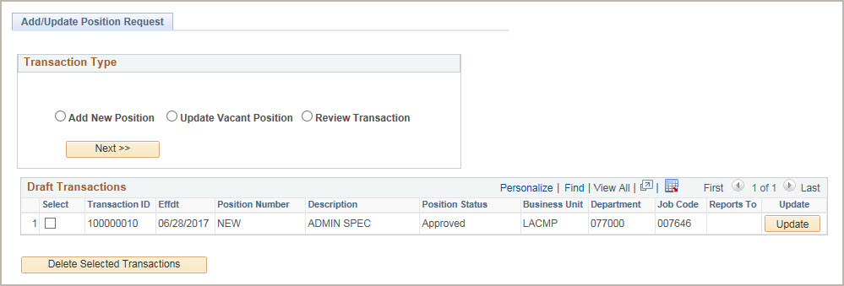
Position Control Request Page
Navigation: PeopleSoft Menu > UC Customizations >
UC Extensions > Position Control Request
The system displays the Add/Update Position Request page.
Click the Add New Position option and click Next to begin the steps for adding a new position control request.
Notes:
Let’s look at how to navigate to the Add/Update Position Request page and select the Add a New Position option, the first two steps in the process of adding a new position UCPath.
First, navigate to the Add/Update Position Request page. The navigation sequence is:
Start at the PeopleSoft Menu
Select UC Customizations
Select UC Extensions
Select Position Control Request
The system will then display the Add/Update Position Request page, which is used to start the process of adding a new position. Click the Add a New Position option and then click Next to begin the steps for adding a new position control request.
Note that Initiators can select only the Add New Position and Update Vacant Position options on this page. The Review Transaction option is for Approvers only. The Draft Transactions section displays transactions that you have started but have not submitted for approval. This list displays only your transactions; you cannot see other users’ draft transactions.
Notice in the Draft Transactions section you can click the Update button to continue editing a transaction you saved for later. Draft transactions are those for which you click the Save for Later button when entering a transaction. This allows you to continue making edits until you are ready to submit for review and approval. To delete an existing draft transaction, click the Select check box next to the transaction you want to delete and click the Delete Selected Transaction button.

Slide 36
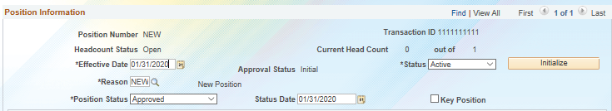
Position Effective Date
Position Effective Dates should be at least 30 days prior to the date of creation.
Position data is not sequenced. This means that once you use a specific date, you cannot make a position update using the same/previous effective date.
  Including the effective date when the position is filled

Slide 37
Position Effective Date (cont.)
Making the effective date 30 days prior to creation date will allow preceding dates to be used in case updates need to be applied to the position.
Additionally, back-dating the position effective date will allow ample time to make changes or corrections to the position, prior to hiring an employee.
Notes:
Please do not create a position with an effective date that matches the employee’s hire date. This will complicate the process of making position updates that you would like to impact an employee’s job.
For example: HR initiator creates a position at a .5 FTE effective 12/1, and they plan on hiring an employee into that position effective 1/1 but at a 1.0 FTE….
Because the position currently has a .5 FTE, the initiator will want to make an update and increase the FTE to 1.0
HR initiators can update vacant position with effective date of 12/2 and apply the FTE change to increase it to 1.0
Please note: If you use same effective date for position and hire, corrections to the position this will warrant a ticket to the UCPC.

Slide 38
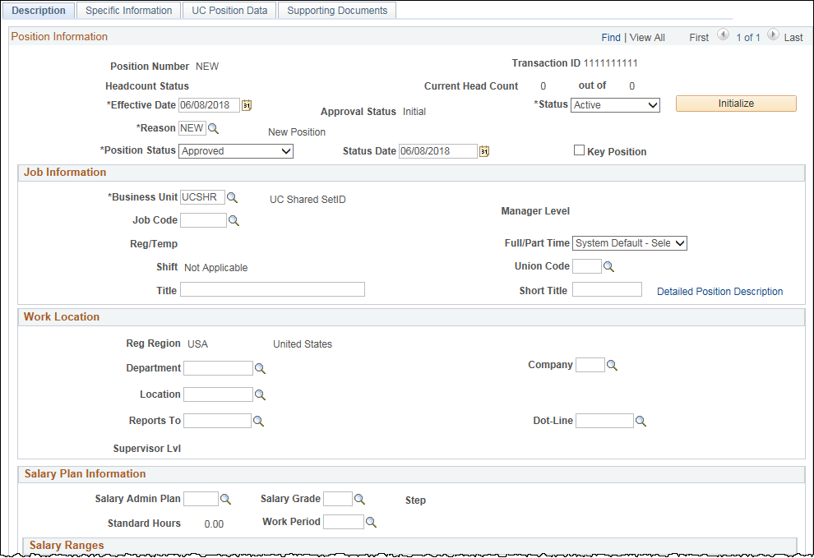
Position Control Request Page
Use the Position Control Request component to enter details regarding the new position you are requesting.
The initial steps for requesting a new position include entering the Effective Date which is when the position becomes active, entering job information, including the job code and specifying work location information.
Use Job Information section to enter a Job Code (Title Code) for the position. Other fields in this section auto-populate when the Job Code is entered.
Use Work Location section to enter the Department ID and ‘Reports To’ for a position. The Location field (building) will default from the Department but can be overridden.
Salary Admin Plan selections are narrowed based on the Job Code.
Notes:
Now let’s look at how to use the Position Control Request page to enter details regarding the new position you are requesting. This is the third step in adding a position in UCPath.
The Position Control Request page contains 4 tabs, which you use to enter the new position information, including job data, work location details, salary plan information, special training information, security clearance details, and more. You also have the ability to upload supporting documents.
The initial steps for requesting a new position include entering the date on which the position becomes effective, entering job information, including the job code, and specifying work location information.
Notice that the Position Number field defaults to NEW. Upon final approval, the system automatically assigns the next available position number.
The Transaction ID defaults to all ones when you begin entering data. When you save the transaction, the system automatically assigns the next available transaction number.
Effective Date for the position can be anytime between today’s date and one day prior to the hire date. Due to the lack of effective sequencing on position it’s recommended that positions effective date are set to a few weeks prior to the planned hire date.
Position Status: Always accept the default ‘Approved’ status when creating a new position; It is assumed that all positions that are being created have gone through the pre-approval process and have been authorized.
UCI: Key Position field is not at UC
Job Information Section
Use Job Information to enter a Job Code (previously known as Title Code) for the position. Once you’ve entered the Job Code the other fields in this section pre-populate. You can use the Title field to enter a working title for the position.
Work Location Section
Use Work Location to enter a location and ‘Reports To’ for the position. The Location (building) will default from the Department but can be overridden. UC does not use Dot-Line field.
Salary Plan Information
Salary Plan Information including Salary Admin Plan, Grade and Work Period default from the Job Code. Standard Hours default from the position FTE which is entered under Specific Information Tab.
You have the ability to save data prior to submitting for review and approval by clicking the Save for Later button at the bottom of any page in the component, which is not pictured here. The Save and Submit button appears only on the last tab – the Supporting Documents tab.

Slide 39
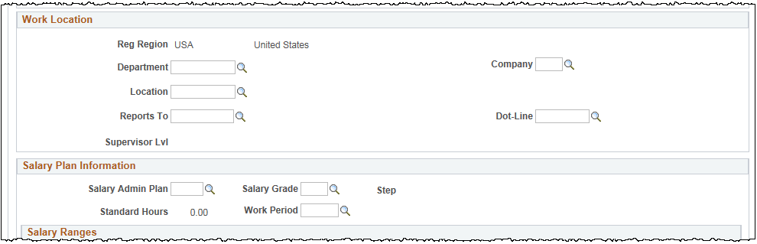
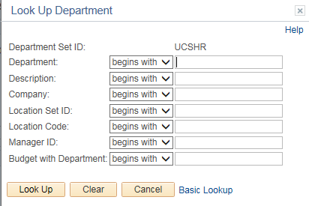
Position Data– Search Functionality
Use the look up functionality to search for the desired data in any applicable field. Narrow the search by using any of the search criteria available.
- For example: to select a desired department search by either department number (e.g. xxx) in the ‘Department’ field or by department name (e.g. Athletics) in the ‘Description’ field.
Use % as a ‘Wildcard Character’ to facilitate the search process. The % sign represents one or more other characters and allows you to search for a word embedded with the wider description, e.g., enter ‘%athletics’ to search for all departments that have a word ‘athletics’ in the description field.

Slide 40
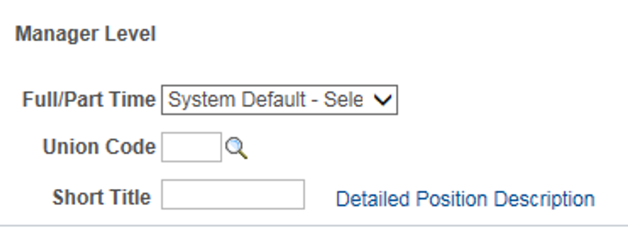
Full / Part Time Field
As you’re filling out the job details, please be sure to identify “Fixed” or “Variable” in the Fill / Part time schedule field. If you are not sure which option to choose, please contact your CPO.

Slide 41
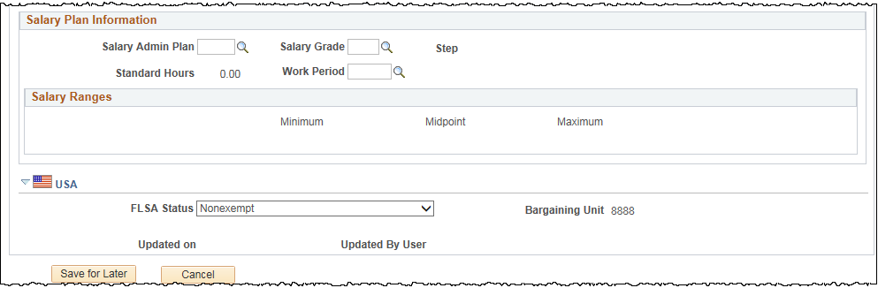
Salary Plan & Salary Grade
The Salary Admin Plan & Grade determine the compensation values that will be accepted, based on the job code, when a hire transactions takes place for that position.

Slide 42
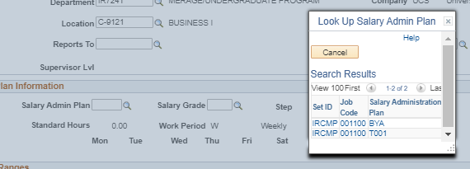
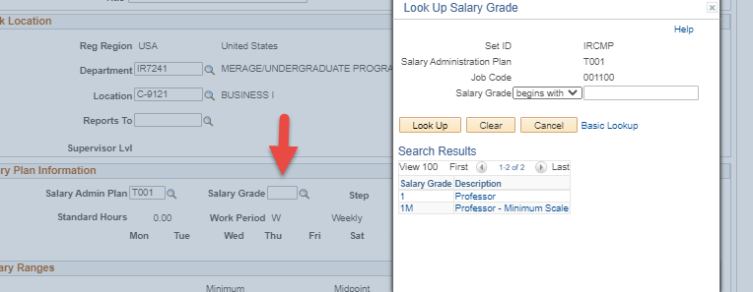
More Info: Salary Admin Plan
Compensation for a potential employee is NOT entered on the position.
These fields only determine an acceptable salary step or range based on job code.
Notes:
Example A:
Salary Admin Plan: BYA (By Agreement)
Grade: BYA (By Agreement)
This allows the initiator to manually enter the compensation amount at the time of hire on the Smart HR Template.
Example B:
Salary Admin Plan: T022
Grade: 01
This may require the entry of a Salary Step at the time of hire on the Smart HR Template.

Slide 43

FLSA Status
FLSA is an attribute of the position and defaults from the Job Code.
In UCPath an employee can only be assigned one FLSA status. When there is a need to change the FLSA due to a conflict when adding Concurrent Jobs, the Units can contact Academic Personnel or Central HR for further guidelines. They will evaluate the jobs and decide what the FLSA status should be. The FLSA Status can then be overridden as required. For more guidelines on updating the FLSA statuses visit:
http://ap.uci.edu/compensation/flsa/ for academic employee or
http://hr.uci.edu/partnership/flsa/ for staff
Notes:
There are 4 FLSA statuses available:
Exempt
No FLSA Required
Nonexempt
Nonexempt alt overtime (this value is used to track whether someone is eligible for an alternate overtime calculation, which is applicable for employees who are working in certain states that do not use the federal overtime guidelines)

Slide 44
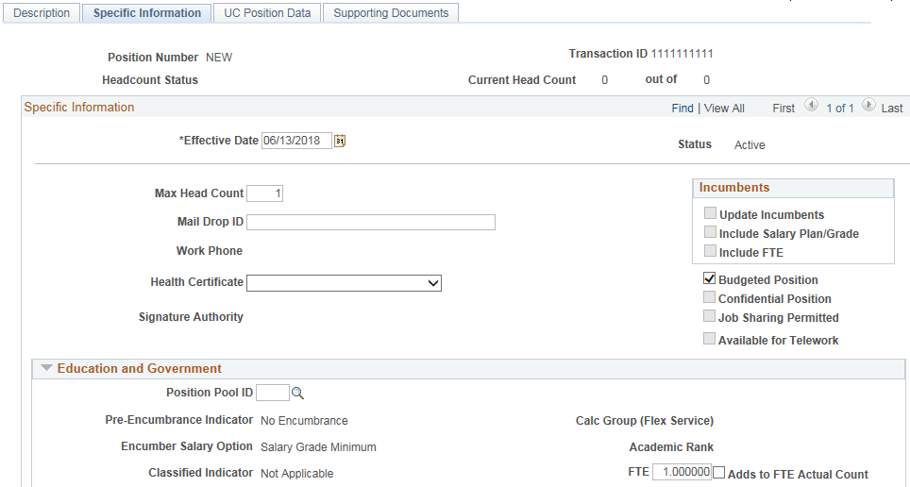
Specific Information Tab
Use the Specific Information Tab to enter additional details regarding the position you are creating, including:
Max Head Count
Budgeted Position
Position FTE (Percent of time)
Position Pool ID (used to add Work Study funding)
Max Head Count should be “1” to reflect a single headcount position.
Budgeted Position box is NOT related to permanently budgeted positions list.
FTE field refers to percentage time for the position. Example:
1.0 = full-time (40 hr./wk.)
0.5 = part-time (20 hr./wk.)
*Add to FTE Actual Count is not used by UC.
Use Position Pool ID to assign Work Study funding.
Notes:
Only Position Pool ID and FTE are used by UCI in the Education and Government section. Notice the Transaction ID for the new position control request defaults to 11111111 until the transaction is submitted. Once it’s submitted a Transaction ID is assigned.

Slide 45
Position Pools
What are Position Pools?
Position Pools are used to group similar positions in the same department that share funding.
How to use them?
At UCI, Position Pools will only be used for Work Study. As part of that process Work Study Positions will be assigned a designated Position Pool. This mechanism will help manage the split between department funding and work study program funding.
$
$
$
$
$
$

Slide 46
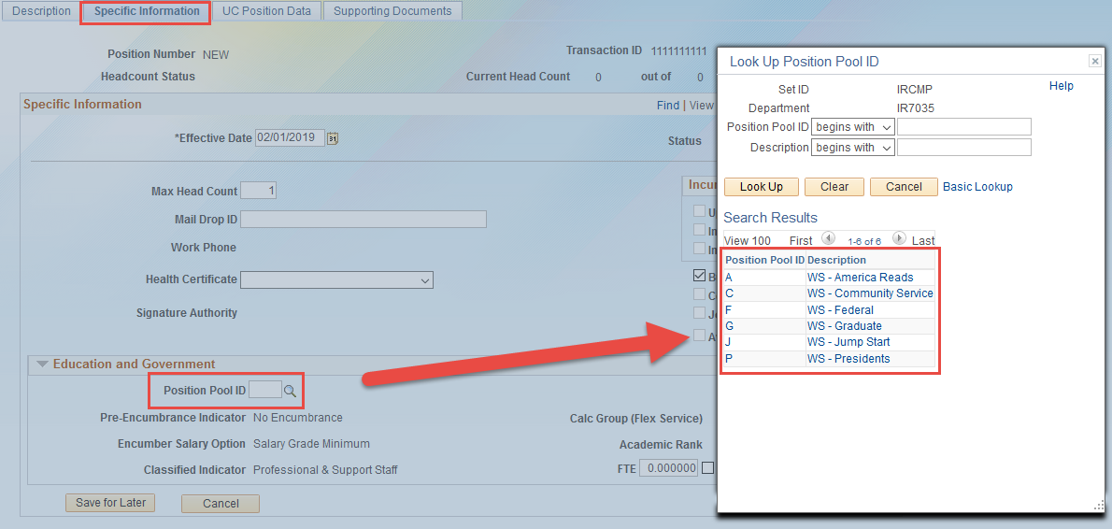
Position Pool ID
The Specific Information tab houses the Position Pool ID field. The funding for the position is split based on the position pool ID selected.
The funding configuration (splits) are already established in UCPath therefore no additional transactions are needed for the funding allocations to occur.
Best practice is to update the position with the Position Pool ID before hiring the student so that you are not waiting on approval of the hire transaction from the UCPath Center.
Notes:
Whenever you see Position Pool ID in UCPath I want you to think work study.
The Position Pool ID selected will be based on the award that is provided to the student as part of their financial aid package. The Office of Financial Aid is responsible for ensure these pool ids are setup correctly in UCPath. The funding can be added as soon as the student is hired and the WS funding is approved.

Slide 47
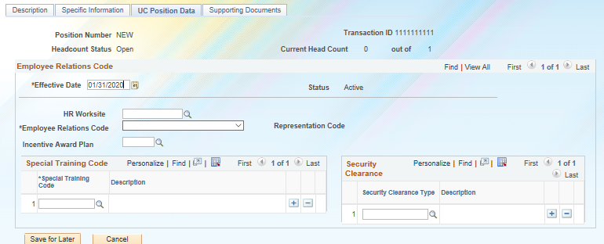
UC Position Data Tab
Use the UC Position Data Tab to:
Select the HR Worksite
Specify Employee Relations Code for the position
Identify Special Training needed
Add necessary Security Clearances
1
2
4
3
Notes:
The HR Worksite is required in order to initiate the notification to the employee, when hired, to complete section 1 of their I-9 profile in Tracker. Other fields are described in the following slides.

Slide 48
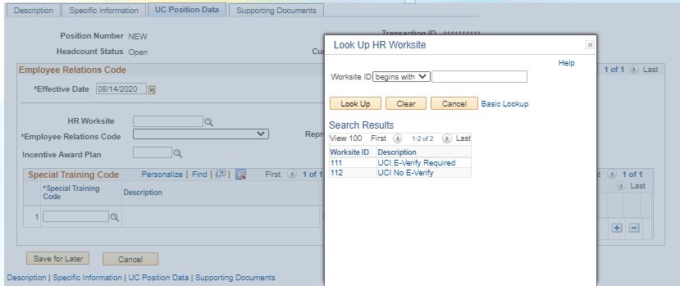
HR Worksite ID
UCI E-Verify Required: Use if your school or department manually performs i-9 verification for new hires.
  System-generated i-9 notification sent to employee once hired.
UCI No E-Verify: Use if your school or department utilizes the UCI Central Onboarding team to perform i-9 verification for new hires.

Slide 49
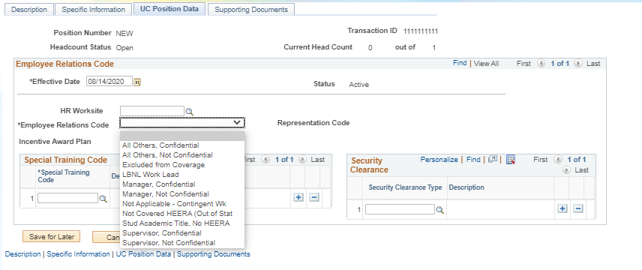
UC Position Data Tab – Employee Relations Code
To determine which Employees Relations Code to choose from the drop down menu use the UC Irvine Employee Relations (EREL) Code Chart
Notes:
Most employees will fall under the All Others, Not Confidential

Slide 50
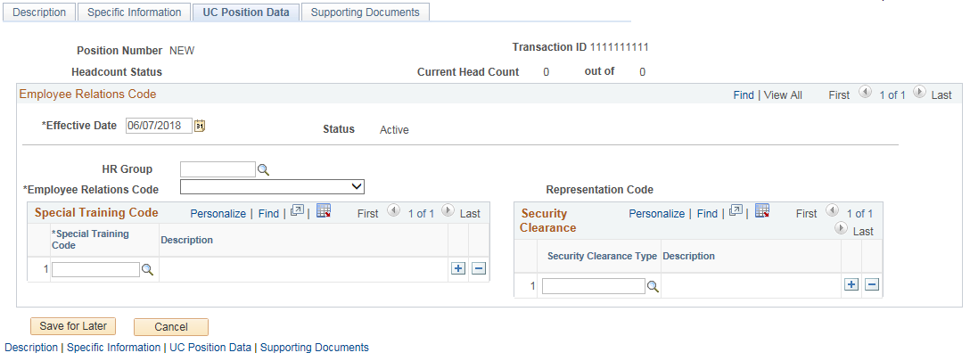
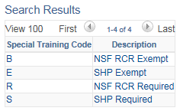
Position Control Request – Special Training Code
The Employees Relations Code helps to determine what Special Training is required for a position. It provides the ability to identify which employee’s must take Federal and/or State government classes.
The available Special Training codes are listed under the look up box below.
NSF RCR = National Science Foundation Responsible Conduct of Research
SHP = Sexual Harassment Program

Slide 51
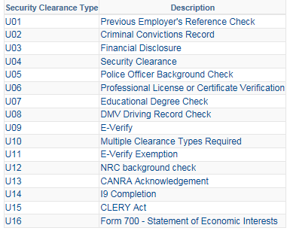
Position Control Request – Security Clearance Type
Use the Security Clearance Type field to add a special clearance type for a position. You can add multiple entries using the plus button.
The field will be used for reporting and auditing purposes only (no downstream impacts).
The completion of a security clearance will be entered Security Clearance component.

Slide 52
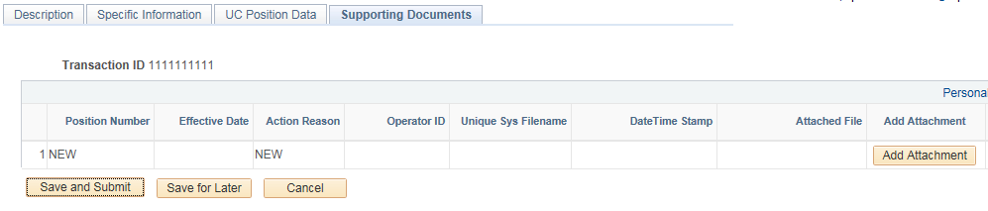
Position Control Request – Save & Submit
Use the Supporting Documents Tab to attach supporting documents to a transaction. (If applicable)
  For example, pre-approval documents authorizing the creation of the position.
Once you have entered all of the position details, Click Save & Submit.
The attached documents & transaction will be routed to the AWE Approver assigned for this transaction for review.
Click ‘Save and Submit’ to submit the transaction for review and approval
Use ‘Cancel’ to cancel the entire transaction without saving it in the system.
Click ‘Save for Later’ to save the transaction.

Slide 53
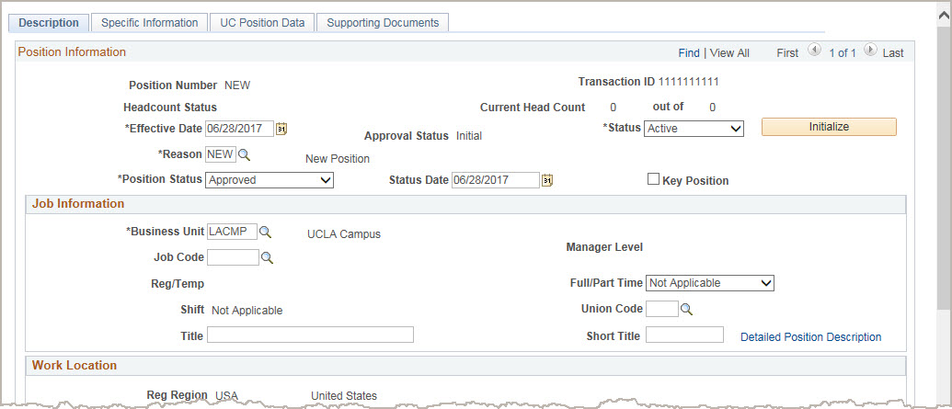
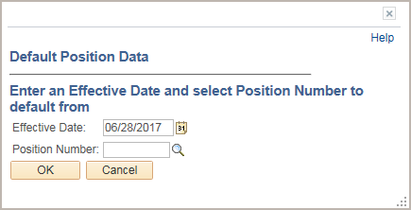
Copy an Existing Position
You can also copy information from an existing position in UCPath to initiate a request for a new position.
1
Click Initialize to begin the steps for copying data from an existing positon.
2
The system displays the Default Position Data dialog box, which you use to specify the position from which you want to copy data.
Notes:
To avoid duplicative data entry, UCPath allows you to copy existing position information and use it to create a new position.
You begin the system steps for copying an existing position just as you do for requesting a new position:
Navigate to the Position Control Request component, select the Add New Position option and click the Next button.
On the Description tab, enter the appropriate Effective Date, but instead of entering all the required data for the new position, click the Initialize button to copy the appropriate data from an existing position.
The Default Position Data pop up window will appear, and here you can enter the effective date and the position number that you want to copy the data from.
After you click the ‘OK’ button, the new position’s data will be populated.
Please note that some fields you’ll see on UCPath pages were custom created for the UC system and are not standard in PeopleSoft. This is relevant to copying an existing position because when you click on Initialize, the custom UC Fields do not get copied over (such as Employee Relations Code and Security Clearance). Those fields will need to be manually updated.

Slide 54
Position Management for Retirees
For employees that elect to retire and become Emeritus, the position initiator will need to create a position for that employee (if one not already created).
A recall appointment of an Emeriti will be considered a Concurrent Appointment.
            Another/separate job record
Employees can elect to become Emeritus 1 day after retirement.
            Effective July, 1st
Recall appointments are allowed 30 days after retirement.

Slide 55
Adding Positions:
Position Approval & Transaction Roles

Slide 56
Position Approvals
The Position Control Request will utilize Approval Workflow Engine (AWE) to route the request for approvals after the transaction is entered into UCPath.
After department approval through AWE, data from a Position Control Request transaction is saved to the system and a Position number is auto generated.
Positions do not need to be processed by the UCPath Center.
Notes:
Positions are approved using Approval Workflow Engine, or AWE. Each organization or department is responsible for creating a workflow that defines approvals that must be in place before a new position is created, or an existing position is updated, and includes the appropriate employees.
Here is how position approvals work in UCPath:
Departments request the creation of a new position or updates to an existing position and obtain necessary pre-approvals before entering the position into UCPath.
Once pre-approvals are secured, the initiator will submit a Position Control Request
The Position Control Request will utilize AWE to route the request for approvals before saving to UCPath.
After final organization or department approval through AWE, data from a Position Control Request transaction is saved to the system; the information does not need to be processed by the UCPath Center.

Slide 57
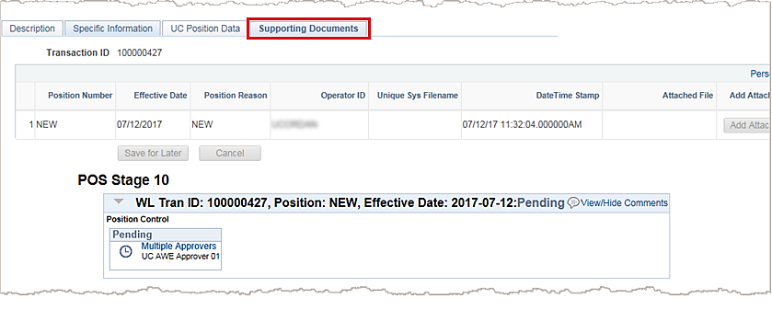
Approval Workflow
When you successfully save and submit a Positon Control Request transaction, the system automatically routes it to the appropriate Approver(s).
The bottom portion of the Supporting Documents page displays the approval flow for the transaction.
To display the specific Approvers’ names for an approval level, click the Multiple Approvers link.
Notes:
The final step is to save and submit the Position Control Request from the Supporting Documents tab. After you successfully complete all the tabs on the Position Request page, the transaction is routed through AWE.
The bottom portion of the Supporting Documents page displays the Approvers to which the system routes the transaction. Notice that the Transaction ID is now assigned.
For additional information on AWE approvals, refer to the AWE Overview training course.

Slide 58
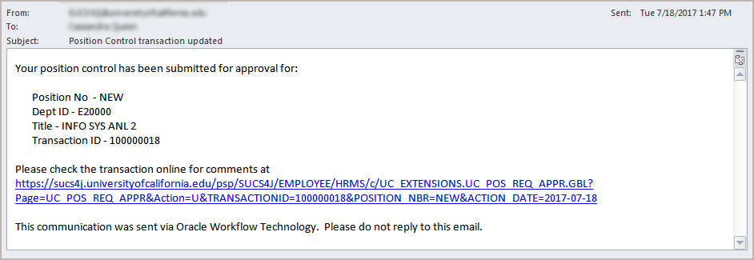
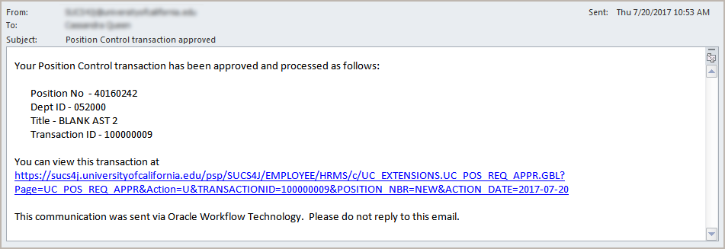
Email Notifications
System-generated notifications confirm when your Position Control transaction is submitted and when it is approved.
Notes:
After you successfully save and submit a Positon Control Request the system sends an automated notification indicating your request was submitted for approval (first example).
After final approval of a transaction, the system automatically sends an approval email to you indicating the request was approved (second example).
Additionally, if the request is denied or pushed back to another Approver, the system sends an automated email notification providing the approval status update (not shown here).
When you click the link in the email, if you are signed in to UCPath, the transaction details appear. If you are not logged in, you are prompted to do so before the system displays the appropriate transaction.
Please note that the Initiator cannot copy a denied transaction.

Slide 59
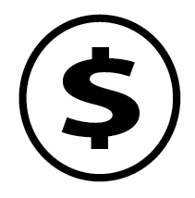
Introduction to Position Funding
Funding can only be entered AFTER the position has been approved.
Funding is assigned to a position not an employee.
The position can be vacant or filled when new funding is assigned, or when funding updates are made.
As employees move in and out of a position, funding remains the same unless changes are made.
When no funding is assigned, the employee will be paid from the department/school/unit default account.

Slide 60
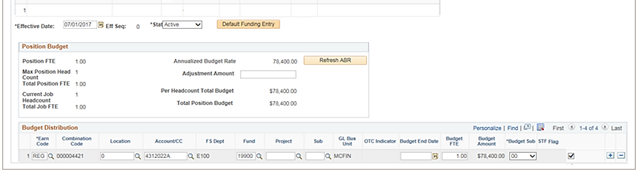
Permanently Budgeted Positions
Permanently budgeted positions are identified on the Budget Distribution page and will need to have the STF flag checked, along with the budgeted salary amount for that position.
Notes:
Please note, some position initiators will not be able to update the data on the budget distribution page.
More information is available in the Budget Distribution course.

Slide 61
Position Control Example
Marketing Department – Before
The Marketing Department has four employees, each with their own position. All the positions are filled, and the department has no vacancies.
But! The department’s responsibilities have grown and Alex decides she needs to:
Create a new ‘Analyst’ position
Promote Danielle from Executive Assistant to Analyst*
Hire a new Executive Assistant
Alex
Director
Bonnie
Manager
Colin
Senior Analyst
Danielle
Exec. Assistant
* It is assumed that an open recruitment or a waiver has occurred prior to Danielle’s promotion to Analyst.
Notes:
Now let’s walk through a position management example.
In this example, the Marketing Department has four employees, each with their own position. All the positions are filled, and the department has no vacancies. But! The department’s responsibilities have grown and Alex decides she needs to:
One, create a new ‘Analyst’ position
Two, promote Danielle from Executive Assistant to Analyst (please assume that an open recruitment or a waiver has occurred prior to Danielle’s promotion to Analyst).
And, three, hire a new Executive Assistant

Slide 62

Position Management Example Cont’d
Step one ‘Add a new position’
Create a new position for the Analyst role in the department.
Make sure to attach the right funding to the Position!
Alex
Director
Bonnie
Manager
Colin
Senior Analyst
Analyst
Danielle
Exec. Assistant
Notes:
The first step is to create a new position for the Analyst role in the department. After creating the position, make sure to attach the right funding to the position.

Slide 63

Knowledge Check
Assessment
You now have the opportunity to assess your knowledge of the information presented in this module.
The questions and answers presented in this review help you to determine whether you remember and understand the important points.

Slide 64
True or False
Positions is one of the primary components to creating a job record?
True: Position & a person create a job record
Notes:
The correct answer is: False

Slide 65
True or False
Positions are created by the department initiator using the position control request page.
True.
Notes:
The correct answer is: False

Slide 66
True or False
Position Control Requests utilize Approval Workflow Engine (AWE) to route transactions locally for approvals and also must be processed by the UCPath Center.
False: After UCI / Department approval, data from a Position Control Request transaction is saved to the system.
Notes:
The correct answer is: False

Slide 67


Instructor Demo
Initiate New Position Control Request
Watch as your instructor demonstrates how to add a new position in UCPath.
Follow along using the UCPath Help topic.
  Open the UCPath Help site and refer to the Initiate New Position Control Request topic.
  Launch the See It version of the topic.
At the end of the demonstration, you will have the opportunity to practice this task.
Notes:
For UPK simulation-based demonstrations, open the See It view and walk through the activity while providing details and explaining the task. The users should follow along with the See It version of the UPK.

Slide 68

BREAK TIME

Slide 69
LESSON 3
Fast Class: Position Classification

Slide 70
Lesson Objectives
In this lesson, we will:
Understand the new Fast Class application
Learn when to initiate a position classification/reclassification request.
Comprehend the Fast Class process for Career, Limited-Career, and Contract positions.
Position Management Overview
Add New Positions
Fast Class: Pos. Classification
Review Position Transactions
Updating Positions
3

Slide 71

What is Fast Class?
Fast Class is a position classification system that incorporates elements of CareerTracks to identify job classifications .
All Career, Career-Limited, and Contract (CareerTrack & Non-CareerTrack) positions are required to go through the Fast Class process.
Job Descriptions are assigned for recruiting once the classification process has been completed.

Slide 72
High Level Fast Class Process
Create Positon in UCPath
Department AWE Approval for Position
Initiate classification request via Fast Class
Classification is approved, Job Description assigned for recruitment activities

Slide 73
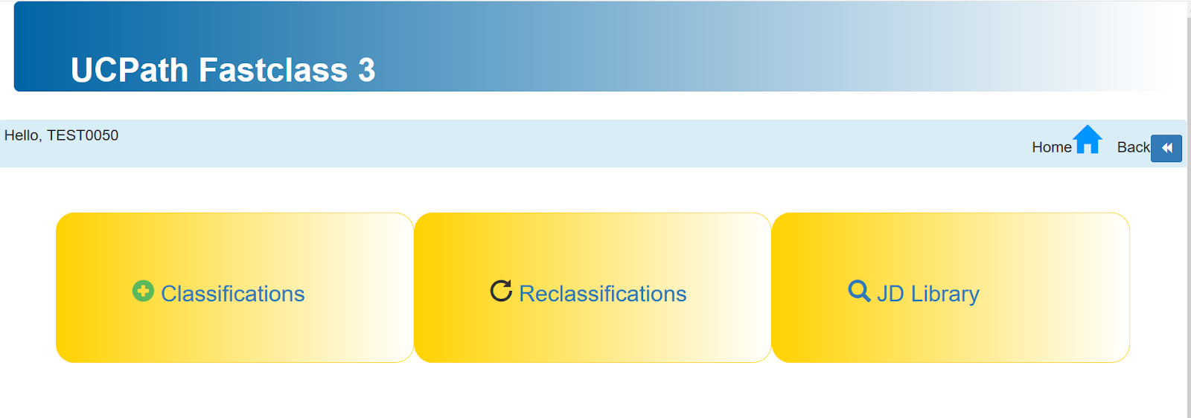
Classification Initiator
When is a Fast Class request required?
New Positions
Rehiring into Vacant Position
Making Changes to Existing Position
1
2
3
Notes:
No additional KSAMS access is required.
Anyone with a UCINet ID can submit a classification Request

Slide 74
UCPath & Fast Class
Positions are created and approved in UCPath by dept. HR Initiators & Approvers.
A 24-hour nightly batch service automatically sends approved position information to the Fast Class database.
HR Initiators can then search for the position in Fast Class to initiate the classification process.
  Position number can be used.

Slide 75
Fast Class Process
Click “Classification” then search for approved position/
Create request for new job description and provide requisition details.
Submit requisition request for approval.

Slide 76

Fast Class:
Approvers

Slide 77
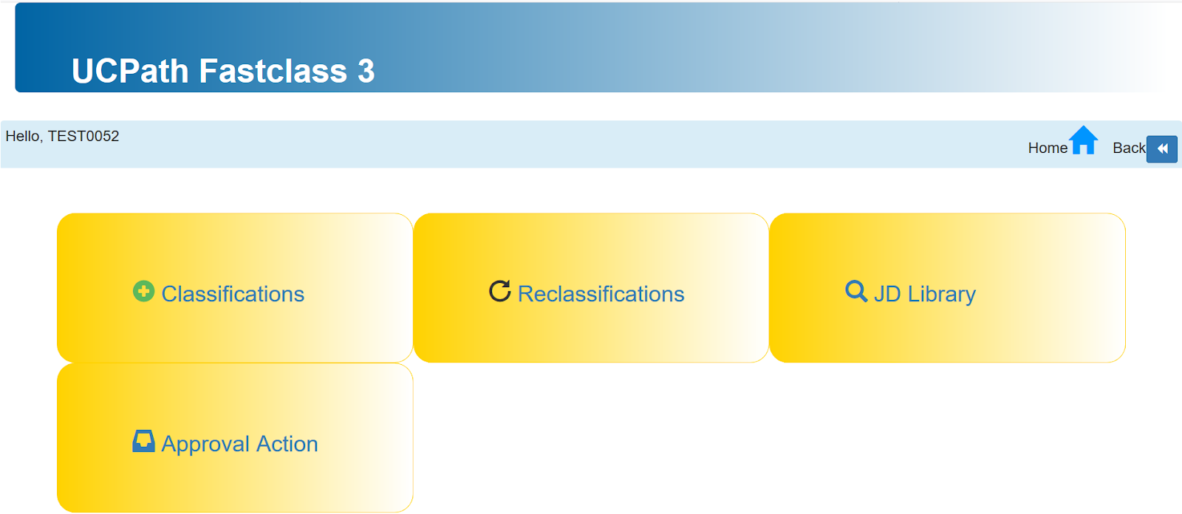
FastClass Approvers
Is your department centralized or decentralized?
Centralized: approval is performed by Central HR Approver
Decentralized: School/Dept Approver
MSP job codes are all approved by Central HR Approver
Career Tracks vs Non-Career Tracks approval flow is the same.
Requires KSAMS role ‘FastClass|Approver 3’ role
Notes:
In order to approve classification request, this Requires KSAMS role ‘FastClass|Approver 3’ role.
Please speak with your DSA if you have questions about your access.

Slide 78
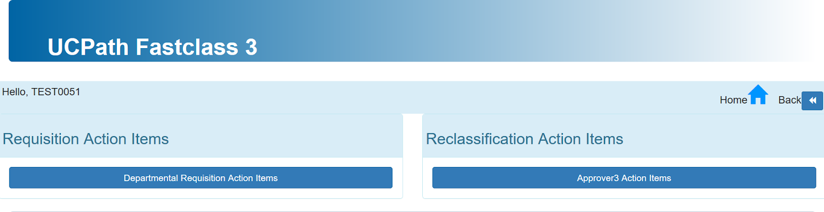
Fast Class Approver View
Requests submitted for NEW positions will appear in the “Requisition Action Items” bucket.
Requests submitted for updated positions, or rehires, will appear in the “Reclassification Action Items” bucket.
1
2
Notes:
Approver will receive an email on an incoming request.
Initiators will receive email of any action taken by the approver
Approved, denied, returned request

Slide 79
Union Positions
Unions are required to approve classifications for Represented positions only.
35 day waiting period
Represented Position?
Yes
No
Notify Union
Approval done by Central HR
After waiting period elapsed or waived

Slide 80

Recruitment & Fast Class
Once position classifications are approved, the information becomes available to People Services team. The employment representatives are responsible for posting Job Descriptions from Fast Class - onto the job opening in the new recruitment tool, TAM – Talent Acquisition Management.
Job Posting information is only a subset of information collected during the classification approval process.

Slide 81
Fast Class:
Job Description Library

Slide 82
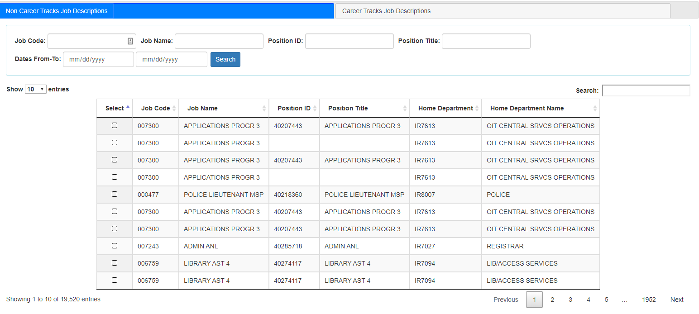
Job Description Library
*No special access required to view job description library in KSAMS.

Slide 83

Lesson Objectives Review
Having completed this lesson, you should now be able to:
Understand how and when to submit a classification request for a position.
Understand the Fast Class approval process for Career and Non-Career track positions.

Slide 84
LESSON 4
Update Positions

Slide 85
Lesson Objectives
In this lesson, we will:
List the key system steps to update positions.
Initiate a position control request for updates to a vacant position.
Initiate PayPath transaction to update a filled position.
Position Management Overview
Add New Positions
Fast Class: Pos. Classification
Review Position Transactions
Updating Positions
3

Slide 86
Position Updates
Whether the position is filled or vacant, determines where in UCPath you will go to make changes.
Vacant Positions
Filled Positions
Position Control Request
PayPath
New positions and changes to existing vacant positions can be made via Position Control Request page.
Changes to existing filled positions can be made via PayPath - a custom made UCPath component where multiple position, job and additional pay changes can be made.
Notes:
If you are making changes to a single-headcount position, you will make these changes using either Position Control Request or PayPath.
Please refer to PayPath Actions training materials for additional information on making position changes to filled positions. Please note, changes to filled positions may have downstream impacts that may affect employee pay.
If a position is vacant, you will use Position Control. For example, if an WFA Initiator received authorization to recruit for a new job in your department, and Central HR has approved the job description, the position and job data would be changed by accessing Position Control.
If a position is filled, you will use PayPath to make a change. For example, if you need to reclassify a staff position, such as reclassifying an Accountant III to an Accountant IV, you would access PayPath to change the position and job data.
Note: Changes to multiple-headcount positions must be coordinated with the Position Administrator.

Slide 87
Updating Vacant Positions
A vacant position is defined as a position that is already created in UCPath, with no employee or incumbent assigned.
There are times when you must update a vacant position’s data, (e.g., the Reports To Position, Job Code, Salary Plan, etc.)
To update a vacant position in UCPath, the Initiator must enter updates to by using the Position Control Request page.
Remember: Updates to a filled position must be completed using a PayPath Actions transaction.
Notes:
A vacant position is defined as a position that is unfilled by an employee. There will be times when you must update a vacant position’s data, such as the Reports To Position, Job Code, or Salary Plan. To update a vacant position, the WFA Initiator must enter updates by using the Position Control Request Page.

Slide 88
Update Vacant Position – Key System Steps
*Effective date should be after the original date.
Navigate to the Position Control Request Page
Select Update Vacant Position option, click Next
Search and select appropriate position
Update appropriate position data
Click Save & Submit for Review and Approval
Notes:
Here are the steps for Updating a Vacant Position: (Navigation: PeopleSoft Menu > UC Customizations > UC Extensions > Position Control Request)
First, navigate to the Position Control Request page.
Next, select the Update Vacant Position option and click Next.
Enter the effective date – this should be a date after the original effective date. Remember, positions are not sequenced, therefore, you cannot make a change and backdate it to reuse the same/original effective date of position.
Search for and select the appropriate position.
Update the appropriate position data.
Finally, click Save and Submit to route the request through AWE workflow.

Slide 89
Updating Vacant Staff Positions
When changing or updating vacant Staff position attributes, a “Reclassification” request will need to be submitted via Fast Class.
Changes to vacant positions should be driven by departmental needs, and reflect the actual evolution of the position.
STAFF
(Career, Limited- Career, Contract)

Slide 90
Updating Academic Positions
Vacant positions can be updated whenever a department needs to change the data on an unfilled position.
Changes to an empty/unfilled position are done via Position Control Request, using the “Update Vacant Position” option.
Changes to vacant positions should be driven by departmental needs and reflect the actual evolution of the position.
Academic
(All)
    Example: My principal analyst retired, and I need to hire someone to replace them, but we want to hire someone at the senior analyst level.
Notes:
Vacant Positions can be updated when a department discovers a need to change the data on a position. These updates are entered and approved via the AWE-enabled Position Control page. There are fewer downstream effects when updating a vacant position.
Depending on the situation, existing position attributes can be changed, or an entirely new position can be created.

Slide 91
Updating Academic Senate Positions
Although Academic Senate positions are created by the budget office, each individual department is responsible for maintaining the position until vacated.
Please do assign more than 1 person to a position. No multi-head count.
  In transition situations where shadowing or cross training may occur, create another position with the same attributes for the new employee.
Academic Senate
Notes:
Vacant Positions can be updated when a department discovers a need to change the data on a position. These updates are entered and approved via the AWE-enabled Position Control page. There are fewer downstream effects when updating a vacant position.

Slide 92
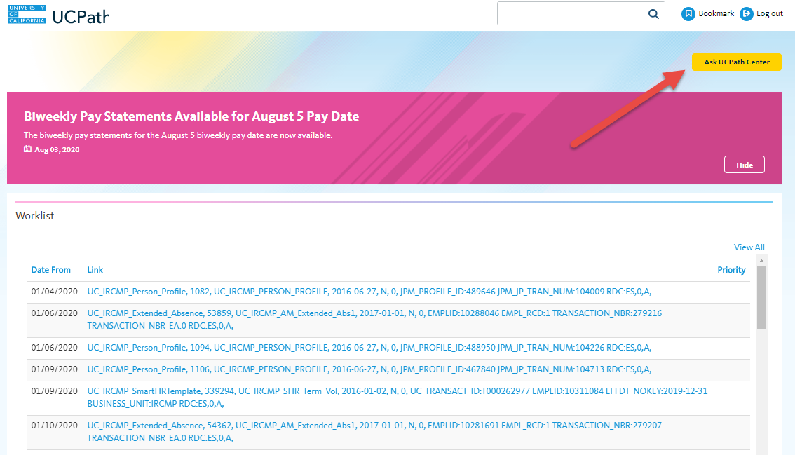
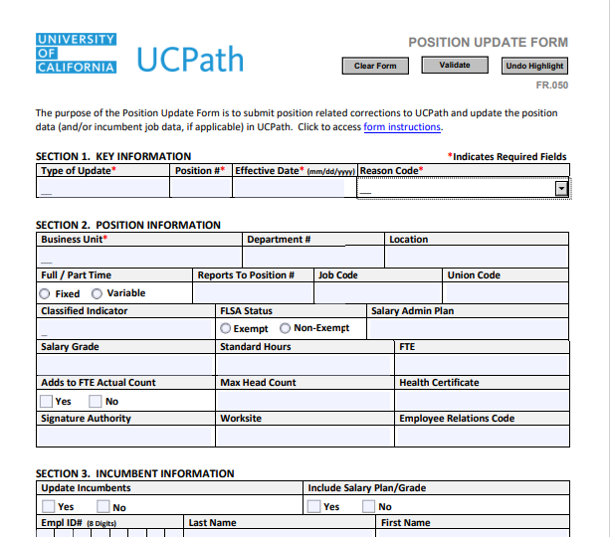
Position Update Form
It is strongly recommended to download and save the document to your computer in order to activate values for each required field.
Please make sure to fill out the areas with red asterisks. Those fields are required.
If the position change affects the Employee, please include employee’s ID number in the required section.
Please ensure to enter detailed comments so the UCPath Center understands the change you’re looking to make.
This form is located in the Forms Library from the UCPath dashboard, or on our UCI UCPath website in the Transactor Users section.
Submit form as a case to the UCPath Center.
Notes:
Use for vacant position changes that need to be effective on the original effective date

Slide 93

Updating Existing Filled Positions
Making changes to a position that is filled, are done via PayPath Actions, on the Position Data tab.
Changing position data on a filled position may have unintended downstream impacts that could affect employee payroll.
  Position changes cascade directly to the incumbent’s job data, and may occur concurrently with other jobs, compensation, benefits, or additional pay may be impacted
When modifying or correcting filled position data, this may require the use of a “Job Data Update” form, which can be found in the forms library on the employee dashboard menu
Filled Positions
Example: I need to reclassify one of my employees position & change their FTE.
Notes:
You can think of updating a position as updating a chair that is already filled because an employee is sitting in it.
Filled positions can be updated if there are approved changes to a position’s data, such as who an employee reports to. Position changes cascade directly to the incumbent’s job data and may occur concurrently with other job, compensation, or additional pay changes. Reclassifications occur when the job code or salary grade on an existing position is changed, for example, due to higher level responsibilities.

Slide 94

Moving/Transferring Positions
A position should only be moved between departments if the actual role and funding are being transferred.
If the position is filled, and the department needs to be changed, this would be initiated as a ticket to the Employee Experience Center.
You may also submit a Position Update Form.
Notes:
Moving of positions is probably not very common. In most cases, switching departments on a filled position can be done via PayPath action.
Otherwise, if the position is empty, it can be updated via Position Control Request, using the “Update Vacant Position” option.
In some cases, if the department change needs to be backdated/ retro effective, a position update request form may be warranted.

Slide 95
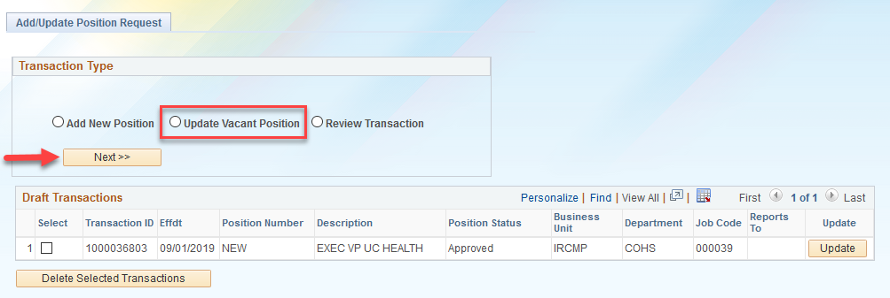
Updating Vacant Position Steps
Navigation: PeopleSoft Menu > UC Customizations > UC Extensions > Position Control Request
Click the Update Vacant Position option, then click Next to begin the steps for initiating an update to a vacant position.
Notes:
Let’s look at how to Update a Vacant Position via the Add/Update Position Request page in UCPath.
First, navigate to the Add/Update Position Request page. The navigation sequence is:
Start at the PeopleSoft Menu
Select UC Customizations
Select UC Extensions
Select Position Control Request
The system displays the Add/Update Position Request page.
Click the Update Vacant Position option and then click Next to begin the steps for initiating a position update control request.

Slide 96
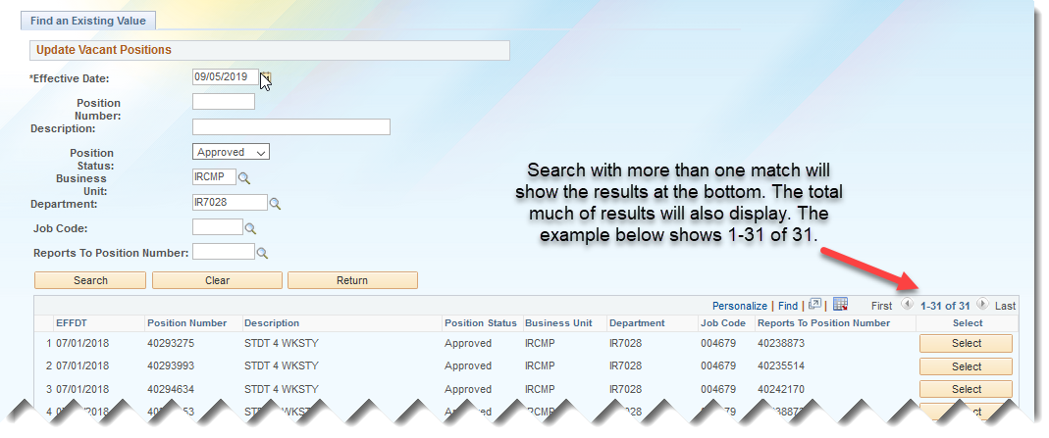
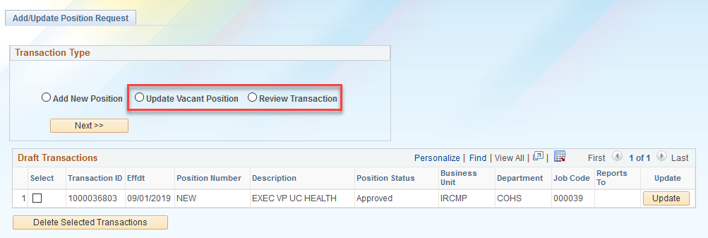
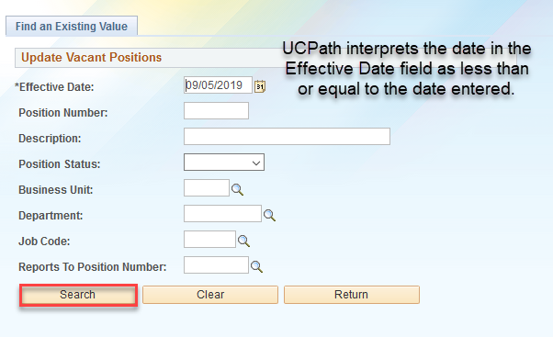
Search for Vacant Position
Navigation: PeopleSoft Menu > UC Customizations > UC Extensions > Position Control Request
Effective date of update needs to be AFTER date of initial creation.
Notes:
Let’s look at how to Search for a Vacant Position in UCPath.
First, navigate to the Find an Existing Valuepage. The navigation sequence is:
PeopleSoft Menu > UC Customizations > UC Extensions >Position Control Request
Once you perform the search:
If no records match the search criteria, the system displays a message that 0 results were retrieved.
If only one match is found, the system displays the record.
If multiple records match the search criteria, the system displays a list of those results.
The Search Results section displays only those vacant positions that match the search values you entered. Click the Select button next to the position you want to update.

Slide 97
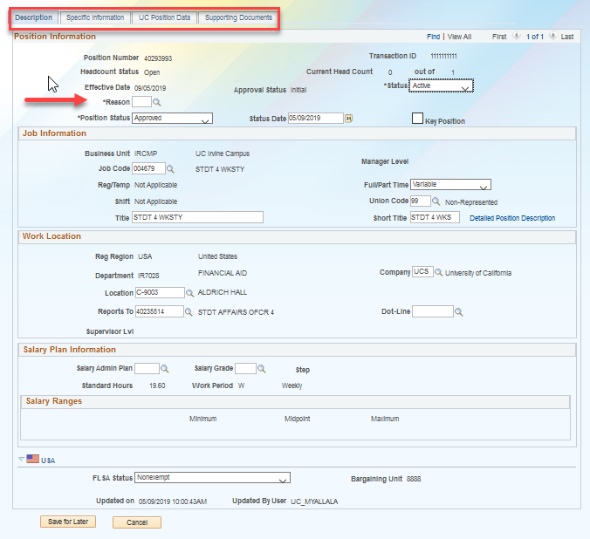
Position Change Reason
If only one match is found, the system displays the record in the Position Information page.
A Reason for the change must be selected in order to submit the change for approval.
Click Submit from the Supporting Documents tab.
Notes:
After you search for and select the position, you will see the Position Information page. This page is composed of five tabs, which display information related to a specific position, such as job-related information, and position attributes.
When making a change to a position, you must first enter Reason for the position change. Then proceed to make the necessary changes to the position. The Submit button is only accessible from the Supporting Documents tab. Remember this change will require approval from your location before it is saved to UCPath.

Slide 98

Inactivating vs Freezing Positions
Inactive: Used for vacant positions that a dept. does not plan to recruit for in the future (e.g., Permanent layoff)
Frozen: Remains an active position, can be used for vacant positions that the Org/Dept. intends to recruit for in the future.
Example: Employee retires, and the dept. intends to recruit for the role in the future, but does not choose to fill it immediately. Or the Budget office freezes a Senate Faculty position once an employee vacates it.
Example: I had to lay off a number of employees in my unit. I’ve completed all the involuntary terminations. I will not be recruiting to those positions in the future.
Notes:
If you no longer plan to use a position it should be inactivated. Note that inactivating a position changes your department’s organizational structure because now the chair no longer exists.
If you want the position to remain in your department but you simply don’t want to hire anyone into it for a while, the position can be set to a Frozen status. When a position is frozen your department organizational structure remains intact. The Budget office may also freeze a position once an employee vacate the position to prevent someone from accidently using this position for another hire.

Slide 99
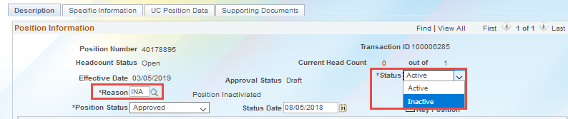
Inactivating a Position
To inactive a position:
Navigate to Position Control Request Form (PeopleSoft Menu > UC Customizations > UC Extensions > Position Control Request)
Click the Update Vacant Position option and then click Next to begin the steps for initiating a position update control request.
Enter Effective Date and Reason Code ‘Position Inactivated’.
Change the Status to ‘Inactive’.
Click Save and Submit

Slide 100
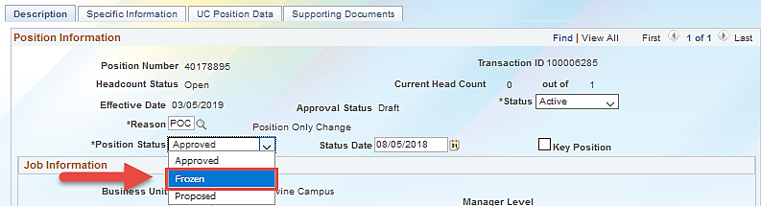
Freezing a Position
To freeze a position:
Navigate to Position Control Request Form (PeopleSoft Menu > UC Customizations > UC Extensions > Position Control Request)
Click the Update Vacant Position option and then click Next to begin the steps for initiating a position update control request.
Enter Effective Date and select the relevant Reason Code, e.g.
Change the Position Status to ‘Frozen’.
Click Save and Submit.

Slide 101

Instructor Demo
Initiate Update Vacant Position Request
Watch as your instructor demonstrates how to update an existing position in UCPath.
Follow along using the UCPath Help topic.
  Open the UCPath Help site and refer to the Initiate Update Vacant Position Request topic.
  Launch the See It version of the topic.
At the end of the demonstration, you will have the opportunity to practice this task.
Notes:
For UPK simulation-based demonstrations, open the See It view and walk through the activity while providing details and explaining the task. The users should follow along with the See It version of the UPK.

Slide 102
Knowledge Check
Assessment
You now have the opportunity to assess your knowledge of the information presented in this module.
The questions and answers presented in this review help you to determine whether you remember and understand the important points.

Slide 103
True or False
You can request updates to any position – vacant or filled –by initiating a Position Control Request transaction.
False: You can initiate requests only for vacant positions.
Notes:
The correct answer is: False

Slide 104
Multiple Choice
When you initiate a Position Control Request transaction to update a vacant position, besides the effective date, the____________ code is also required.
Action
Business Unit
Reason
None of the above
Notes:
The correct answer is: Reason

Slide 105
True or False
Position updates you enter on a Position Control Request transaction are not routed through AWE workflow; the updates are written directly to the database.
False: All requests submitted using a Position Control Request transaction, whether for a new position or an update to a vacant position, route through AWE workflow.
Notes:
The correct answer is: False

Slide 106
True or False
Position changes can entered using the same effective date it was created.
False: Position effective dates cannot be re-used. Including other dates changes were entered

Slide 107

Lesson Objectives Review
Having completed this lesson, you should now be able to:
Understand how to manage vacant Staff, Academic, & Academic Senate faculty positions.
List the key system steps to update vacant positions.
Initiate a position control request for updates to a vacant position.

Slide 108
Key Takeaways
When initiating a Position Control Request transaction to update a vacant position, it’s important to review and select the appropriate action reason code.
You can only make updates to vacant positions through the Position Control Request page. To make updates to a filled position, you have to initiate the transaction through PayPath. To learn more about PayPath, please refer to the PayPath Actions training courses.
For changes to Position data using a previously used effective date, please submit a Position Update form
For changes to Department ID, please submit a ticket to EEC (Employee Experience Center)
Notes:
Before we start the next module, let’s review the key takeaways from the Updating Vacant Positions module:
When initiating a Position Control Request transaction to update a vacant position, it’s important to review and select the appropriate action reason code.
You can only make updates to vacant positions through the Position Control Request page. To make updates to a filled position, you have to initiate the transaction through PayPath. To learn more about PayPath functionalities, please refer to the PayPath Transactions training course.

Slide 109
BREAK TIME

Slide 110
LESSON 5
Review Position Control Transactions

Slide 111
Lesson Objectives
In this lesson, we will:
Access and view existing position control request transactions
Understand how to search and review position control request transactions that you have submitted:
  Add/Update Position Request Page
Position Management Overview
Add New Positions
Fast Class: Pos. Classification
Review Position Transactions
Updating Positions
4

Slide 112
Review Position Transactions
When Position Control Request transactions are submitted, the department initiator can use the Review Transactions option on Position Control Request page.
Additionally, the Position Control – Approval page can be used to check by Transaction ID number.
Notes:
After you have submitted your position transaction in UCPath, there are two ways to view this information.
One, by using the Position Control Transaction page or
We will learn more about how to use these pages in the following slides.

Slide 113
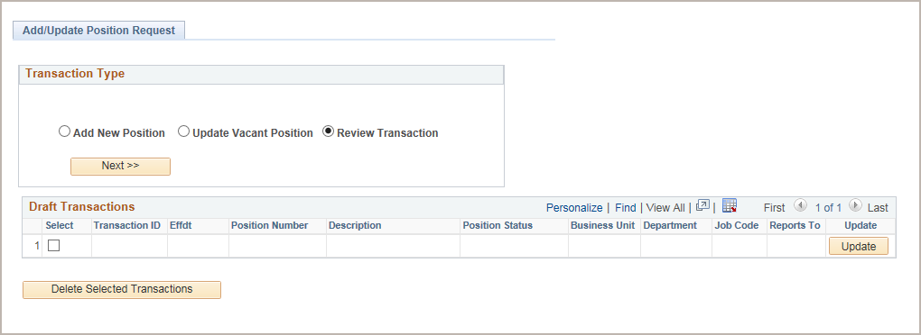
Review Transactions Page
To view already submitted position transactions:
Use the same page on which you begin the steps for adding a new position, click on the Review Transactions option, then click Next.
Click the Review Transaction option and click Next to begin the steps for viewing an existing position control request.
Notes:
This is the first option you have to Review Position Control Transactions.
Navigate to the Add/Update Position Request page to review transactions you’ve submitted. This is the same page on which you begin the steps for adding a new position or updating a vacant position.
Click the Review Transaction option and click Next to begin the steps for viewing an existing position control request.

Slide 114
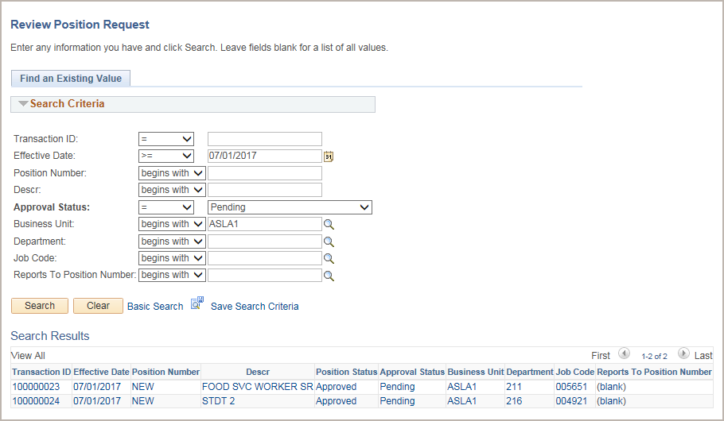
Find the Existing Position
Use this page to enter known search criteria to narrow the search to only the position control transaction(s) you want to view.
You have the option to search for requests with any status by leaving the Approval Status field blank, or you can search for requests with one or more specific statuses.
When the Search Results display more than one transaction, click the one you want to view.
Notes:
Next, use the Review Position Request page to enter known search criteria to narrow the search to only the position control transactions you want to view. You have the option to search for requests with any status by leaving the Approval Status field blank or you can search for requests with one or more specific statuses.
If multiple records match the search criteria, the system displays a list of those results. If no records match the search criteria, the system displays a message that 0 results were retrieved. If only one match is found, the system displays the record in the Position Control component.

Slide 115
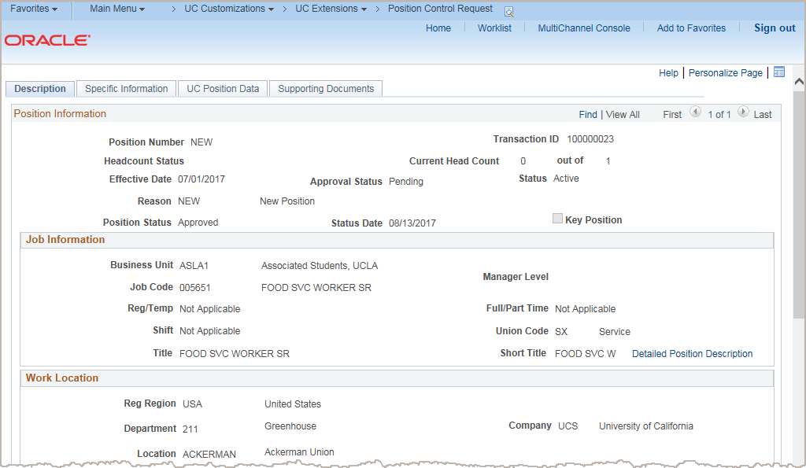
Position Control Request Page
Notes:
Once you have found the position, you’ll view it on the Position Control Request page. In this example, the position has an Approval Status of Pending. While approval is pending, the Position Number displays NEW. Upon final Location approval, the system assigns the next available nine-digit position number.

Slide 116
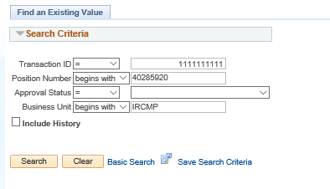
Position Control – Approval Page
Navigation: PeopleSoft Menu > UC Customizations > UC Extensions > Position Control - Approval
Use the Transaction ID number from the approval workflow engine to view status of submitted position control requests.

Slide 117

Lesson Objectives Review
Having completed this lesson, you should now be able to:
Access and view existing position control request transactions.

Slide 118
Knowledge Check
Assessment
You now have the opportunity to assess your knowledge of the information presented in this module.
The questions and answers presented in this review help you to determine whether you remember and understand the important points.

Slide 119
True or False
After you submit a Position Control Request transaction, you cannot access and review the request until final Location approval.
False: You can view the transaction by using the Review Transaction function on the Position Control Request page to access requests you have submitted.
Notes:
The correct answer is: False

Slide 120
Multiple Choice
Which Salary components are identified on the Position?
FTE & Compensation Amount
Salary Plan & Compensation Amount
Salary Plan & Salary Grade
Salary Plan, Salary Grade & Compensation Amount

Slide 121
Fill-in the Blank
When a position is filled, changes to the position can be done using _____________.
PayPath Actions

Slide 122
True or False
When an active employee has their position reclassified, they need a new position / position number.
False: They do not. The reclassification of a position that has an active incumbent is done on that same position as a PayPath Action.

Slide 123
Course Review

Slide 124
Course Objectives Review
Having completed this course, you should be able to:
Identify features of the Position Management module.
Explain the relationship between position data and job data.
View position information.
Initiate a position control request for a new position.
Initiate a position control request for updates to a vacant position.
Access and view existing position control request transactions.

Slide 125

Putting It All Together
Position Initiators use Position Control Requests to add positions or update vacant positions.
  PayPath Initiators update positions that have a single incumbent using the PayPath Actions component.
A vacant position is one that is unfilled on or after the Effective Date you enter on the Find an Existing Value page of the Position Control Request.
Because there is not an incumbent employee, there are fewer downstream effects to updating a vacant position.
Position Control Requests utilize AWE to route transactions locally for approval before writing to UCPath.

Slide 126
Course Resources

Slide 127
Positions – Action / Page matrix
Where: | Position Control Request | PayPath Actions | Position Management | Position Management
Who: | Role: Position Control Initiator | Role: PayPath Initiator | Role: Position Administrator | Role: UCPath Center WFA Production
What: | Used to request a new position. And to request an update to a vacant position. This method initiates AWE. | Used to update position data for positions that have a single incumbent. This method initiates AWE. | Used to add and update position data including multi-headcount positions. This method does not initiate AWE. | Used to add, update and correct position data. This method does not initiate AWE.
Notes:
For Position Administrators, refer to the following simulations for adding and updating positions in Position Management:
Position Administrator: Add Position
Position Administrator: Add Position – Copy from Existing Position
Position Administrator: Update Position

Slide 128
The Position Lifecycle
1.
2.
Create a Position
Associate the Position with Job and Personal Data
When hiring an employee, they are placed into an approved position.
During the hire process, the Initiator inputs additional information on the Smart HR Template, such as compensation data (comp rate, comp rate code, etc.) as well as the new employee’s personal information that complete an employee’s job record.
4.
3.
Maintain the Position
Position remains static until a change is made to the position data. At UCI, positions can be inactivated or frozen when not in use.
Update the Position
When a position change is submitted, as in the case of a job reclassification, the position and job data will be updated in UCPath.
Notes:
This diagram shows the lifecycle of a position during the hire process. Let’s walk through this position lifecycle:
The first step is to create a position. When an employee is hired, promoted, or transferred, they are placed into an authorized position.
The second step is to associate the positon with the correct job and personal data. During the hire process, the HR initator inputs that additional information, such as compensation data and the new employee’s personal data. This completes an employee’s job record.
The third step is to update the position, when necessary. When a position change is submitted, as in the case of an upward job reclassification, the position and job data will be updated in UCPath.
Finally, the position is simply maintained in UCPath. The position remains the same in UCPath even as job or personal data is changed, such as during a transfer.

Slide 129
Reference Material for Review
Links to helpful reference material:
http://www.hr.uci.edu/ - UCI HR Website
https://ap.uci.edu/ - UCI Academic Personnel Website
http://www.uclc.uci.edu/ - UC Learning Center Website
https://ucpath.uci.edu/training/index.php - UCI UCPath Training Website
List of Other Relevant UPKs:
Initiate New Position Control Request
Initiate Update Vacant Position Request
View Position Information
Enter Direct Retro Funding Update
Enter Direct Retro Funding Update – MCOP
Review Direct Retro Distribution

Slide 130

Where to Get Help
The UCPath Help site is your first level of support. Search for conceptual content, job aids or step-by-step instructions for UCPath tasks.
  From the UCPath portal homepage, expand the Help / FAQ section on the left side of the page and then click the “Location Users” link to open the site. *An Adobe PDF version is available for users with screen readers.
If you’re experiencing issues, or have questions about transactions, please contact the Employee Experience Center at (949) 825- 0500, or submit a ticket by visiting UCPath.UCI.Edu

Slide 131

Position Control Lab

Slide 132
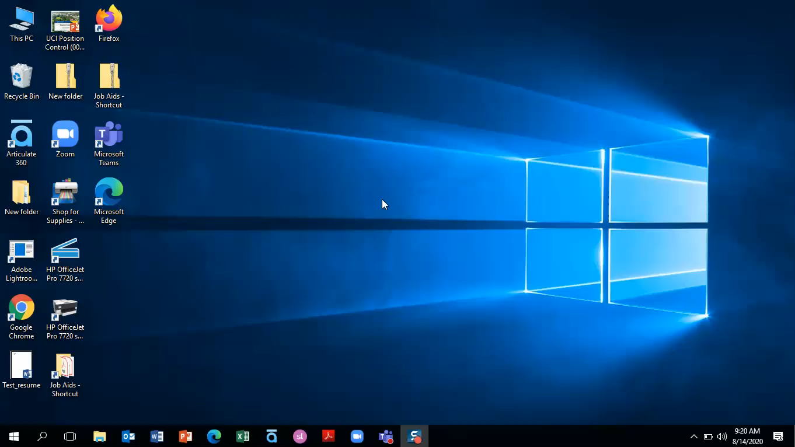
VPN Login
Username: uci_ucpathvpn_01
VPN Password: Force!Force
VPN Address: sdsc-vpn.edu

Slide 133

Exercise 1
Initiate New Position Control Request
This is your opportunity to practice this task on your own.
Complete the Initiate New Position Control Request on your latop.
Ask your instructor for assistance, if needed.
User name: IRCMP_WFAInitiator_0##
Password: ucpath2019
Notes:
Complete exercise #1 from your workbook.

Slide 134
Exercise 2
Update a Vacant Position: Change FTE or Reports – To field
This is your opportunity to practice this task on your own.
Complete a vacant position update on your computer.
Data will be provided for you to use.
Ask your instructor for assistance, if needed.
User name: IRCMP_WFAInitiator_0##
Password: ucpath2019
Notes:
Complete exercise #1 from your workbook.

Slide 135
Thank You!
Training End

