Slide 1
Welcome to
Absence Management
Extended Absence (EA)
Please locate and open the
Cisco AnyConnect VPN Client while waiting for class to start.
Notes:
Welcome to the Workforce Administration course:
This UCPath training course is designed to teach you how to interact with the UCPath system. It will focus on the concepts, terminology, and processes directly related to the system. Your UC Location may also provide additional resources to help you understand relevant business process or policy information specific to your location or role.

Slide 2
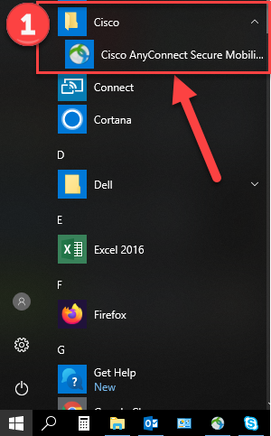
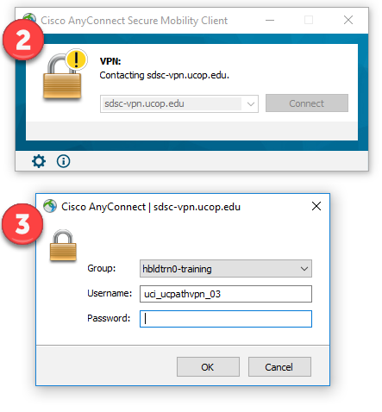
Steps to Log Into VPN
Locate and open the Cisco AnyConnect VPN client.
Enter sdsc-vpn.ucop.edu and click the Connect button.
Enter the following:
  Select Group: hbldtrn0-training
  Enter 1 of these 3 Usernames:
    uci_ucpathvpn_01
    uci_ucpathvpn_02
    uci_ucpathvpn_03
  Enter this week’s Password:
    Money|Jump
https://hbldtrn1.ucpath-build.devops.universityofcalifornia.edu

Slide 3


Introductions
Instructor
Patricia Roffe
proffe@uci.edu
UCI role
UCPath role
Years at UC
Functional experience

Slide 4
General Rules
Safety &
Housekeeping
Classroom Etiquette
Emergency evacuation procedures
Restrooms
Breaks
Please turn off cell phones
No email or web surfing
Return from breaks on time
Please use trash receptacles in the room

Slide 5
Course Agenda
Lesson
1: Request Extended Absence
3: Return from Extended Absence
2: View and Edit Extended Absence
4. View EA Transaction History
Notes:
What we’re covering

Slide 6

Course Objectives
Key Objectives:
Describe the Extended Absence system process.
Identify the fields and functionality of the three (3) Extended Absence (EA) pages.
Create new Extended Absence.
Extend and Edit Extended Absence.
Return employee from Extended Absence.
Understand the need for the Cognos Report.
Notes:
Basically, what you will need for Extended Leaves of Absence.

Slide 7
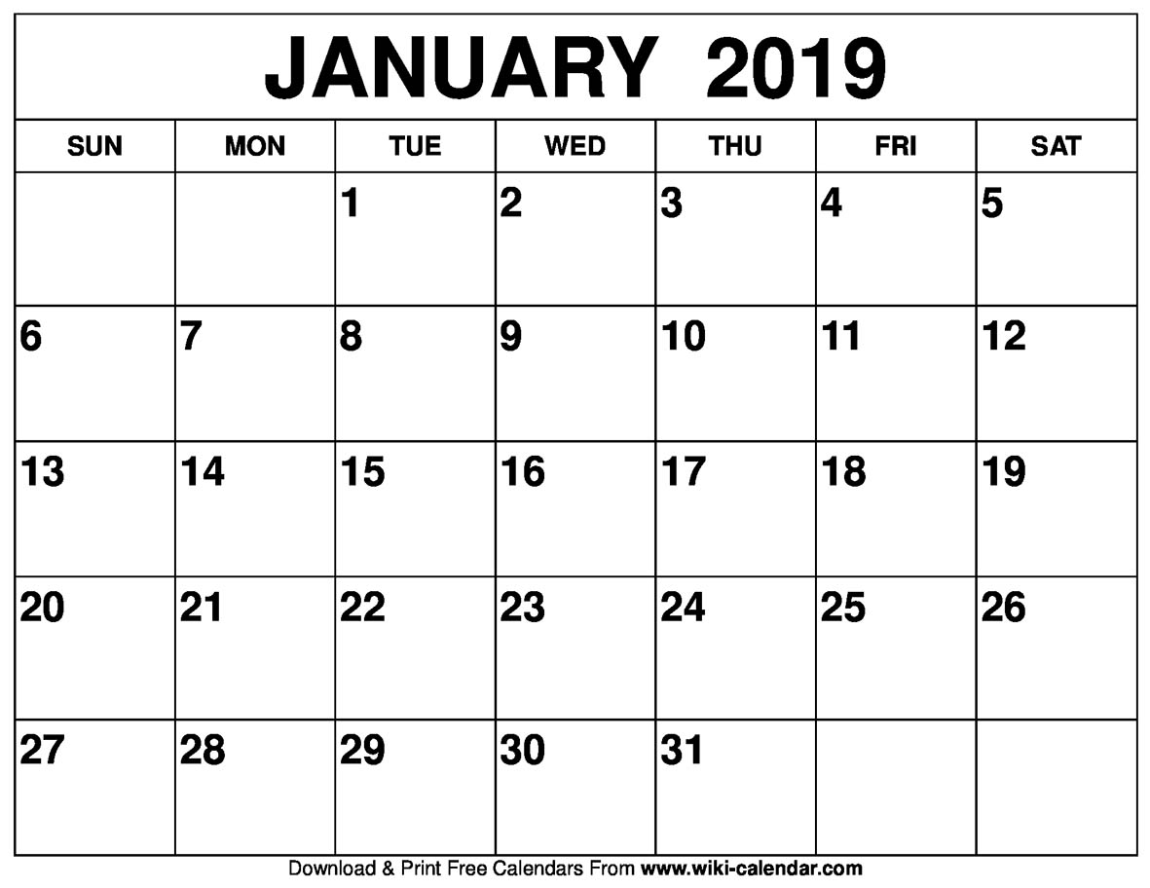
Things to Know
  Extended Absence Requests are used for leaves greater than 5 days.
  Absences less than or equal to 5 days should be entered on Timesheet (TRS)
  Extended Absence Requests are not for Sick and Vacation or Short Work Breaks
Notes:
Policy support is available from HR.

Slide 8
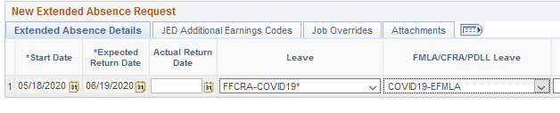

Covid 19
Here’s what we know about entering Covid 19 Extended Absences…
A Covid 19 job aid, dated 5/4/2020 is located on the UCI UCPath website.
Job Aid: The Families First Coronavirus Response Act (FFCRA or Act)12
Stay Current with Covid 19 Updates
Edit the Extended Absence Leaves completed before these leave types were released to include the leave types as needed.

Slide 9
Extended Absence Types
Leave Initiators submit extended absence requests (after 5 days) on behalf of employees.
Examples of Leave Types
EA Leave Type Examples
Medical Workers’ Compensation Sabbatical Military Leave Personal Bereavement Rehabilitation
Family and Medical Leave (FML)
Leaves under any of the following statutes: FMLA–Family and Medical Leave Act CFRA–California Family Rights Act PDLL–Pregnancy Disability Leave Law
Notes:
Some familiar examples

Slide 10
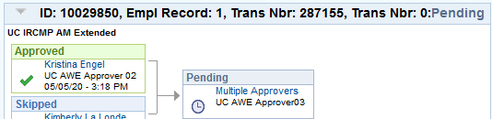
Extended Absence – Approvals
ALL submitted absence requests automatically routes to the appropriate Approvers using Approval Workflow Engine (AWE).
AWE is required for ALL transactions including:
  A new absence request
  A change to an initial/ existing absence request.
    A new line on the request.
    An edit.
#X#X#
#X#X#
#X#X#X#X#
Notes:
Animation – ALL
After submission, ALL EA transactions go to local and UCPC Approval.
To the trainer…this was something learners didn’t ‘hear’.

Slide 11
AWE – UCPC
UCPC
Receives email notification that an EA request needs review and approval.
Reviews the absence request.
  If approved, enters the leave into Job Data
  If leave is incorrect or invalid, they will Pushback or Deny
Notes:
Lastly, UCPath enters any appropriate data on the Job Data page.

Slide 12
Extended Absence – Overview
Extended Absence Process Responsibilities:
Employee
UCPath Center
Works with their leave administrator to create or update a leave.
Location Approver
Reviews and processes all EA requests submitted by the location.
Push Back/ Deny/ Cancel EA Requests.
Manually enter EA Requests in Job Data to ensure the Pay status is updated appropriately and timely.
Approver approves the EA request for further processing.
Runs local reports to monitor employees on leaves.
Leave Administrator
Submits an EA Request in UCPath.
Extend/Update the EA Request.
Returns employee from Extended Absence.
Notes:
High level overview
The location – UCI – uses an initiator and an approver.
UCPC approves and edits Job Data.

Slide 13
Terminology and Definitions
Term | Definition
Absence Management (AM) | A module in UCPath that UC Leave Administrators used to plan and manage absence events (including extended leaves) and to calculate vacation and sick time. AM is UC’s single system of record for all paid time off.
Absence Takes | The number of units (hours) an employee takes in association with an absence.
Approval Workflow Engine (AWE) | A component of UCPath that is used to approve transactions, etc.
Extended Absence (EA) Request | Transaction Request to place employee on a Paid/Unpaid Leave of Absence. It has several tabs to capture additional information for different types of leaves.
Job Data | Module in which employee’s job records are stored. Job Data changes are entered in PayPath by an initiator.
Leave with Pay | Job Data –is entered by UCPC, payroll status is edited to Paid Leave of Absence. The employee continuesThe number of units (hours) an employee takes in association with an absence. to get paid and maintain existing benefits.
Leave without Pay | Job Data –is entered by UCPC, payroll status is edited to Unpaid Leave of Absence. The employee does not get paid and may elect to not receive benefits or to pay for selected benefits through applicable monthly premiums via the Direct Billing process.
Intermittent Leave/ Reduced Schedule | Job Data - Leaves submitted with this option are not entered into Job Data. Leave with or without pay must be recorded using Manage Accruals.
Return from Leave (RFL) | Job Data – is entered by UCPC, payroll status is edited to Active. The actual return date is entered on the initial EA Transaction. Benefits billing is assessed and employee’s previous benefits are restored.
Short Work Break (SWB) | This action can be used to stop an Employee’s pay for a temporary period, but allows the employee to remain on an active status.
Absence Takes
The number of units (hours) an employee takes in association with an absence.
Job Data
Module in which employee’s job records are stored.
Job Data changes are entered in PayPath by an initiator.
Notes:
Absence Takes are in hours.

Slide 14


Extended Absence – Process
Enter leave of absence request
Approve, Push back, Deny, request
Approve or deny request
Update employee’s Job Data
Preliminary Actions
Location
Leave Initiator
Location
Leave Initiator
Location
Approver
WFA Production
Approver
WFA Production
Approver
AWE
AWE
Push Back
Deny
Notes:
Note: UCI has two levels of AWE approval: one Approver at the Location and one Approver at UCPC WFA Production.
Location Leave Initiator
Caution: gather pre-approval documents
Reviews Benefits Summary information with employee if the employee informs the Location of the extended absence prior to the beginning of the leave. This is especially important for unpaid leaves of absence.
Location Leave Approver
Reviews the EA information. Approves or denies the request. Can also make edits as needed
UCPC WFA Production Approver
Reviews the EA information. Can approve, deny or push back.
If the request is approved, UCPC WFA Production enters the EA information into the employee’s Job Data.
If there are any issues with the request, UCPC WFA Production does not update the employee’s Job Data and has the option to deny the request or push the request back to the previous Approver for edit.

Slide 15
EA Pages - Navigation
Navigation: PeopleSoft Menu > Global Payroll & Absence Mgmt > Payee Data > Maintain Absences > UC Customizations……………
There are three (3) pages associated with Extended Absences.
As they appear in the navigation:
  Administer Absence Request – Edit Initial Request
  Extended Absence Trans[action] History – View empl’s req’s history
  Request Extended Absence Page – Enter Initial Request/Add new row
As you will probably use them!
2.
3.
1.
Note: Your access and what is displayed is based on your security.
Notes:
Animation
To trainer: explaining the order will help eliminate confusion of the navigation.

Slide 16
LESSON 1
Request Extended Absence

Slide 17

Lesson Objectives
In this lesson we will:
Describe the Request Leave of Absence system process.
Review preliminary information
Identify the fields and functionality of the Request Extended Absence page.
Submit various types of leave.
2: View and Edit Extended Absence
4: View EA Transaction History
3: Return from Extended Absence
1: Request Extended Absence
Notes:
The Leave of Absence Request submission starts the process.

Slide 18
Request Extended Absence Page
Navigation: PeopleSoft Menu > Global Payroll & Absence Mgmt > Payee Data > Maintain Absences > UC Customizations > Request Extended Absence
Notes:
Continuing with navigation explanation and components.

Slide 19
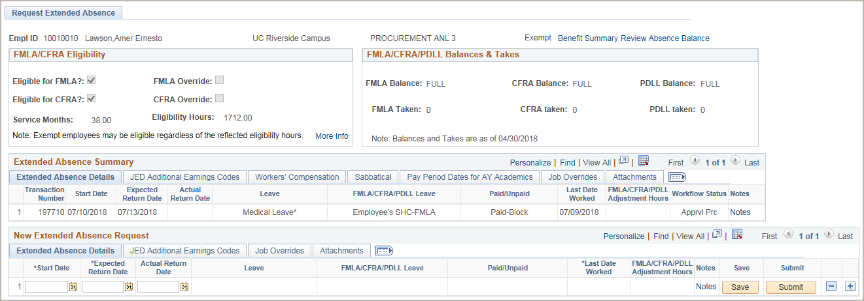


Preliminary Actions
Initiate the EA Request
Preliminary actions and information
Contact your HR as soon as you know about a EA.
Notes:
Animation – 2 clicks
Before entering the EA, there is preliminary work to do.
This is the Request Extended Absence page.
Note there are links to other pages you will use in completing the request.
Employee/ initiator remain responsible for any leave counseling and pre-approval for extended absence.

Slide 20
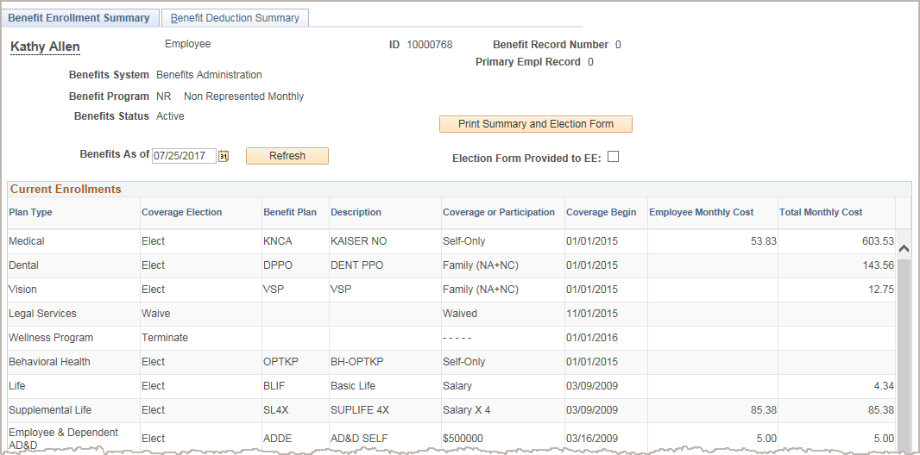

Preliminary Actions (con’t)
Navigation: PeopleSoft Menu > Benefits > Review Employee Benefits > Benefits Summary
Click the Print Summary and Election Form button.
Give the forms to the employee.
Click the Election Form Provided to EE check box after giving them to the employee.
The Benefits As of date must be a prior month in order to populate the summary page with costs.
Change the date, if necessary, then click Refresh.
Notes:
Animation – 1 click
Initiators prints the forms and gives them to the employee.
Two ways to access this page: Use the navigation indicated in this slide or use the link provided within the Request Extended Absence page (shown above).
If employee does not return the Election Form, they continue enrollments in their current elections and will be billed by UCPC for all of the enrollment plans.
If the employee returns the Election Form, UCPC updates their benefits and bills for elected benefits.
If all benefits are cancelled, employee does not receive statements.
Completed forms can be submitted on the UCPath site, via fax or via mail.
Note: The UC continues to pay the employer portion for Health, Vision and Dental during any FML leave (Paid or Unpaid).

Slide 21
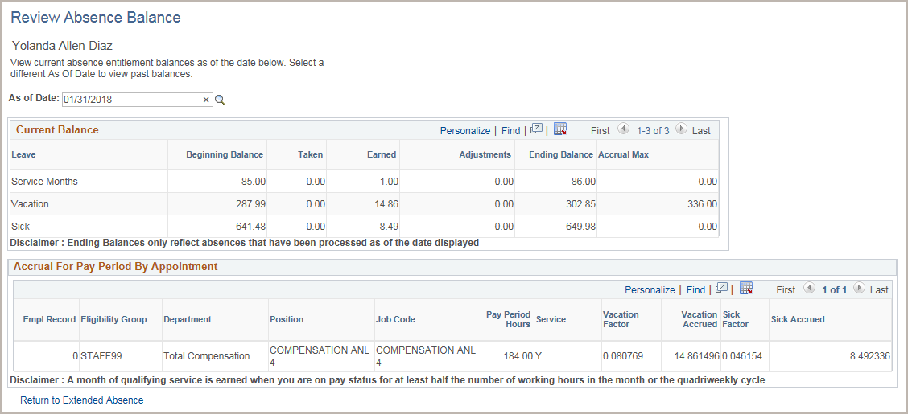

Preliminary Actions (con’t)
Click the Review Absence Balance link to review the employee’s absence balances for all current assignments.
Click to return to Request Extended Absence page.
Notes:
Animation –
The next link from the Request page..
You can review the employee’s current leave balances on the Review Absence Balance page. This includes Sabbatical credits.
The As of Date defaults to the most recent payroll end date.
For monthly employees the takes processed in the current pay cycle are from the previous calendar month and appear for the previous As of Date on this page.
The Current Balance section displays current balance details for the leave types associated with the employee.
The Accrual for Pay Period By Appointment section displays leave details by job assignment. If the employee has multiple jobs, the page displays multiple rows – one for each job.
Accruals
Bi-weekly accrue on a quadri-weekly basis.
Monthly accrue on a monthly basis.
Balances are updated every pay period with takes.

Slide 22
EA Page Layout
The FMLA/CFRA Eligibility section provides details on FMLA/CFRA eligibility.
The FMLA/CFRA/PDLL Balances & Takes section provides details on balances and usage (takes).
1 Review
2 Review
3 Enter
The Extended Absence Summary section provides a history of leaves taken.
The New Extended Absence Request section allows you to initiate one or more extended absence requests.
Notes:
Animation.
The sections of the page…emphasize that the entry is mostly on the bottom.
1st FMLA – At conversion, FMLA/CFRA balances will be ZER0 for all employees. Employees taking FLMA or CFRA will require an override. More later
2nd – Summary History –two years
3rd – The request portion
The next few slides review the tabs, fields and hyperlinks in more detail.

Slide 23
Entry Fields
Use the New Extended Absence Request section to enter an initial absence request for an employee.
  Each row is a separate absence or consecutive request.
  Accurate entry of these fields is important. They may affect the employee’s pay, accruals, balances, and so on.
  Correct leave types ensure that Benefits are billed accurately from UCPath Center.
Notes:
The NEW [Current] EA Request…where you enter details.
Stress accuracy!

Slide 24
Field Details - Dates
Start Date: Date the employee begins leave*. This date becomes the effective date of the leave in Job Data.
Expected Return Date: Date the employee is expected to return to work.
Actual Return Date: Leave blank for the initial absence request. This field is completed after the employee returns to work.
*Start of leave is the start of their next work day/shift (ie. LDW Friday, Start day Mon if EE works M-F)
Notes:
Animation
The Start Date, Expected Return Date, and Actual Return Dates are considered service dates and reflect the actual leave dates.
If the employee is Academic Year (AY) Academic, then a new tab appears for you to enter the employee’s service dates. This topic is discussed later in this training.
UCPath said that this is a common mistake. Don’t add the Actual Return Date on the Request until employee returns.

Slide 25
Field Details - Leave Type
If there are any questions:
Leave Types and FMLA-type codes are provided by HR and AP.
    Staff: Contact Department or Campus HR office.
    Academic: Contact Academic Personnel (AP) Office.
Job Aid is available for Leave Type Descriptions in UPKs
Notes:
Contact HR as part of the preliminary actions for the EA.
Do not select leave types and FMLA data w/o their approval.

Slide 26
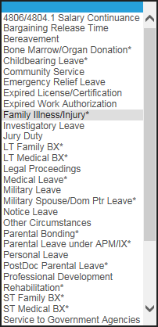
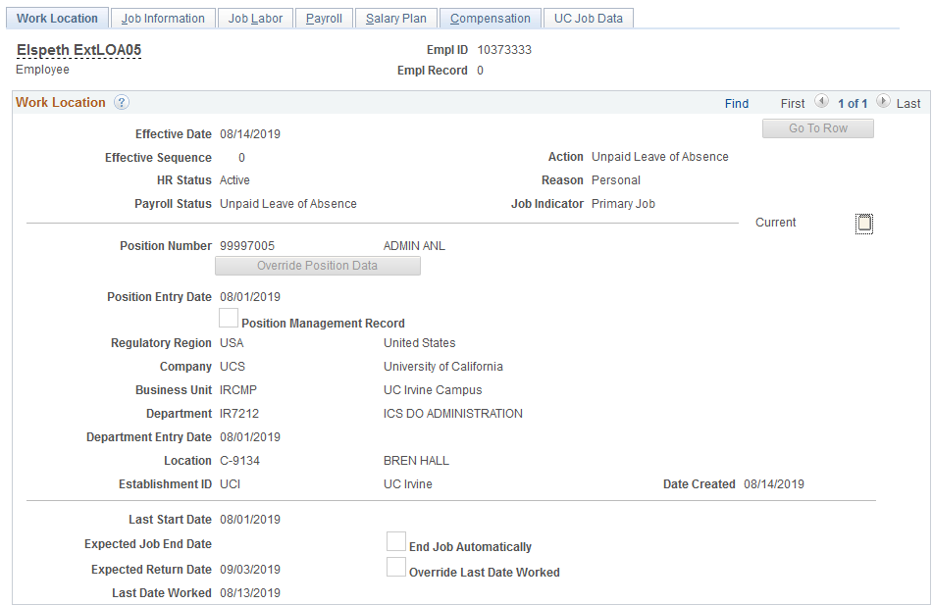
Field Details – Leave Type (Cont)
The Leave field displays after the dates are entered.
Leave is necessary for the EA Request.
Select the type of leave given to you by HR.
The Leave options that appear in the list are dependent on the Eligibility Group assigned to the employee.
Job Data Entry
*
Notes:
Note the leave options. The list depends upon the employee’s eligibility group.
(Mention this again.) Contact HR Benefits to select leave type and FMLA. This applies to all initiators. Some selections can have minor differences in the title, but big implications.

Slide 27
Field Details – Leave Type (Cont)
*
Remember, the Leave field is necessary for the EA Request.
If an * is next to the Leave Type, then it may be necessary to select a value from the drop-down in the FMLA/CFRA/PDLL Leave field. The data for these fields is provided by HR.
  Accurate entry of these fields is important. They may affect the employee’s pay, accruals, balances, and so on.
Notes:
Leave values with an * may require an FMLA/CFRA/PDLL Leave.

Slide 28
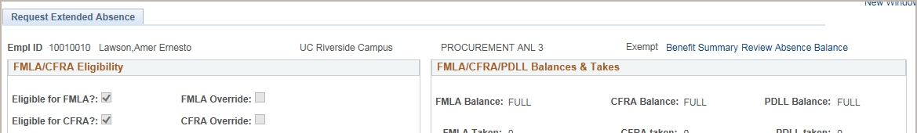
Field Details - FMLA/CFRA/PDLL
Eligible for FMLA? Eligible for CFRA? | Check box is automatically selected if employee meets eligibility for FMLA/CFRA.
FMLA Override CFRA Override | When it is determined that an employee must go on an FMLA leave, but the employee is not eligible for a FMLA leave, or doesn’t have any FMLA hours available to take, the FMLA or CFRA Override Box needs to be checked and FMLA/CFRA selected on the request line.
Service Months | Displays current service months. Must have 12 months of service to meet eligibility.
Eligibility Hours | Displays rolling hours during 12 months for FMLA/CFRA eligibility.
FMLA/CFRA/PDLL Balances | Displays FMLA/CFRA/PDLL balances.
FMLA/CFRA/PDLL Taken | Displays FMLA/CFRA/PDLL usage.
Use only if FMLA eligibility is wrong, or told to do so by HR.
Notes:
Animation
To meet eligibility the employee must have 12 months of cumulative UC service and have worked at least 1250 hours in the 12 months immediately preceding the leave.
After implementation, some examples of when you may need to use the override:
Employee met the hours requirement after the last system update.
Exempt employees who routinely work hours over their appointment percentage.
Employee worked at another UC location and the information has not yet been captured in UCPath.

Slide 29
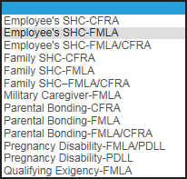
Field Details - FMLA/CFRA/PDLL (Cont)
Select the option from the FMLA/CFRA/PDLL Leave list given to you by HR.
*
The FMLA/CFRA/PDLL field is needed only when the EA is specific to FMLA, CFRA or PDLL. SHC = Serious Health Condition.
You MUST use a Leave type when using the FMLA/CFRA/PDLL Leave field.
Use a single row when using both.
Notes:
Another list of options display. Note that the Leave-type and FMLA selections are on the same line.

Slide 30

Field Details - Paid/Unpaid
The following options are available for the Paid/Unpaid field, which identifies whether the leave is paid or unpaid.
Paid/Unpaid Options | Description
Intermittent/ Reduced Schedule | Paid or unpaid EA for an intermittent date range or at a reduced work schedule. For example, an employee uses medical leave for physical therapy twice a month. Leave with or without pay must be recorded using Manage Accruals. Leaves submitted with this option are not entered into Job Data.
Paid-Block | Paid EA for the specified date range.
Unpaid-Block | Unpaid EA for the specified date range.
Notes:
Some employees take EAs with part being PAID and part being UNPAID.
Note: Intermittent/Reduced Schedule are not entered into Job Data

Slide 31
Field Details - Last Date Worked
Last Date Worked is a required field.
  Last date the employee was physically at work. Holidays are accounted for in TRS.
  This field is used to complete the UC Statements to the Disability Vendor.
  Start Date should be the employee’s next normal work day/shift (ie. LDW Friday, Start day Mon if EE works M-F)
  AFTER Last Day Worked!
Notes:
For example, if a person is paid hourly and they became sick or injured during their workday, they could have a Last Date Worked the same date as the Start Date.
Ignore holidays, which are accounted for in TRS. What was the last day worked?

Slide 32

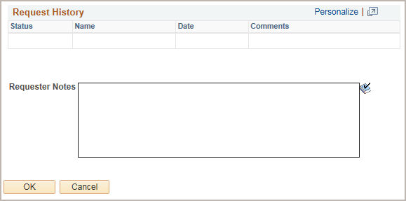
Field Details - Notes
Notes are required.
Notes are the only way to record the history of actions taken on a request.
The Notes link is visible only when on the Extended Absence Details tab.
A note about notes.
“Mrs. Hart! You need to sign this HIPAA privacy form before the doctor can look at those warts on your stomach!”
Notes:
Animation - Absence requests are NOT Effective Dated. It’s important to explain any details of the absence request using the Notes field.
Notes are saved along with the date of the absence request and the name of the person who entered the notes. Each time an edit is entered and a new note is added, the note is stacked on top of the previous notes.
Click for animation; – A bit about notes…Don’t get too personal (HIPAA?) but make it meaningful. It is good to think about this for all notes you enter in UCPath.

Slide 33
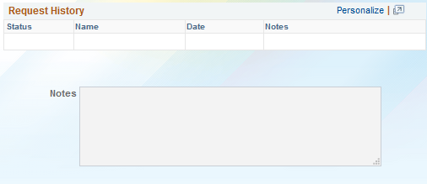

Field Details – Notes (con’t)
Edit EA Transaction 12345: 10/01/2019-10/22/2019 Paid Leave/ Parental Bonding. Leave is no longer paid. Change – ‘Paid/Unpaid’ field to Unpaid
Edit the initial extended absence request and update the Paid/Unpaid field from Paid to Unpaid
(an okay note)
(a better note)
Notes are used by UCPC:
To understand the request.
For guidance in selecting entries on the employee’s Job Data.
Notes:
Animation - 2 clicks
Not a good note. A better note.
Notes will help UCPC enter the right leave-type in Job Data.
The leave list in EA is not the same as the list available in Job Data

Slide 34
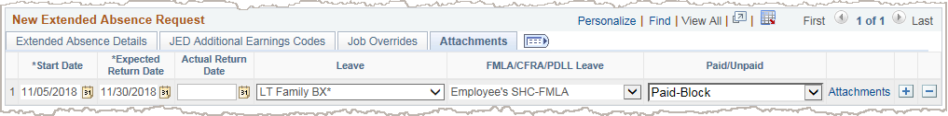
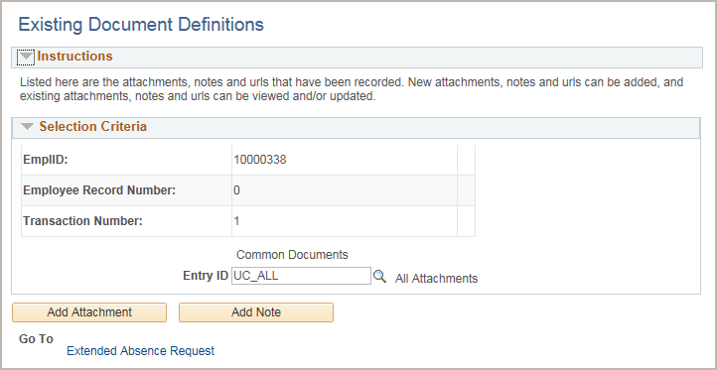
Field Details - Attachments
Expand tabs
The Attachments tab displays the Attachments link. Click the link to upload EA attachments.
Add the attachment to the appropriate folder.
  Attachments may include confidential documents, such as an FML certification.
Best Practices – scan when the documents are physically first received
Note: Use this sequence.
Save
Add attachments
Submit on EA Details Tab.
Notes:
Recommended / required process for adding attachments:
Scan documents as you get them.
Complete absence request entry.
Click Save.
Add attachments.
Click Submit.

Slide 35

Extended Absence – Job Data
EA fields which UCPC updates on the employee’s Job Record appear on Job Data .
Workforce Administration>Job Information>Job Data
Use the Work Location Tab to view the following
Leave Dates
Leave type and/or FMLA/CFRA/PDLL Leave
Paid/Unpaid
Notes:
Job Data is an important part of the EA process, completed by UCPC.

Slide 36


Extended Absence – Job Data (con’t)
The UCPath Center (UCPC) WFA Production:
  Reviews and enters request information in Job Data.
  Records on all employee’s active Empl Records (Multiple jobs) in all Business Units unless otherwise indicated in the request.
Job Data Page
Notes:
Animation- 3 clicks
What they look like in Job Data.
Initially the information on Job Data is created by UCPath Center using HR Template.

Slide 37

Exercise 1
Submit Medical EA Request
This is your opportunity to practice this task on your own.
Create a new leave request for a person on:
FMLA Medical Leave for SHC Aug 12, returning Oct 16
Ask your instructor for assistance.
https://hbldtrn1.ucpath-build.devops.universityofcalifornia.edu

Slide 38
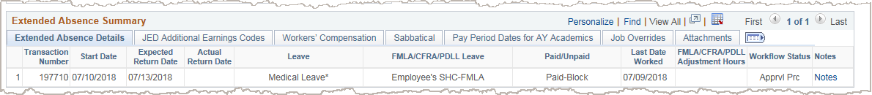
Extended Absence Summary
This section displays two years of leave history submitted for the employee.
Click the View All link to display all leave history.
Select the tabs to view additional leave information.
Note: The requests submitted from the exercises are displayed in the summary.
Notes:
When the EA request is submitted it is viewed in the EA Summary section. This section is view only.

Slide 39
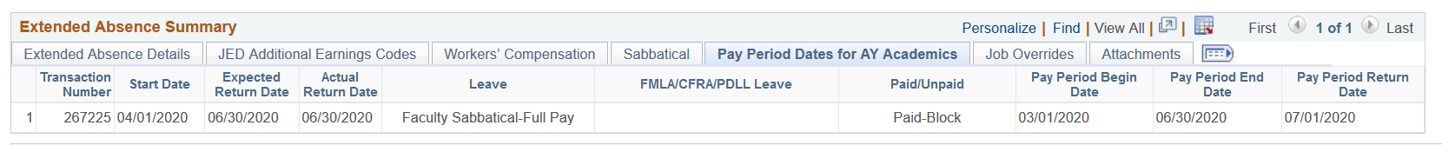
Extended Absence Request – Other Tabs & Data
JED
Sabbaticals
Job Overrides
Workers’ Compensations
Pay Period Dates for AY Academics
FMLA/CFRA/PDLL Adjustment Hours
Notes:
There is other information required on the EA request, depending upon…
leave-type
type of employee

Slide 40
Dynamic Fields
FMLA/CFRA/PDLL hours are auto-calculated using:
TSR for Paid EA
Normal hours for Unpaid EA
BUT …
For employees with alternative schedules, you can manually provide FMLA/CFRA/PDLL usage hours for the entire leave period using the FMLA/CFRA/PDLL Adjustment Hours field.
  If manual hours are provided, UCPath system does not automatically calculate FMLA/CFRA/PDLL hours and deduct from balance.
  UCPC updates the balance.
Notes:
The FMLA/CFRA/PDLL Adjustment Hours field becomes available for the Unpaid-Block option. Entries in this field override whatever is submitted for the auto-calc value for unpaid.

Slide 41
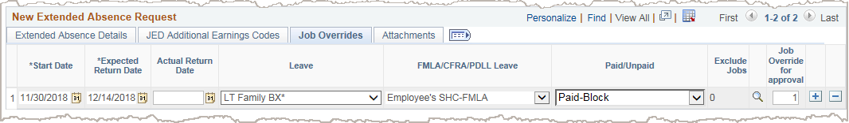
Job Overrides Tab – Exclude Jobs
The Job Overrides tab displays two fields: Exclude Jobs and Job Override for approval.
The absence request applies to all of the employee’s jobs across all Business Units…UNLESS…
User enters the Empl Record(s) of the job(s) to exclude in the Exclude Jobs field.
Use a comma to exclude one or more of the jobs; such as 0,2 in the Exclude Job field.
The Lookup button for the Exclude Jobs field displays only if the employee has more than one job.
Notes:
Click and complete the Job Override tab only when a job is being excluded from the leave.

Slide 42
Job Overrides Tab – Job Override/approval
Job Override for approval field:
Defaults to the Empl Record number of the primary job.
The Empl Record number can be changed.

Slide 43

BREAK TIME
Break

Slide 44
Academic Personnel Tabs and Dynamic Fields
    The Office of Academic Personnel’s website [ap.uci.edu] has information on:
      Policies and Procedures
      Service and Pay Period dates
        Depends on Pay Freq AY9/12 or 12/12 (Job Aid > Comp)
The following academic section applies to only AY Faculty.
      To find out a faculty member’s Eligibility Group:
        Go to Job Data, the Payroll Tab
        Absence Management System
        Look for
If a Senate Faculty member does not have the Eligibility Group of ACAYSABB, fill out the Job Data and Position forms to change Union Code to A9 and Elig Grp to ACAYSABB and open a UCPC Case.
Eligibility Group ACAYSABB Academic AY Faculty Sabbatical

Slide 45
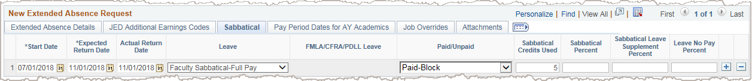
Dynamic Tabs - Academic Year (AY)
If an academic year (AY) academic employee is selected, the Pay Period Dates for AY Academics tab displays for all EAs.
If a sabbatical Leave type is selected, the Sabbatical tab displays.
These tabs display if the employee’s
Eligibility Group is ACAYSABB.
Contact the AP group or go to ap.uci.edu for more information.

Slide 46
Dynamic Tabs – Dates for AY Academics
Service Dates
Enter appropriate service dates in:
Start Date
Example: Qtr Begin Date
Expected Return Date
Example: Qtr End Date + 1 day
Actual Return Date
Same as Expected Return Date
Note: Enter prior to return ONLY for sabbaticals.
Pay Periods
Complete tab for ALL AY EA.
Pay Period Begin Date
Beginning of Pay Period when leave begins
Effective Date of the leave in Job Data
Pay Period End Date
End of Pay Period when leave ends
Expected Return Date in Job Data
Pay Period Return Date
Pay Period End Date (when the employee returns to work) + 1 day
Enter ONLY for a Sabbatical Leave
Contact the AP group or go to ap.uci.edu
for leaves that occur in the middle of a Pay Period, for more information.
Notes:
Important - The last bullet under Pay Periods is a change 9.2020. Do Not enter Pay Period Return Date unless the leave is a Sabbatical.

Slide 47
Dynamic Tabs - Sabbatical
Intermittent
Unpaid
If a sabbatical Leave type is selected, the Sabbatical tab appears.
Sabbatical Credits Used: Entered as a positive number. (Review on Absence Balance page) After the leave is approved, credits are populated in Manage Accruals.
Sabbatical Percent: Percent of sabbatical leave.
Sabbatical Leave Supplement Percent: Dean’s Supplement (subject to Location approval).
Leave No Pay Percent: The percent of the leave with no pay.
Do Not enter earn codes in the JED Additional Earning Codes tab for partial sabbatical absence requests.
AP Support
Notes:
Animation
There are no intermittent or unpaid sabbaticals!
For sabbatical adjustments, a row is inserted in the Manage Accruals page upon approval of the transaction
and Locations can see those adjusted hours on Manage Accruals page.
There are NO Academic leaves such as Sabbatical or Partial Sabbatical as intermittent or unpaid leaves. The JED percentages should be entered in the leave request to include the percent of leave no pay or supplements.
AP Support is available to help with what to enter.

Slide 48
JED – Additional Earning Codes Tab
  Do not include Job Earnings Distribution for FML/ CFRA/ PDLL type leaves for non-academic jobs.
Use the JED – Additional Earnings Codes tab for:
  Some Military leaves
  Some Academic Medical
  Partial Academic Leaves without pay excluding Sabbatical
    For sabbatical, use Sabbatical Tab
Notes:
Per the organization alignment…Location should not include Job Earnings Distribution for FML/ CFRA/ PDLL type leaves for non-academic appointees.
Note the limited number of applicable employees that JED applies to.
Job Earnings is used for some Academic Medical leaves, as well as Sabbatical, Workers Comp and Military Leaves.

Slide 49
JED – Additional Earning Codes (cont’d)
Job Earnings Distribution must match how compensation is setup in Job Data.
Earnings Codes added to the Absence Request must be edited on the Absence Request.
Enter the Job Earnings Distribution for the employee when needed – this provides direction for UCPC when updating employee record.
The sum of each earnings codes percentages must equal 100%.

Slide 50
Exercise 2
Submit Sabbatical Leave of Absence Request
This is your opportunity to practice this task on your own.
Create an initial leave request for an AY/FY academic on sabbatical according to the details on the workbook.
Ask your instructor for assistance.
Academic Personal Resources
AP website
AP email
UPK Sabbatical
UPK Partial Sabbatical
Job Aid Partial Sabbatical
Notes:
For UPK simulation-based exercises, instruct the users to open the Try It view and complete the task.

Slide 51
Dynamic Tabs - Workers’ Compensation
The Workers’ Compensation Leave is entered by UCI Central HR.
Note: The WC Election Form needs to be provided to employee and returned to UCI Central HR prior to processing.
When an employee notifies the department of a Workers’ Compensation leave, contact Central HR.
Central HR will work with UCPC to complete.
Notes:
HR and/or UCPC will complete Workers’ Compensation EAs.

Slide 52
Add and Delete Rows
Click the add-a-row button to insert a new absence request ROW.
  Different absence with immediately preceding working days.
  Same absence (consecutive) with details/edits which require a new row.
  No Concurrent absences allowed. (1 request for both parents sick).
  Click the delete-a-row button to remove a absence request row.
  You cannot delete a row after it has been submitted for approval.
The add/delete row buttons are only available from the Request Extended Absence page.
  If you access a request from the Administer Extended Absence page, the add/delete row buttons are not available.
Notes:
Further explanations on entering multiple request rows is covered a bit later.

Slide 53
Lesson Objectives Review
Having completed this lesson, you should be able to:
Describe the Request Leave of Absence system process.
Find and send preliminary information.
Identify the fields, tabs and functionality of the Request Extended Absence page.
Understand and submit the various types of leave.

Slide 54
LESSON 2
Administer EA page -
View & Edit Leave of Absence

Slide 55
Lesson Objectives
In this lesson we will:
Identify the fields and functionality of the Administer Extended Absence page.
View leave of absence requests.
List the key system steps to edit a leave of absence.
Extend leave of absence.
Edit leave of absence request.
Cancel leave of absence request.
2: View and Edit Extended Absence
4: View EA Transaction History
3: Return from Extended Absence
1: Request Extended Absence
Notes:
The Leave of Absence Request submission starts the process.

Slide 56
Administer EA – Overview
The Administer Extended Absence page is used by Initiators and Approvers to edit existing Absence Request.
Search for EA’s using various search criteria, such as status, leave type or employee ID.
View the details of existing EA requests.
Edit a EA request
  Change existing fields on an existing line. (type over)
  Add a new row to create a sequential and different action.
  Cancel an EA request
Notes:
Edits and cancels for a leave are initiated from this page.

Slide 57
The Language of Edit EA
New Request
Initial Request
New [Request] Row = needed for Edit
The first time a EA request is created
Notes:
It’s important to use the right/same terminology to avoid confusion between a New Request and a New Request ROW.

Slide 58
Administer Extended Absence
Navigation: PeopleSoft Menu > Global Payroll & Absence Mgmt > Payee Data > Maintain Absences > UC Customizations > Administer Extended Absence

Slide 59
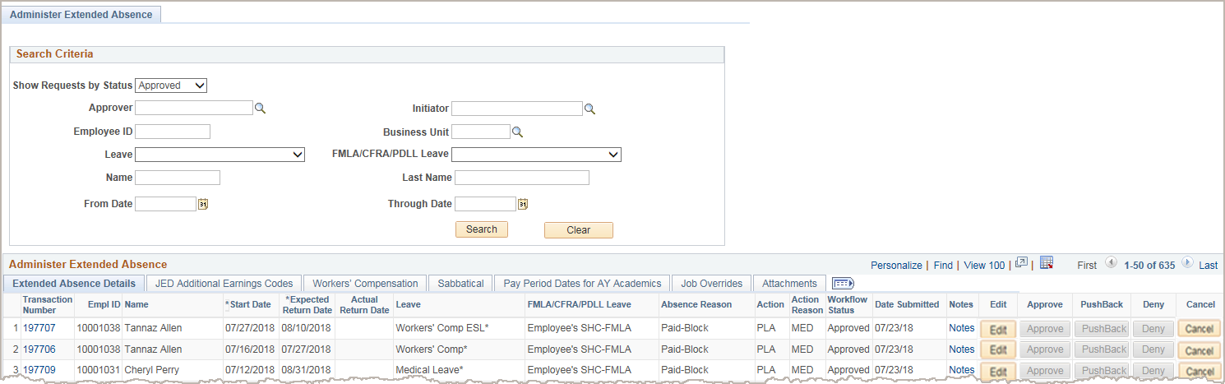
Administer Extended Absence
Navigation: PeopleSoft Menu > Global Payroll & Absence Mgmt > Payee Data > Maintain Absences > UC Customizations > Administer Extended Absence
Information for employees for whom you have security (row-level security).
Enter Search Criteria,
click Search, and
view results in the Administer Extended Absence section.
Job Data
AWE
Use the tabs to view specific information for each EA row.
Notes:
Animation for yellow box information.

Slide 60
Administer Initial Request
Locate the initial request using the Administer Extended Absence page.
Only requests with a status of Submitted and Approved can be edited from the Administer Extended Absence page.
Click Edit to open the absence request details page.
Saved (Saved for Later) requests must be accessed from the Request Extended Absence page.
Notes:
Animation – 3 clicks
Click the edit button to Edit.

Slide 61
Edit Leave of Absence – Key Steps
Click Edit
Enter a Note about the edit
Click Submit
Display existing absence request
Make absence request
Edit(s)
Notes:
You need to understand the ways to make edits so you can decide which one to choose.

Slide 62
Administer Request Keys
The initial request is new…using Request Extended Absence.
ANY change to the initial (existing) request is EDIT…starting with Administer Extended Absence.
Administer = EDIT
There are two (2) ways to Edit…
  Type over/add
  Add a new request row to the existing request
Notes:
Using the right language, the 2 ways to edit an EA become clearer.

Slide 63
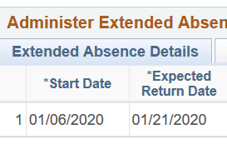
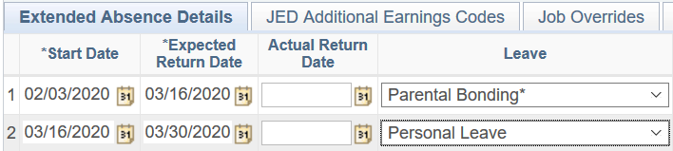

Administer Request Keys (con’t)
Type Over/Add
Changes on the same row
Stay on Administer page
Add a New Request Row
Add subsequent rows
Switch to Request Extended Absence
➠
1/28/2020
Notes:
Location Leave Initiator
Access the existing approved leave of absence using the Administer Extended Absence page.
Edit the request by typing over the existing data, enter a note and submit the edited request.
The updated request routes for approval.
Or
Access the existing approved leave of absence using the Administer Extended Absence page.
Click edit
Add a new request ROW if changing leave type or moving a portion of the EA from Paid to Unpaid or Unpaid to Paid.
Ensure the Start Date of the new absence request matches the Expected Return Date of the existing absence request. (You may need to edit the Expected Return Date of the existing absence request.)
Enter a note and submit for approval.
The updated request routes for approval.

Slide 64
Administer Request Keys (con’t)
Type Over/Add
Extend
Change same leave type to un/paid
Add note
Add tab info
Return from EA
Workers’ Comp to Medical
Add a New Request Row
Immediate sequential action
Start Date = Exp. Date of Return
Change of Un/Paid for ‘portion’
Change of Leave Type - except WC to Medical
➠
1/28/2020
ACTIONS
Notes:
How/where to make Edit actions.

Slide 65
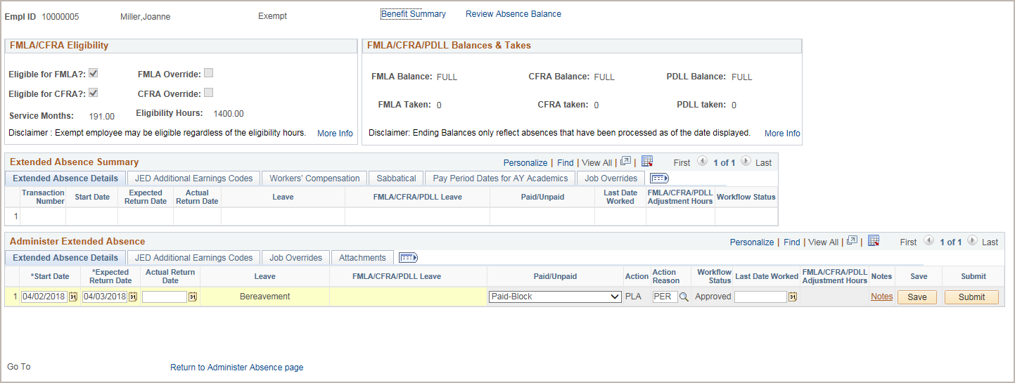
Extend Return Date
  To extend an existing EA (no change in leave type), edit the request and submit.
Click Submit to send the edited request for approval.
Enter a detailed note describing the action taken. This is the only way the Approvers know what was edited.
Type over with the new Expected Return Date.
Notes:
Animation
Extend an EA by typing over the Expected Return Date.

Slide 66
Edit Absence Request New vs. Edit
When entering a new absence request ROW:
Expected Return Date of the initial absence request
EQUALS
Start Date of the new request row.
Notes:
A new request ROW start-date MUST equal the existing request expected-end date.

Slide 67
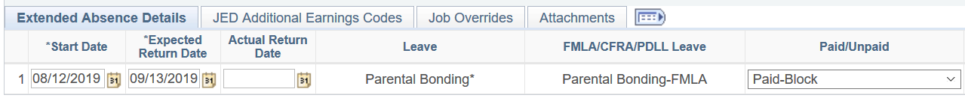
Absence Request New vs. Edit (Cont.)
Paid to Unpaid or Unpaid to Paid Scenario A
An employee takes a 5 week PAID parental bonding leave. [Assuming he has enough in his leave balances…]
The Initiator entered a EA request with all 5 weeks as PAID.
One week later he changes his mind and decides to take his entire 5 weeks as UNPAID parental bonding leave.
ACTION: Edit the initial extended absence request and update the reason from Paid to Unpaid and indicate in the notes the leave type is updated and job data will be corrected.
NOTE: Entire leave is no longer paid and will now be unpaid, edit EA Transaction 12345, 08/12/2019-9/13/2019 update leave to Unpaid/ Parental Bonding.
Select on the existing line
Unpaid-Block

Notes:
Animation
The best way to show the various ways to Edit is to go through Scenarios.
This scenario is a type-over Edit.
The field is available to edit

Slide 68
Absence Request New vs. Edit (Cont.)
Paid to Unpaid or Unpaid to Paid Scenario B
An employee takes a 5 week PAID parental bonding leave.
The Initiator entered a EA request with all 5 weeks as PAID.
One week later he discovers he doesn’t have enough paid leave available. He still wants to take the full 5 weeks, but the last week will have to be UNPAID parental bonding leave.
ACTION: 2 STEPS are needed
Edit expected return date on the paid leave to match start date of unpaid leave (Type over - Administer EA)
Create a new request for the last week as unpaid leave. (New line-Request EA)
Notes:
2 steps are required- there are changes within the time period of the leave

Slide 69
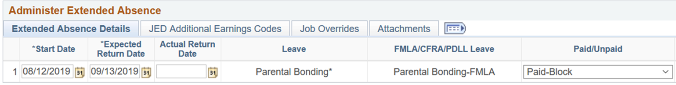

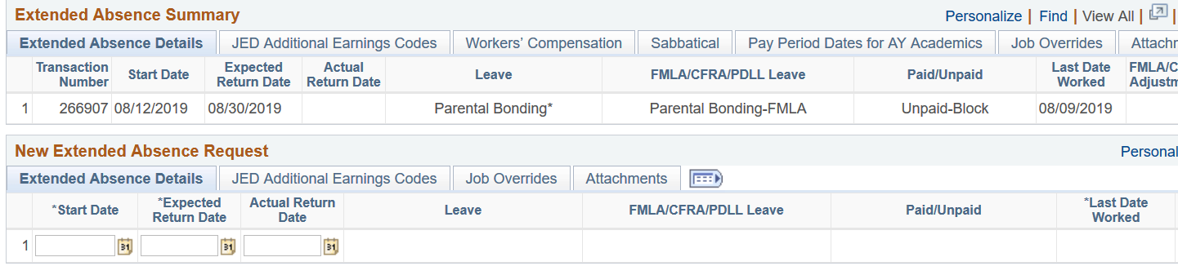
Paid to Unpaid or Unpaid to Paid Scenario B con’t
Step 1 – Administer Extended Leave
08/30/2019
Step 2 – Administer Extended Leave / New Leave Request Row
08/30/2019
09/13/2019
Parental Bonding*
Parental Bonding-FMLA
Unpaid-Block
08/09/2019
NOTE: Edited initial transaction 266907: added new expected return date 8/30/19 Submitted new request line: 08/30/2019-09/13/2019 with Unpaid Leave/ Parental Bonding.
Notes:
A new line is required to record the Unpaid portion.

Slide 70
Absence Request New vs. Edit (Cont.)
Paid to Unpaid or Unpaid to Paid Scenario C
An employee wants to take a 5 week parental bonding leave.
Before going to his absence initiator, he knows he doesn’t have enough paid leave available.
He decides to take the first 3 weeks as PAID leave and the last two weeks as UNPAID parental bonding leave.
ACTION: Enter 2 initial, sequential requests lines are needed:
One for the first 3 weeks -PAID
A second one for the remaining 2 weeks – UNPAID.
Notes:
Two lines to record the PAID and UNPAID time.

Slide 71
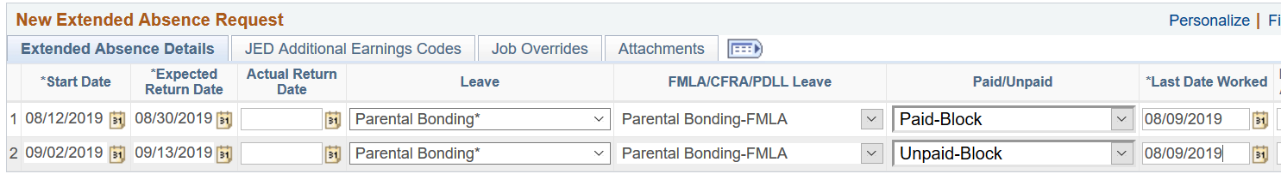
Absence Request New vs. Edit (Cont.)
Paid to Unpaid or Unpaid to Paid Scenario C con’t
Two initial and sequential Extended Leave lines.
08/12/2019
08/30/2019
Parental Bonding*
Parental Bonding-FMLA
Paid-Block
08/09/2019
08/30/2019
09/13/2019
Parental Bonding*
Parental Bonding-FMLA
Unpaid-Block
08/09/2019
NOTE: This is the initial request. 08/12/2019-08/30/19 Paid leave/Parental Bonding. 08/30/2019-009/13/19 Unpaid Leave/ Parental Bonding.

Slide 72
Absence Request New vs. Edit (Cont.)
Paid to Unpaid or Unpaid to Paid Scenario D
An employee wants to take a 5 week parental bonding leave.
Before going to his absence initiator, he knows he doesn’t have enough paid leave available.
He decides to take the first 3 weeks as PAID leave and the last two weeks as UNPAID parental bonding leave.
ACTION: Enter 2 initial, sequential requests lines are needed:
One for the first 3 weeks -PAID
A second one for the remaining 2 weeks – UNPAID.
Notes:
Two lines to record the PAID and UNPAID time.

Slide 73
Absence Request New vs. Edit (Cont.)
Paid to Unpaid or Unpaid to Paid Scenario C con’t
Two initial and sequential Extended Leave lines.
08/12/2019
08/30/2019
Parental Bonding*
Parental Bonding-FMLA
Paid-Block
08/09/2019
08/30/2019
09/13/2019
Parental Bonding*
Parental Bonding-FMLA
Unpaid-Block
08/09/2019
NOTE: This is the initial request. 08/12/2019-08/30/19 Paid leave/Parental Bonding. 08/30/2019-009/13/19 Unpaid Leave/ Parental Bonding.

Slide 74
Cancel an Absence Request
Reasons for Canceling:
  Correcting entries that cannot be changed (to redo-leave type)
  Remove a transaction that should not have been done
When Cancel button is available:
  Submit before local approval
  After UCPC approval
Method for Canceling:
  Two methods depends on the current status of the request.

Slide 75

Cancel an Absence Request (con’t)
Method for Canceling: depends on the current status of the request. From Administer Absence Request
WAYS to CANCEL
Method 1 | Method 2
Request is approved by: No Approvers ALL Approvers, including UCPath Center. | Request is in still in AWE with UCPC but has not been approved or entered in Job Data.

Slide 76
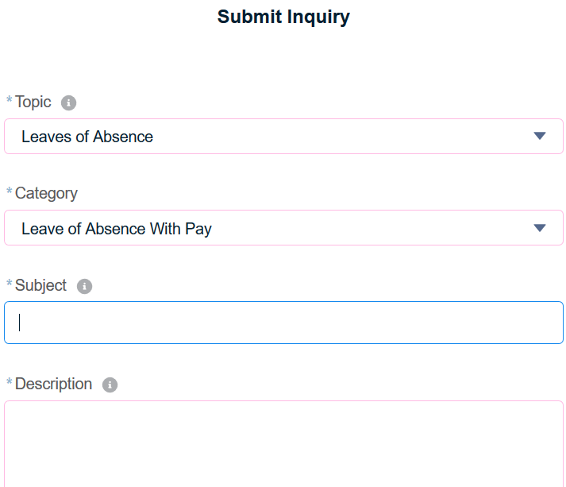
Cancel an Absence Request (con’t)
PROCESSING a CANCEL
Method 1 | Method 2
Display initial/existing absence request. Click Cancel, enter Note and Submit. Review and approve cancel request. | Create a case to notify WFA Production to deny absence request.
Important: In the Notes indicate any accrual hours or FMLA/CFRA/PDLL balances that must be adjusted. UCPC WFA Production uses this information to ensure appropriate adjustments are made in UCPath.

Slide 77
Lesson Objectives Review
Having completed this lesson, you should be able to:
Identify the fields, tabs and functionality of the Administer Extended Absence page.
View EA requests.
List the key system steps to edit a leave of absence.
Extend EA.
Cancel EA request.

Slide 78
LESSON 3
Return from Extended Absence: a Specific Edit

Slide 79
Lesson Objectives
In this lesson we will:
List the key system steps to return an employee from leave.
Return an employee from leave of absence.
2: View and Edit Extended Absence
4: View EA Transaction History
3: Return from Extended Absence
1: Request Extended Absence
Notes:
The Leave of Absence Request submission starts the process.

Slide 80
Return from Leave – Key System Steps
Click Edit
Enter a Note about the edit
Click Submit
Display initial/exist-ing absence request
Enter Actual Return Date
Notes:
Same as an Edit
Location Leave Initiator
Access the existing approved leave of absence using the Administer Extended Absence page.
Click the Edit button to open the request.
Enter Actual Return Date.
Enter a Note and Submit for approval.
The request automatically routes for approval.

Slide 81
Administer Initial Request
Return an employee from leave of absence using the Administer Extended Absence page.
Default Status is Pending. Change to ALL.
Search using the Employee ID
Click Edit to open the absence request details page.
Notes:
Same as an Edit.

Slide 82
Return Leave of Absence
When the employee returns to their job, add the Actual Return Date to the initial/existing request and submit for processing.
The Actual Return Date must be on or before the Expected Return Date.
If needed, edit the Expected Return Date.
Then the Actual Return.
Click Submit to send for approval and processing.
Enter the Actual Return Date on the same row.
Enter a note describing the action taken. This is the only way the Approvers and UCPC WFA Production know what was edited.
Notes:
Animation
Actual Return date cannot be after the Expected Return Date, –2 edits need to be done on the SAME line.
One t2
o change the Exp Return Date so it is after the Actual Return Date.
Second one to record the Actual Return Date.
Easiest way to fix this issue is to make them equal, because Expected Return Date is moot.

Slide 83
Return Leave of Absence
When the employee returns to their job, add the Actual Return Date to the initial/existing request and submit for processing.
The Actual Return Date must be on or before the Expected Return Date.
If needed, edit the Expected Return Date.
Then the Actual Return.
Click Submit to send for approval and processing.
Enter the Actual Return Date on the same row.
Enter a note describing the action taken. This is the only way the Approvers and UCPC WFA Production know what was edited.
Notes:
Animation
Actual Return date cannot be after the Expected Return Date, –2 edits need to be done on the SAME line.
One t2
o change the Exp Return Date so it is after the Actual Return Date.
Second one to record the Actual Return Date.
Easiest way to fix this issue is to make them equal, because Expected Return Date is moot.

Slide 84
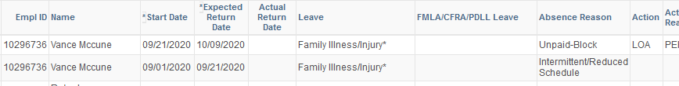
Return Leave of Absence
Intermittent Leave
Special Returns
When an Intermittent EA precedes or follows an Paid/Unpaid Block,
the employee must be returned from leave.
First | Paid Block
Second | Intermittent/Reduced Schedule
Third | Unpaid Block
Intermittent then Unpaid - Block
Notes:
Animation
Actual Return date cannot be after the Expected Return Date, –2 edits need to be done on the SAME line.
One t2
o change the Exp Return Date so it is after the Actual Return Date.
Second one to record the Actual Return Date.
Easiest way to fix this issue is to make them equal, because Expected Return Date is moot.

Slide 85
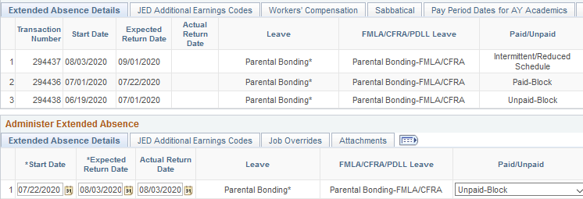
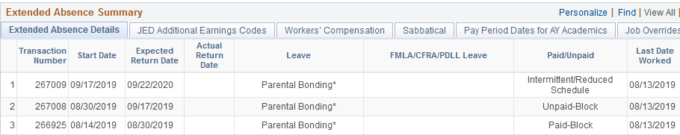
Return Leave of Absence
Intermittent Leave
Special Returns
Return from Unpaid to Intermittent

Slide 86
Lesson Objectives Review
Having completed this lesson, you should be able to:
List the key system steps to return an employee from leave.
Return an employee from an Extended Absence.

Slide 87
LESSON 4
View EA Transaction History

Slide 88
Lesson Objectives
In this lesson we will:
View EA history using the Extended Absences Trans History page.
2: View and Edit Extended Absence
4: View EA Transaction History
3: View and Edit Extended Absence
1: Request Extended Absence
Notes:
The Leave of Absence Request submission starts the process.

Slide 89
Extended Absence Trans. History page
Navigation: PeopleSoft Menu > Global Payroll & Absence Mgmt > Payee Data > Maintain Absences > UC Customizations > Extended Absence Trans History
Notes:
This page covers all history on an employee. Two years is also displayed on the Request page.

Slide 90
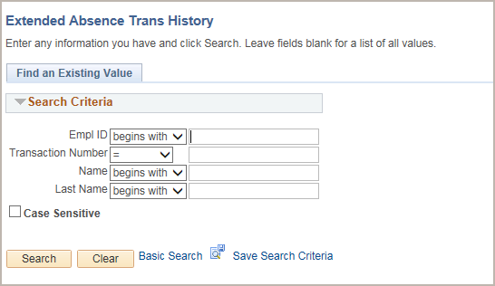
Extended Absence Trans. History page
Navigation: PeopleSoft Menu > Global Payroll & Absence Mgmt > Payee Data > Maintain Absences > UC Customizations > Extended Absence Trans History
Search using any or all:
Empl ID
Transaction Number
Name
Last Name

Slide 91
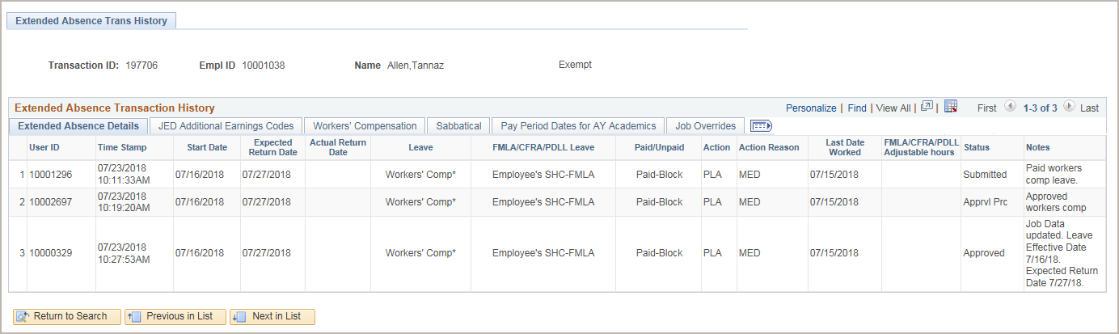
Extended Absence Trans. History (con’t)
Each row represents a change in Status and displays the User ID and Time Stamp, as well as Notes from the request.
  In this example, a workers’ compensation absence request was
  submitted on 7/23/18 at 10:11am
  approved on 7/23/18 at 10:19am
  and entered into Job Data and approved on 7/23/18 at 10:27am
Click the tabs to view additional information about the absence request.
Who
When
Notes
Notes:
When and who entered the transaction is only on the EA Transaction History page.

Slide 92
Lesson Objectives Review
Having completed this lesson, you should be able to:
View EA history using the Extended Absences Trans History page.

Slide 93

Course Review

Slide 94
Course Objectives Review
Having completed this course, you should be able to:
Describe the Leave of Absence system process.
Identify the fields and functionality of the Request Extended Absence page and the Administer Extended Absence page.
Submit various types of employee EA.
Extend employee EA.
Edit employee EA.
Return employee from EA.

Slide 95

Putting It All Together
After preliminary actions, Leave Initiator submits extended absence requests.
New and Edited requests routes to the local Approver(s).
Then to the Approver at UCPC.
  The UCPC WFA Production Approver adds the leave information to the employee’s Job Data and approves the absence request.
EA changes require an edit or new request row.
Enter a meaningful Comment every time you request a new EA or edit one.

Slide 96
Actions per Page
 | Pages
 | __ Request Extended Absence __
Preliminary Actions
Person Org Summary
Benefits Summary
Review Absence Balances
Election Form
Contact HR
Pages | EA Actions
Request Extended Absence | Initial Request Change Type Add New ROW
Administer Absence Request | Edit Return from Absence Status Paid, Unpaid Cancel
Extended Absence Trans History | All EA per Empl.

Slide 97


Leave of Absences
Where do I do What?
Edit Initial - Administer Extended Absence
Change length of leave
Workers’ Comp to Medical
Paid to Unpaid or vice versa and Intermittent
Canceled Leave
Returned from Leave
Request Extended Absence
Initial New Request
Edit – New Request Row
Change leave type, except Workers’ Comp to Medical
Note: Start Date of New = Expected Return Date of existing
Notes:
The two action pages

Slide 98


Leave of Absences
When can I do What?
Submitted Status
UCI Approved
Cancel via case -
UCPath Approved /Entered
Edit
Return
Cancel
● Edit
● Email local
approver
to deny
Notes:
Send a case to UCPath when waiting for them to approve.

Slide 99

Leave of Absences
does
What
Who
?
?
# | Scenario | Sender | Receiver | Method(s)
1 | Send notification of noncompliance | UCPath Center | Location | Case email
2 | Send additional information (as needed) | Location | UCPath Center | Email response
3 | Send notification of SWB transaction complete | UCPath Center | Location | Case email
4 | Submit request for leave (with pay, without pay, or sabbatical) | Employee / Location | Location / UCPath Center | Various / UCPath
5 | Send notification of leave request denied (as applicable) | UCPath Center | Location | Case email
6 | Send notification of corrections to leave request needed (as applicable) | UCPath Center | Location | UCPath
7 | Send notification of leave request processed | UCPath | Location | Email
8 | Generate and send Leave Monitoring Report for employees on leave | UCPath Center | Location | UCPath
9 | Generate and send benefits billing statements | UCPath | Employee | Mail to home/mailing address
10 | Submit payment for benefits | Employee | UCPath Center | Mail
11 | Send notification of delinquency (as applicable) | UCPath Center | Employee | Mail
12 | Send notification of de-enrollment (as applicable) | UCPath Center | Employee / Location | Case email
13 | Send election packet and custom benefits forms (as applicable) | UCPath Center | Employee | Mail
14 | Submit direct billing election form | Employee | UCPath Center | UCPath Inquiry
15 | Submit Extended Absence request to return employee to active status | Location | UCPath Center | UCPath
16 | Send notification of UCRP buyback eligibility | UCPath Center | Employee | Case email
17 | Send notification of new benefits event | UCPath | Employee | Email
18 | Send notification of enrollment eligibility for appropriate plans (as applicable) | UCPath Center | Employee | Case email
19 | Submit Return from Leave Benefits form | Employee | UCPath Center | UCPath Inquiry / Mail / Fax
20 | Submit benefit elections | Employee | UCPath Center | UCPath
Notes:
List of common scenarios and the roles involved.

Slide 100

Course Resources

Slide 101

Where to Get Help
The UCPath Help site is your first level of support. Search for conceptual content, job aids or step-by-step instructions for UCPath tasks.
  From the UCPath portal homepage, expand the Help / FAQ section on the left side of the page and then click the “Location Users” link to open the site. *An Adobe PDF version is available for users with screen readers.
If you’re experiencing issues, or have questions about transactions, please contact the Employee Experience Center at (949) 824- 0500, or submit a ticket by visiting UCPath.UCI.Edu

Slide 102
Appendices

Slide 103
Recommended slides
15 Navigation
34 Attachments
41, 42 Exclude jobs
44-47 AY Academics
62-64 Administer Request Keys
67-71 Scenarios
74 Cancel
92-95 Review Aids

Slide 104
Approval & Workflow Status Descriptions
Workflow Status | Description
Saved | Saved for later processing by Leave Initiator but not submitted for approval.
Submitted | Submitted by Leave Initiator and awaiting first Location Approver processing. First Approver can edit and approve in this status.
Apprvl Prc | If Location has one Approver: Approved by Location Approver and awaiting WFA Production Approver processing. If Location has two Approvers: Approved by first Location Approver and awaiting second Location Approver processing.
Approved | Processed and approved by UCPC WFA Production. The Leave Initiator can edit or cancel leaves in this status.
Sub Cancel | Cancel submitted by Leave Initiator and awaiting first Approver processing.
App Cancel | If Location has one Approver: Cancel approved by Location Approver and awaiting WFA Production Approver processing. If Location has two Approvers: Cancel approved by first Location Approver and awaiting second Location Approver processing.
Cancelled | Cancel processed and approved by UCPC WFA Production.
PushBack | Pushed back from Approver 2 or 3 to previous Approver.
Denied | Denied by any Approver.
Notes:
We won’t review these at this time, but we will as they come up in class. You may want to review this later, or even print it.

Slide 105
Online Job Aid
Job Aid: The Families First Coronavirus Response Act (FFCRA or Act)

Slide 106
Job Aid: Extended Absence Request Leaves and Description
The types of leaves that appear in the Leave field on the Request Extended Absence page are based on the eligibility group that is assigned to the employee.
The full list of leaves is provided in this table. Leaves that include an asterisk (*) may also require FMLA/CFRA/PDLL to be completed for the absence request.
Leave Description
Personal Leave | Staff - Leave of absence granted to employee for employees own personal reasons without pay. Academic Personnel Us - Due to religious beliefs, non-expectant faculty to assist expectant parent prepare for birth, can take a year of personal leave to work at another university on pay status, take an additional quarter off after parental bonding, new H1B visa approval.
PostDoc Parental Leave* | Leave of absence granted to Postdoctoral Scholar’s to bond with their newborn or newly placed child. Must be initiated and concluded within one year of birth or placement of child.
Pregnancy Disability-FMLA/PDLL | Pregnancy Disability Leave (PDL) of absence occurs when an employee takes a disability leave due to pregnancy, childbirth or a related medical condition. Pregnancy Disability Leave gives an employee the right to return to the same or similar position. Academic Personnel Use. Paid leave granted to an employee who is disabled because of pregnancy, childbirth or related medical conditions that runs concurrently with FMLA.
Pregnancy Disability-PDLL | Pregnancy Disability Leave (PDL) of absence occurs when an employee takes a disability leave due to pregnancy, childbirth or a related medical condition. Pregnancy Disability Leave gives an employee the right to return to the same or similar position. Academic Personnel Use. Paid leave granted to an employee who is disabled because of pregnancy, childbirth or related medical conditions.
Professional Development | Leave of absence granted to an employee for career-related or job-related professional development activities such as opportunities for on-the-job training, cross training, coaching, and internships; attendance at courses, workshops, seminars, conferences, institutes, lectures, and meetings; and participation in professional and technical associations.
Qualifying Exigency-FMLA | Leave of absence for eligible employee who is the spouse, domestic partner, son, daughter or parent of a covered military member may take Qualifying Exigency Leave to attend to any qualifying exigency when the covered military member is on active military duty or has been notified of an impending call or order to active military duty in the Armed Forces.
Rehabilitation* | Leave of absence for an employee who wishes to voluntarily enter and participate in an alcohol or drug rehabilitation program.
Service to Government Agencies | Leave of absence for employees to accommodate their need to be away from work to perform certain military service, public service, and civic duties.
Special 2-Month Unpaid Lve LX | Leave of absence granted to employees under the LX union who request a 2-month leave without pay.
Special Research Leave | Academic Personnel Use: Unpaid leave of absence granted for non-UC research activities.
ST Family BX* | Short-term family leave of absence granted to employees under the BX union to care for an ill family member, family emergencies or federal immigration hearings for a family member.
ST Medical BX* | Short-term medical leave of absence granted to employees under the BX union to take for their own personal illness, disability or birth of a child.
Supplemental FMLA | Leave of absence for a regular status (non-represented) employee who has exhausted all Family and Medical Leave is eligible for Supplemental Family and Medical Leave for up to an additional 12 workweeks (or until the end of calendar year, whichever is less) if the need for a Family and Medical Leave that is in progress continues beyond 12 work weeks.
Leave | Description
Suspension/Corrective Action | Unpaid leave of absence for employee who may be subject to removal from the workplace due to corrective action and may be suspended for a defined period of time.
Temporary Layoff | Leave of absence used to temporarily place an employee on layoff that does not exceed a cumulative total of four calendar months in a calendar year and for which there is a specific date to return to work.
Union Business Leave | Granted to a represented employee for a paid reimbursed leave to engage in union business.
Workers' Comp ESL* | Leave of absence for employee who has exhausted her/his accrued sick leave and is unable to work due to a work-incurred injury or illness.
Workers' Comp* | Leave of absence for employee who is injured or becomes ill as a result of work performed for the University.

Slide 107
Leave Description
LT Medical BX* | Long-term medical leave of absence granted to employees under the BX union to take for their own serious health condition, pregnancy, childbirth or related medical conditions for the period prior to, during, after childbirth.
Medical Leave* | Leave of absence for an employee who is unable to perform their job due to illness, injury or impairment.
Military Caregiver-FMLA | Leave of absence for employees entitled to FMLA to care for a family member or next of kin who is a covered service member undergoing medical treatment, recuperation or therapy for a serious injury or illness.
Military Leave | Leave of absence granted to employees called to active duty or for reserve or active duty training. Note: An employee who is not eligible for military leave with pay may elect to substitute accrued vacation leave and/or compensatory time off (or PTO, if applicable).
Military Spouse/Dom Ptr Leave* | Leave of absence for an employee who is a spouse or domestic partner of the Armed Forces, National Guard or Reserve where the qualified member is on leave from deployment during a period of military conflict.
Notice Leave | Leave of absence for employee during a layoff, individual notice to each employee of the effective date of the layoff and whether the layoff is temporary or indefinite is given by the University.
Other Circumstances | Leave of absence offered to University employees to accommodate for other circumstances for which they may need to take time away from work for personal reasons such as, school suspensions, school activities, victim of domestic violence/sexual assault/stalking, victims or serious/violent felonies, literacy leave, Family School Partnership Act or Administrative Leave.
Parental Bonding* | For non-FMLA usage. Leave of absence for employee bond with her/his child after the child’s birth or placement with the employee for adoption or foster care, and to attend to matters related to the birth, adoption, or placement of child within 12 months.
Parental Bonding-CFRA | Leave of absence for employees to bond with her/his child after the child’s birth or placement with the employee for adoption or foster care, and to attend matters related to the birth, adoption, or placement of the child within 12 months. Covered under the California Fair Employment and Housing Act that contain family care and medical leave provisions for California employees.
Parental Bonding-FMLA | Not Commonly Used. Used when CFRA entitlement was used when FMLA didn’t run concurrent. Leave of absence for employees entitled to FMLA to bond with her/his child after the child’s birth or placement with the employee for adoption or foster care, and to attend matters related to the birth, adoption, or placement of the child within 12 months.
Parental Bonding-FMLA/CFRA | Most commonly used. Leave of absence for employees entitled to FMLA to bond with her/his child after the child’s birth or placement with the employee for adoption or foster care, and to attend matters related to the birth, adoption, or placement of the child within 12 months. Covered under the California Fair Employment and Housing Act that contain family care and medical leave provisions for California employees.
Parental Leave under APM/IX* | Leave of absence granted to appointment employees under the IX union to bond with their newborn or newly placed child. Must be initiated and concluded within one calendar year f the birth or placement of child.

Slide 108
Leave Description
FFCRA-COVID19* | Used if the employee is unable to work or telework because of: Quarantine or isolation order, including shelter-in-place/stay-at-home order Told by health care provider to self-quarantine Experiencing COVID-19 symptoms and seeking diagnosis Caring for individual subject to quarantine/isolation order or who was told by health care provider to self-quarantine Caring for child whose school/place of care is closed or child care provider is unavailable because of COVID19 Other substantially similar condition specified by HHS Secretary Please refer to the Job Aid: The Families First Coronavirus Response Act (FFCRA or Act) for additional information and instructions.
Investigatory Leave | Leave of absence for an employee with or without notice, to permit the University to review or investigate actions including but not limited to dishonesty, theft, or misappropriation of University property, fighting on the job, insubordination, acts endangering others, or conduct which warrants removing the employee from the work site.
Jury Duty | Leave of absence for employee summoned to required jury duty. Note: Must provide a copy of the summons to her/his supervisor upon request.
Legal Proceedings | Leave of absence for employee to attend administrative or legal proceedings as directed by the University or is subpoenaed by the University to appear as a witness in an administrative or legal proceeding.
Lieu of Sab in Res-Full Pay | Leave of absence for an appointee in residence at the university (residence: qualified individuals who engage in teaching, research or other creative work) and who is eligible for a sabbatical leave may be eligible for an administrative leave with pay in lieu of a full sabbatical leave (100%). Allows administrators to devote effort to their research which may have been interrupted by administrative service.
Lieu of Sab in Res-Part Pay | Leave of absence for an appointee in residence at the university (residence: qualified individuals who engage in teaching, research or other creative work) and who is eligible for a sabbatical leave may be eligible for an administrative leave with pay in lieu of a partial sabbatical leave (anything less than 100%). Allows administrators to devote effort to their research which may have been interrupted by administrative service.
Lieu of Sab-Full Pay | Leave of absence for an appointee who holds an administrative position and who is eligible for a sabbatical leave may be eligible for an administrative leave with pay in lieu of a full sabbatical leave (100%). Allows administrators to devote effort to their research which may have been interrupted by administrative service.
Lieu of Sab-Part Pay | Leave of absence for an appointee who holds an administrative position and who is eligible for a sabbatical leave may be eligible for an administrative leave with pay in lieu of a partial sabbatical leave (anything less than 100%). Allows administrators to devote effort to their research which may have been interrupted by administrative service.
LT Family BX* | Long-term family leave of absence granted to employees under the BX union to care for a family member with a serious health condition or for the employee to care for/bond with newborn child or newly placed child.

Slide 109
Leave Description
Employee's SHC-FMLA/CFRA | Used most commonly when running concurrently with FMLA. Leave of absence for employees entitled to FMLA when they are unable to perform their job due to their own serious health condition such as an illness, injury, impairment or mental condition also covered under the California Fair Employment and Housing Act that contain family care and medical leave provisions for California employees.
Expired License/Certification | Leave of absence due to a pending license or recertification.
Expired Work Authorization | Leave of absence given to employee to renew their expired work authorization.
Faculty Medical Leave* | Leave of absence granted to Faculty who are unable to perform their job due to illness, injury or impairment.
Faculty Sab in Res–Full Pay | Sabbatical leave in residence at the university may be granted to a faculty member who is eligible for a regular full sabbatical and who, in addition to a program of research and/or study, will teach at the University of California (100%). (Residence: qualified individuals who engage in teaching, research or other creative work.)
Faculty Sab in Res–Part Pay | Sabbatical leave in residence at the university may be granted to a faculty member who is eligible for a regular partial sabbatical and who, in addition to a program of research and/or study, will teach at the University of California (anything less than 100%). (Residence: qualified individuals who engage in teaching, research or other creative work.)
Faculty Sabbatical-Full Pay | Leave of absence for full sabbatical. Used when the faculty member is taking full sabbatical (100%).
Faculty Sabbatical-Part Pay | Leave of absence for partial sabbatical. Used when the faculty member is taking a partial sabbatical (anything less than 100%) therefore, should be entered as Partial Pay to reflect the nature of the sabbatical leave.
Family Illness/Injury* | For non-FMLA usage (if using kincare for a non-FMLA qualifying employee). Leave of absence to care for spouse, domestic partner, child or parent with an illness, injury or disability.
Family SHC-CFRA | Leave of absence when the employee’s assistance is required to care for a domestic partner with a serious health condition or to care for an ill or injured service member if the service member is a child, parent, or spouse of employee. Under the California Fair Employment and Housing Act that contain family care and medical leave provisions for California employees.
Family SHC-FMLA | Leave of absence for employees entitled to FMLA when the employee’s assistance is required to care for a child or parent with a serious health condition when CFRA was exhausted for other eligible leaves.
Family SHC–FMLA/CFRA | Used most commonly. Leave of absence for employees entitled to FMLA when the employee’s assistance is required to care for a spouse, domestic partner, child or parent with a serious health condition covered under the California Fair Employment and Housing Act that contain family care and medical leave provisions for California employees.

Slide 110
Leave Description
4806/4804.1 Salary Continuance | Granted to University Police Officers Association under the California Labor Code Section 4806, a leave with full salary for a period not exceeding one year for an injury/illness arising out of and in course of the employee’s duties. This leave shall not be charged to accrued sick leave or vacation.
Bargaining Release Time | The University shall provide release time in a without-loss-straight-time-pay status to attend scheduled bargaining sessions for negotiations.
Bereavement | Leave of absence due to death of a family member or another person close to the employee.
Bone Marrow/Organ Donation* | Leave of absence due to employee donating blood, platelets, bone marrow or an organ.
Childbearing Leave* | Used when an expectant mother is taking a leave for pregnancy (doesn’t have to be FMLA eligible). Leave of absence granted to an employee who is disabled because of pregnancy, childbirth or related medical conditions.
Childcare Leave (NX Contract) | Leave of absence for employee to bond with her/his child after the child’s birth or placement with the employee for adoption or foster care, and to attend to matters related to the birth, adoption, or placement of child within 12 months. This will be applied after the use of CFRA (if applicable).
Community Service | Leave of absence for employees to provide volunteer services to University sanctioned non-profit organizations engaged in charitable or community service efforts. Not to exceed 24 hours.
COVID19-EFMLA | Used when the employee is unable to work or telework because the employee is caring for a child whose school/place of care is closed or whose child care provider is unavailable due to COVID-19. Please refer to the Job Aid: The Families First Coronavirus Response Act (FFCRA or Act) for additional information and instructions.
Emergency Relief Leave | Leave of absence granted to an employee to perform emergency duty as a volunteer firefighter, reserve peace officer, emergency rescue personnel, or to provide other service to a city, state, federal or other public entity.
Employee's SHC-CFRA | Leave of absence for employees who are unable to perform their job due to their own serious health condition, such as an illness, injury, impairment or mental condition covered under the California Fair Employment and Housing Act that contain family care and medical leave provisions for California employees.
Employee's SHC-FMLA | Used when CFRA is not being applied. Not as commonly used. Leave of absence for employees entitled to FMLA when they are unable to perform their job due to their own serious health condition such as an illness, injury, impairment or mental condition.

Slide 111
Leave Description
4806/4804.1 Salary Continuance | Granted to University Police Officers Association under the California Labor Code Section 4806, a leave with full salary for a period not exceeding one year for an injury/illness arising out of and in course of the employee’s duties. This leave shall not be charged to accrued sick leave or vacation.
Bargaining Release Time | The University shall provide release time in a without-loss-straight-time-pay status to attend scheduled bargaining sessions for negotiations.
Bereavement | Leave of absence due to death of a family member or another person close to the employee.
Bone Marrow/Organ Donation* | Leave of absence due to employee donating blood, platelets, bone marrow or an organ.
Childbearing Leave* | Used when an expectant mother is taking a leave for pregnancy (doesn’t have to be FMLA eligible). Leave of absence granted to an employee who is disabled because of pregnancy, childbirth or related medical conditions.
Childcare Leave (NX Contract) | Leave of absence for employee to bond with her/his child after the child’s birth or placement with the employee for adoption or foster care, and to attend to matters related to the birth, adoption, or placement of child within 12 months. This will be applied after the use of CFRA (if applicable).
Community Service | Leave of absence for employees to provide volunteer services to University sanctioned non-profit organizations engaged in charitable or community service efforts. Not to exceed 24 hours.
COVID19-EFMLA | Used when the employee is unable to work or telework because the employee is caring for a child whose school/place of care is closed or whose child care provider is unavailable due to COVID-19. Please refer to the Job Aid: The Families First Coronavirus Response Act (FFCRA or Act) for additional information and instructions.
Emergency Relief Leave | Leave of absence granted to an employee to perform emergency duty as a volunteer firefighter, reserve peace officer, emergency rescue personnel, or to provide other service to a city, state, federal or other public entity.
Employee's SHC-CFRA | Leave of absence for employees who are unable to perform their job due to their own serious health condition, such as an illness, injury, impairment or mental condition covered under the California Fair Employment and Housing Act that contain family care and medical leave provisions for California employees.
Employee's SHC-FMLA | Used when CFRA is not being applied. Not as commonly used. Leave of absence for employees entitled to FMLA when they are unable to perform their job due to their own serious health condition such as an illness, injury, impairment or mental condition.

Slide 113
Thank You!
Training End

Slide 114

Leave of Absences Pages
“Pre”- actions
Person Org Summary
Benefits Summary
Review Absence Balances
Election Form
Contact HR
Request Page
Initial Request
Change Type
Add New ROW
Administer Page
Edit
Return
Status
Paid, Unpaid
Cancel
EA Trans History
All EA per Empl.
Cognos Report
Custom
Job Data
Notes:
A look at the 5 pages we’ve discussed;
‘pre-pages’ for employees and pre-approval
Request page to submit an Ext abs request
Administer page to edit, end and find status
Monitoring page for status and review
History page

Slide 115
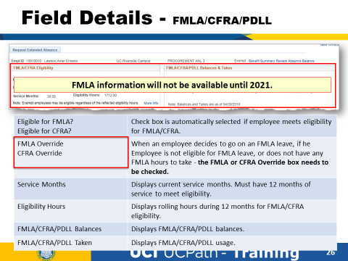

Slide 116
What it looks like after notes
make changes

