Slide 1
Welcome to Template Transactions Part 2
Notes:
Welcome to the Summer Salary training course.
This UCPath training course is designed to teach you about Summer Salary guidelines, as well as how summer salary is recorded in UCPath.

Slide 2

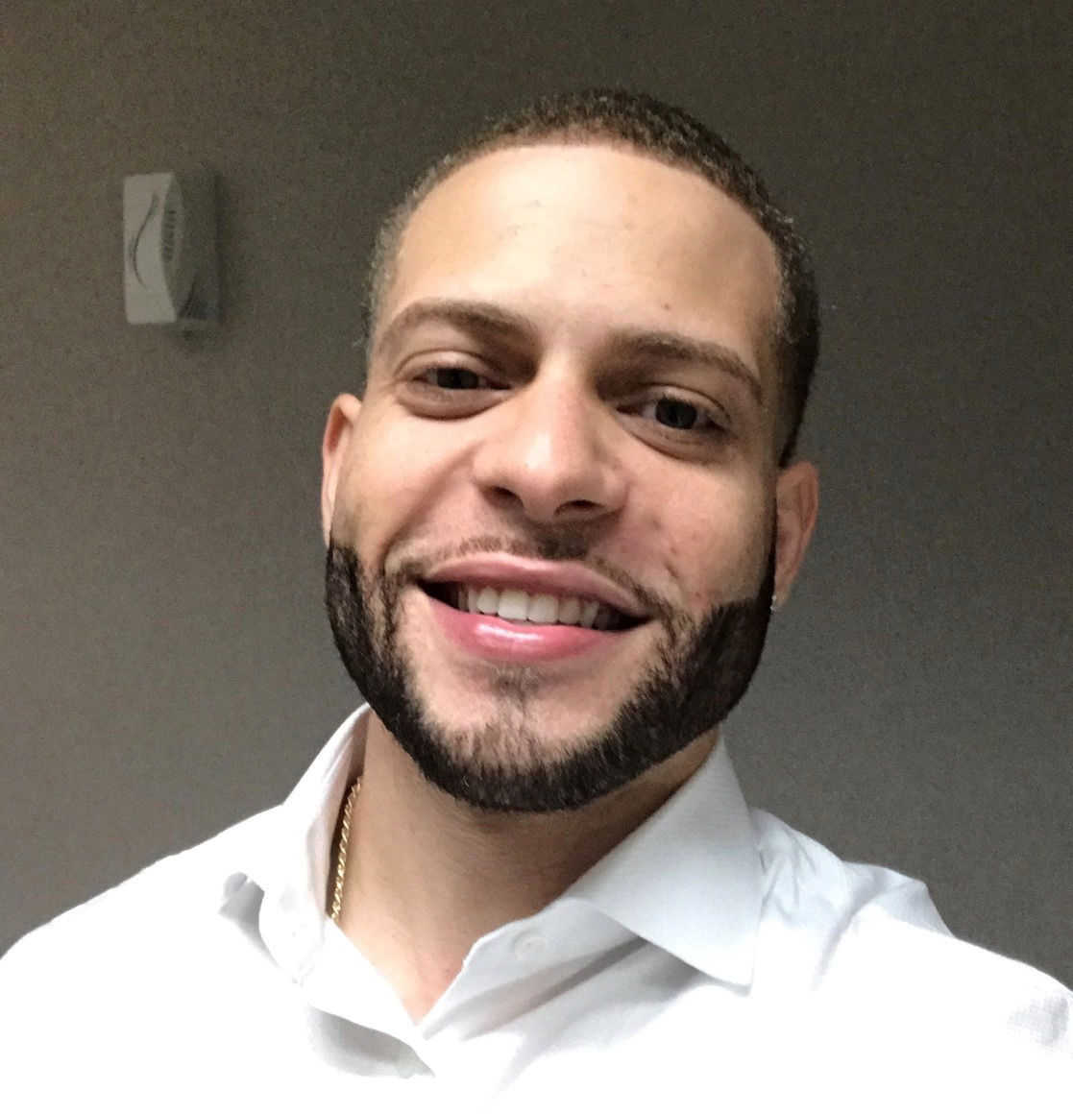
Introductions
Instructor
Name: Angel Rivera
UCI Role: Training Lead
2 Years in UCPath
10 Years of PeopleSoft related experience.

Slide 3
General Rules
Classroom Etiquette
Please silence cell phones
Keep your mics muted
No email or web surfing
Return from breaks on time
Please communicate via zoom chat

Slide 4
Template Transactions Pt. 2
Template Transactions Pt. 2
1. Personal Data Changes
2: Rehire
5. Transfers
3.Terminations
4. Retirements

Slide 5

Course Objectives
By the end of this course, you should be able to:
Update personal information.
Describe the key system steps to complete a personal data change, intra-location transfer and inter-location transfer template transaction.
Determine which templates and reason codes are used to submit rehire and transfer transactions.

Slide 6
PART 2: Lesson 1
Personal Data Change Template

Slide 7

Lesson Objectives
Personal Data
Rehire
Transfers
Terminations
Retirements
In this module you will learn how to:
Describe the key system steps to complete a personal data change template transaction.
View personal information.
Initiate a personal data change template transaction.
Update personal information UCPath pages.

Slide 8
Personal Data Change Methods
There are 3 methods to update personal / employee data in UCPath.
UCPath Employee Self-Service
In most cases, employees enter their own personal data changes using the UCPath Employee Actions.
Updates that can be made includes: Legal/Preferred name, SSN, personal email, emergency contacts, home and mailing address, employee disclosures, phone number, ethnic groups, military status and disability status.
UCPath “Person Data Change” Template Transaction
This method can be used to update the personal data mentioned above.
Notes:
Business e-mail and business address are updated through the UCI Identify management system.
Paperwork has to be submitted to legally update an employee’s gender. If your department or school is participating in the Onboarding Pilot you do not do the Social Security Number Verification (SSNVS) anymore.

Slide 9
Personal Data Change Methods (cont’d)
Submit “Ask UCPath” ticket on Behalf of Employee*
This method is used when the Initiator is requested to update certain personal information or submit a UCPC ticket “on behalf of” an employee. Examples include Legal Name, Date of Birth, Address, Phone number, gender, etc..
Location initiates a case and UCPC WFA team enters the update directly in UCPath. For example, for a gender marker change, the employee must submit a copy of a government issued ID, which indicates gender, to substantiate the request.
* A special security role must be granted in order to enter transactions on behalf of an employee
Notes:
This training covers the following methods that can be performed by a Template Initiator:
UCPath Template Transaction
AWE is not used when a personal data change is requested using Case Management.
Refer to the PHCMPOR110 course folder (in the Portal and Self Service folder) for additional information on submitting a case/inquiry.

Slide 10
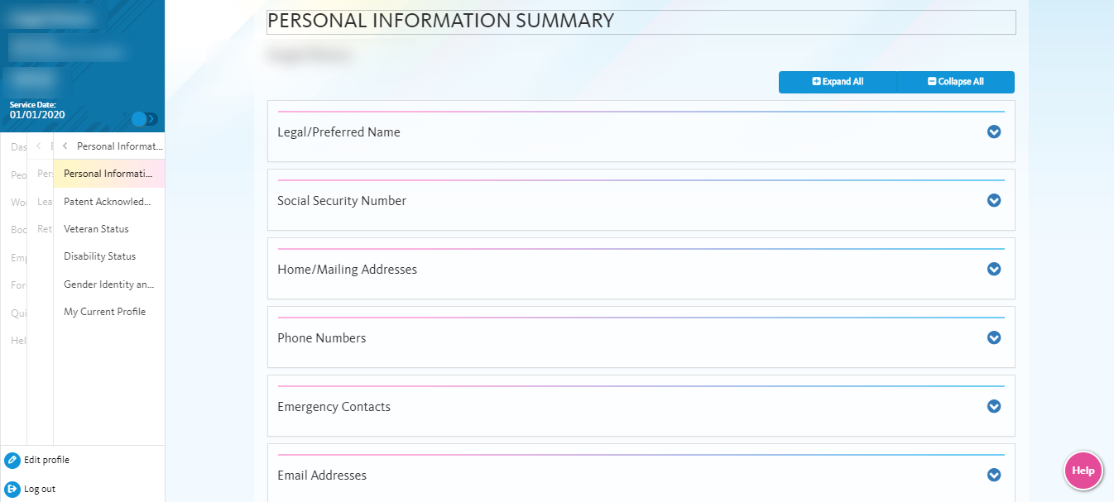
Employee Self Service Updates
Employees can update much of their personal information using Employee Self Service via the UCPath Portal.
Navigation: Employee Actions > Personal Information
Notes:
The sections available for employees to go in and make updates are:
Legal/Preferred Name
Home/Mailing Address
Phones Numbers
Emergency Contacts
Email Addresses
Ethnic Groups
Other Personal Information

Slide 11
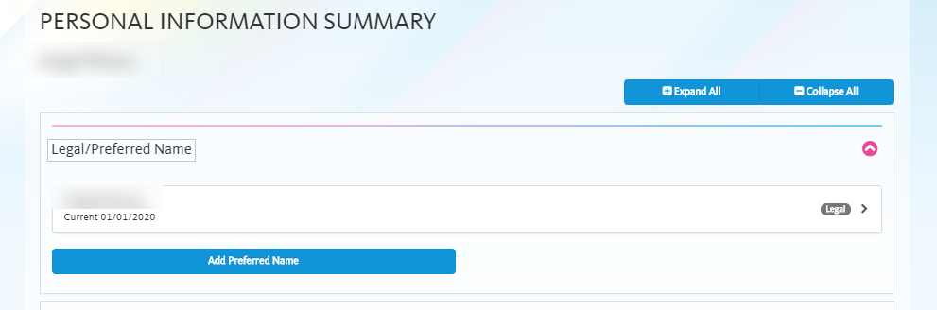
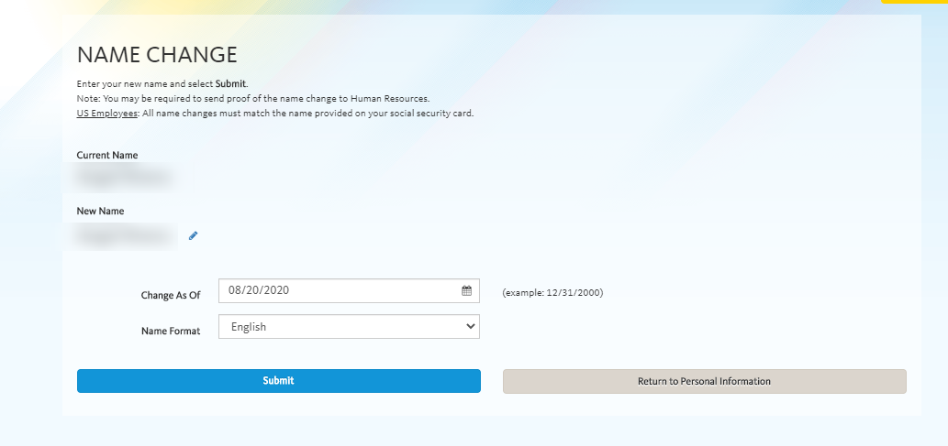
Legal/Preferred Name Updates
Update preferred name in UCPath with no required documentation
Notes:
The update for the preferred name happens as soon as the transaction is saved. Changes to the legal name will approve documentation and approval. When an employee changes their preferred name, unfortunately no notification is provided to their manager/supervisor. The new name will start appearing on the employee roster.
Click animation to display the Edit Name page.

Slide 12
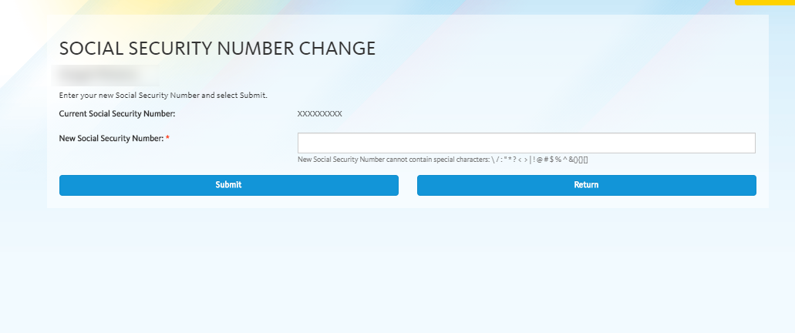
Social Security Updates
Employees are now able to update their Social Security numbers in UCPath
via Self-Service.

Slide 13
Employee Self Service – Personal Data Changes
Change Type | AWE? | Reviewed at UCPC? | Can be Updated by Department?**
Legal Name* | Yes | Yes | Yes
Date of Birth* | Yes | Yes | Yes
Self Service Gender | No | Yes | No
Personal Email | No | No | Yes
Personal Phone Number | No | No | Yes
Home and Mailing Address | No | No | Yes
Ethnicity | No | No | Yes
Military Status | No | No | Yes
Employee Disclosures | No | No | No
Disability | No | No | No
Emergency Contact | No | No | Yes
* Indicates where documentation is required to be submitted ** All transactions will go through AWE if using Template Transactions
Notes:
Here are the things that can be changed using Method #1 – Employee Self Service. Legal Name, Date of Birth and Legal Gender require documentation to be submitted. Additional security can be added to managers with direct reports called “submit on behalf of”. This functionality allows a manager to submit self service transactions on behalf of their direct reports with the exception of life events.

Slide 14
Employee Self Service - Person Profile Changes
Change Type | AWE? | Reviewed at UCPC? | Can be Updated by Department?
Licenses and Certifications* | Yes | Yes | Yes
Degrees* | Yes | Yes | Yes
Honors and Awards | Yes | Yes | Yes
Oath and Patent Acknowledgement | Yes | Yes | Yes
Patent Amendment | Yes | Yes | Yes
* Indicates where documentation is required
Notes:
These fields on the Person Profile can also be changed in Employee Self Service.

Slide 15

Department-Initiated Data Changes
Personal Data changes submitted by department initiators via a Smart HR template are subject to the AWE process. Personal Data change template entries are reviewed by UCPC before data is updated.
This includes changes to:
Legal Name
Date of Birth
Degrees
Licenses and Certifications
Notes:
Just to repeat certain changes have to be submitted by the location initiator because documentation is required. Some of these items may be verified during the centralized onboarding process.

Slide 16
Personal Data – Key System Steps
Review & validate new employee information.
Save & Submit
Enter any applicable changes and attach supporting documentation
Select the Personal Data template
Navigate to the Smart HR Transactions page
Notes:
Personal Data Change Template Transaction process.
Review the employee’s current personal information using the Modify a Person component.
Navigate to the Smart HR Transactions page.
Select the Personal Data template. There is only one template that is used for both Academic employees and Staff employees.
Update the employee’s personal information and add attachments.
Indicate what fields were updated in the comments.
Comments for the approvers should be entered in Initiator Comments field.
Any information that is meant for UCPC WFA Production, and cannot be entered in one of the existing fields, are entered in Comments field.
When the transaction is complete, select the Save and Submit button.
After the Initiator saves the transaction, it is automatically routed for approval using AWE. A designated Location Template Approver reviews and, if applicable, approves the transaction. After AWE, the template is staged until it is processed by UCPC WFA Production.

Slide 17
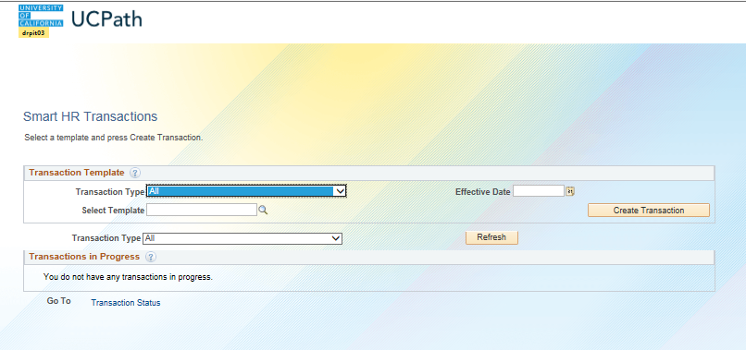
Smart HR Transactions – Page
Use the Transaction Template section to select the type of template appropriate for the request.
Use the Transactions in Progress section to review the template transactions you have submitted or saved for later. You also can select and delete your transactions.
Use the Select Template field to select the appropriate template
Pending transactions will appear here. If needed, you can delete transactions you have initiated.
Notes:
When displayed in Slide Show mode, this slide includes animation for the gray captions. Click to individually display each caption (and hide the previous caption) as you describe the objects on the Smart HR Transactions page.
The Transactions in Progress section displays only the transactions you have initiated or have “saved for later.” After the transaction is approved in AWE, it no longer appears on this list.
Remember, the Transactions in Progress section displays only the transactions you have initiated. After the transaction is approved in AWE, it no longer appears on this list.
Keep in mind that if you delete a transaction in progress, it is removed from the Manage Transactions queue (UCPC WFA Production).
The Transaction Type field can be left as ALL and the user can use the select template field to choose the desired SmartHR Template.
Choosing a Transaction Type will filter the available templates relevant to that transaction type selected.
This page will show completed Smart HR Transactions.

Slide 18
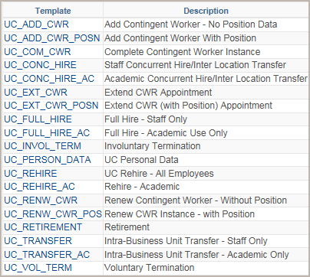
Personal Data – Template Transaction
The UC Person Data template can be used for staff or academic employees.
If the employee has jobs in multiple business units, the employee’s personal data should be updated by the employee’s Primary Job Location.
Personal Data Changes can be submitted for future dated Hires, as long as the effective date is the SAME or GREATER than the hire date.
Available Templates

Slide 19
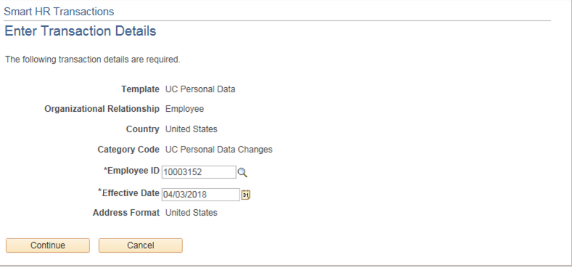
Enter Transaction Details Page
The Personal Data Changes template does not have any Reason Codes associated.
Simply enter the Employee ID and the Effective Date.
Click the Employee ID search button to locate the employee.
Click Continue to enter the remaining details of the personal data change.
Enter the Effective Date of the change.
Notes:
Click to individually display each caption (and hide the previous caption) as you describe the objects on the Enter Transaction Details page. Notice there is no Reason Code to select for Personal Data changes.

Slide 20
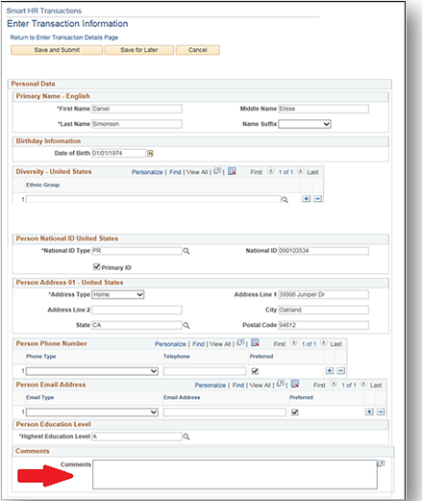
Enter Transaction Information Page
The employee’s existing personal information is automatically displayed.
Update relevant emloyee personal data.
Enter a comment to inform UCPC WFA Production specifically what field was updated.
When complete, click the Save and Submit button to submit the template for review and approval.
Notes:
The system steps are covered in more detail during the instructor demonstration and participant exercise.
The Ethnic Group, Phone, and Email fields do not populate.

Slide 21

Lesson Complete
Having completed this lesson, you should now be able to:
Describe the key system steps to complete a personal data change template transaction.
View personal information.
Initiate a personal data change template transaction.
Update personal information UCPath pages.

Slide 22

Module Review
Assessment
You now have the opportunity to assess your knowledge of the information presented in this module.
The questions and answers presented in this review help you to determine whether you remember and understand the important points.

Slide 23
True or False
There are several Reason Codes associated with the UC Person Data template.
True
False
Notes:
After clicking on an answer box, click on a blank part of slide to reveal the answer.
Correct answer: False

Slide 24
True or False
A UC employee can update his or her birthdate through the UCPath portal.
True
False
Notes:
After clicking on an answer box, click on a blank part of slide to reveal the answer, then click next to move on.
Correct answer: False

Slide 25

Instructor Demo UPK
Personal Data Change Transaction
This is your opportunity to view this task on your own.
Open the UCPath Help site and refer to the Clone Template Transaction topic.
Launch the See It version of the topic.
Ask your instructor for assistance.
Notes:
For UPK simulation-based exercises, instruct the users to open the See It view and complete the task.

Slide 26
PART: Lesson 2
Rehire Transactions

Slide 27
Lesson Objectives
Personal Data
Rehire
Transfers
Terminations
Retirements
The module learning objectives are:
Describe the key system steps to complete a rehire template transaction.
Initiate a rehire template transaction.
Initiate a rehire reinstatement template transaction.

Slide 28
Rehire – Overview
Use the UC Rehire template to rehire a previous UC employee from the same business unit.
The Rehire template can be used only when there is an existing employee record within the same business unit with a gap in service.
If the employee's only terminated employee record is at a different BU or Location, you must use the Full Hire template with the appropriate rehire reason code.
Available Templates
Notes:
Because the Rehire template has business-unit level security, Locations can only rehire employees within the BU’s they have access to.
If they are rehiring an employee from another BU, they must use the Hire template.

Slide 29
Other Rehire Scenarios
Rehire Scenario | Template to Use
If you want to rehire an Employee that previously worked at your UC location who has an existing UCPath employee ID. | UC_Rehire Template
If you want to rehire a previous UC employee from another location, who had an existing UCPath employee ID. | UC_Conc_Hire Template, Reason code Rehire
If you want to rehire a previous UC employee who does not have an employee ID in UCPath. | UC_FullHire Template, Reason code of Rehire – Break in Service
All Smart HR Templates
Please refer to the Template Transaction User guide for additional information.

Slide 30
Rehire – High Level System Steps
Review Person Org Summary page
Navigate to Smart HR Transactions
Select appropriate Rehire Template
Click Save & Submit for Review and Approval
Enter rehire details and attach documenta- tion as needed
Notes:
Rehire Template Transaction key system steps.
Access the Person Org Summary page before initiating a rehire template transaction to gain an understanding of the employees current assignments. If you are not able to locate the employee in UCPath, then the employee does not have a UCPath Empl ID and must be processed as a full hire.
Navigate to the Smart HR Transactions page.
Select the appropriate rehire template: Academic or Staff.
Update the employee’s personal information, if needed. Add the job information, JED, additional pay and add attachments as needed.
Comments for the approvers should be entered in Initiator Comments field. Any information that is meant for UCPC WFA Production, and cannot be entered in one of the existing fields, are entered in Comments field.
When the transaction is complete, select the Save and Submit button.
After the Initiator saves the transaction, it is automatically routed for approval using AWE. A designated Location Template Approver reviews and, if applicable, approves the transaction. After AWE, the template is staged until it is processed by UCPC WFA Production.
There may be multiple AWE Approvers depending on your Location’s business process.

Slide 31
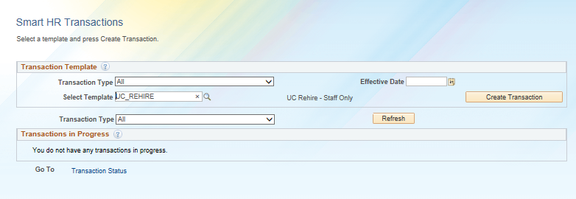
SmartHR Template - Rehire
Navigation: PeopleSoft Menu > Workforce Administration > Smart HR Template > Smart HR Transactions
Enter the Effective Date of the transaction
Select the rehire (staff or academic) template.
Click Create Transaction to begin entry of the template transaction.
Notes:
When displayed in Slide Show mode, this slide includes animation for the gray captions. Click to individually display each caption (and hide the previous caption) as you describe the objects on the Smart HR Transactions page.

Slide 32
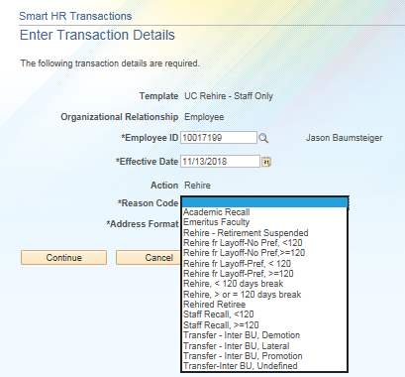
Rehire Transaction Details Page
Enter the details for the rehire, beginning with the Employee ID, Effective Date and Reason Code.
Important
Ensure that you select the correct Effective Date, Action and Reason Code.
These fields are important entry points for the employee’s record and have many downstream effects.
Click the Employee ID search button to locate the employee. If the rehired employee does not exist in UCPath, they must be processed as a full hire.
Click Continue to enter the remaining details of the rehire.
Select the appropriate Reason Code.
Notes:
When displayed in Slide Show mode, this slide includes animation for the gray captions. Click to individually display each caption (and hide the previous caption) as you describe the objects on the Enter Transaction Details page.

Slide 33
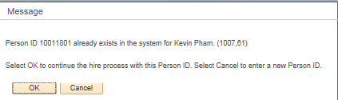
Existing Person Record
When the initiator enters the employee ID number into the Transaction details page, UCPath runs a person search to find matching values. Typically, when there is a match, the system generates a warning message.
Th
Notes:
Click OK to continue if it is indeed the same employee; if not click Cancel.

Slide 34
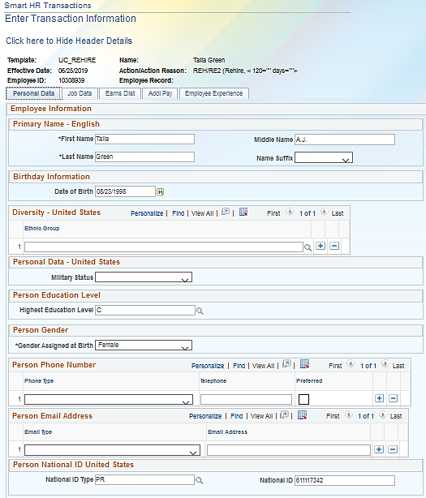
Enter Transaction Information Page
Enter the details for the rehire on the template tabs.
The last documented employee’s personal information is automatically displayed.
You must navigate through all the tabs before the Save and Submit button is available
Template is routed for approval.
Notes:
The system steps are covered in more detail during the instructor demonstration and participant exercise.

Slide 35
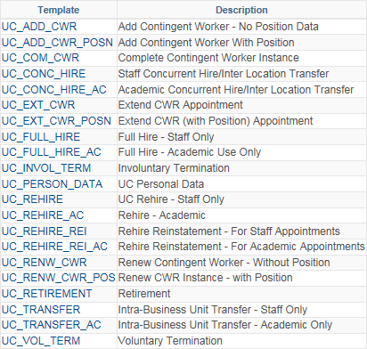
Rehire Reinstatement Overview
Use the UC_REHIRE_REI templates to reinstate employees who were automatically terminated in error.
The Effective Date of the reinstatement template must be the day AFTER termination date.
The Position entered on the reinstatement template must be the same position number employee was terminated from.
Available Templates
Notes:
There are two versions of the Rehire Reinstatement template: Academic and Staff. This template is only used when the termination was accidental and the employee must be reinstated without a break in service. For this reason, the Effective Date must be the same as the Effective Date of the Termination. The employee also must be hired back into the same Position.

Slide 36
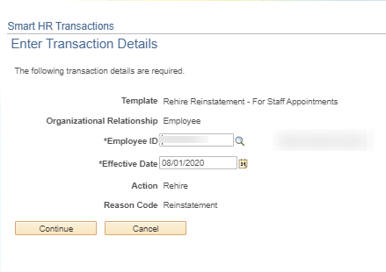
Rehire Reinstatement
Reason Code in not required with the reinstatement template.
Auto-defaulted

Slide 37
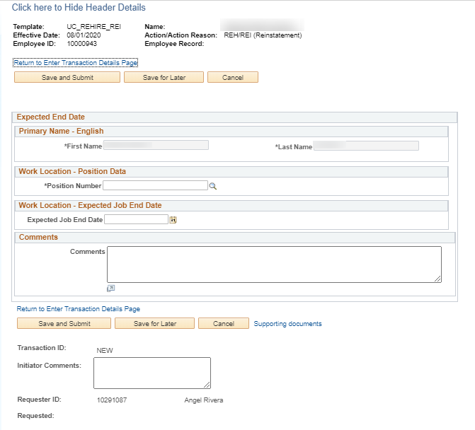
Required Fields
Only the position number they were terminated from, along with a new appointment end date, is required to be entered.
Please be sure to enter comments within the template to explain reason for reinstatement.
Also always include your initiator notes. Can be the same or different.

Slide 38

Lesson Complete
Having completed this lesson, you should now be able to:
Describe the key system steps to complete a rehire template transaction.
Describe the various rehire scenarios.
Initiate a rehire template transaction.

Slide 39

Knowledge Check
You now have the opportunity to assess your knowledge of the information presented in this module.
The questions and answers presented in this review help you to determine whether you remember and understand the important points.

Slide 40
True or False
The UC Rehire template can be used for employees without a gap in service.
True
False
Notes:
Correct answer is: False

Slide 41
Fill-In-The-Blank
Use the ___________________ template to rehire someone who was terminated erroneously.
UC_Rehire_REI / Reinstatement
Notes:
Correct answer is: UC Concurrent Hire

Slide 42
True or False
When using the Rehire Reinstatement template the date used to reinstate the employee must be one day after the termination date.
True
False
Notes:
Correct answer is: False

Slide 43
PART 2: Lesson 3
Transfers

Slide 44
Lesson Objectives
Personal Data
Rehire
Transfers
Terminations
Retirements
In this lesson you will learn how to:
Describe the key system steps to complete a Inter/Intra Location Tranfer template transaction.
Understand the difference between each type of employee transfer.
Initiate a transfer template transaction.

Slide 45
Intralocation Transfer – Overview
Intralocation transfers are initiated when an employee transfers from one position to another within the same business unit (campus) or to a related business unit (medical center).
The receiving department initiates the intralocation transfer template.
Intra-location transfer will auto terminate the old job record, once template is processed.
A separate transfer template is available for academic and staff.
Available Templates

Slide 46
Intralocation Transfer – Examples
An employee transfers from one position to another:
Within the same business unit.
To a related business unit.
UCI
UCI
UCI
UCI Medical Center
Notes:
It is not necessary to terminate an employee’s existing job in order to transfer them into a new position at the same Business Unit.
Employee must be active in order to transfer, and they can not be transferred while on a Leave, Short Work Break or Terminated.
Be sure to review Multiple Jobs to ensure:
FLSA Statuses across all active jobs are compatible.
Pay cycles across all active appointments are compatible.

Slide 47
Intralocation Transfer – Key System Steps
Save & Submit
Enter Transfer job details attach supporting documentation as needed
Select the UC_Transfer template
*Navigate to the Smart HR Transactions page
Review Person Org Summary page
*This process is initiated by the receiving department/location
Notes:
Intralocation Transfer Template Transaction process. This process is initiated by the receiving department/location.
Access the Person Org Summary page before initiating a transfer template transaction to gain an understanding of the employees current assignments.
It is not necessary to terminate an employee’s existing job in order to transfer them into a new position at the same Business Unit.
Navigate to the Smart HR Transactions page.
Select the appropriate transfer template. There is one for Academic employees and one for Staff employees.
Add the employee’s job information. Add attachments and enter comments to the Approver, if needed.
When the transaction is complete, click the Save and Submit button.
After the Initiator saves the transaction, it is automatically routed for approval using AWE. A designated Location Template Approver reviews and, if applicable, approves the transaction. After AWE, the template is staged until it is processed by UCPC WFA Production.

Slide 48
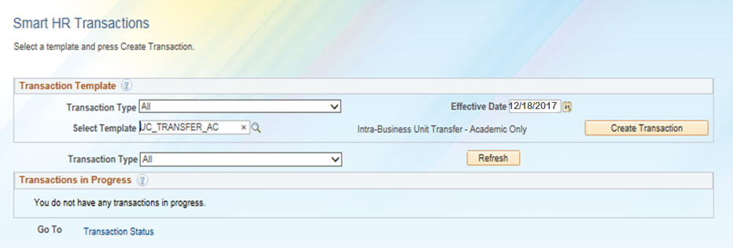
Smart HR Template – Intra Location Transfer
Navigation: PeopleSoft Menu > Workforce Administration > Smart HR Template > Smart HR Transactions
Enter the Effective Date of the transaction
Click Create Transaction to begin entry of the template transaction.
Select the transfer template (staff or academic).
Notes:
When displayed in Slide Show mode, this slide includes animation for the gray captions. Click to individually display each caption (and hide the previous caption) as you describe the objects on the Smart HR Transactions page.

Slide 49
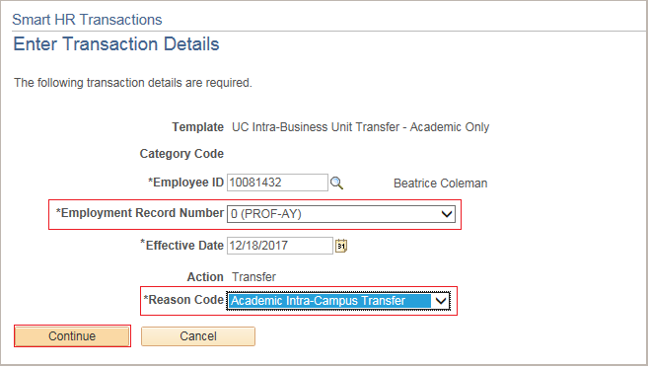
Enter Transactions Details Page
Enter the details for the intralocation transfer.
Important
Ensure you select the correct Effective Date and Reason Code.
These fields are important entry points for the employee’s record and have many downstream effects.
Select the correct Employment Record Number for the job to transfer.
Click Continue to enter the remaining details of the template.
Notes:
When displayed in Slide Show mode, this slide includes animation for the gray captions. Click to individually display each caption (and hide the previous caption) as you describe the objects on the Enter Transaction Details page.

Slide 50
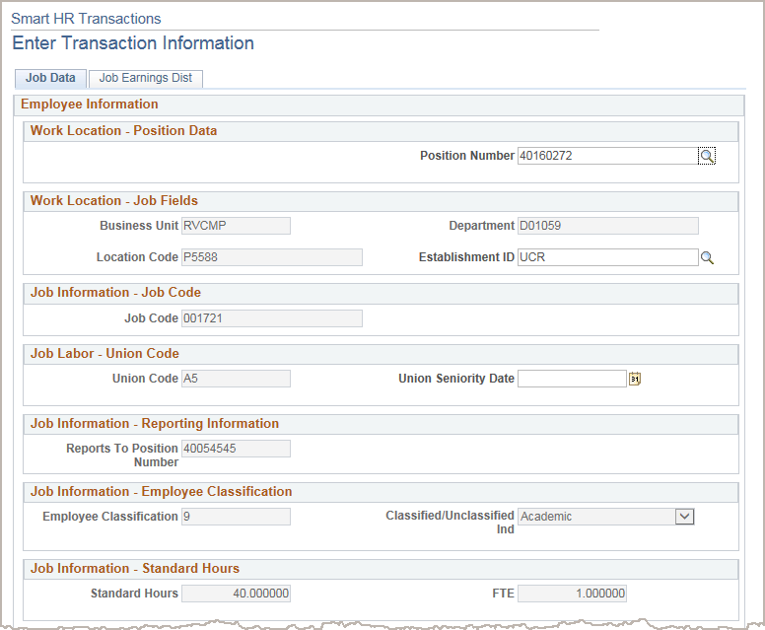
Enter Transactions Information
The receiving department/location initiates the Intralocation transfer template.
Enter the details for the intralocation transfer on the Job Data and Job Earnings Dist tabs, as needed.
Enter Comments
When complete, click the Save and Submit button to submit the template for review and approval.
Notes:
Coordination is needed between the receiving and originating departments to ensure the Termination is submitted by the originating department.
There is no Personal Data Tab on the template and the location should not submit personal data changes in the comments. Use the UC_Personal Data Template to submit personal data changes or the employee can use Employee Self Service.
The system steps are covered in more detail during the instructor demonstration and participant exercise.

Slide 51

INTER-Location Transfers

Slide 52
Interlocation Transfer – Overview
Interlocation transfers are initiated when an employee transfers from one UC Location to another without a break in service. For example, an employee transfers from UCLA to UCI.
Two separate templates must be initiated:
Concurrent Hire
Initiated by the receiving business unit.
Voluntary Termination
Initiated by the Home business unit.
Available Templates
Notes:
This overview assumes both locations are on UCPath system.
It is necessary to terminate an employee’s existing job in order to transfer employee into a new position at a different Business Unit.
Effective dates for both the termination and transfer templates should not reflect a break in service. A break in service is defined as any gap of employment, even a one day break.
Both the transfer and termination templates should be submitted simultaneously to UCPC.
The hiring location should coordinate with the terminating location before submitting the templates. Always enter Comments to give the UCPC a heads up to look out for two transactions. Let them know what you intentions are so they don’t have to try and figure it out.

Slide 53
Transferring UCPath → UCPath
For interlocation transfers, a concurrent hire template is initiated by the Location to which the employee is transferring, and a voluntary termination template is initiated by the Location from which the employee is transferring.
There should be no break in service.
The Effective Date of the termination should be the same Effective Date as the concurrent hire.
This process should be coordinated between the two Locations.
Before processing the templates, UCPC WFA Team validates there is both a concurrent hire (interlocation transfer) template and a termination (interlocation transfer) template for the employee. UCPC processes the concurrent hire template prior to the termination template to ensure there is no break in service.
Notes:
If both templates are not submitted for the interlocation transfer, WFA Production notifies the Location via Case Management and requests that it submit the appropriate templates.
Refer to the PHCMPOR110 course folder (in the Portal and Self Service folder) for additional information on submitting a case/inquiry.

Slide 54
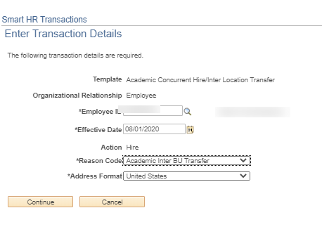
Inter Location – Conc. Hire
The Concurrent Hire process must be coordinated and entered first.
The appropriate Staff or Academic Interlocation Transfer reason code should be used.
Please refer to the Template Transaction User guide for additional information on Inter Location Transfers.

Slide 55

Instructor Demo – Part 1
Initiate Interlocation Transfer (Concurrent Hire) Template Transaction
Watch as your instructor demonstrates how to initiate an interlocation transfer template transaction in UCPath. This demonstration is for a transfer from a UCPath Location to another UCPath Location.
Follow along using the UCPath Help topic.
Open the UCPath Help site and refer to the Initiate Interlocation Transfer (Concurrent Hire) Template Transaction topic.
Launch the See It version of the topic.
At the end of the demonstration, you will have the opportunity to practice this task.
Notes:
For UPK simulation-based demonstrations, open the Try It view and walk through the activity while providing details and explaining the task. The users should follow along with the See It version of the UPK.
This is the first part of a two-part demonstration.
1st: The Location that the employee is transferring to initiates the Concurrent Hire template transaction.
2nd: The Location that the employee is transferring from initiates the Termination template transaction.

Slide 56
Instructor Demo – Part 2
Initiate Interlocation Transfer (Terminate) Template Transaction
Watch as your instructor demonstrates how to initiate an interlocation transfer (terminate) template transaction in UCPath. This demonstration is for a transfer from a UCPath Location to another UCPath Location.
Follow along using the UCPath Help topic.
Open the UCPath Help site and refer to the Initiate Interlocation Transfer (Terminate) Template Transaction topic.
Launch the See It version of the topic.
At the end of the demonstration, you will have the opportunity to practice this task.
Notes:
For UPK simulation-based demonstrations, open the See It view and walk through the activity while providing details and explaining the task. The users should follow along with the See It version of the UPK.
This is the second part of a two-part demonstration.
1st: The Location that the employee is transferring to initiates the Concurrent Hire template transaction.
2nd: The Location that the employee is transferring from initiates the Termination template transaction.

Slide 57
Lesson Complete
Having completed this lesson, you should now be able to:
Describe the key system steps to complete an intralocation transfer template transaction.
Initiate an intralocation transfer template transaction.
Describe the key system steps to complete an interlocation transfer template transaction.
Initiate an interlocation transfer (Concurrent hire) template transaction.
Initiate an interlocation transfer (Termination) template transaction.

Slide 58
Knowledge Check
You now have the opportunity to assess your knowledge of the information presented in this module.
The questions and answers presented in this review help you to determine whether you remember and understand the important points.

Slide 59
True or False
An INTERlocation transfer applies when an employee terminates employment at one UC Location (Business Unit) and accepts employment at another UC Location (Business Unit), without a break in service.
True
False
Notes:
The correct answer is: False
False. An interlocation transfer applies when an employee terminates employment at one UC Location (Business Unit) and accepts employment at another UC Location (Business Unit), without a break in service.
After clicking on an answer box, click on a blank part of slide to reveal the answer, then click next to move on.

Slide 60
Multiple Choice
For an INTERlocation transfer (from a UCPath Location to another UCPath Location), a _________ template and a termination template must be initiated for the employee.
A. Rehire
B. Retire
C. Concurrent Hire
D. Data Changes
E. None of the Above
NEXT
Notes:
The correct answer is: C

Slide 61
True or False
INTRAlocation transfers are initiated when an employee transfers within the same business unit (campus) or to a related business unit (medical center).
True
False
Notes:
The correct answer is: True
After clicking on an answer box, click on a blank part of slide to reveal the answer, then click next to move on.

Slide 62
PART 2: Lesson 4
Terminations

Slide 63
Lesson Objectives
Personal Data
Rehire
Transfers
Terminations
Retirements
In this lesson you will learn how to:
Describe the key system steps to complete a termination template transaction.
Initiate a voluntary termination template transaction.
Initiate an involuntary termination template transaction.

Slide 64
Termination – Overview
There are two templates available for terminations: Voluntary and Involuntary.
Available Templates
Initiate Voluntary Termination:
When an employee decides to resign their UC employment.
Initiate an Involuntary Termination:
When it is necessary to terminate an employee, lay off an employee, student graduates, or you learn of the death of an employee.
Notes:
The Involuntary Termination template is also used when a student graduates. "There are two templates available for terminations: Voluntary and Involuntary. There is a separate template available for Retirement."

Slide 65
Termination – Overview (cont’d)
The termination template are used for both academic and staff employees.
Initiators can only submit termination templates for employees in departments they have security access to. If applicable, you must coordinate with other departments for terminating other UC jobs.
If an employee holds multiple jobs in an event of death, only one Involuntary termination template must be submitted with a Reason code of Death.
UCPC WFA Team terminates all other jobs for the employee.
Notes:
The Termination template is not used for retirement. It has its own template.

Slide 66
Termination – Key System Steps
Save & Submit
Enter termination details and attach supporting documentation as needed
Select the Termination template
Navigate to the Smart HR Transactions page
Review Person Org Summary page
Initiate Final Pay, if needed
Notes:
Termination Template Transaction process.
Access the Person Org Summary page before initiating a termination template transaction to gain an understanding of the employee’s assignments. If the employee has multiple assignments, ensure that you work with other Departments/Locations so that a termination template is submitted for all jobs as necessary. If the termination reason is Death, only one Involuntary Termination template needs to be initiated; UCPC WFA Production will terminate all other jobs for the employee.
Navigate to the Smart HR Transactions page.
Select the appropriate termination template; voluntary or involuntary.
Complete the termination fields, add attachments and enter comments for the Approver, if needed.
When the transaction is complete, click the Save and Submit button.
After the Initiator clicks the Save and Submit button, the Submit Confirmation page appears. A link is available on this page to initiate the final pay process, if needed. Final Pay only needs to be initiated if this is the only job the employee has at UC (all other jobs are terminated or retired).
After the Initiator saves the transaction, it is automatically routed for approval using AWE. A designated Location Template Approver reviews and, if applicable, approves the transaction. After AWE, the template is staged until it is processed by UCPC WFA Production.
There may be multiple Location AWE Approvers depending on your Location’s business process.

Slide 67
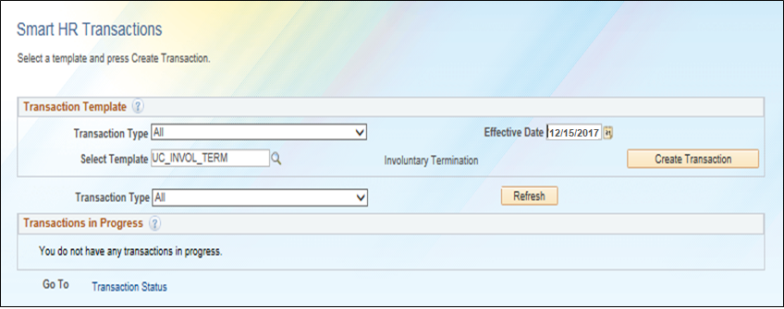
Smart HR Transactions Page
Navigation: PeopleSoft Menu > Workforce Administration > Smart HR Template > Smart HR Transactions
Enter the Effective Date of the transaction
Select the termination template (voluntary or involuntary).
Click Create Transaction to begin entry of the template transaction.
Notes:
When displayed in Slide Show mode, this slide includes animation for the gray captions. Click to individually display each caption (and hide the previous caption) as you describe the objects on the Smart HR Transactions page.

Slide 68
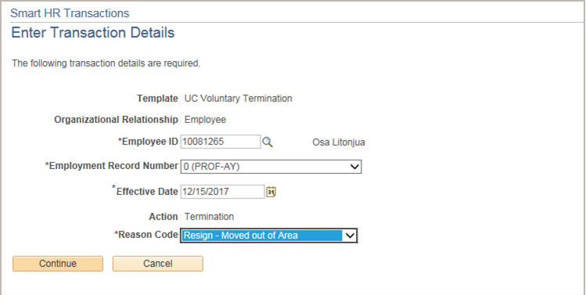
Enter Transactions Details Page
Enter the details for the termination.
Important
Ensure you select the correct Effective Date and Reason Code.
These fields are important entry points for the employee’s record and have many downstream effects.
Select the correct Employment Record Number for the job to terminate. If the employee has multiple assignments, submit a termination template for all jobs, as necessary. If the termination reason is Death, only one termination template needs to be initiated; UCPC WFA Production will terminate all other UC jobs for the employee.
Click Continue to enter the remaining details of the template.
Notes:
When displayed in Slide Show mode, this slide includes animation for the gray captions. Click to individually display each caption (and hide the previous caption) as you describe the objects on the Enter Transaction Details page.
Emphasize, if the termination reason is Death, only one termination template needs to be initiated and one Employment Record Number selected; UCPC WFA Production will terminate all other UC jobs for the employee.

Slide 69
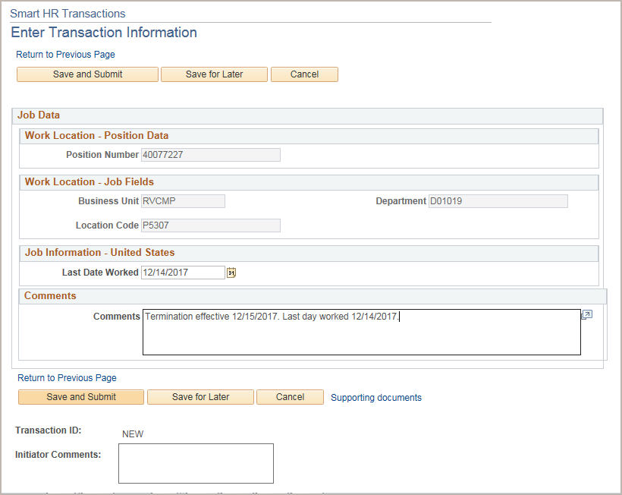
Enter Transactions Information
The Last Date Worked automatically populates with a date that is one day prior to the Effective Date.
Enter the last day worked, if needed.
The Last Date Worked must be prior to the Effective Date of Termination.
When complete, click the Save and Submit button.
Update the Last Date Worked if needed and enter a Comment.
Notes:
The system steps are covered in more detail during the instructor demonstration and participant exercise.
The Comments box stay with the record. But if you have comments for the Approver enter in the Initiator Comments.

Slide 70
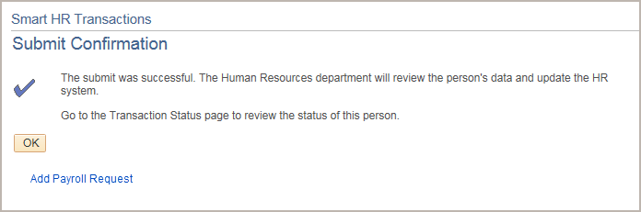
Termination & Final Pay
Final pay is required when an employee is separated and all other jobs are terminated or retired.
The termination and retirement templates provide a link for initiating final pay after entering the template. Access to the link, Payroll Request, is determined by UCI business process and requires a separate security role.
For additional information on final pay, refer to the Payroll Request course.

Slide 71

Instructor Demo
Initiate Voluntary Termination Template Transaction
Watch as your instructor demonstrates how to initiate a voluntary termination template transaction in UCPath.
Follow along using the UCPath Help topic.
Open the UCPath Help site and refer to the Initiate Voluntary Termination Template Transaction topic.
Launch the See It version of the topic.
At the end of the demonstration, you will have the opportunity to practice this task.
Notes:
For UPK simulation-based demonstrations, open the See It view and walk through the activity while providing details and explaining the task. The users should follow along with the See It version of the UPK.

Slide 72
Instructor Demo
Initiate Involuntary Termination Template Transaction
This is your opportunity to practice this task on your own.
Open the UCPath Help site and refer to the Initiate Involuntary Termination Template Transaction topic.
Launch the See It version of the topic.
Ask your instructor for assistance.
Notes:
For UPK simulation-based exercises, instruct the users to open the See It view and complete the task.

Slide 73
Lesson Complete
Having completed this lesson, you should now be able to:
Describe the key system steps to complete a termination template transaction.
Initiate a voluntary termination template transaction.
Initiate an involuntary termination template transaction.

Slide 74
Knowledge Check
You now have the opportunity to assess your knowledge of the information presented in this module.
The questions and answers presented in this review help you to determine whether you remember and understand the important points.

Slide 75
Multiple Choice
A termination template is used when:
A. An employee decides to resign his or her employment
B. An employee retires
C. A Location decides to lay off an employee
D. All of the above
E. None of the above
NEXT
Notes:
The correct answer: E. A and C

Slide 76
Fill-In-The-Blank
When terminating an emplpoyee, the Last Date Worked field must be one day prior to the _________________.
Effective Date

Slide 77
PART 2: Lesson 5
Retirement

Slide 78
Lesson Objectives
Personal Data
Rehire
Transfers
Terminations
Retirements
In this lesson you will learn how to:
Describe the key system steps to complete a retirement template transaction.
Initiate a retirement template transaction.

Slide 79
Retirement – Overview
Initiate a retirement template when an employee decides to retire.
There is one retirement template that is used for both academic and staff employees.
When UCPC WFA Production receives a retirement transaction, they will retire the employee from all UC jobs.
Available Templates

Slide 80
Retirement – Key System Steps
Save & Submit
Enter Retirement details, attach documentation as needed
Select the Retirement template
Go to Smart HR Transaction page
Review Person Org Summary page
Initiate Final Pay, if needed
Notes:
Retirement Template Transaction process.
Access the Person Org Summary page before initiating a retirement template transaction to gain an understanding of the employee’s assignments. If the employee has multiple assignments, only one template needs to be initiated; UCPC WFA Production will retire all other UC jobs for the employee.
Navigate to the Smart HR Transactions page.
Select the retirement template.
Complete the retirement fields, add attachments and enter comments for the Approver, if needed.
When the transaction is complete, click the Save and Submit button.
After the Initiator clicks the Save and Submit button, the Submit Confirmation page appears. A link is available on this page to initiate the final pay process, if needed. Final Pay only needs to be initiated if this is the only job the employee has at UC (all other jobs are terminated or retired).
After the Initiator saves the transaction, it is automatically routed for approval using AWE. A designated Location Template Approver reviews and, if applicable, approves the transaction.
After AWE, the template is staged until it is processed by UCPC WFA Production.
There may be multiple AWE Approvers depending on your Location’s business process.

Slide 81
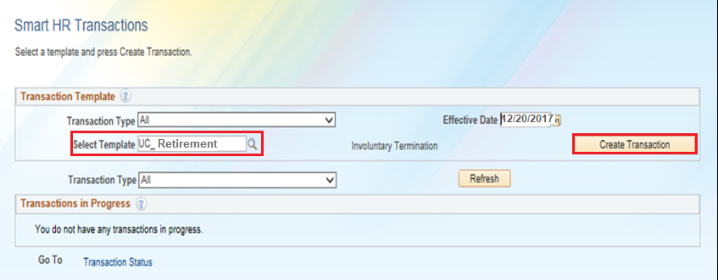
Smart HR Transactions Page
Navigation: PeopleSoft Menu > Workforce Administration > Smart HR Template > Smart HR Transactions
3. Click Create Transaction to begin entry of the template transaction.
1. Select the UC_Retirement template.
2. Enter the Effective Date of the retirement.
Notes:
When displayed in Slide Show mode, this slide includes animation for the gray captions. Click to individually display each caption (and hide the previous caption) as you describe the objects on the Smart HR Transactions page.

Slide 82
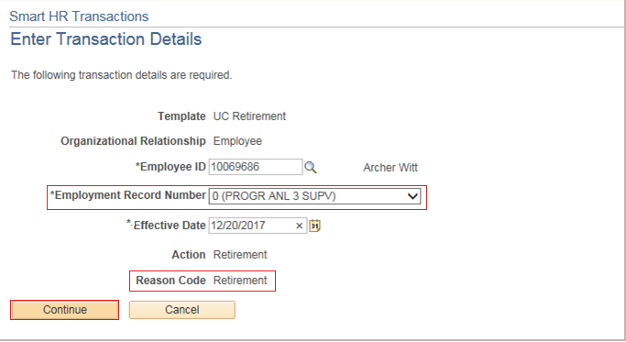
Enter Transactions Details Page
Enter the details for the retirement.
Important
Ensure you select the correct Effective Date.
This field is an important entry point for the employee’s record and has many downstream effects.
Select the correct Employment Record Number for the job to retire. If an employee retires from UC, only one retirement template needs to be initiated; UCPC WFA Production will retire all other jobs for the employee, as needed.
Click Continue to enter the remaining details of the template.
There is only one Reason Code for the retirement template.
Notes:
When displayed in Slide Show mode, this slide includes animation for the gray captions. Click to individually display each caption (and hide the previous caption) as you describe the objects on the Enter Transaction Details page.

Slide 83
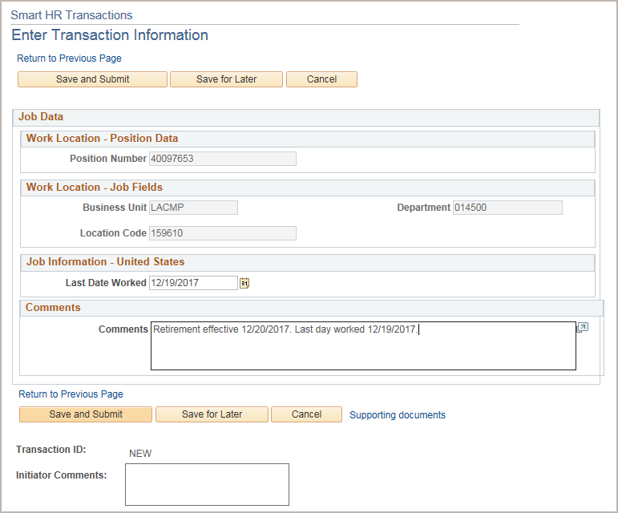
Enter Transactions Information
The Last Date Worked automatically populates with a date that is one day prior to the Effective Date.
Enter the last day worked, if needed.
The Last Date Worked must be prior to the Effective Date of Termination.
When complete, click the Save and Submit button.
Update the Last Date Worked if needed and enter a Comment.
Notes:
The system steps are covered in more detail during the instructor demonstration and participant exercise.

Slide 84
Retirement – Final Pay
Final pay is required when an employee is separated and all other jobs are terminated or retired.
The termination and retirement templates provide a link for initiating final pay after entering the template. Access to the link, Add Payroll Request, is determined by UCI business process and requires a separate security role.
For additional information on final pay, refer to the Payroll course: Payroll Requests.

Slide 85
Instructor Demo
Initiate Retirement Template Transaction
Watch as your instructor demonstrates how to initiate a retirement template transaction in UCPath.
Follow along using the UCPath Help topic.
Open the UCPath Help site and refer to the Initiate Retirement Template Transaction topic.
Launch the See It version of the topic.
At the end of the demonstration, you will have the opportunity to practice this task.
Notes:
For UPK simulation-based demonstrations, open the See It view and walk through the activity while providing details and explaining the task. The users should follow along with the See It version of the UPK.

Slide 86
Lesson Objectives Review
Having completed this module, you should now be able to:
Describe the key system steps to complete a retirement template transaction.
Initiate a retirement template transaction.

Slide 87
Knowledge Check
You now have the opportunity to assess your knowledge of the information presented in this module.
The questions and answers presented in this review help you to determine whether you remember and understand the important points.

Slide 88
True or False
The Last Date Worked must be after the Job Effective Date.
True
False
NEXT
Notes:
The correct answer is False.
False. The Last Date Worked must be prior to the Effective Date.
After clicking on an answer box, click on a blank part of slide to reveal the answer, then click next to move on.

Slide 89
Multiple Choice
Use the retire template for either academic or staff employees when:
A. An employee decides to resign his or her employment
B. An employee retires
C. A Location decides to lay off an employee
D. All of the above
E. A and C
NEXT
Notes:
The correct answer is: B.

Slide 90
Fill-In-The-Blank
On the retirement template, the __________________ field automatically populates with a date that is one day prior to the Effective Date.
Last Date Worked
Notes:
The correct is: Last Date Worked.

Slide 91

Course Review

Slide 92

Putting It All Together
Initiate the final pay process for termination and retirement template transactions if an employee is separated from the University (and all other jobs are terminated or retired).
Intralocation transfers are initiated when an employee transfers within the same business unit (campus → campus) or to a related business unit (campus → medical center).
Interlocation transfers are initiated when an employee transfers from one business unit to another business unit without a break in service.
For interlocation transfers between two UCPath Locations, two separate templates must be initiated:
Concurrent Hire and Voluntary Termination
Refer to the Template Transactions – Action Reason Codes and Descriptions job aid for a list of all the templates, associated Reason Codes and a description.

Slide 93
Course Objectives Review
Having completed this course, you should be able to:
Identify the pages used to initiate template transactions.
View template transaction status.
Describe the key system steps to complete a full hire, concurrent hire and add contingent worker template transaction.
Initiate full hire and concurrent hire template transactions.
Update personal information.
Describe the key system steps to complete a personal data change, voluntary termination, involuntary termination, retirement, intralocation transfer and interlocation transfer template transaction.
Initiate personal data change, voluntary termination, involuntary termination, retirement, intralocation transfer and interlocation transfer template transactions.

Slide 94

Parking Lot
Review parking lot
Have all questions been answered during our class?
Are there any new questions to add to the list?

Slide 95
Thank You!
Training End

Slide 96
Reference Material for Review
Links to helpful reference material:
http://www.hr.uci.edu/ - UCI HR Website
https://ap.uci.edu/ - UCI Academic Personnel Website
http://www.uclc.uci.edu/ - UC Learning Center Website
https://ucpath.uci.edu/training/index.php - UCI UCPath Training Website
List of Other Relevant UPKs:
Initiate New Position Control Request
Initiate Update Vacant Position Request
View Position Information
Enter Direct Retro Funding Update
Enter Direct Retro Funding Update – MCOP
Review Direct Retro Distribution

Slide 97

Where to Get Help
The UCPath Help site is your first level of support. Search for conceptual content, job aids or step-by-step instructions for UCPath tasks.
From the UCPath portal homepage, expand the Help / FAQ section on the left side of the page and then click the “Location Users” link to open the site. *An Adobe PDF version is available for users with screen readers.
If you’re experiencing issues, or have questions about transactions, please contact the Employee Experience Center at (949) 825- 0500, or submit a ticket by visiting UCPath.UCI.Edu

Slide 98

Template Transaction 2 Lab

Slide 99
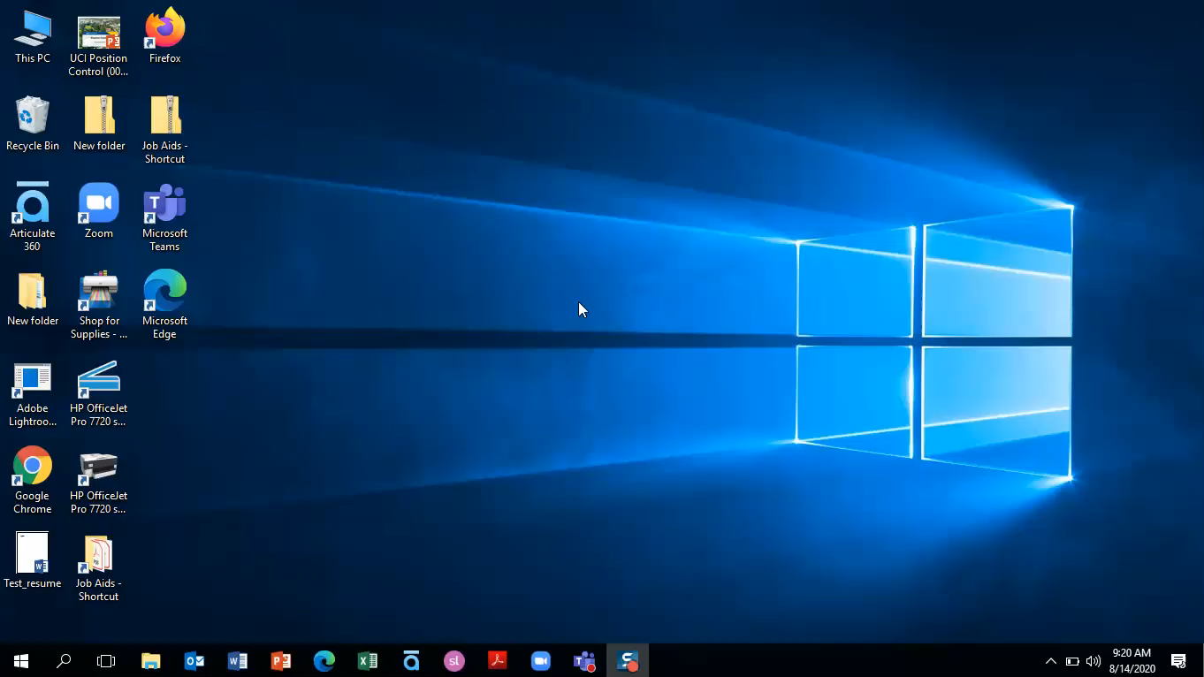
VPN Login
Username: uci_ucpathvpn_01
VPN Password: Force!Force
VPN Address:
sdsc-vpn.ucop.edu

Slide 100
Training Environment Login
Training Environment Link
https://hbldtrn1.ucpath-build.devops.universityofcalifornia.edu
Username: IRCMP_WFAInitiator_001-020
Password: ucpath2019

Slide 101
Exercise #1
Initiate Personal Data Change Template Transaction
This is your opportunity to practice this task on your own.
Complete the View/Modify Personal Information exercises in your workbook.
Ask your instructor for assistance, if needed.
Notes:
Complete this exercise using your workbook provided by your instructor.

Slide 102
Exercise #2
Initiate Intralocation Transfer Template Transaction
This is your opportunity to practice this task on your own.
Open the UCPath Help site and refer to the Initiate Involuntary Termination Template Transaction topic.
Launch the See It version of the topic.
Ask your instructor for assistance.
Notes:
For UPK simulation-based exercises, instruct the users to open the Try It view and complete the task.

Slide 103
Exercise #2
Initiate Rehire Reinstatement Template Transaction
This is your opportunity to practice this task on your own.
Complete the Rehire Reinstatement exercise in your workbook.
Ask your instructor for assistance, if needed.
Link to UPK if needed.
Notes:
Use UPK if this exercise does not work.

Slide 104
Exercise #3
Initiate Involuntary Termination Template Transaction
This is your opportunity to practice this task on your own.
Complete the Initiate a Voluntary Termination Template exercise in your workbook.
Ask your instructor for assistance, if needed.

Slide 105
Thank You!
Training End

