Slide 1
Budget Distribution Ensure you have your phone or fob for the Duo Mobile multi-factor authentication
Notes:
Welcome to Budget Distribution training. This course outlines the process required to create and maintain permanently budgeted positions in UCPath so that the information is transferred into Kuali Budget Module (KBM). It is recommended to take the Funding Entry training prior to taking this course. Many of the concepts taught in Funding Entry are carried over into this course.

Slide 2


Introductions
Instructor
Name
UCI role
UCPath role

Slide 3
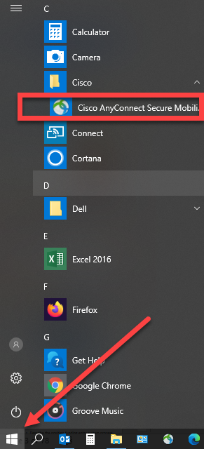
Connect Cisco Anyconnect VPN
Locate the Cisco AnyConnent Secure Mobile application using your windows button.

Slide 4
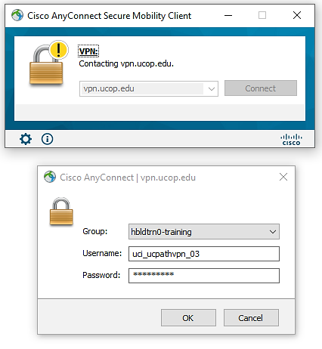
Connect Cisco Anyconnect VPN
Enter VPN Address: vpn.ucop.edu
Select Group: hbldtrn0-training
Enter one of these Usernames: uci_ucpathvpn_01 uci_ucpathvpn_02 uci_ucpathvpn_03
Password: Slow=Blow
Note: Link and credentials to access the training environment are in the Funding Entry workbook document.

Slide 5
Course Agenda
Lesson
1: Budget Distribution Overview
3: Update Budget Distribution Data
4: Staffing List
2: Enter Budget Distribution Data

Slide 6
Budget Distribution Considerations
Budget Distribution is entered by Position and Department, like Funding.
The Budget Distribution page (BDP) is only updated for permanently budgeted positons.
The checked STF flag identifies which positions get sent over to KBM for the Staffing List.
Vacant positions use the budget amount from the salary grade minimum.
Filled positions use the employee’s compensation information for the budget amount.

Slide 7

Course Objectives
Key Objectives:
Describe the uses of budget distribution data for recording permanent/base budget.
Summarize the budget distribution process.
Explain the position maintenance required for budgeting.
Describe the processes for entering and updating budget distribution data.
Enter and update budget distribution data.

Slide 8
LESSON 1
Budget Distribution Overview

Slide 9

Lesson Objectives
Budget Distribution Overview
3: Update Budget Distribution Data
4: Staffing List
2: Enter Budget Distribution Data
In this lesson, we will:
Review the Budget Distribution process
1

Slide 10

Budget Distribution Overview
Permanently funded positions require a budget and must be accounted for on the Staffing List which comes from the Kuali Budget Module (KBM).
The Budget Distribution page is used to manage the Filled and Vacant (Open Provision) Positions that appear on the Staffing List.
Open Provisions/Vacant Positions serve as a placeholder for unfilled positions on the Staffing List.
Locations must continue to maintain a balanced Staffing List between UCPath and their Budget System for permanently funded positions.
Notes:
Here is a general introduction to Budget Distribution:
Permanently funded positions require a budget and must be accounted for on the Staffing List.
The Budget Distribution page is used to manage the Filled and Vacant (Open Provisions) that are to appear on the Staffing List.
Open Provisions serve as a placeholder for vacant positions on the Staffing List.
Locations must continue to maintain a balanced Staffing List between UCPath and their Budget System for permanently funded positions.
The Budget Distribution page must also be updated when Group Provisions, a set of unfilled positions that help budget for multiple as-yet-unfilled positions, are created.

Slide 11
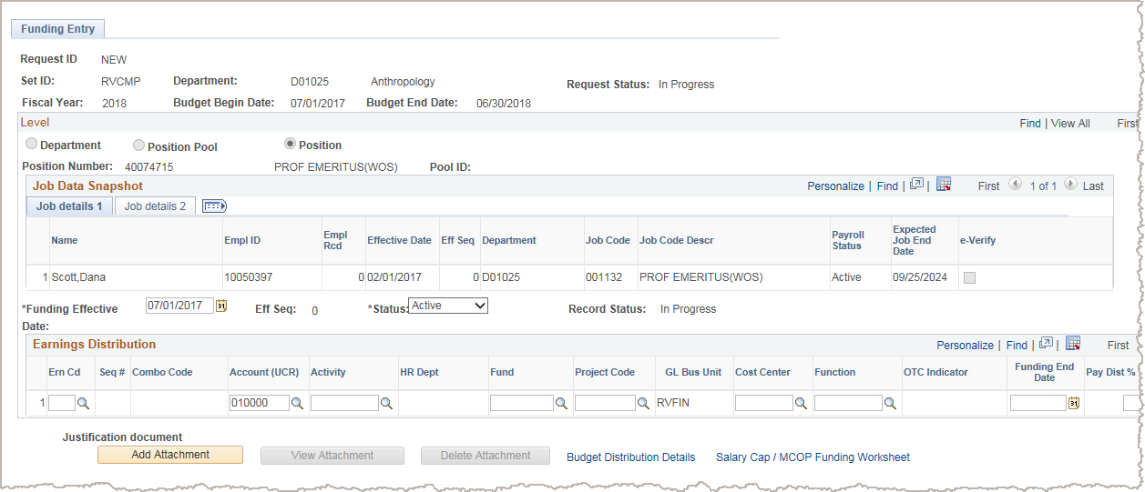
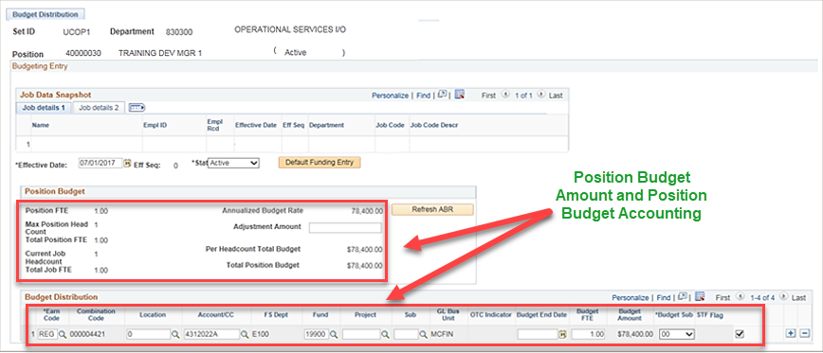
Budget Distribution Overview
The Budget Distribution page stores the position budget amount and position budget distribution (accounting).
This page can be accessed directly from a link on the Funding Entry page.
Link to Budget Distribution page from the Funding Entry page

Slide 12

Budget Distribution Overview
Budget distribution can use the same accounting data as funding entry.
Position budget data can have the same funding source as the position funding, but it is not required to be exactly the same.
Budget distribution data has no impact on funding accounting entries.
Budget distribution amounts must be entered for both filled and vacant positions.
Amounts on filled positions come from the employee’s annual compensation in Job Data.
Amounts for vacant positions come from the low end of the position compensation range from the Salary Grade.
Budget Data
Identifies projected salary costs, which UC uses for analysis of budgeted and actual staffing, and for required state reporting.
Notes:
The Budget Distribution page houses the position budget account and position budget amount.
Position budget data and funding data are both required and may be the same but may be different. The budget data (amounts and accounting) have no impact to funding.
An example of why the Budget Distribution would be different than funding, could be when a salary may be paid on a grant for a year. However the department does not want to lose the funding for that position. So in this example, the Funding Entry page

Slide 13
Enter Budget Data – Process Overview
The Budget Distribution page must be updated when:
New positions are created for permanently budgeted positions either by the departments or the Budget office.
Any type of pay change occurs for permanently budgeted positions. This includes:
Promotions and/or Reclassifications
Step increases
Merit increases
Equity increases
Permanently budgeted positions are vacated:
Terminations (Including transfers out)
Retirements
Notes:
The Budget office will create positions for Academic Senate Faculty and Librarians. Those position numbers will replace the previous Salary Control numbers. Departments will create positions for permanently budgeted staff positions. Both positons should follow the naming convention that will be discussed on the next slide.
Whenever a permanently budgeted position has a pay impacting change that has been fully processed, you must then go to the Budget Distribution page so that the new Annualized Budgeted Rate gets updated.
The same is true when a permanently budgeted position is vacated. You must go to the Budget Distribution page once the change is fully processed so that the Annualized Budgeted Rate is updated to the low end of the Salary Grade for the position.

Slide 14

Budget Distribution Overview (cont’d)
Budget entry transactions do not go through approval workflow (AWE) in UCPath; data is written directly to the system.
AWE
Notes:
When displayed in Slide Show mode, this slide includes animation.

Slide 15
LESSON 2
Enter Budget Distribution Data

Slide 16
Lesson Objectives
1: Budget Distribution Overview
3: Update Budget Distribution Data
4: Staffing List
2: Enter Budget Distribution Data
In this lesson, we will:
Enter Budget Distribution data
2

Slide 17


Enter Budget Data – Overview
UC records budget distribution at a position level; therefore, the position and position funding should be in UCPath to allow budget distribution entry.
A position’s budget distribution data can be allocated to multiple fund sources just like the funding.
Use the Budget Distribution page to enter budget data for a single position.
Enter Data Enter data using Budget Distribution page
Once these transactions are fully processed you should update the Budget Distribution page so the information stays up to date.
Notes:
When displayed in Slide Show mode, this slide includes animation. Click to display the graphic and click again to display the talking points.

Slide 18
Enter Budget Data – System Process
Navigate to Budget Distribution page and click Add a New Value tab
Enter appropriate department and position numbers, then click Add
Enter effective date and position budget information
Click Save

Slide 19
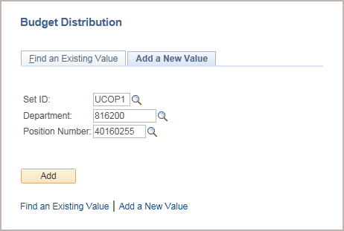
Budget Distribution Search Page
Navigation: PeopleSoft Menu > Set Up HCM > Product Related > Commitment Accounting > Budget Information > UC Customizations > Budget Distribution
1. Click the Add a New Value tab.
2. Enter the appropriate Department and Position for which you want to enter new position budget data.
3. Click the Add button to display the page on which you enter the new funding details.
Notes:
When displayed in Slide Show mode, this slide includes animation for the gray captions. Click to display each caption (and hide the previous caption) as you describe the objects on the Budged Distribution Search page.

Slide 20
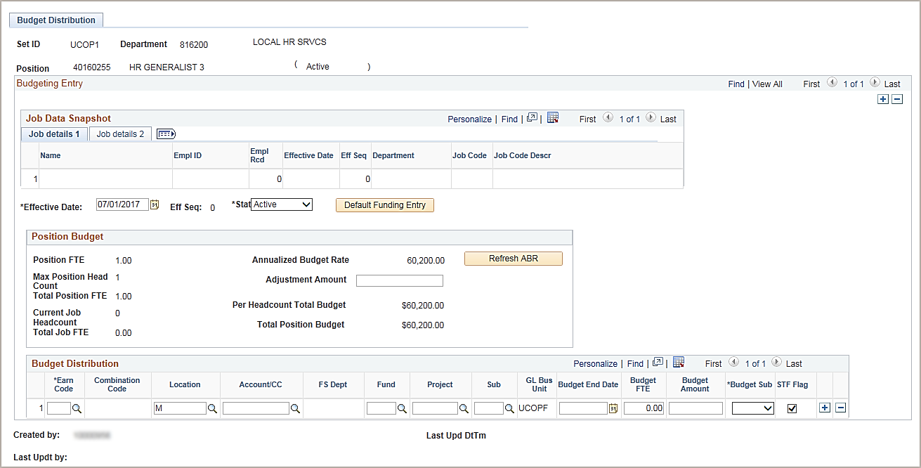
Budget Distribution Page
The header includes the set ID, department ID and position number values you entered to create the new budget distribution.
In this example, the Job Data Snapshot section is blank, which indicates this is an unfilled position. For a filled position, this section displays a summary of the incumbent employee's job data.
Notes:
When displayed in Slide Show mode, this slide includes animation for the gray captions. Click to display each caption (and hide the previous caption) as you describe the objects on the Budged Distribution page.
Header contains the information entered on the previous. It identifies the department and position being updated. The position associated with this budget is vacant. We know that because the Job Data Snapshot section is blank. This page looks a lot like the Funding Entry page with a few extra fields which we will cover.

Slide 21
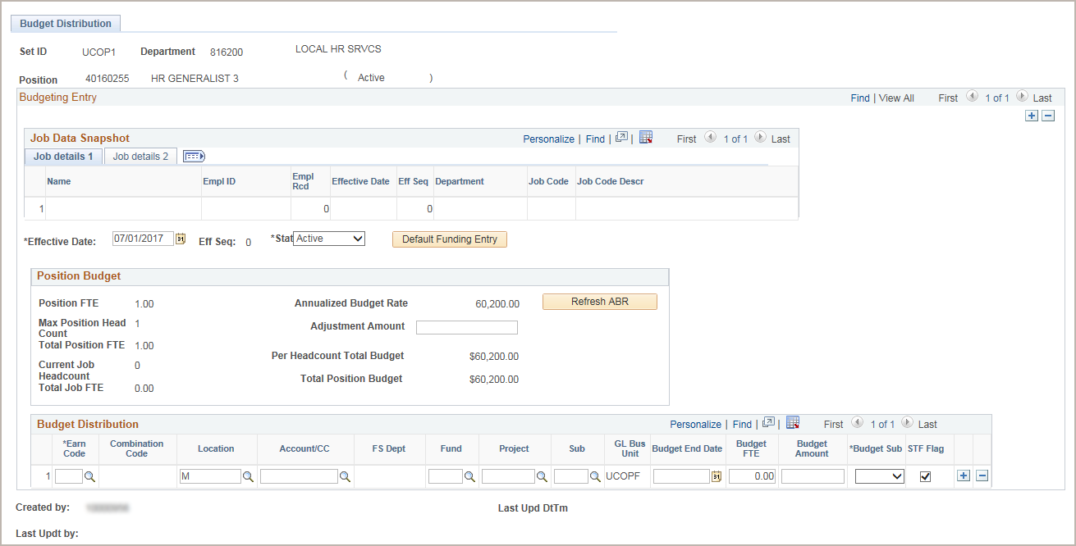
Budget Distribution Page
Upon entering the effective date, the system locates the position budget data and populates the Position Budget section.
In this example the Annualized Budget Rate populated is calculated from the minimum JOB salary grade or step.
If the position is filled, the Annualized Budget Rate would be calculated using the following formula: employee's annual rate / JOB FTE * Position FTE.
Click the Default Funding Entry button to load the current funding distribution for the position.
After you default the funding into the Budget Distribution section, the button appears grayed out.
If necessary, enter an adjustment amount to increase or decrease the Annualized Budget Rate.
Click after the annual increase in salary has been done, after funding has been approved; check if there is a report to support this process.
Notes:
When displayed in Slide Show mode, this slide includes animation for the gray captions. Click to display each caption (and hide the previous caption) as you describe the objects on the Budged Distribution page.
The position associated with this budget is vacant. We know that because the Job Data section is blank. Adjustment amount example: Bonuses are not currently part of the position compensation plan. To include a bonus in the budget amounts, enter the bonus amount in the Adjustment Amount field. After you enter an adjustment, click the Refresh ABR button to recalculate the Annualized Budget Rate (ABR), Per Headcount Total Budget and Total Position Budget amounts.

Slide 22
Enter Budget Data – REG Earn Code
Permanently funded positions must be identified on the Budget Distribution page and therefore accounted for on the Staffing List.
Funding Entry Page
Budget Distribution Page
Position Number | 000000123
REG Earnings | $105,000
Stipend | $2,000
Negotiated | $45,000
Position Number | 000000123
REG Earnings | $105,000
Note: This illustration shows the various funding on the Funding Entry page. The Budget Distribution page is only interested in capturing and tracking REG and those earnings that pertain to the permanent budget.
Notes:
All permanently funded positions must be identified on the Budget Distribution page a budget and must be accounted for on the Staffing List.
This illustration shows the various funding on the Funding Entry page. The Budget Distribution page is only interested in capturing and tracking REG and those earnings that pertain to the permanent budget.

Slide 23
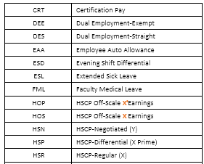
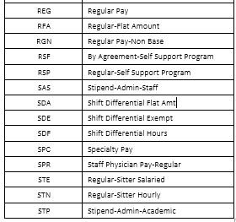
Earn Codes Used for Permanent Budget
Here is a list of earn codes that could be used for permanent budget.

Slide 24
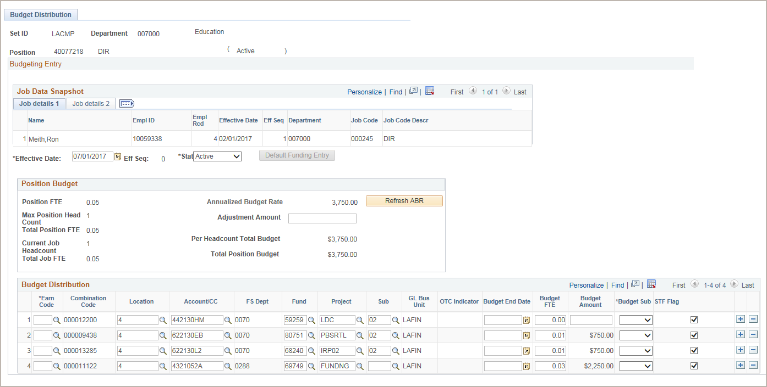
Budget Distribution Page – Default Funding
When the position funding requires minor changes, use the option of the Default Funding Entry button to quickly load the data from the Funding Entry page and then enter the changes necessary for budgeting distribution.
If the Budget FTE value is 0.00, then the Budget Amount field is editable.
If the Budget FTE is not 0.00 then the Budget Amount field is disabled and will be automatically calculated.
Use the + and – signs to add or remove distribution lines.
You must enter the appropriate earning codes and the budget sub values for each distribution row.
Budget FTE will automatically populate with the Distribution % from Funding Entry Page if the Default Funding Entry button is clicked.
Rows with the STF Flag checked will appear on the Staffing List.
Notes:
There are two options for entering budget distribution data; Default the current funding data from the Funding Entry page (this is the example shown here) or manually enter it.
When the budget distribution is similar to the Funding Sources on the funding page, you can use this option to quickly load the data directly from the funding page by clicking the Default Funding Entry button on to the budget page and then make the changes necessary in the Budget Distribution section.
In the Budget Distribution section we have:
Earn Code – if you used a blank earn code on the Funding Entry page, you should update to the REG code here. Budgeting is primarily interested in the REG earnings and need to have the earn code entered in this section.
Budget Sub – should only use either Staff-Sal (01) or Acad-Sal (00)
The budget amounts on the distribution line must match the Total Position Budget field value.
The Budget FTE cannot exceed the Position FTE. If the position is also being paid with 50% permanently budget funds and 50% “soft” money the Budget FTE would be .5 and the Position FTE would be 1.0.
The STF Flag check box determines whether the distribution line is to appear on the Staffing List and would be included in the data reported to the State of California. By default, the check box is checked.
Uncheck the STF Flag check box if you do not want the distribution lines to appear on the Staffing List.
If you budget for an adjustment amount as a separate distribution line using an earning code other than regular earnings, the FTE should be zero. The system displays a warning message, but you can save the entry.

Slide 25
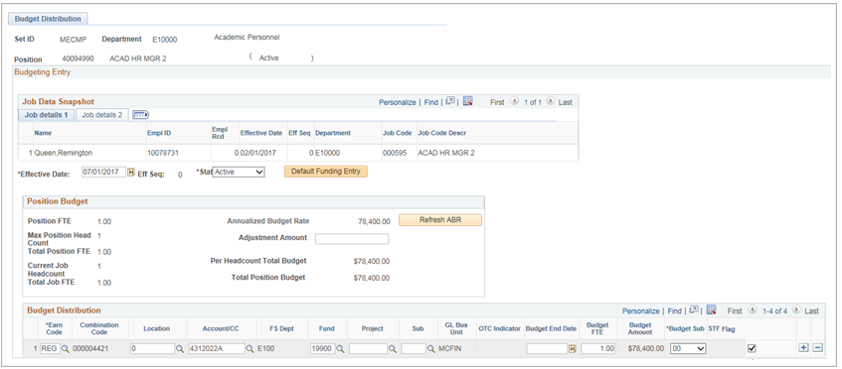
Budget Distribution Page – Manual Entry
The second option is to manually enter the budget, as seen here.
Use this method when the budgeting distribution is not similar to the funding distribution. Enter appropriate values in the available fields.
Manually enter the budget distribution earning codes, FAU values and budget sub values. Enter as many rows as needed.
Rows with the STF Flag checked will appear on the Staffing List.
If the Budget FTE value is 0.00, then the Budget Amount field is editable.
If the Budget FTE is not 0.00 then the Budget Amount field is disabled and will be automatically calculated.
Use the + and – signs to add or remove distribution lines
Notes:
The second option is to manually enter the budget, as seen here.
Enter the Effective Date, the system locates the position budget data and populates the Position Budget section.
If necessary, enter an Adjustment Amount to increase or decrease the Annualized Budget Rate.
As an adjustment amount example, consider that bonuses are not currently part of the position compensation plan. To include a bonus in the budget amounts, enter the bonus amount in the Adjustment Amount field. After you enter an adjustment, click the Refresh ABR button to recalculate the Annualized Budget Rate (or ABR), Per Headcount Total Budget and Total Position Budget amounts.
You must enter the appropriate earning codes and the budget sub values for each distribution row.
Use the + and – signs to add or remove distribution lines.
If the Budget FTE value is 0.00, then the Budget Amount field is editable.
If the Budget FTE is not 0.00 then the Budget Amount field is disabled and will be automatically calculated.
Rows with the STF Flag checked will appear on the Staffing List.
Use the manual entry method when the budgeting distribution is not similar to the funding distribution. Enter appropriate values in the available fields.

Slide 26

Instructor Demo
Enter Budget Distribution
Watch as your instructor demonstrates how to enter budget distribution data on the data entry page in UCPath.
Follow along using the UPK topic.
Open the UCPath Help site and refer to the Enter Budget Distribution topic.
Launch the See It version of the topic.
At the end of the demonstration, you will have the opportunity to practice this task.

Slide 27

Exercise 1
User ID: IRCMP_BudgetEntry_0##
Password: ucpath2019
Enter Budget Distribution
This is your opportunity to practice this task on your own.
Ask your instructor for assistance.
Notes:
Use the Exercise and Data Sheet provided

Slide 28
LESSON 3
Update Budget Distribution Data

Slide 29
Lesson Objectives
1: Budget Distribution Overview
Update Budget Distribution Data
4: Staffing List
2: Enter Budget Distribution Data
In this lesson, we will:
Explain when Budget Distribution data should be updated
Update Budget Distribution data
3

Slide 30
Updating Budget Data – Overview
Update Data Update data using Budget Distribution page
Whenever changes occur to a position that impact pay, the Annualized Budget Rate on the Budget Distribution page must also be updated.
Changes that impact pay include:
Step increases
Equity increases
Promotions/Reclassifications
Terminations/Retirements (including Transfers)
Once these transactions are fully processed you should update the Budget Distribution page so the information stays up to date.
Notes:
When displayed in Slide Show mode, this slide includes animation. Click to display the graphic and click again to display the talking points.
When these changes occur, you must go to the Budget Distribution page to update the Annualized Budget Rate.
Any type of pay change occurs for permanently budgeted positions. This includes:
Promotions and/or Reclassifications
Step increases
Merit increases
Equity increases
Permanently budgeted positions are vacated
Terminations (Including transfers)
Retirements

Slide 31
Update Budget Data – System Process
Navigate to Budget Distribution page and click Find and Existing Value tab
Search for and select appropriate budget distribution record
Insert effective-dated row and enter appropriate updates
Click Save

Slide 32
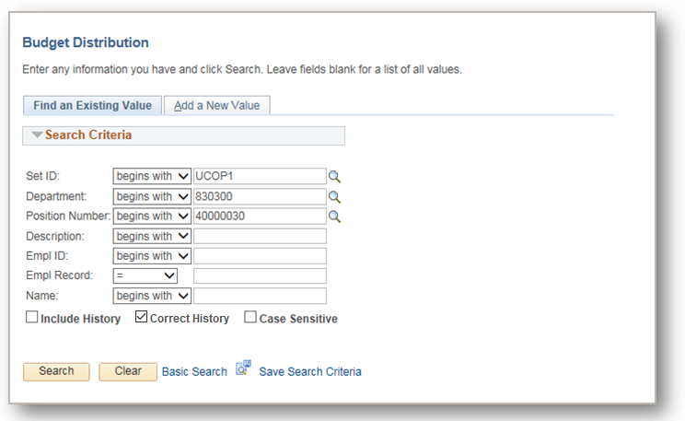
Budget Distribution Search Page
Navigation: PeopleSoft Menu > Set Up HCM > Product Related > Commitment Accounting > Budget Information > UC Customizations > Budget Distribution
Begin the steps for updating budget distribution data on the Find an Existing Value tab.
Enter the appropriate Search Criteria values.
Select Correct History to make corrections to previously entered rows.
Click Search to display the Budget Distribution page for the selected position.
Notes:
When displayed in Slide Show mode, this slide includes animation for the gray captions. Click to display each caption (and hide the previous caption) as you describe the objects on the Budged Distribution Search page.

Slide 33
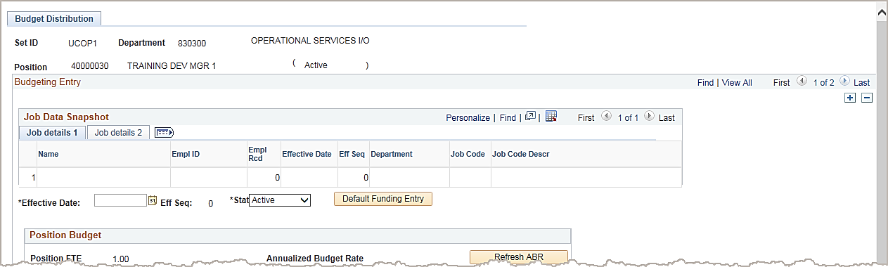
Budget Distribution Page
This page is effective-dated, so you can maintain a history of budget changes. Once the Effective Date of the change is entered and you tab out of the field, this page reads Job Data to pull in the change that occurred on that date into the Position Budget section.
After you search for and select the appropriate budget distribution record, begin the system steps for updating data by inserting a new row and entering the date the changes are effective.
UCI Employee
12345678
Notes:
If you enter a new effective-dated row with the same effective date as the previous row of data, the system increments the Eff Seq (effective sequence) field to the next valid number, such as 1, 2 and so on. The first row for an effective date is always 0, as in this example.

Slide 34
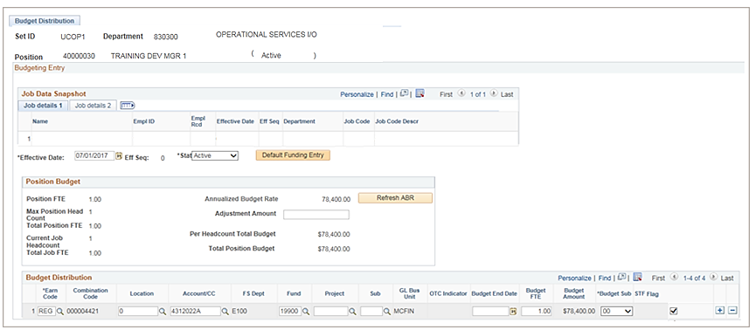
Budget Distribution Page Cont’d
Enter the Budget Distribution data identifying the REG earn code, accounting information, and the selecting the STF flag.
UCI Employee
12345678
2/1/2019
Department
Description of job code
Use the + and – signs to add or remove distribution lines
You must enter the appropriate earning codes and the budget sub values for each distribution row.
Notes:
Data entry is the same as adding new budget distribution data, including the ability to default funding entry data to the Budget Distribution section.
You must enter the appropriate earning codes and the budget sub values for each distribution row.
Use the + and – signs to add or remove distribution lines.

Slide 35
Instructor Demo
Update Budget Distribution
Watch as your instructor demonstrates how to update budget distribution data in UCPath.
Follow along using the UPK topic.
Open the UCPath Help site and refer to the Update Budget Distribution topic.
Launch the See It version of the topic.
At the end of the demonstration, you will have the opportunity to practice this task.
Notes:
For UPK simulation-based demonstrations, open the See It view and walk through the activity while providing details and explaining the task. The users should follow along with the Print It version of the UPK.

Slide 36
Exercise 2
User ID: IRCMP_BudgetEntry_0##
Password: ucpath2019
Update Budget Distribution
This is your opportunity to practice this task on your own.
Ask your instructor for assistance.
Notes:
For UPK simulation-based exercises, instruct the users to open the See It mode and complete the task.

Slide 37
Knowledge Check
Knowledge Check:
You now have the opportunity to assess your knowledge of the information presented in this module.
The questions and answers presented in this review help you to determine whether you remember and understand the important points.

Slide 38
Multiple Choice
Why is budget data required in UCPath?
To create detailed accounting entries
To identify projected salary costs for analysis and required staffing reports
To re-allocate benefit costs
To meet UC requirements for general ledger detail
All of the above

Slide 39
Multiple Choice
Under what circumstances should you review the Budget on the Budget Distribution Page?
When a Position is Filled
When a Position is Vacated
When there is a compensatory change to the position
All of the above

Slide 40
Multiple Choice
Which of the following items is not entered on the Budget Distribution page?
Position
Pay group
Effective date
Adjustment amount
FAU values

Slide 41
LESSON 4
Staffing List

Slide 42
Lesson Objectives
1: Budget Distribution Overview
3: Update Budget Distribution Data
Staffing List
2: Enter Budget Distribution Data
In this lesson, we will:
Learn the purpose of the Staffing List
Review and validate the Staffing List
4

Slide 43
Staffing List – Overview
Budget data for permanently funded positions must be balanced annually between UCPath and KBM.
The Staffing List displays any relevant variances between the KBM base budget and UCPath Budget Distribution Page.
Each unit should continue to reconcile their Staffing List monthly, ensuring that base budgeted funds and FTE are aligned with payroll commitments for filled positions.
The reconciled Staffing List for the campus is provided quarterly to UCOP.

Slide 44
Staffing List Reconciliation Overview
Step 1
Step 2
Step 3
Step 4
Step 5
To correct PPME errors, make updates in UCPath on the BDP to remove STF flag or correct Ern Code
Data is loaded into KBM from UCPath
Review Payroll Position Maintenance Error (PPME), if any, in KBM
Review Staffing List
Update variances to balance via BAT
Notes:
The following is needed to validate the Staffing List:
Data is loaded to KBM.
Units run and review the Staffing List in KBM to ensure it is Balanced.
If the Staffing List is not Balanced then units will make the necessary adds/updates (revisions) in UCPath on the Budget Distribution page and/or KBM.
Review the Payroll Position Maintenance Error (PPME) documents in the KBM user Action List.
The document will display the positions that are not to be budgeted and state the error message
Users will only be allowed to ‘Acknowledge’ the document
Users will need to go back to UCPath Budget Distribution page and update that position

Slide 45
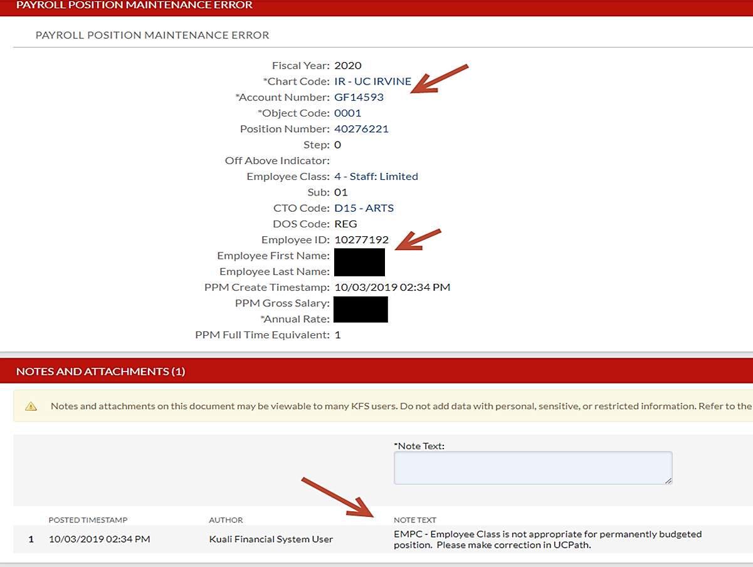
Sample of PPME Error in KBM
Note Text:
Employee Class is not appropriate for permanently budgeted position.
Please make correction in UCPath.

Slide 46
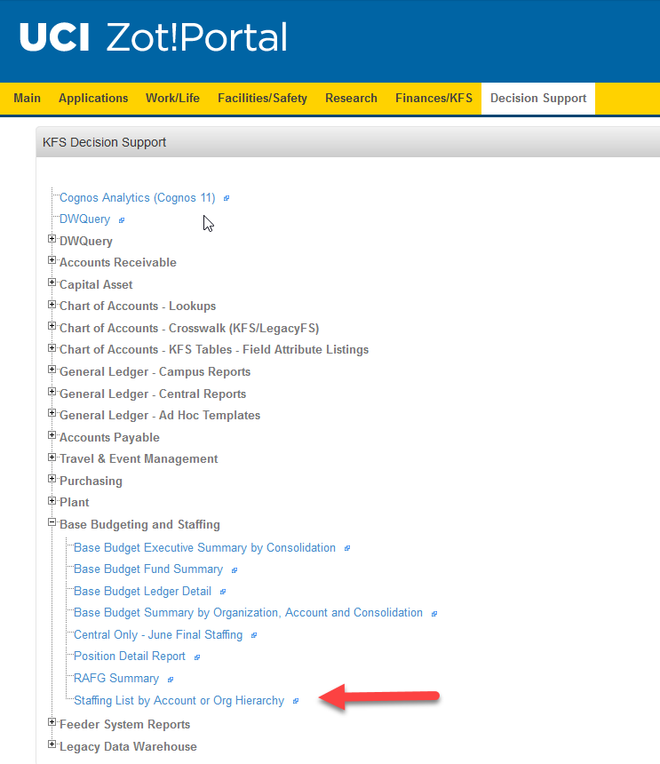
Staffing List – Reconciliation Process
Run the KBM Staffing List report.
Review to determine if the program correctly matches all incumbents’ KBM base budget and UCPath payroll information by their unique UCPath position number.
Correct any remaining variances on the KBM Staffing List to ensure that base budgeted funds and FTE are aligned with payroll commitments by each unique UCPath position number.
KBM users should process a BAT document for any salary increases/decreases or FTE changes. For any salary adjustments, departments should also include funding to cover benefits.
This will be done centrally for Sub 0.
Notes:
Usually MAABOs and Finance Directors have access to process BAT documents in KBM for Sub 1.

Slide 47
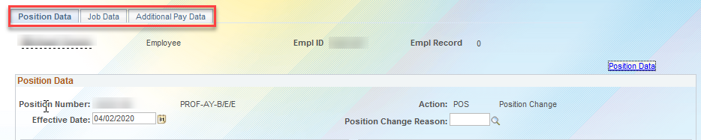
Staffing List – Salary and FTE Updates
In UCPath, updates to Salary and FTE for filled positions are done in PayPath. While updates to vacant positions are done in Position Control Request.
PayPath Actions page in UCPath

Slide 48
Staffing List - Budget Distribution
If it is determined that the budget in UCPath is not correct, then update the budget distribution page using the Adjustment Amount field.
The new budget will be reflected on the Staffing List on the next payroll update.
Only those budget distribution lines that have the STF flag checked on the Budget Distribution page will appear on the Staffing List.
STF Flag appears on the far right of the page
Notes:
Remember: Updates to vacant positions must be made in the Position Control Request module, while updates to filled positions must be made in PayPath Actions.

Slide 49
Staffing List – Summary
This shows at a high level how data flows.
Departments will use the Staffing List reports to identify out-of-balance situations.
UCPath
KBM
Staffing List
Notes:
Departments will use the Staffing List reports to identify out-of-balance situations.

Slide 50

Who To Contact in Budget Office
Permanently Budgeted Academic Senate Faculty Positions
Romain Fravien - rfravien@uci.edu
Permanently Budgeted Staff Positions
Sang Le Ta – slta@uci.edu

Slide 51
Course Objectives Review
Having completed this course, you should be able to:
Describe the budget distribution process.
Enter budget distribution data.
Update budget distribution data.
Understand and validate the staffing list.

Slide 52
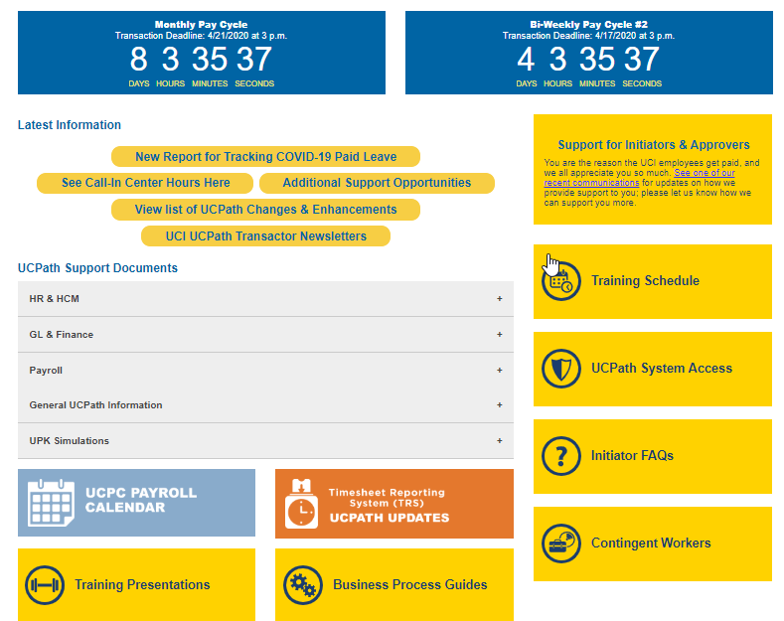
Reference Material for Review
The UCPath Help site is your first level of support. Search for conceptual content, job aids or step-by-step instructions for UCPath tasks.

Slide 53

Where to Get Help
The UCPath Help site is your first level of support. Search for conceptual content, job aids or step-by-step instructions for UCPath tasks.
From the Transactional Users website, expand the UPK Simulation section in the middle of page and then click the “Location Users” link to open the site. *An Adobe PDF version is available for users with screen readers.
If you’re experiencing issues, or have questions about transactions, please contact the Employee Experience Center at (949) 825- 0500, or submit a ticket by visiting UCPath.UCI.Edu

Slide 54
Thank You!
Training End

Slide 55

BREAK TIME
Break

